Slide 1
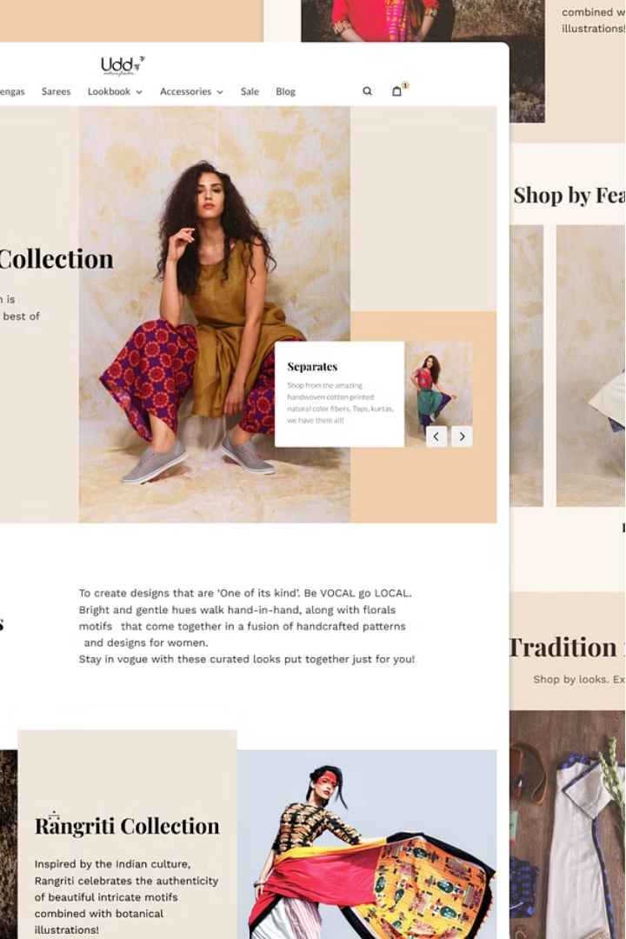


Welcome to Bhoosha E-Commerce
Bhoosha is revolutionizing the online shopping experience for Indian consumers. Our fashion-focused e-commerce platform caters to diverse needs, offering a wide range of products tailored to the unique preferences of the Indian market.
by Raj Shukla

Slide 2

Customer Satisfaction Guaranteed
At Bhoosha E-Commerce, we prioritize customer satisfaction above all else. We strive to provide a seamless shopping experience, from browsing to checkout. Our dedicated customer support team is always ready to assist you with any inquiries or concerns you may have.

Slide 3
Our Mission and Values
Save Money
Free Shipping
24/7 Support
We provide the best prices to help our customers get the most for their money.
Enjoy the convenience of free delivery on all your purchases.
Our dedicated team is available around the clock to assist you.

Slide 4
Powering the Platform
1
React
2
Express
Delivering a seamless and responsive user interface.
Providing a robust and scalable backend infrastructure.
3
Node.js
4
MongoDB
Enabling fast and efficient server-side processing.
Storing and managing product data and user information.

Slide 5



Key Features
Store
Browse and purchase a wide range of fashion products.
Cart
Add items to your cart and manage your orders.
Account
Create an account, sign in, and manage your profile.

Slide 6




Future Enhancements
Product Recognition
Mobile-Friendliness
Expanded Product Range
Enhanced CX
Continuously improve customer experience through feedback and insights.
Leverage image recognition to assist customers in finding products.
Optimize the platform for seamless mobile shopping experiences.
Introduce new categories like men's, women's, and children's clothing.

Slide 7
The Bhoosha Advantage
Unbeatable Prices
Seamless Checkout
Reliable Shipping
Wide Selection
Secure Payments
Exceptional Support
Bhoosha E-Commerce is poised to become the premier destination for online fashion shopping in India. With our commitment to innovation, customer-centric approach, and relentless pursuit of excellence, we're transforming the e-commerce landscape.

