Slide 1

CoronaVirus Analysis with SQL

Slide 2
INTRODUCTION
The following presentation outlines the approach and key findings from the analysis of the COVID-19 dataset. The analysis covers data cleaning, summary statistics, and trends related to confirmed cases, deaths, and recoveries over time and across regions.

Slide 3
Data Preprocessing
Original Data Format:
The original CSV file had the 'Date' column in the format DD-MM-YYYY.
PreProcessing Step:
Using Pandas, the 'Date' column was converted to the format YYYY-MM-DD.

Slide 4
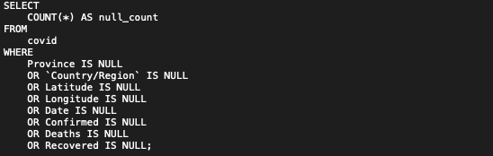
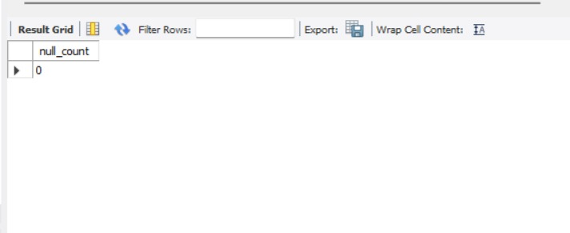
Checking for NULL Values
MySQL Query:
Key Finding:
There were no NULL values in the Dataset.

Slide 5
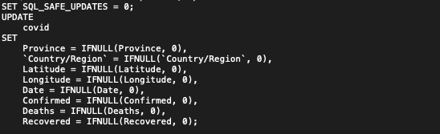
Handling NULL Values
MySQL Query:
Key Finding:
If any NULL values were present in the Dataset, it would be updated to 0.

Slide 6

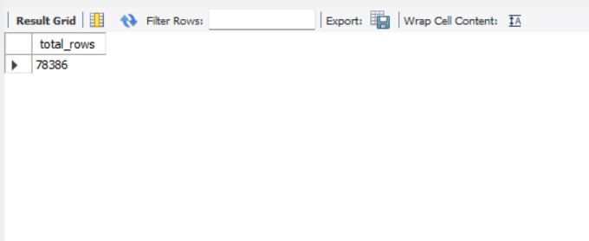
Total Number of Rows
MySQL Query:
Key Finding:
Outputs the total number of rows from the given Dataset.

Slide 7

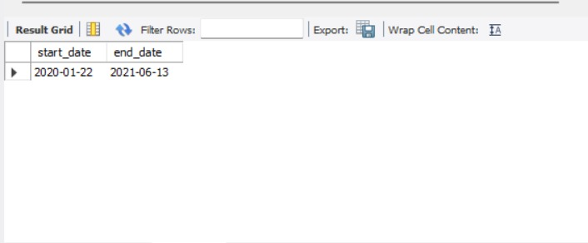
Date Range
MySQL Query:
Key Finding:
The Dataset spans from [start_date] to [end_date].

Slide 8

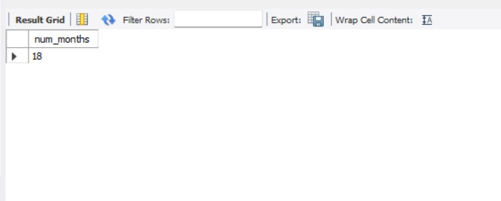
Number of Months Present in Dataset
MySQL Query:
Key Finding:
Outputs the total number of distinct number of months present in Date column of the Dataset.

Slide 9
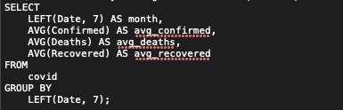
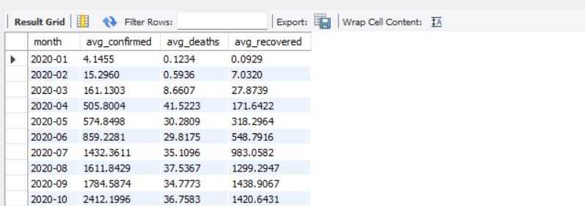
Monthly Averages for Confirmed, Deaths and Recovered
MySQL Query:
Key Finding:
Monthly averages for confirmed cases, deaths, and recoveries were calculated.

Slide 10
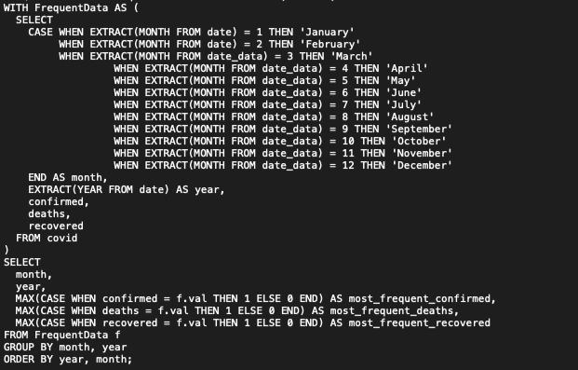
Most Frequent Values Each Month
MySQL Query:

Slide 11
Most Frequent Values Each Month
Key Finding:
Identified the most frequent values for confirmed cases, deaths, and recoveries each month.

Slide 12
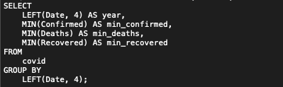
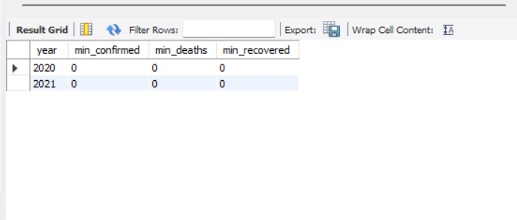
Minimum Values Per Year
MySQL Query:
Key Finding:
Minimum values for confirmed cases, deaths, and recoveries per year.

Slide 13

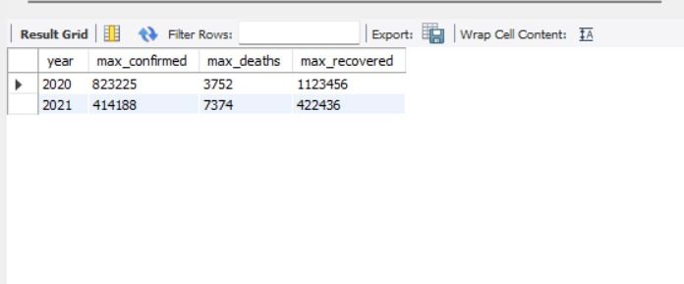
Maximum Values Per Year
MySQL Query:
Key Finding:
Maximum values for confirmed cases, deaths, and recoveries per year.

Slide 14
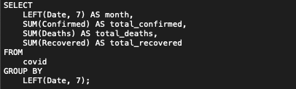
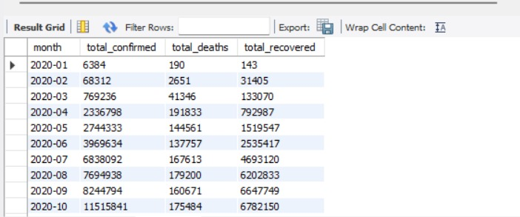
Total Cases Each Month
MySQL Query:
Key Finding:
Calculated the total number of confirmed cases, deaths, and recoveries each month.

Slide 15
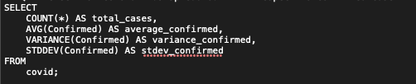
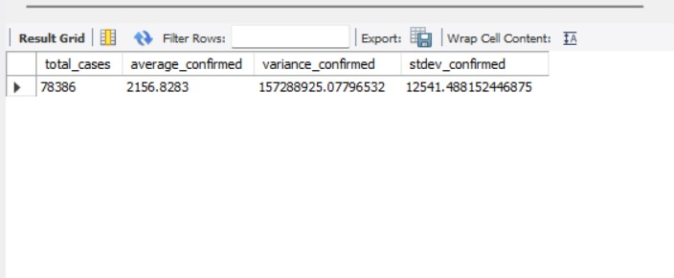
Spread of Confirmed Cases
MySQL Query:
Key Finding:
Analysed the spread of confirmed cases using total, average, variance, and standard deviation.

Slide 16
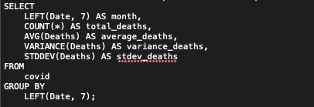
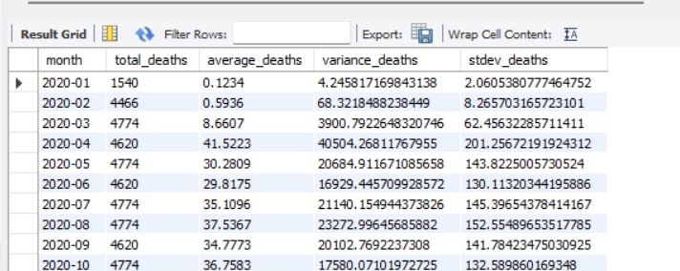
Spread of Death Cases
MySQL Query:
Key Finding:
Analysed the spread of death cases each month using total, average, variance, and standard deviation.

Slide 17

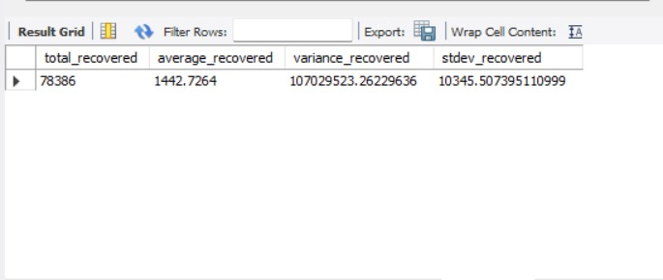
Spread of Recovered Cases
MySQL Query:
Key Finding:
Analyzed the spread of recovered cases using total, average, variance, and
standard deviation.

Slide 18
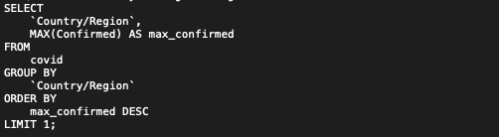
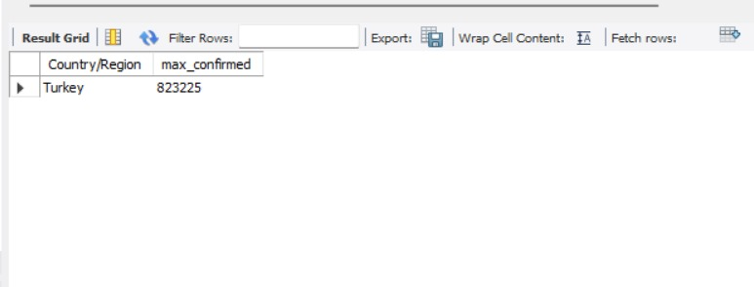
Country with Highest Confirmed Cases
MySQL Query:
Key Finding:
Identified the country with the highest number of confirmed cases.

Slide 19
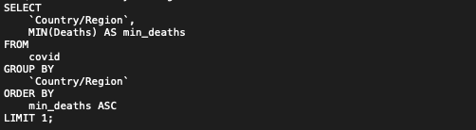
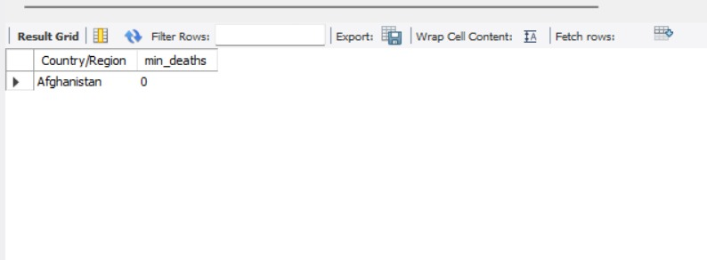
Country with Lowest Death Cases
MySQL Query:
Key Finding:
Identified the country with the lowest number of death cases.

Slide 20
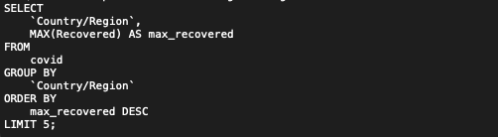
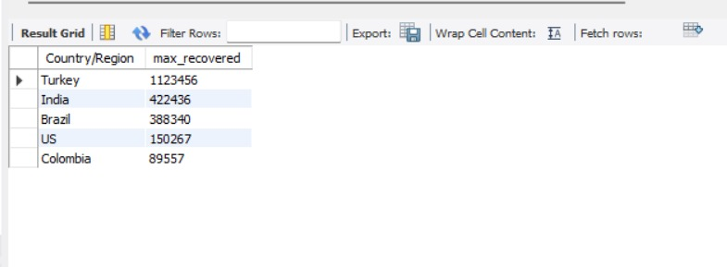
Top 5 Countries with Highest Recovered Cases
MySQL Query:
Key Finding:
Identified the top 5 countries with the highest number of recovered cases.

Slide 21
Conclusion
The analysis provided insights into the spread and impact of COVID-19 across different regions and time periods. Key findings include monthly trends, spread patterns, and identifying regions with the highest and lowest cases. This analysis can be used for further research and policy-making to address pandemic-related challenges.

