Slide 1

Analysis of nrega dataset with Power bi

Slide 2
INTRODUCTION
This project delves into the analysis of data related to the National Rural Employment Guarantee Act (NREGA), a transformative government scheme aimed at providing rural households with guaranteed wage employment opportunities. The dataset used for this analysis encompasses a wide range of parameters, including:
Number of job cards issued
Workforce engaged
Budget allocation
Work completion statistics
And much more
Through the application of data analytics techniques, we aim to gain valuable insights into the implementation and impact of NREGA across different states and districts in India.

Slide 3
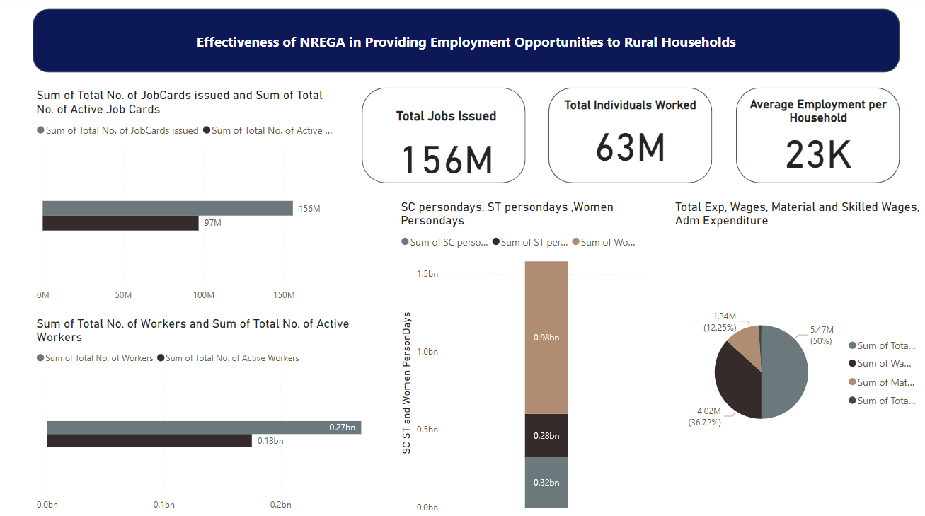
Effectiveness in Employment Opportunities
Key Findings:
NREGA has significantly contributed to reducing rural unemployment.
Variations in the effectiveness across different states.

Slide 4
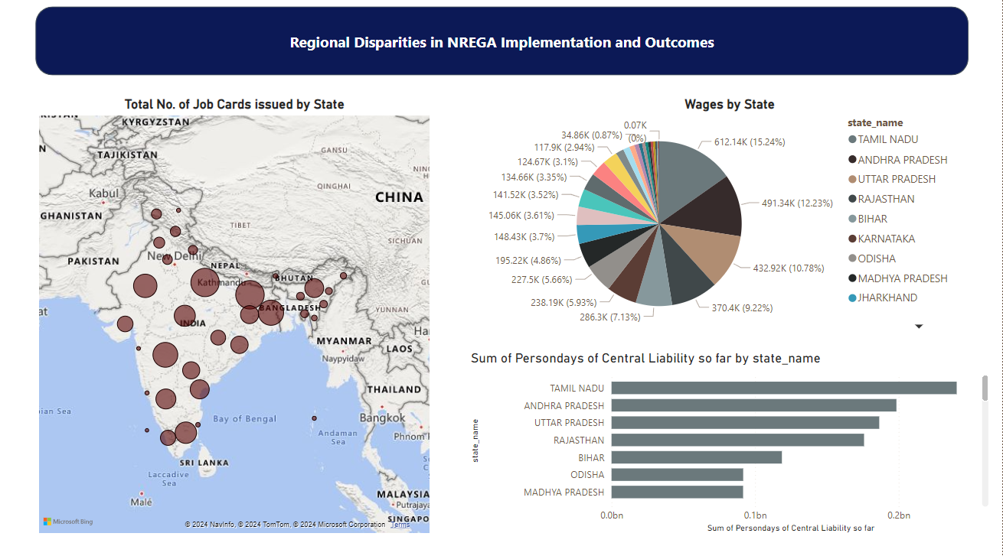
Regional Disparities
Key Findings:
Significant disparities in implementation and outcomes.
Factors contributing to these disparities (e.g., administrative efficiency, state government support).

Slide 5
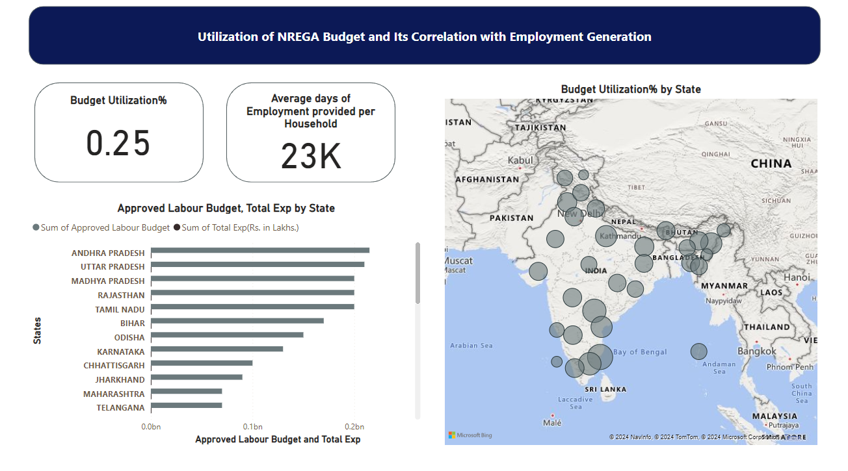
Budget Utilization and Employment Correlation
Correlation with Employment Generation:
Regions with high budget utilization often show better employment outcomes.
Key Findings:
Effective budget utilization is crucial for maximizing employment opportunities.

Slide 6
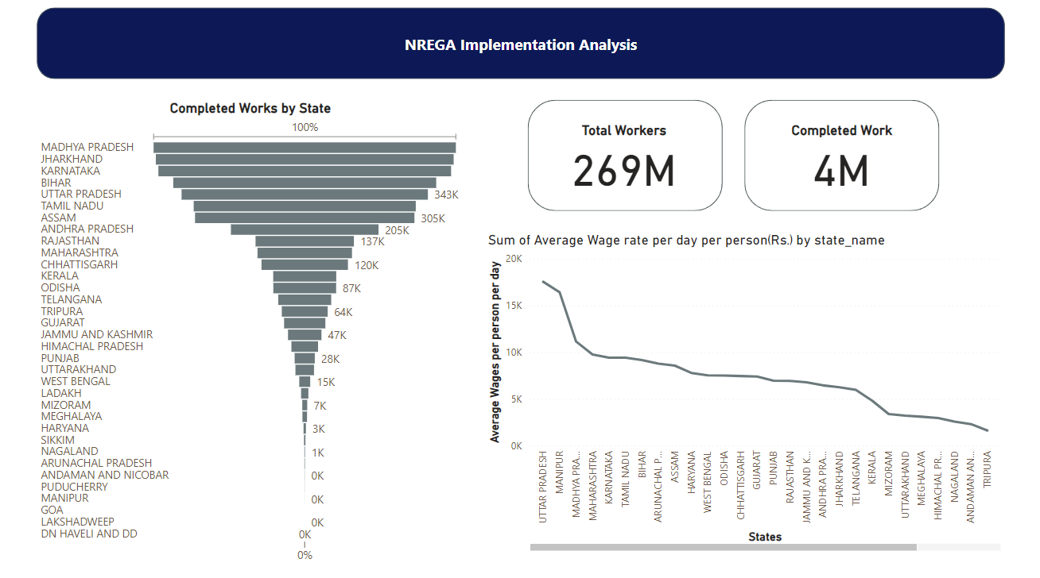
Factors Influencing Completion of NREGA Works
Success Factors:
Community participation, effective planning, and timely disbursement of funds.
Roadblocks:
Delays in payment, administrative bottlenecks, lack of awareness among rural households.

Slide 7
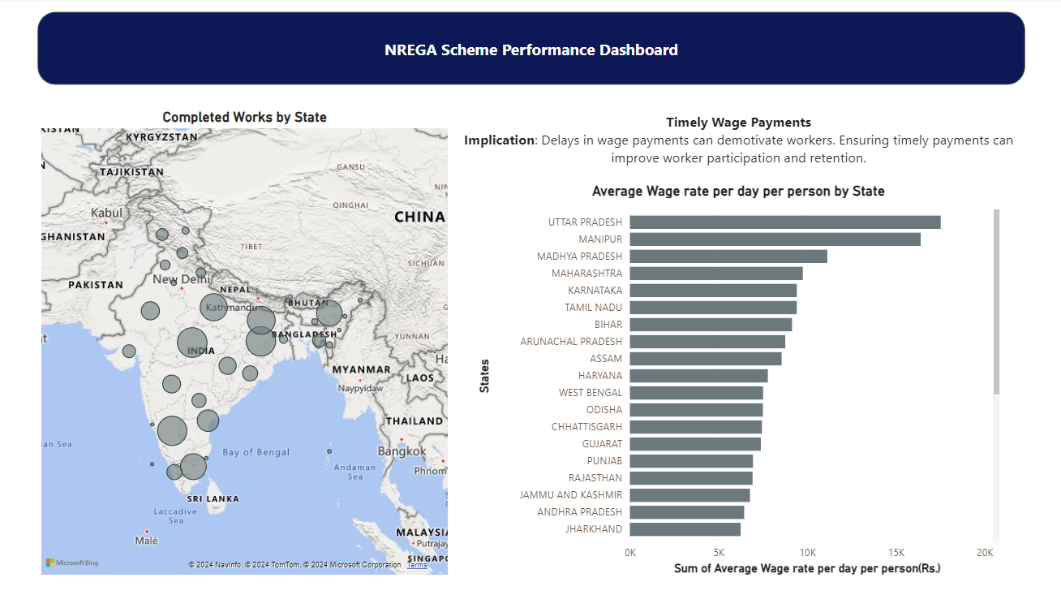
Data-Driven Insights for Policy Optimization
Insights for Policymakers:
Data-driven strategies to address regional disparities.
Recommendations for improving budget utilization and administrative efficiency.

Slide 8
CONCLUSION
Summary of Key Findings:
NREGA is a vital tool for rural employment and poverty alleviation but requires improvements in implementation.
Regional disparities and budget utilization are critical areas to address.
Final Thoughts:
Data-driven approaches can significantly enhance the effectiveness and impact of NREGA.
Continued monitoring and adaptive strategies are essential for the scheme's success.

