Slide 1
TITLE PAGE
Problem Statement ID- 1
Problem Statement Title- Eco-Loop Building Agent
Theme- Smart Building Automation Agent, Industrial AI, Sustainability
PS Category- Software
Student Name (Registered on portal) – Raj Kokate
Student ID- 23BIT0269

Slide 2
IDEA TITLE
Proposed Solution - Eco-Loop: Autonomous AI-Driven Building Energy Agent
Eco-Loop is an autonomous AI system that continuously monitors building conditions and optimizes HVAC operations using an LLM, EnergyPlus simulations, BACnet controllers, and real-time sensor data.
How it solves the problem
Continuously monitors HVAC, occupancy and environmental conditions
Predicts energy demand before wastage occurs
Automatically adjusts HVAC setpoints every 15 minutes
Maintains occupant comfort while reducing electricity consumption
Detects equipment anomalies for predictive maintenance
Supports natural language interaction for facility managers
Innovation & Uniqueness
Autonomous AI decision-making instead of fixed rule-based control
Multi-agent architecture
Digital Twin using EnergyPlus
Hardware-in-the-loop BACnet integration
OpenADR demand response support
Self-correcting AI workflow

Slide 3
TECHNICAL APPROACH
Programming Language | Python 3.11
AI | Qwen2.5 7B Instruct Model using Ollama
Simulation | EnergyPlus 26.1
Protocols | BACnet/IP, OpenADR 2.0b
Dashboard | Plotly Dash
Architecture | Multi-Agent Swarm, MCP (Model Context Protocol)

Slide 4
FEASIBILITY AND VIABILITY
Feasibility
Uses open-source AI models
Compatible with existing Honeywell BMS
Works with standard BACnet devices
Easily scalable across commercial buildings
Cloud or on-premise deployment
Challenges
Sensor data quality
Real-time communication delays
LLM safety in industrial control
Hardware compatibility
Expected Benefits
Around 24% energy reduction
Improved occupant comfort
Lower operational costs
Reduced carbon emissions
Predictive maintenance support
Mitigation
Safety guardrails
Rule-based validation
Human override capability
Fail-safe default HVAC settings

Slide 5
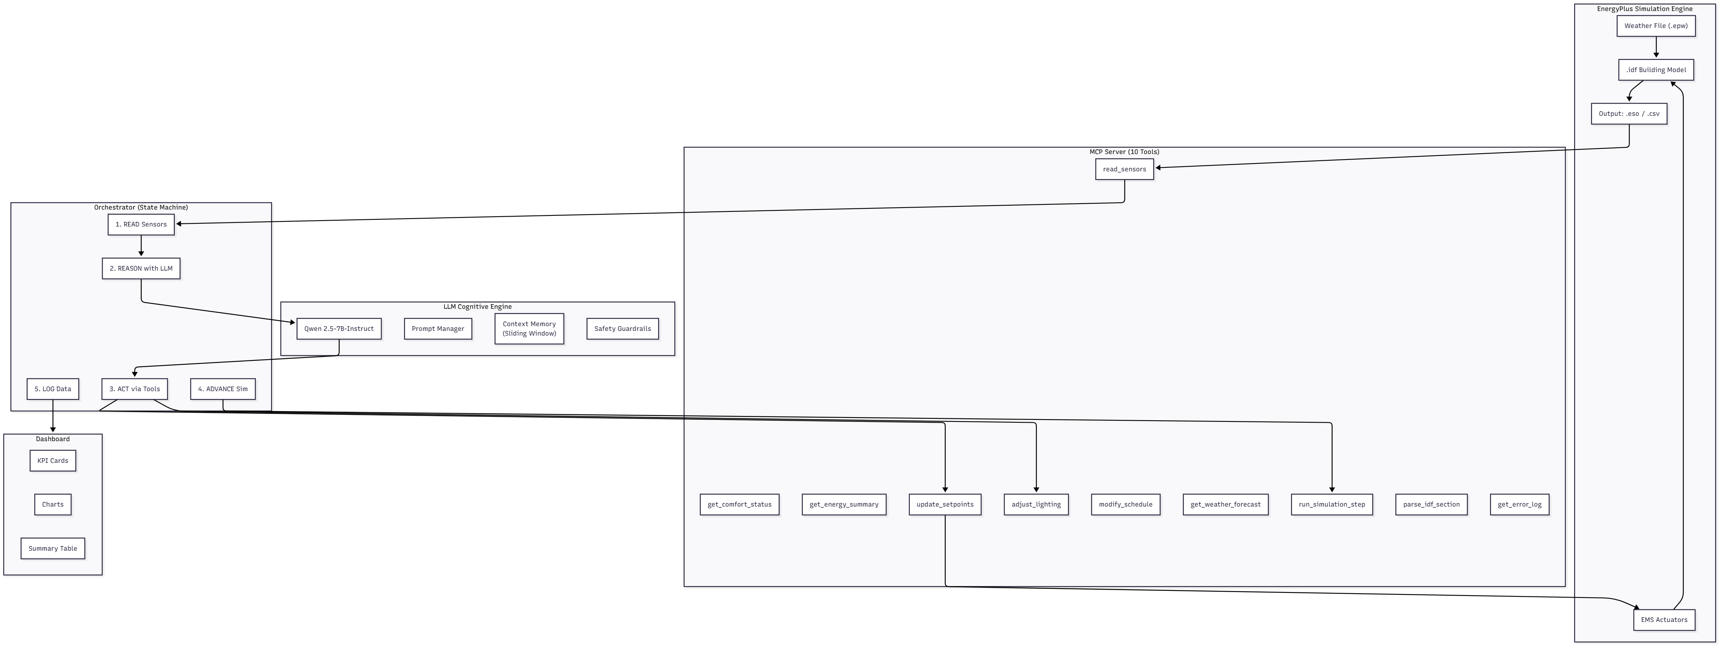
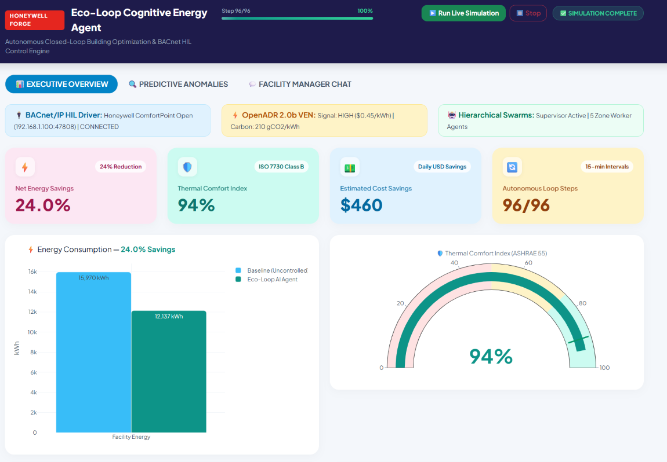
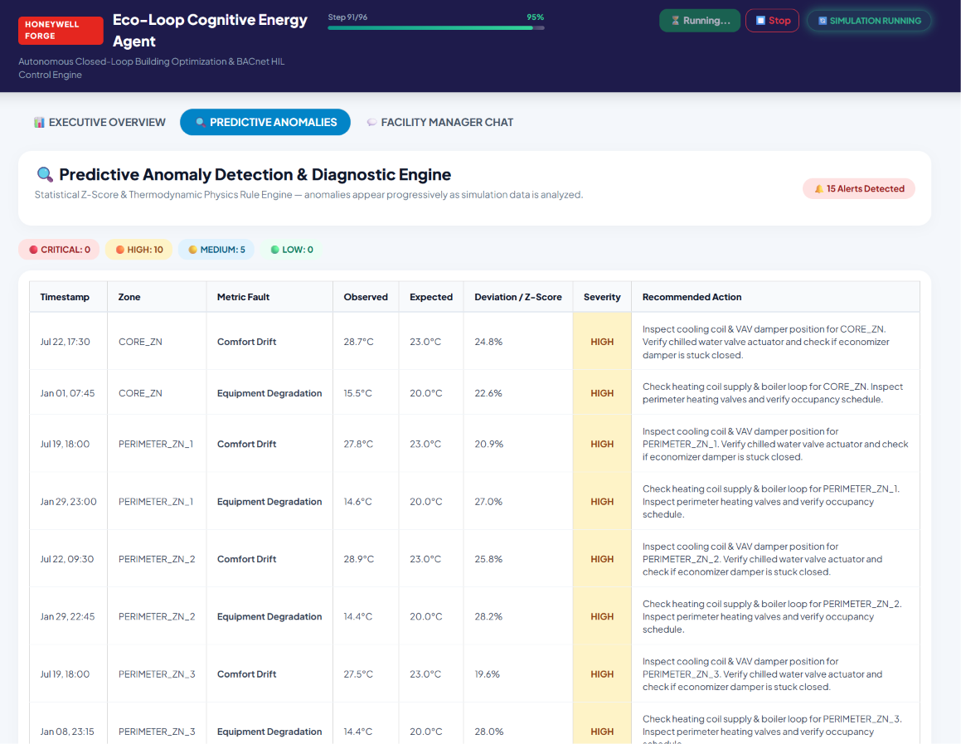
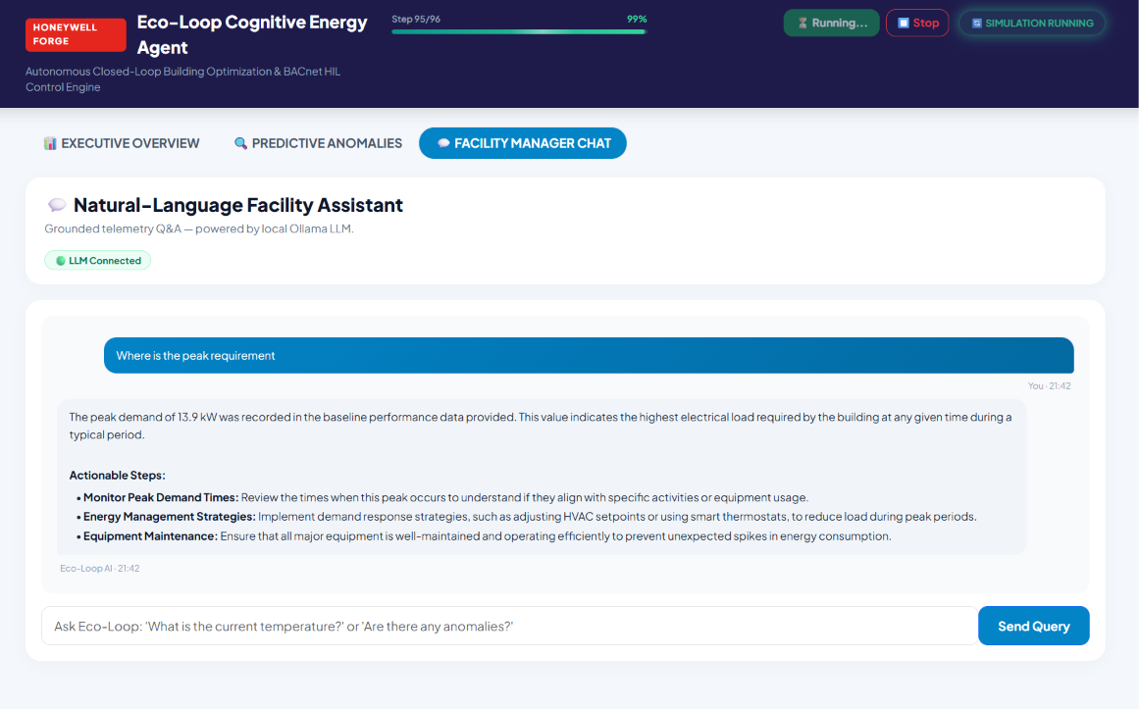
ARTIFACTS

Slide 6
RESEARCH AND REFERENCES
Resource | Official Link
EnergyPlus Documentation | https://energyplus.readthedocs.io
Honeywell Forge Documentation | Honeywell Forge Documentation
Ollama Documentation | https://github.com/ollama/ollama/tree/main/docs
Qwen 2.5 Technical Report | https://qwenlm.github.io/blog/qwen2.5/
Plotly Dash Documentation | https://dash.plotly.com/
Python Documentation | https://docs.python.org/3/
BACnet International Documentation
OpenADR Alliance Documentation
Model Context Protocol (MCP) Documentation

