Slide 1
TEAM ROBOLUTION
GROUP PROJECT -1
Team Members
Darshika
Neelesh
Vartesh
Raj

Slide 2
What is Our Project?
We had made some Complex LED patterns using very simple Arduino Coding and then we simulate it on proteus.
We get our idea from Decoration lightings and the idea for structure is from a Sand Clock.
We put each LED bulb as when it come together it will look like a Sand Clock.
12 Input/Output pins of Arduino were used by us.
This project was stimulated in Arduino Uno.
A total of 72 LEDs are there in our project.
End results was recorded in Proteus Software.

Slide 3
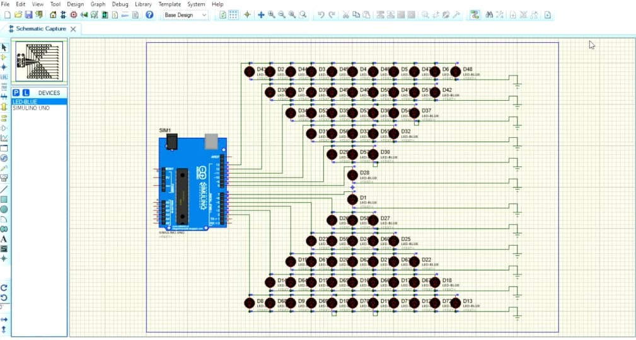
PROJECT DESIGN

Slide 4
What have been used in our Project?
HARDWARE-
BLUE LEDS (72)
CONNECTING WIREs (to connect the LEDs with Arduino board and to make other connections)
GROUND PIN
ARDUINO UNO BOARD
SOFTWARE-
ARDUINO IDE
PROTEUS 8.9

Slide 5
What we done?
IDEA-
The Idea was by Raj, Vartesh and all other the members contributed in making it more presentable and making it in reality.
DESIGN-
Design was done by Neelesh with a little help of Darshika.
CODING-
The code was written by Vartesh, Neelesh and Darshika.
WORKING ON PROTEUSE-
It was basically done by Neelesh and Darshika.
POWER POINT PRESENTATION-
It was made by Raj.
WE ALL HAVE DONE HARD WORK AND PUT100% EFFORT ON THIS PROJECT.

Slide 6
THANK YOU!

