Slide 1
Final Year Project
Topic : Enhancing Data Security
Under Guidance : Prof. Ajitkumar Khachane
Group Members :
Raj Wadekar 18101A0060
Anuj Joshi 18101A0068
Kshitij patil 18101A0020

Slide 2
intRODUCTION
Data Security has become one of the biggest concerns ,we are trying to solve this problem using our technology .
On our website user can upload any type of files(eg-txt,ppt,excel,etc) and encrypt them ,after encryption the user gets a secret key ,the user then can use the key to open and download the uploaded document
If any other user needs to see the document uploaded by other user he can request the secret key and can download the file.

Slide 3
Literature Review
SR.NO | TITLE OF PAPER | AUTHORS | KNOWLEDGE GAINED
1) | “An Enhanced Cloud Storage ” | 1)Sirisha Sanatha, 2)Swathi Amancha | In this paper we have proposed an advanced technique for securing data in cloud through fog computing. In this paper we have come up with fog computing and it gave advancement to the existing methodologies of securing data in cloud. Disadvantage : Data is not been encrypted.

Slide 4
SR.NO | TITLE OF PAPER | AUTHORS | KNOWLEDGE GAINED
2) | “A Study of Data Storage Security Issues in Cloud Computing” | A Venkatesh, 2) Marrynal S Eastaff | In this paper, we will discuss the different techniques that are used for secure data storage on cloud. Cloud computing enables users to store their data in remote storage location. But data security is the major threat in cloud computing.To overcome this, confidentiality, integrity, availability should be encapsulated in a CSP’s Service- Level Agreement (SLA) to its customers Disadvantage : Data is directly sent to cloud and processing is done in cloud which increases load on cloud

Slide 5
SR.NO | TITLE OF PAPER | AUTHORS | KNOWLEDGE GAINED
3) | “Securing the Internet of Things (IoT): A Security Taxonomy for IoT” | 1)Syed S Rizv 2)Andrew Kurtz | In Internet of Things (IoT), there is a vast number of connected devices that exist. These devices are collecting and transmitting great volumes of data from device to device,device to enterprise systems, and occasionally from device to humans. The primary goal of this research work is to advance the current state of the art in IoT research by identifying(a) the security requirements and challenges that IoT is currently facing, and (b) the existing security solutions that have been proposed or implemented with their limitations. Disadvantages SQL injection is possible Badly protected IDs
SR.NO
TITLE OF PAPER
AUTHORS
KNO

Slide 6
Technology stack
Software Requirements :
Python / Java
HTML
CSS
SQLite
Javascript
Django
Apache

Slide 7
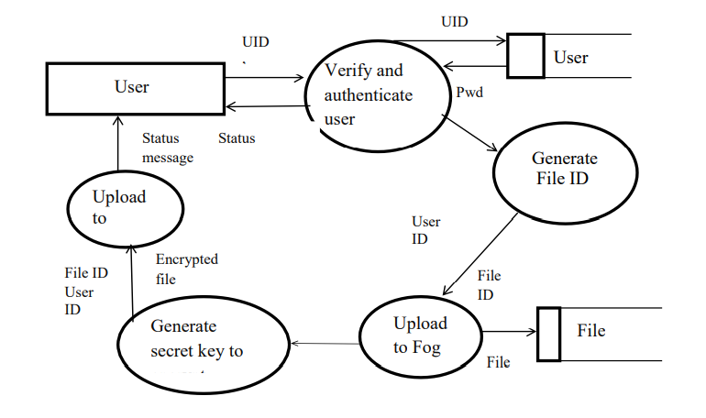
Implementation Process
Data flow diagram for file encryption :
In this project initially the user enters user ID and password to store his data, this will be verified in the user database if it is valid then the user will be authenticated and sends a status message to the user. A file ID will be generated to the file that has to be uploaded. The file ID will be used to fetch the required file from file database and then it is uploaded to the fog node. A secret key is generated to encrypt the file in fog node. The encrypted file is then stored in the cloud along with the file ID and user ID, then a status message is sent to the user.

Slide 8
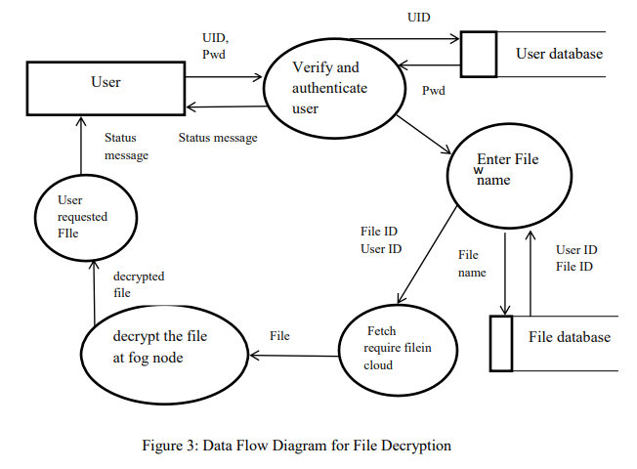
Data flow diagram for file decryption :
In this project initially the user enters user ID and password to retrieve required data, this will be verified in the user database if it is valid then the user will be authenticated and a status message is sent to the user. User enters the file name and corresponding file ID will be retrieved from the file database. The file ID along with user id will be sent to cloud to fetch required file. The file is sent to fog node where it is decrypted and then sent to the user.

Slide 9
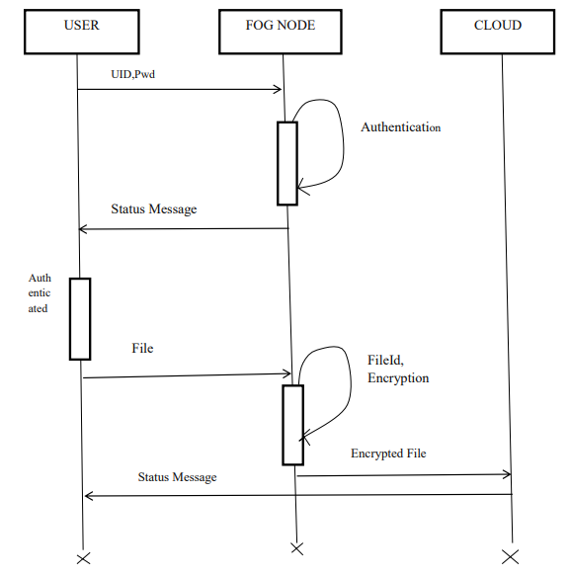
Sequence Diagram :
Initially the user enters user ID and password to retrieve required data, this will be verified in the user database if it is valid then the user will be authenticated and a status message. A file ID will be generated to the file that has to be uploaded. The file ID will be used to fetch the required file from file database and then it is uploaded to the fog node then file will be encrypted and stored in the cloud. Similarly to fetch a file the user enters user id and password, the file of entered file Id will be sent from cloud to fog then decrypted file is given to the user.

Slide 10
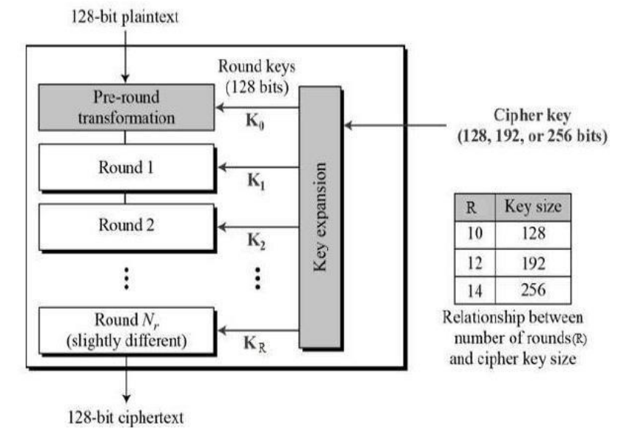
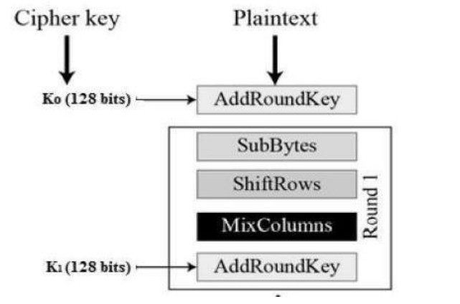
Advanced Encyption Standard Process (AES)

Slide 11
Thank YOU

