Slide 1
Learning Programming Concepts in C Lab

Slide 2
Lab 1 (Review)
Write a C program to display “Hello World!.”
Write a C program to print an integer entered by a user.
Write a C program to print the sum of two integers entered by a user.
Write a C program to find quotient and remainder of two integers entered by a user.
Write a C program to check whether the entered number is even or odd using remainder operator without IF-ELSE.

Slide 3
Lab 1 (Review)
Write a C program to find the area of a circle using constants.
Write a C program to check whether the entered year is a leap year.
Write a C program to check whether the entered number is even or odd using bitwise operator without IF-ELSE.
Write a C program to find the largest of three numbers using ternary operator.

Slide 4
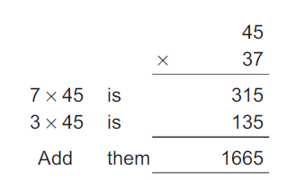
Lab 1 (Review)
Write an interactive program to demonstrate the process of multiplication. The program should ask the user to enter two two-digit integers and print the product of integers as shown below.

Slide 5
Lab 2
Read a string and count the number of a’s, e’s, i’s, o’s, u’s and number of consonants using switch case.
Repeat the above exercise using if-else.
Write a program to swap two numbers using functions.
Repeat the above program using only two variables.
Write a function to find the length of a string. Verify the same using string.h function.
Write a function to copy the string from source to destination. Verify the same using string.h function.
Write a function to concatenate two strings. Verify the same using string.h function.
Write a function to compare two strings. Verify the same using string.h function.

