Slide 1
Learning Programming Concepts in C Lab

Slide 2
Lab 2 (Review)
Read a string and count the number of a’s, e’s, i’s, o’s, u’s and number of consonants using switch case.
Repeat the above exercise using if-else.
Write a program to swap two numbers using functions.
Repeat the above program using only two variables.
Write a function to find the length of a string. Verify the same using string.h function.
Write a function to copy the string from source to destination. Verify the same using string.h function.
Write a function to concatenate two strings. Verify the same using string.h function.
Write a function to compare two strings. Verify the same using string.h function.

Slide 3
Lab 3
Find 2nd largest number from an array of size N.
Write a program to find out the frequency of occurrence of a given value v inside an array of size N. Read N, the actual numbers, and value v from the keyboard before you compute the frequency.
Modify the above program to compute the frequencies of all distinct numbers that appear in the array.
Print a triangle of ’*’s of height ’r’ rows. Now modify your program to print it upside down. of given size ’r’, where r represents the no. of rows in the triangle.

Slide 4
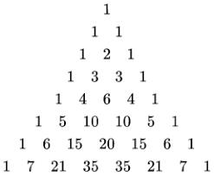
Lab 3 (Contd.)
Write a program to display Pascal’s triangle. Pascal’s triangle represents the binomial coefficients. The first few rows of Pascal’s triangle are displayed below. Observe how a row is related to the row above it.
Develop functions to compute factorial n till n terms using iteration.

Slide 5
Lab 3 (Contd.)
Repeat above problem using recursion.
Develop functions to compute the Fibonacci series till n terms using iteration.
Repeat above problem using recursion.
Compute the maximum value from an array of n integers using recursion.

