Slide 1

FULL-STACK WEB APPLICATION
Angular • Spring Boot • MySQL
Angular
Spring Boot
MySQL
JWT
BCrypt
AES
REV Password
Manager
OBJECTIVE
Secure Password Management System
To design and implement a secure password manager with encryption, authentication, and vault management.
Presented by: Raj
1 / 9

Slide 2









Table of Contents
01
Introduction and Objective
02
System Architecture
03
Methodology
04
Core Features Implemented
05
Security Features
06
Findings & Observations
07
Challenges & Key Learnings
08
Conclusion
2 / 9

Slide 3





Introduction & Objective
INTRODUCTION
OBJECTIVES
REV Password Manager is a secure web application that empowers users to:
✓
Secure password storage using AES encryption
Store passwords securely
✓
JWT-based authentication system
Generate strong passwords
✓
BCrypt hashing for master password
Access via master password
✓
Password strength analysis & audit
Analyze password security
✓
Backup & recovery mechanisms
3 / 9

Slide 4





System Architecture
MONOLITHIC FULL-STACK APPLICATION
FRONTEND
BACKEND
DATABASE
SECURITY
Angular
→
Spring Boot
→
MySQL
→
Multi-Layer
UI Components
HTTP Requests
Token Storage
REST APIs
Authentication
Encryption Logic
User Data
Password Entries
Security Questions
JWT Auth
BCrypt Hashing
AES Encryption
Flow: User → Angular → Spring Boot → MySQL
4 / 9

Slide 5
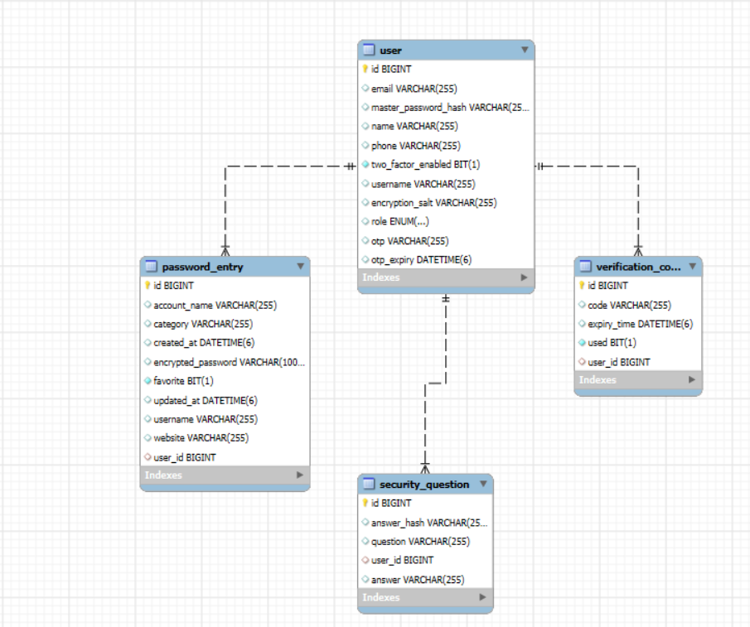
Entity Relationship Diagram

Slide 6




Methodology — Step-by-Step Implementation
1
User Authentication
2
Password Vault Management
Registration with security questions
Login via master password
JWT token generation
Optional 2FA verification
Add password entries
AES encrypt before storing
Decrypt on master password verification
3
Security Features
4
Backup & Recovery
Password strength analysis
Weak password detection
Reused password detection
Export encrypted vault
Import encrypted backup
5 / 9

Slide 7




Findings & Observations
Security Observations
Functional Observations
Performance Observations
Master passwords stored using BCrypt hashing
Password search, sort, and filter work correctly
Fast API response time across all endpoints
Vault passwords encrypted using AES-256
Password generator produces strong passwords
Secure and efficient database query handling
JWT ensures secure stateless API communication
Backup and restore functionality verified
6 / 9

Slide 8

Challenges Faced & Key Learnings
⚠ CHALLENGES FACED
💡 KEY LEARNINGS
1. JWT authentication integration
✓ Secure authentication using JWT tokens
2. Encryption & decryption implementation
✓ Password hashing vs encryption concepts
3. Master password re-authentication flow
✓ Angular frontend integration patterns
4. Angular–Spring Boot API integration
✓ REST API development with Spring Boot
5. UI state and modal management
✓ Secure system design principles
7 / 9

Slide 9





Conclusion
PROJECT ACHIEVEMENTS
SECURITY ACHIEVED THROUGH
Secure password storage system
JWT Authentication
BCrypt Hashing
Full authentication & authorization
AES Encryption
Master Password Verification
AES encryption & decryption
🚀 FUTURE ENHANCEMENTS
Password generator & security audit
→ Email-based OTP verification
Backup and restore functionality
→ Cloud deployment (AWS/GCP)
→ Browser extension integration
8 / 9

Slide 10

LIVE DEMONSTRATION
REV Password Manager
01
02
03
04
05
06
Register new user
Login with master password
Add password entry
View encrypted vault
Generate password
Export backup
9 / 9

