Slide 1
The Study of Severity of Accidents
Author:
Rajkumar Bathani

Slide 2
Introduction
This study finds the relationship between factors that would affect the severity of an accident.
Important factors such as; Weather Conditions, Road Conditions and Lighting etc.

Slide 3
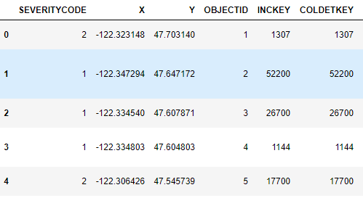
About the Dataset
The data was collected by Seattle Police Department, with over 190,000 observations collected over the last 15+ years.

Slide 4
Problem
The given dataset consists of 37 attributes that is associated with the car accident happened in Seattle, Washington, in which some or all can be used to train the Machine Learning model. Data that might contribute in predicting accident severity, Now, it would be great if you were warned of weather conditions and the road conditions, and about the possibility of you getting into a car accident and how severe it would be, So that you would drive more carefully, or even change your travel if you are able to.

Slide 5
Methodology
Gathering datasets in selected areas
Exploratory analysis of datasets
Data preprocessing and cleaning
Model fitting
Model evaluation and adjustment
Adopted Approach

Slide 6
Machine Learning Models
The used Machine Learning models are Logistic Regression and Decision Tree Classifier.
This is a classification problems.

Slide 7
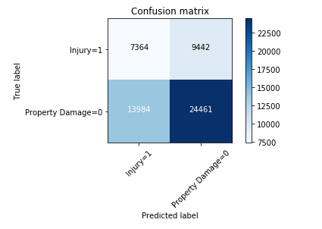
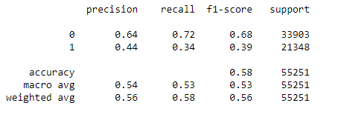
Decision Tree Classifier

Slide 8
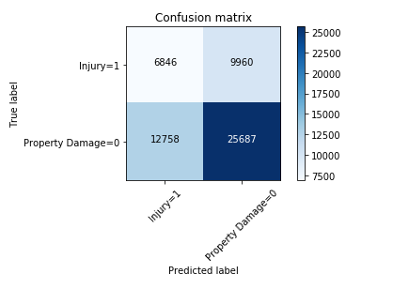
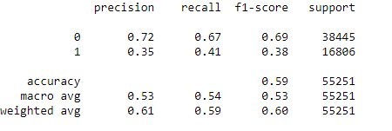
Logistic Regression

Slide 9
Conclusion
F1-scores, Precision and Recall, we can have a clearer picture in terms of the accuracy of the three models individually as a whole and how well they perform for each output of the target variable.
When comparing these scores, we can see that the f1-score is highest for k-Nearest Neighbor at 0.75.
When looking at models, we can see that the Decision Tree has a more balanced precision for 0 and 1.
The average F1 score of the two models are very close but for the Logistic Regression it is higher by 0.04.

Slide 10
Recommendations
The developmental body for the city of Seattle can assess how many of these accidents have taken place on a place where road or light conditions were not ideal for driving.
Government could launch development projects for those areas where most severe accidents take place in order to minimize the effects of these two factors.

