Slide 1
Advance Software Engineering (CS5910) Carpool Arrangement System
Instructor: Dr. Yui Man Lui Team C:
Burra Rajesh Reddy (700654107)
Yellapu Baldev (700657957)

Slide 2
Agenda
Introduction
Class Diagram
SOLID principle and Design Pattern
Sequence Diagram
CRC
Deployment Diagram
Milestones
Responsibilities

Slide 3

Introduction
Share the ride with other passengers
Reduces travel cost
Involves detours
Useful for people travelling to a common work location
Usually takes more time than booking a cab individually

Slide 4
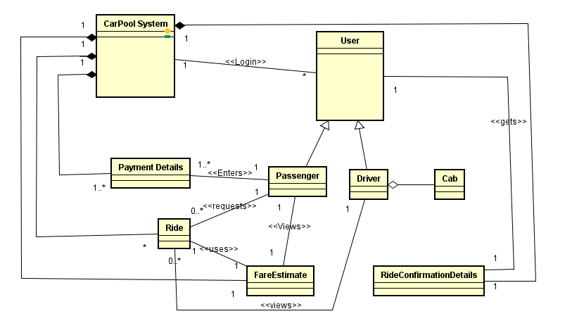
Class Diagram

Slide 5
SOLID Principle and Design Pattern
SOLID Principle – Dependency inversion principle and Single responsibility principle.
Major functions depend upon the low-level classes.
Design Patterns- Abstract Factory Design Pattern
Objects are created accordingly based on the utility of a class.
Responsibilities of object instantiation to another class via composition.

Slide 6
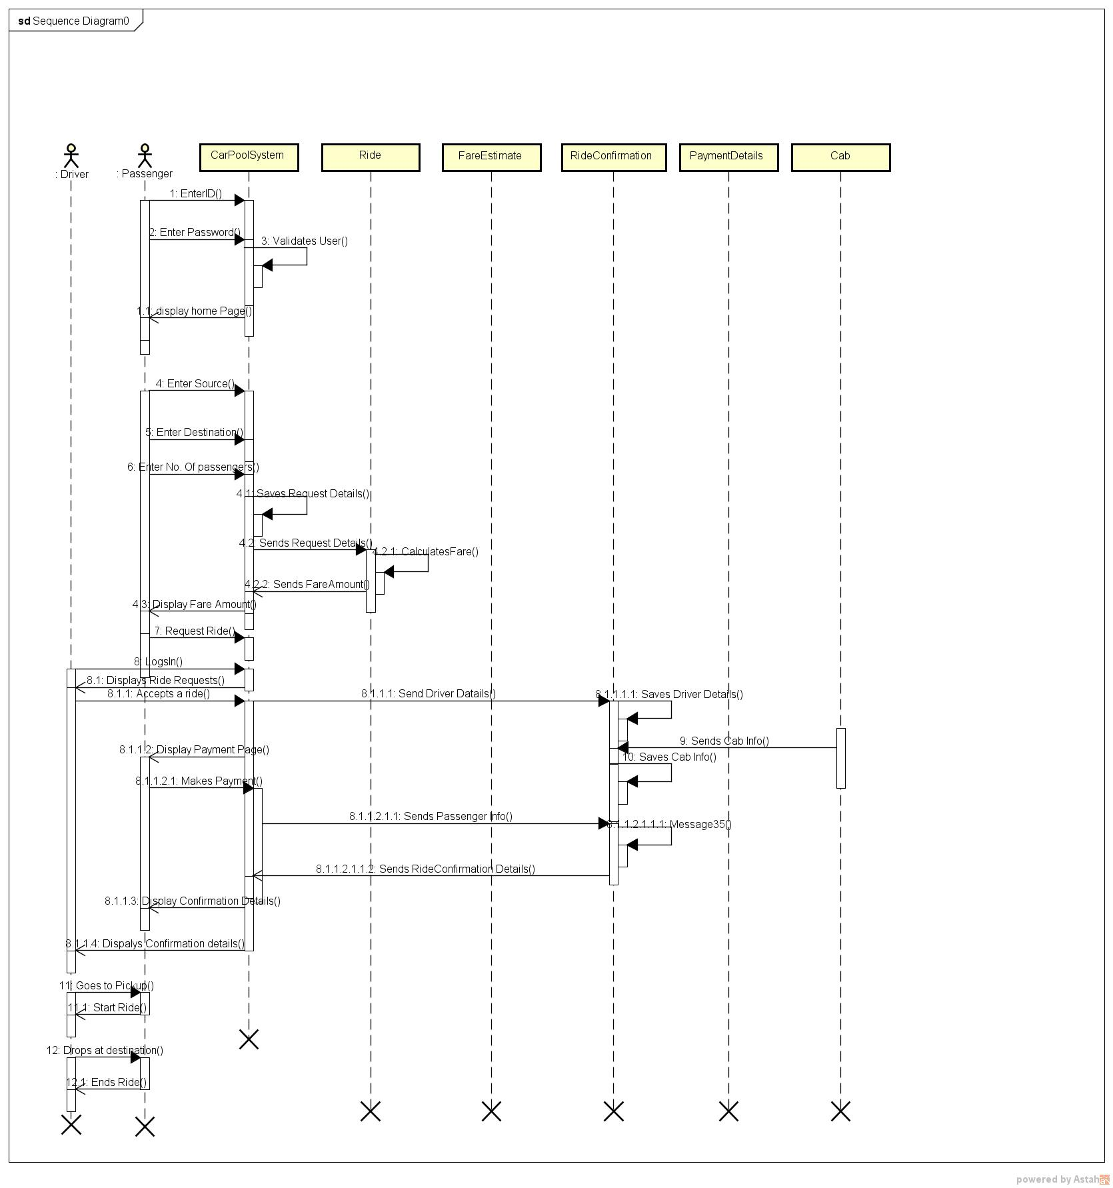
Sequence Diagram

Slide 7
CRC Diagrams
CarPoolSystem
Responsibilities: | Collaborators:
Validates the user Saves the source, destination and number of passengers Displays estimated fare amount to the passenger Saves the payment method entered by the passenger Completes the transaction via saved payment method Shows list of ride requests to driver Sends ride confirmation details to the passenger and driver | Passenger Driver Ride FareEstimate RideConfirmationDetails PaymentDetails

Slide 8
CRC cont..
Passenger
Responsibilities: | Collaborators:
Login into the system Enter ride details Request ride details Adds payment method Makes the payment Takes the ride | CarPoolSystem Ride PaymentDetails Driver
Driver
Responsibilities: | Collaborators:
Login into the system Accepts a ride from the list of available ride requests Pickups and drops the passenger | CarPoolSystem Ride Passenger

Slide 9
CRC cont.…
Ride
Responsibilities: | Collaborators:
Gets Source, destination and number of passengers from CarPoolSystem and saves them Calculates the distance Sends distance and number of passengers to fare estimate | CarPoolSystem Passenger Driver FareEstimate
FareEstimate
Responsibilities: | Collaborators:
Takes the distance and number of passengers from the Ride and calculates the fare. Sends estimated fare amount to the car pool system | CarPoolSystem Ride

Slide 10
CRC cont.….
RideConfirmationDetails
Responsibilities: | Collaborators:
Gets driver details, passenger details, cab details and save them Sends the ride confirmation details to the carpool system | CarPoolSystem Passenger Driver
PaymentDetails
Responsibilities: | Collaborators:
Adds the payment method Saves the payment method Sends the saved payment method to the carpool system | CarPoolSystem Passenger

Slide 11
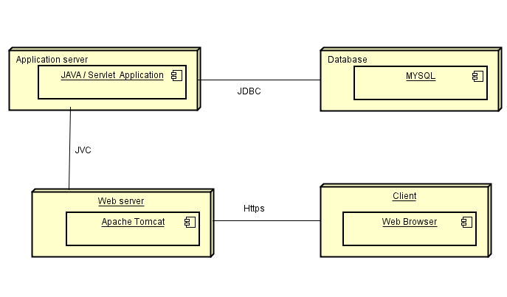
Deployment Diagram

Slide 12
Milestones
Design Document - 11/04/2018
Implementation - 11/15/2018
User Acceptance Testing - 11/ 17/2018
Deployment - 11/25/2018
Final release with bug fixing - 12/09/2018

Slide 13
Responsibilities
Rajesh Reddy Burra - developing the front end of the application, implementation, and documentation
Baldev Yellapu - developing the backend of the application, implementation and documentation.

Slide 14
Thank You!!

