Slide 1
Advance Software Engineering (CS5910) Carpool Arrangement System
Instructor: Dr. Yui Man Lui Team C:
Burra Rajesh Reddy (700654107)
Yellapu Baldev (700657957)

Slide 2
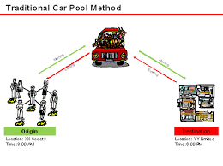
What is Carpool?

Slide 3
Agenda
Introduction about the project
Workflow of the System
Use Cases to explain the workflow steps
System Requirements

Slide 4

Introduction
Share the ride with other passengers
Reduces travel cost
Involves detours
Useful for people travelling to a common work location
Usually takes more time than booking a cab individually

Slide 5
Workflow
Login
Requesting Ride
Fare Estimation
Accepting the ride request
Selecting a cab
Making Payment
Ride Confirmation Details
Taking the ride

Slide 6
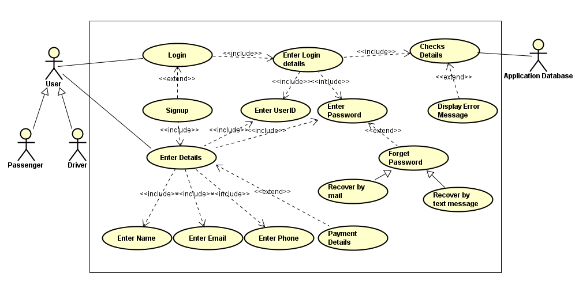
Login Use Case

Slide 7
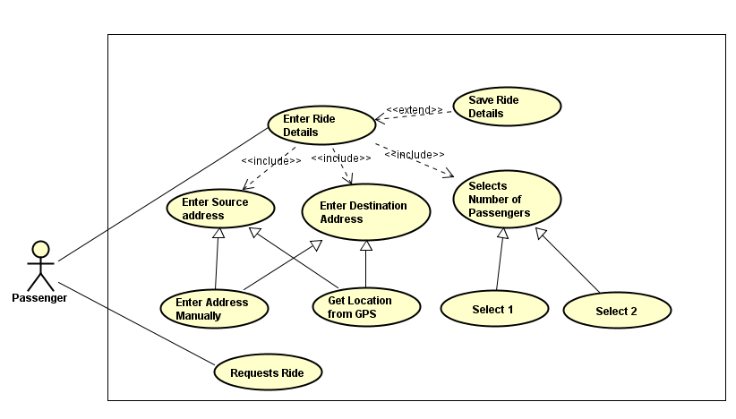
Request Ride Use Case

Slide 8
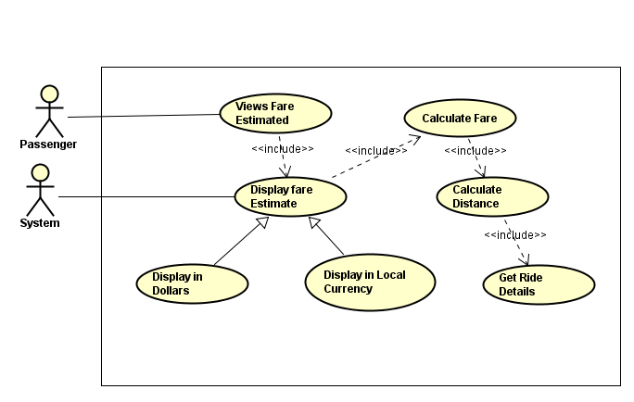
Fare Estimate Use Case

Slide 9
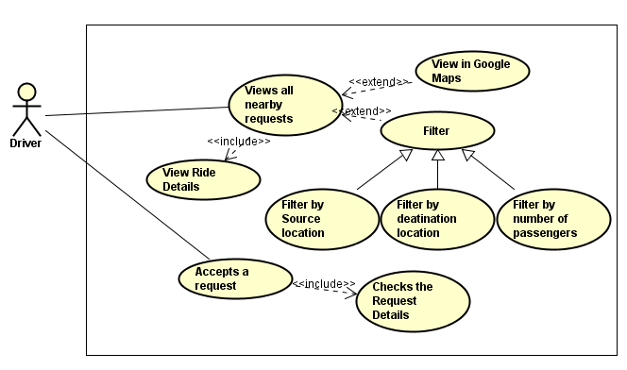
Accepting Ride Request Use Case

Slide 10
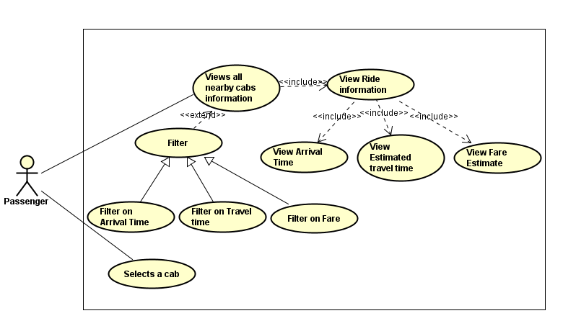
Selecting a Cab Use Case

Slide 11
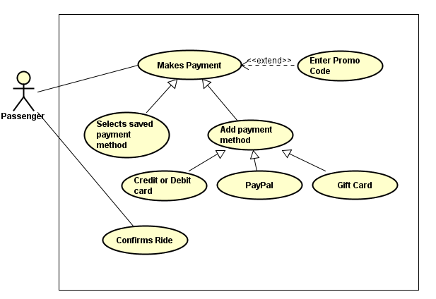
Making Payment Use Case

Slide 12
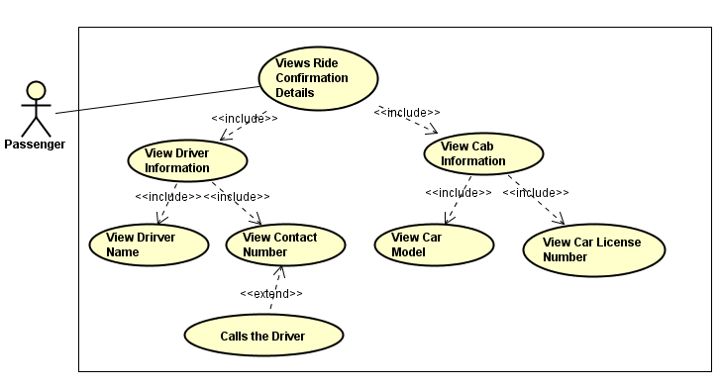
Ride Confirmation Details Use Case

Slide 13
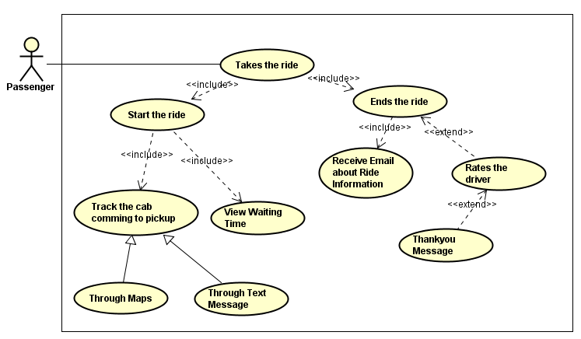
Taking the Ride Use Case

Slide 14
Software, Hardware Requirements and Tools
Operating System: Windows and MAC
RAM : 4GB and above
System must enable location services
Language: JavaScript
Tools used: Astah community to draw Use Cases

Slide 15
Thank You!

