Slide 1



WebIMS -
Intelligent Electronic Medical Office
CHAROTAR UNIVERSITY OF SCIENCE AND TECHNOLOGY
External Guide
Internal Guide
Prepared By
Mr. Nayan Rudani,
Team-Lead (Back-end), WebIMS, Meditab
Mr. Janardan Bharvad,
Assistant Professor,
DEPSTAR-CE
Raj Patel,
19DCE110,
DEPSTAR-CE

Slide 2

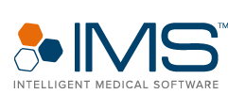
Abstract - Intelligent Medical Software
Medical insurance and payment system projects main idea to use the software application of medical stores and hospitals for maintaining easy billing system. The data is stored on a website, oracle is used as a website for this project. In the current system of medical services and patient information is stored in the form of manual records. In this inaccurate data process there is a risk of data loss and retrieving old records is not possible. It is a mainly use for billing purpose, The medical billing process is a process that involves a third party payer, which can be an insurance company or the patient. Medical billing results in claims.
This software is supported to eliminate and in some cased reduce the hardships faced by this existing system. Moreover this system is designed for the particular need of the company to carry out operations in a smooth and effective manner. It can assist the user to concentrate on their other activities rather to concentrate on the record keeping. Thus it will help organization in better utilization of resources. The organization can maintain computerized records without redundant entries. Basically the project describes how to manage for good performance and better services for the clients.

Slide 3


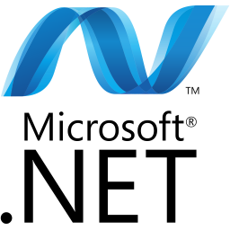

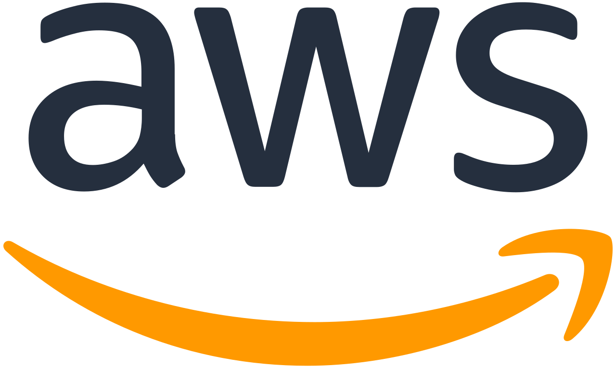
What is IEMO?
Intelligent Electronic Medical Office(IEMO) is basically a Medical billing software and it is mainly used for faceless appointment booking , medical insurance and all type for billing. This web Application is made with Angular which is used for front end development and for backend in this application, .net and node js is used, for database Postgres and MySQL is used and host a web application on server AWS is used.
The web application is reduced as much as possible to avoid error while entering the data. It also provides error message while entering invalid data. Thus by this all it proved it us user-friendly. As described above, Medical office can lead to error free, secure, reliable, easy to operate and fast management system. It can assist the user concentrate on their other activates rather to concentrate on the record keeping. Thus in better utilization of resources.

Slide 4

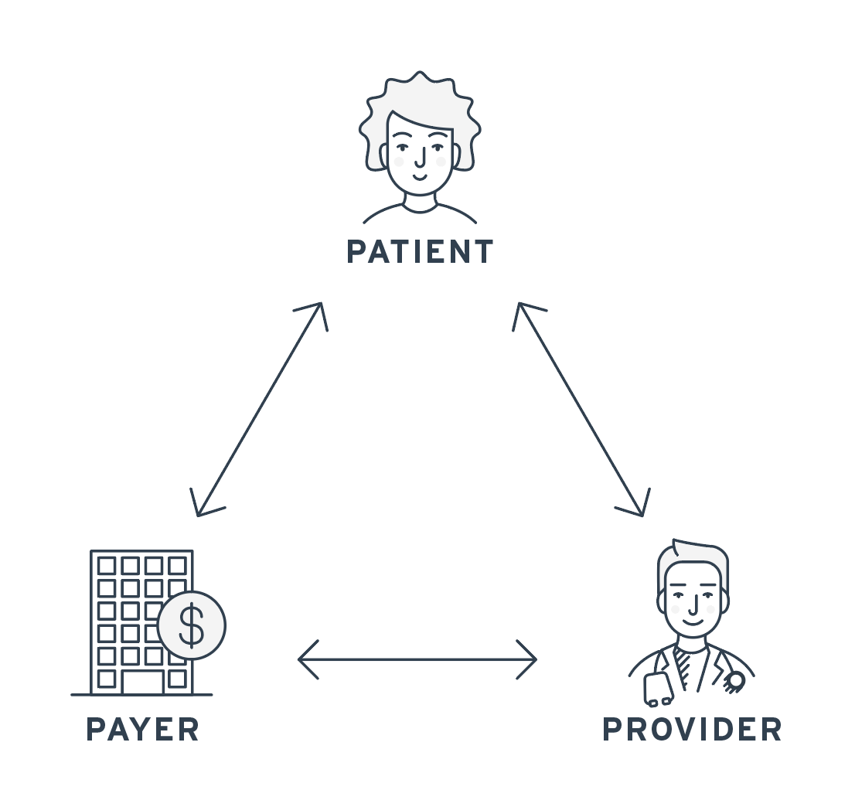

Why IEMO?
The main objective of this project is to manage the details of patients, Medicine, Medicine Company, Facility, Medicine Stock, Sells, Super Bill, Patient Insurance, Provider etc.
It manages all the information about customer, supplier, sales, patient.
It is a mainly used for billing purpose - The medical billing process is a process that involves a third party payer, which can be an insurance company or the patient. Medical billing results in claims.
The claims are billing invoices for medical services rendered to patients. The entire procedure involved in this is known as the billing cycle sometimes referred to as Revenue Cycle Management. A patient can do appointment remotely, and take insurance from any medical company .

Slide 5
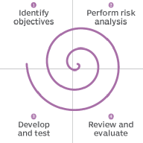
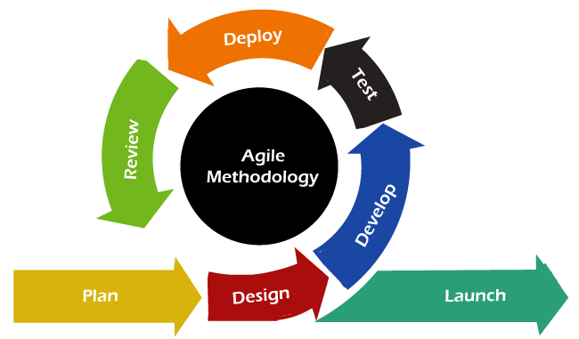
Project Plan
The spiral model is mainly used for IEMO. An adapted Agile development methodology works well for most healthcare solution projects because it enables the product team to more accurately capture the elements and features that matter most to end users (whether it medical clinic staff or patients) and prioritize the delivery of those features.
The concept of agile project management has gone on to spark several specific sub frameworks and methodologies such as lean, Kanban and scrum. Because agile project management methodologies have some principles : It’s quick, It’s open to data-driven change.
As such, agile project methods, all of the work to be done is added to a backlog that teams can prioritizing the backlog so teams know what to focus on first.

Slide 6
Software and Hardware Requirements
SOFTWARE REQUIREMENTS:
Operating System: Windows 10
Editor: Visual Studio Community
Technology: Dotnet Core
Language: C#
Database: Postgres
Web Server: Local
Browser: Microsoft edge, chrome etc.
Node version: 10.15.3
HARDWARE REQUIREMENTS:
Processor : Intel(R) Core(TM) i5-9500 CPU @ 3.00GHz 3.00 GHz
Computer Displays and Display Resolution, Multiple Users and Network Operation, Patient ID Card Scanning, Label Printers, Computers
RAM: 8GB (Preferable)
Hard Disk: 256 GB
ASSUMPTIONS AND DEPENDENCIES:
Each User Must Have Valid User ID and Password
Server must be running for the system to function.
Users must log in to the system to access any record.
Only the administrator can delete the records.

Slide 7
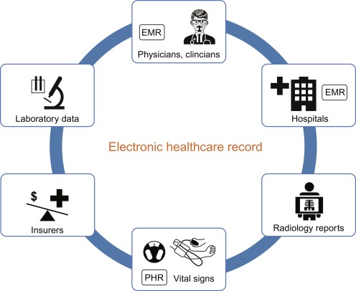
Functional Requirements
Registration Process
Adding Patients : The Medical Billing and Electronic Health record management system enables the staff in the front desk to include new patients to the system
Assigning an ID to the Patient: The Medical Billing and Electronic Health record management system enables the staff in the front desk to provide a unique ID as known as patient chart for each patient and then add them to the record sheet of the patient. The patients can utilize the ID throughout their Appointment Booking time or any time.
Providing Employee/Providers: The Medical Billing and Electronic Health record management system enables the staff in the Employee for a patient to provide a Provider according to patient Emergency and Provider availability.

Slide 8
Non Functional Requirements
There are a lot of software requirements specifications included in the non-functional requirements of Medical Billing and Electronic Health record management system, which contains various process, namely Security, Performance, Maintainability, and Reliability.
Security:
Patient Identification: The system requires the patient to see themselves using the phone.
Login Id: Any users who use the system need to hold a Logon ID and password depending on the location.
Modification: Any modification such as adding, deleting, renewing, etc. on the website can be synchronized quickly and done by the site manager only.
Front Desk Staff Safety Rights: The front desk staff can view any data throughout the Medical Health Record, add a new patient record as they enter, rather than the safety of a particular screen of every patient, so the administrator can assign rights to their clinic staff.
Administrative rights: The administrator may view and modify any information in the Medical Billing and Electronic Health system for records management.
Performance and Maintainability:
Response Time: The system provides one-second consent once 'patient information has been checked after booking.
Strengths: The program needs to support at least 1000 people at a time.
User interface: User interface agrees within five seconds.
Backup: The system provides efficient backup of data.
Errors: The system will track all errors and maintain its own log. If the data does not come correctly the email task you have to do.
Reliability:
Availability: The system is available all the time.

Slide 9
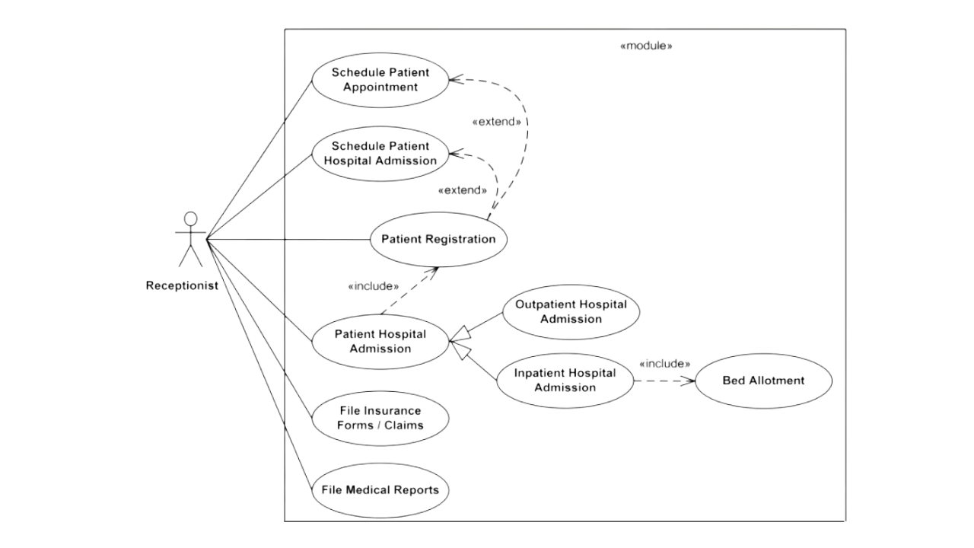
Use Case Diagram
Use Case Diagram

Slide 10
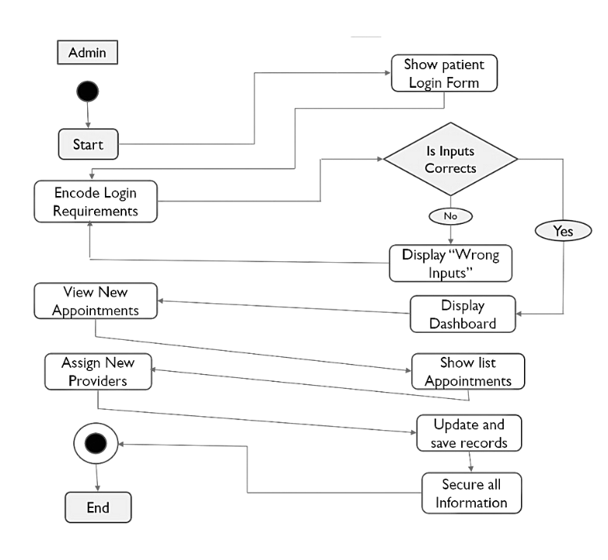
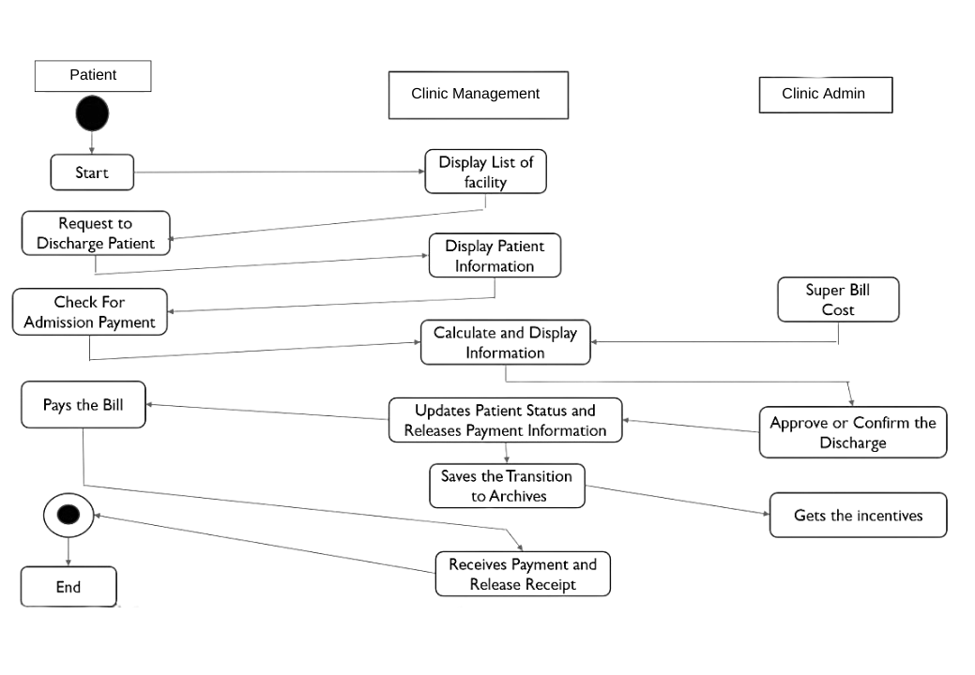
Activity Diagram
Activity Diagram for admin
Activity Diagram for multiple users

Slide 11
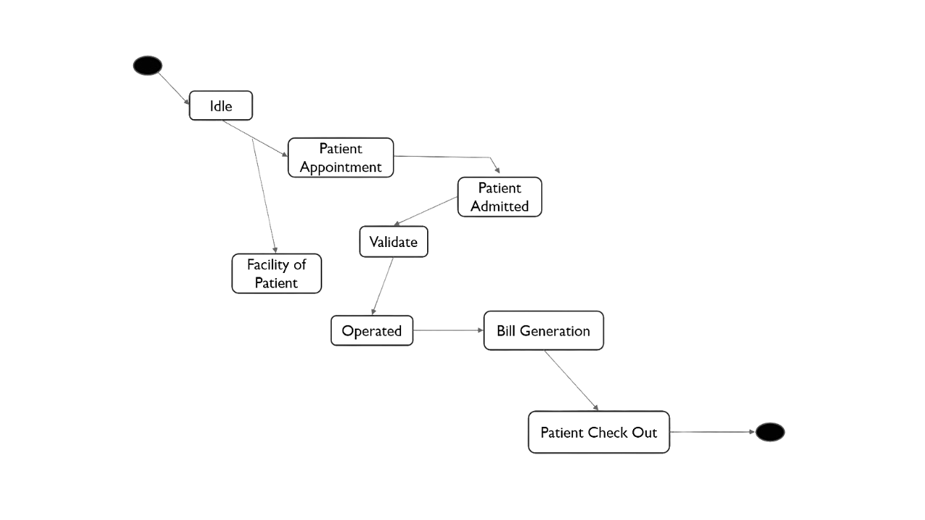
State Chart Diagram
State Chart Diagram

Slide 12
Testing Plan
For Testing plan, I have worked on Security rights testing particular screens. In that I have to checked the user rights of VIEW, CREATE, UPDATE and DELETE and also I have done developer testing for CRUD.

Slide 13
Conclusion
In conclusion, the development of an electronic health record maintaining intelligent medical software is a significant step towards improving healthcare delivery. The software has the potential to revolutionize the way medical records are maintained and accessed, thus enhancing the quality of patient care.
The software incorporates artificial intelligence and machine learning technologies to analyze patient data, diagnose illnesses, and make treatment recommendations. It also enables healthcare providers to share patient information seamlessly, improving collaboration and ensuring continuity of care.
With the increasing need for accurate and timely medical information, the electronic health record maintaining intelligent medical software will undoubtedly become an essential tool for healthcare providers. It has the potential to save time, reduce errors, and improve patient outcomes, making it an indispensable asset in the healthcare industry.
However, the implementation of such technology also presents challenges, such as data privacy and security concerns. It is, therefore, crucial to address these challenges and ensure that the software is compliant with relevant laws and regulations.
Overall, the electronic health record maintaining intelligent medical software is a promising technology that can significantly improve healthcare delivery. As it continues to evolve, it is essential to keep in mind the potential benefits and challenges that come with its implementation.

