Slide 1


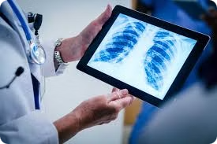
Classifying Chest X-Rays: A Convolutional Neural Network Approach
In the field of medical imaging, analysis of chest X-ray images is an important problem to detect and diagnose respiratory conditions sooner, like pneumonia. The main goal of this project is to build a High accuracy CNN model that can classify the X-ray images into 2 categories Normal or having Pneumonia using Deep learning.

Slide 2

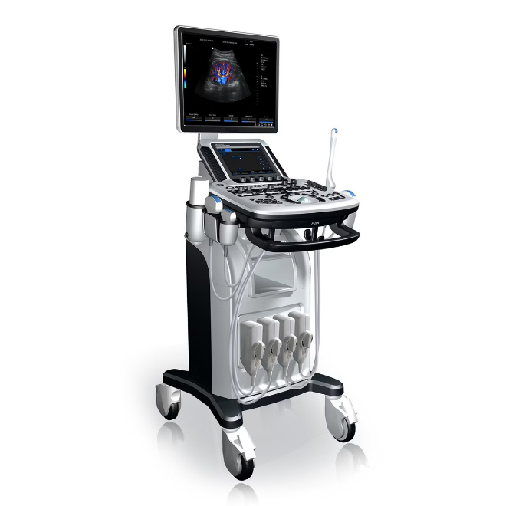
Problem Statement
1
Accurate Pneumonia Detection
2
Reduce Diagnostic Errors
Manually interpreting chest X-rays can be a time-consuming and error-prone process, especially for less experienced radiologists. An automated classification system can help reduce diagnostic errors and improve the efficiency of the healthcare system.
Pneumonia is a serious respiratory condition that can be life-threatening if not detected and treated promptly. The ability to accurately classify chest X-ray images as either normal or indicative of pneumonia is crucial for early intervention and improved patient outcomes.
3
Accessibility to Healthcare
In many parts of the world, access to quality healthcare and radiological expertise is limited. A reliable and accessible AI-powered chest X-ray classification system can help bridge this gap and improve healthcare accessibility in underserved communities.

Slide 3
Proposed Solution
Convolutional Neural Network (CNN)
Transfer Learning
Evaluation Metrics
The project will utilize transfer learning to increase the performance and reduce the complexity of our model. The system can be easily trained on a custom dataset by using an 'off-the-shelf' pre-trained CNN model followed by fine-tuning the whole network specifically for chest X-ray data, taking advantage of knowledge gained from previous large-scale image classification tasks.
The model will be evaluated using various metrics like accuracy, precision, recall and F1-score. It will prevent a final model to overfit, but also if we got that far it would give an extra guarantee of being both robust and reliable in generalization. It will also be solved in efficient and accurate way.
This project essentially revolves around the implementaion of a Convolutional Neural Network (CNN) model, one of the most formidable deep learning architecture best fit in solving image classification tasks. However, the CNN model will be trained on a large dataset of labeled chest x-ray images and it should eventually learn what are some distinctive features or patterns that would indicate normal scans vs pneumonia-resulting cases..

Slide 4

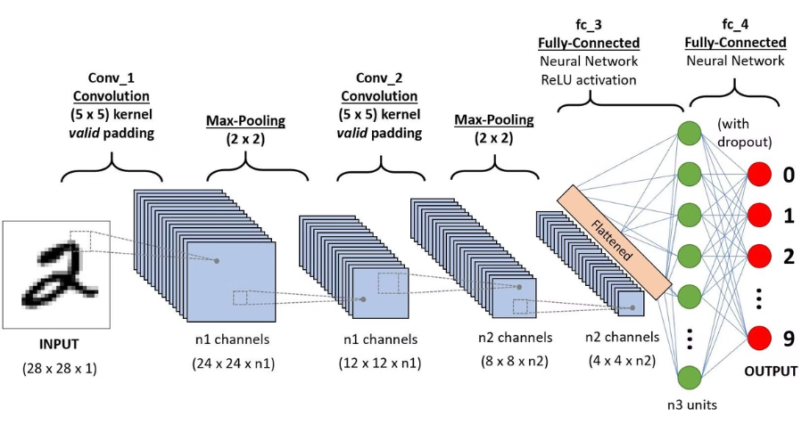
Convolutional Neural Network (CNN)
1
Image Input
The CNN model will take chest X-ray images as input, which will be preprocessed and resized to a consistent format suitable for the
algorithm of the model
2
Convolutional Layers
The input images will pass through a series of convolutional layers, where the model will learn to extract low-level features, such as edges and textures, and progressively higher-level features, such as shapes and patterns, that are relevant for the classification task.
3
Fully Connected Layers
The feature maps generated by the convolutional layers will then be flattened and fed into a series of fully connected layers, where the model will learn to combine the extracted features to make the final classification decision, distinguishing between normal and pneumonia-indicative chest X-ray images.

Slide 5

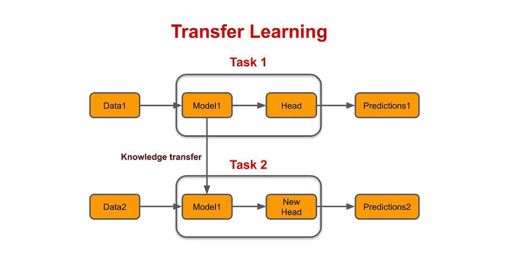
Transfer Learning
Pre-trained Model
Fine-tuning
This will use a pre-trained CNN model (e.g. VGG-16 or ResNet) developed on ImageNet ILSVRC classification dataset with at least 1000 classes as general purpose for the base network of our project. We have use last 10 layers of this model and softmax function for categorical classification in the last layer.
The pre-trained model will be fine-tuned using a specific chest X-ray dataset, enabling it to better recognize and classify the unique features found in these medical images. This process helps the model become more specialized and accurate in its analysis, tailored to the distinct patterns and characteristics within chest X-rays.
Improved Performance
Efficiency
By using transfer learning, the project can improve classification accuracy even with a smaller dataset and less training time. The model builds on knowledge from previous large-scale image classification tasks, making it more effective and efficient for this specific project.
Using transfer learning can also create a more efficient and lightweight model, making it better suited for real-world deployment and easier to integrate into clinical workflows.

Slide 6



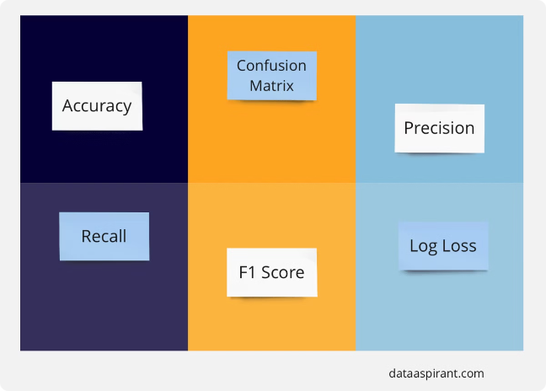


Evaluation Metrics
Accuracy
Precision
The model's overall classification accuracy reflects how often it makes correct predictions, shown as a percentage.
The model's ability to correctly identify positive instances (i.e., pneumonia-indicative X-rays) out of all the positive predictions made.
Recall
F1-Score
The model's ability to correctly identify all positive instances (i.e., pneumonia-indicative X-rays) out of the total number of positive cases.
The harmonic mean of precision and recall offers a balanced view of the model's overall performance.

Slide 7


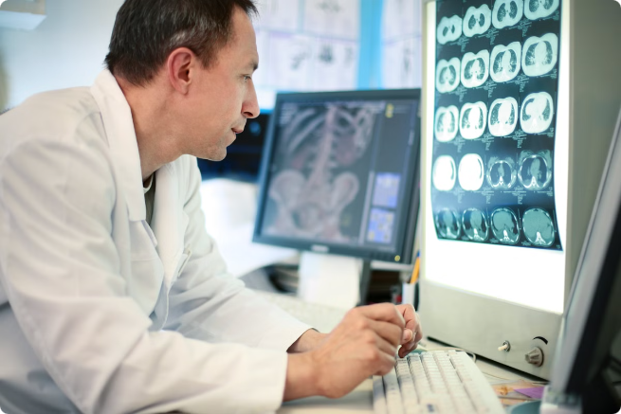


Conclusion
Accurate Pneumonia Detection
The developed Convolutional Neural Network (CNN) model will accurately classify chest X-ray images as either normal or showing signs of pneumonia, helping improve patient outcomes and making healthcare delivery more efficient.
Reduced Diagnostic Errors
The automated classification system will help lower the risk of diagnostic errors, particularly for less experienced radiologists, leading to more reliable and consistent medical diagnoses.
Increased Healthcare Accessibility
By harnessing the power of AI and deep learning, this project can enhance access to quality healthcare, especially in underserved areas where radiological expertise may be limited.

Slide 8
CREDITS
This project was developed by a team of researchers and engineers with expertise in deep learning, medical imaging, and healthcare technology.
RAJ GAURAV TIWARI https://www.linkedin.com/in/rgt2006
MOHAMMAD UMAM ALI https://www.linkedin.com/in/mohd-umam-ali
NEERAJ https://www.linkedin.com/in/neeraj-sharma-80b334301
KSHITIJ KUMAR RAI https://www.linkedin.com/in/kshitizrai-iitg

