Slide 1
CS699
Inhabitant term prediction​
(Assignment - 1)
Manas Jhalani, 22M0806
Raj Gothi, 22M2160
Prathamesh Karandikar, 22M1155​
30th April 2023

Slide 2

Problem Statement
To create a predictive model that, when provided with the name of a city, can generate the corresponding term used to describe its inhabitants, such as "Mumbai" -> "Mumbaikar."
Input : City Name / Place Name
Output : Inhabitant term

Slide 3
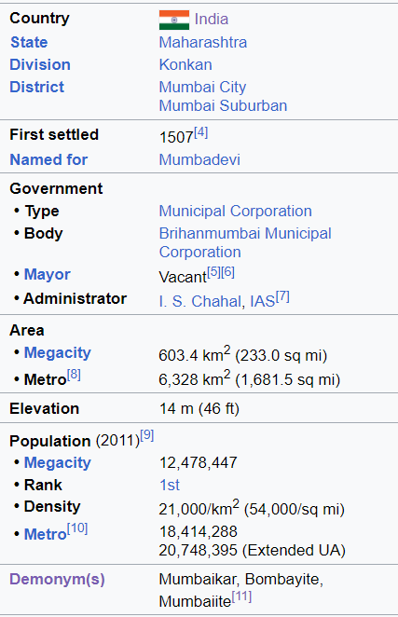

Data Collection
Wikipedia Scraping - Beautiful soup
Kaggle dataset only cities name 40K
Total cities fetched from scrap: 4500

Slide 4
Data Cleaning
In cases where a city has multiple demonyms associated with it, manually selected the most commonly used demonym for that city.
Create a new column by adding a suffix to delve deeper into analyzing the dataset. (eg. ian,ite,an,n,kar etc.)
Removed cities-demonym pair which have unusual relation.
Example : South Shields - Sandancer

Slide 5
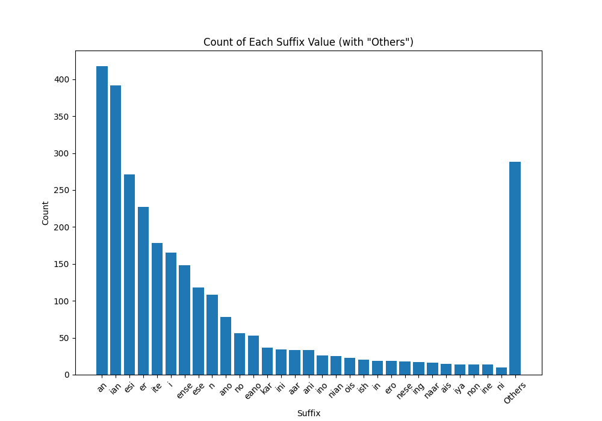
Dataset Statistics
Total Number of Instances - 3000
Unique Suffixes : 164
Train | 2686
Validation | 145
Test | 163
Dataset split according to suffix classes

Slide 6
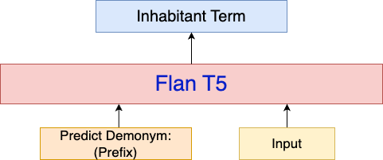
Technique​ (1/2)
Model Architecture when input is city, byte pair encoded city, city+phonemes
Input | Example
City | “ Tokyo ”
Byte Pair Encoded City | “ To<SEP>k<SEP>y<SEP>o ”
City + Phonemes | “ Tokyo<SEP>T OW K IY OW ”

Slide 7
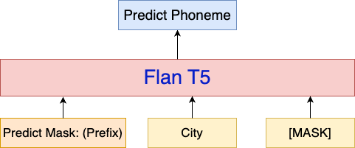
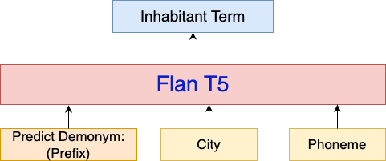
Technique (2/2)
Step 1
Step 2
Finetune for predicting phonemes
Finetune for predicting inhabitant term
Step 1 - Fine-Tune to predict phoneme from city
Step 2 - Fine-Tune to predict demonym from city and phoneme

Slide 8
Model Details
Model Name - Flan T5
Learning Rate - 1e-5
Weight Decay - 0.05
Train Batch Size - 8
Validation Batch Size - 32
Number of Epochs - 100
Vocab Size of BPE - 500
Model used for phoneme prediction - Grapheme-to-phoneme (G2P)

Slide 9
Results
Input | Train Accuracy | Validation Accuracy | Test Accuracy
City | 91% | 42% | 40%
Byte Pair Encoded City | 85% | 20% | 18%
City + Phonemes | 87% | 35% | 34%
City + Phonemes (MASK) | 88% | 37% | 36%

Slide 10
Analysis
City | Predictions
Vadodara | Barodian
Ahmedabad | Amdavadi
Mumbai | Mumbaikar
Indore | Indori
Trivandrum | Trivandrumite
Moscow | Moscovite
New York | New Yorker

Slide 11
Demo

Slide 12
Thank You

