Slide 1
CS699
POS Tagging Using HMM
(Assignment - 2)
Manas Jhalani, 22M0806
Raj Gothi, 22M2160
Prathamesh Karandikar, 22M1155​
8th October 2023

Slide 2
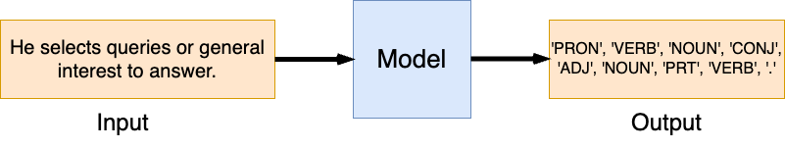
Problem Statement
To create a sequence-to-sequence model capable of generating the Part-of-Speech (POS) tag sequence for a given input sequence of words.
Input : Sequence of words
Output : POS Tags

Slide 3
Overall Performance
We have utilized 5-Fold Cross Validation.
Precision: 0.9563
Recall: 0.9560
F1-score: 0.9560
F0.5-score: 0.9562
F2-score: 0.9560
"All the scores provided are calculated as weighted averages of the individual scores for each of the 12 POS tags mentioned above."

Slide 4
Results (Class-Wise Distribution) (1/2)
POS Tag | Average Precision | Average Recall | Average F1-score
DET | 0.9561 | 0.9869 | 0.9712
NOUN | 0.9618 | 0.9461 | 0.9539
ADJ | 0.9107 | 0.9118 | 0.9113
VERB | 0.9746 | 0.9448 | 0.9594
ADP | 0.9488 | 0.9679 | 0.9582
ADV | 0.9069 | 0.8941 | 0.9004

Slide 5
Results (Class-Wise Distribution) (2/2)
POS Tag | Average Precision | Average Recall | Average F1-score
. | 0.9800 | 0.9995 | 0.9897
CONJ | 0.9899 | 0.9934 | 0.9916
PRON | 0.9524 | 0.9838 | 0.9679
PRT | 0.9068 | 0.8958 | 0.9012
NUM | 0.9691 | 0.9114 | 0.9394
X(Other Foreign Word) | 0.6690 | 0.4490 | 0.5352

Slide 6
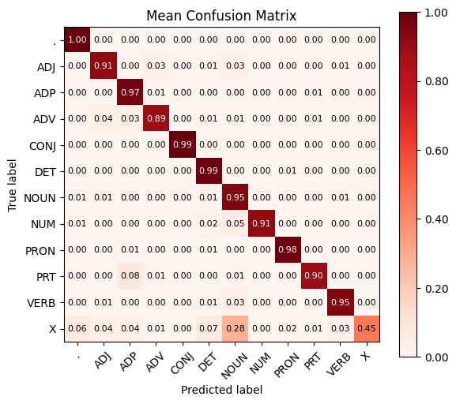
Confusion Matrix

Slide 7
Interpretation (1/2)
From confusion matrix we could conclude that :
‘X’ is maximally confused with ‘NOUN’ Tag :
Reason: X is a foreign term that often takes the place of the NOUN tag in grammar. Moreover, it is less commonly found in the corpus compared to other tags.
Sentence: “It would seem to represent esprit de corps run riot”
Expected Output: ['PRON', 'VERB', 'VERB', 'PRT', 'VERB', 'X', 'X', 'X', 'VERB', 'NOUN', '.']
Output: ['PRON', 'VERB', 'VERB', 'PRT', 'VERB', 'DET', 'NOUN', 'NOUN', 'VERB', 'NOUN', '.']
‘PRT’ is sometimes confused with ‘ADP’ Tag.
Sentence: “I have a hunch Marv Breeding might move up a notch.”
Expected Output: ['PRON', 'VERB', 'DET', 'NOUN', 'NOUN', 'NOUN', 'VERB', 'VERB', 'PRT', 'DET', 'NOUN', '.']
Output: ['PRON', 'VERB', 'DET', 'NOUN', 'NOUN', 'NOUN', 'VERB', 'VERB', 'ADP', 'DET', 'NOUN', '.']

Slide 8
Interpretation (2/2)
‘NUM’ is also sometimes confused with ‘NOUN’ Tag.
Reason: The NUM tag can appear in a sentence where there are also potential occurrences of the NOUN tag.
Example: “As wars go, Laos is an extremely little one.”
Expected Output: ['ADP', 'NOUN', 'VERB', '.', 'NOUN', 'VERB', 'DET', 'ADV', 'ADJ', 'NUM', '.']
Output: ['ADP', 'NOUN', 'VERB', '.', 'NOUN', 'VERB', 'DET', 'ADV', 'ADJ', 'NOUN', '.']
The majority of the remaining tags are easily distinguishable from one another.

Slide 9
Data Processing
Dataset Used - Brown Corpus
Dataset split - 90 : 10
Preprocessing :
Transforming every word in the sentence to lowercase.
Divide the sentence into tokens by separating at spaces and punctuation marks.

Slide 10
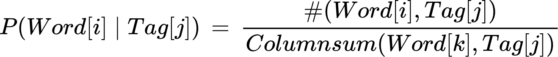
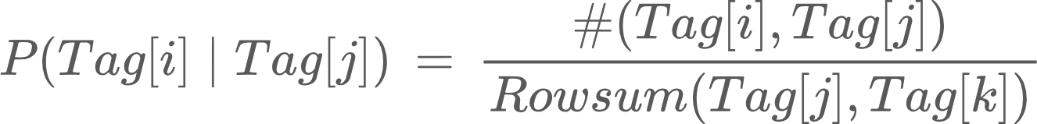
Modelling Details
Without Smoothing :
With Smoothing (S):

Slide 11
Decoding
Implemented Dynamic Programming: It computes the highest probability of reaching a specific tag at the current token for every token and potential tag. This calculation is based on the preceding token's tag, as well as the transition and emission probabilities.
The time complexity is O(n.T²) where n represents the number of tokens and T represents the number of tags.
The backpointers are used to choose the optimal tags for the previous tokens, tracing back until it reaches the beginning of the sequence.
If a word is absent in the corpus during decoding, we assign the emission probability as 1.

Slide 12
Discriminative vs Generative POS Tagging
Discriminative POS Tagging
Focuses on learning the conditional probability of a tag given the observed data (P(tag | word)).
Examples: CRFs, MEMMs, SVMs.
Considers the entire sentence when making predictions.
Performs well with ample labeled training data.
Capable of capturing complex dependencies between tags.
Generative POS Tagging
Aims to model the joint probability of words and tags (P(word, tag)).
Examples: HMMs, Transformation-based learning.
Focuses on learning probability distributions of words for each tag and transition probabilities between tags.
Can work reasonably well with smaller datasets as it generates data based on learned distributions.
Can be computationally more efficient compared to discriminative models.

Slide 13
Demo

Slide 14
Thank You

