Slide 1
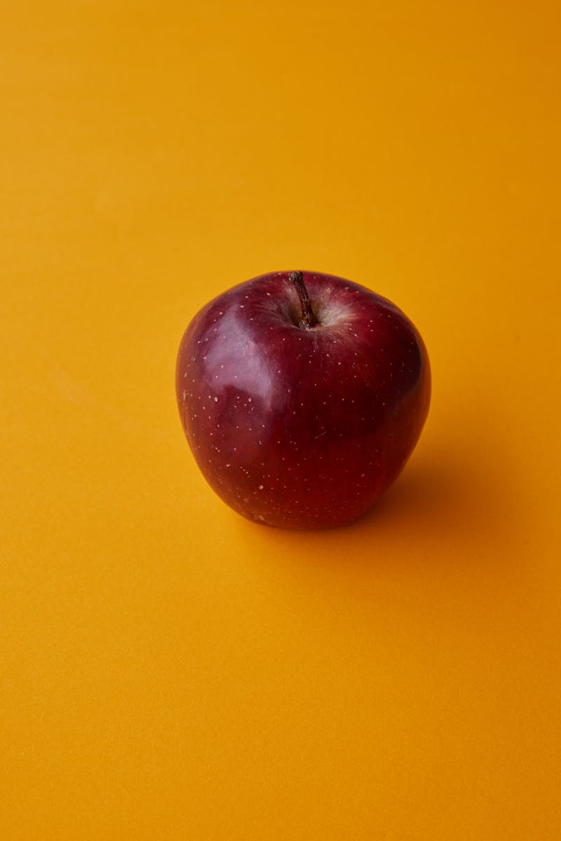
The Power of Apple Innovation and Inspiration
Photo by Pexels

Slide 2
01
A Fruit of Knowledge
Table of Contents
02
Health Benefits Galore
03
Cultural Impact
04
The Business of Apples
05
Thank You!

Slide 3

1
A Fruit of Knowledge
Wisdom in Every Bite
Apples have been a source of inspiration and knowledge for centuries, symbolizing learning and enlightenment. From the biblical story of Adam and Eve to Isaac Newton's discovery of gravity, apples signify important moments in history. These fruits encourage curiosity and exploration, making them a staple in education and learning environments. Every bite represents a step toward understanding the world around us, nurturing both the mind and body.
Photo by Pexels

Slide 4

2
Health Benefits Galore
An Apple a Day
Consuming apples regularly contributes to overall health, promoting heart health among various age groups. Packed with vitamins, fiber, and antioxidants, apples are excellent for digestive health and weight management. Their nutritional profile supports healthy skin and boosts the immune system, making them a superfood. Incorporating apples into your diet is a delicious way to enhance well-being and vitality.
Photo by Pexels

Slide 5

3
Cultural Impact
Apples in Society
Apples hold a significant place in various cultures, often representing peace, prosperity, and knowledge. In art and literature, apples convey deeper meanings, often symbolizing temptation, success, or education. Celebrations like Rosh Hashanah emphasize the apple's role in traditions, showcasing its cultural relevance. Their versatility extends beyond mere consumption, influencing creativity and societal norms globally.
Photo by Pexels

Slide 6

4
The Business of Apples
An Economic Giant
The apple industry generates billions in revenue, impacting agriculture, trade, and local economies worldwide. Innovative apple varieties and sustainable farming practices focus on meeting consumer demand and environmental health. Market trends highlight the growing popularity of organic apples, aligning with health-conscious lifestyles. The business surrounding apples continues to evolve, integrating technology and research for future growth.
Photo by Pexels

Slide 7

5
Thank You!
Gratitude for Your Attention
Thank you for exploring the incredible journey of apples with us. We hope this presentation has inspired you to appreciate the power of this remarkable fruit. May you carry the knowledge of apples into your daily lives, enriching your health and cultures. Let's continue to celebrate the apple's influence in our world together!
Photo by Pexels

