Slide 1


HADOOP LIFECYCLE PROJECT
By : PRWATECH

Slide 2
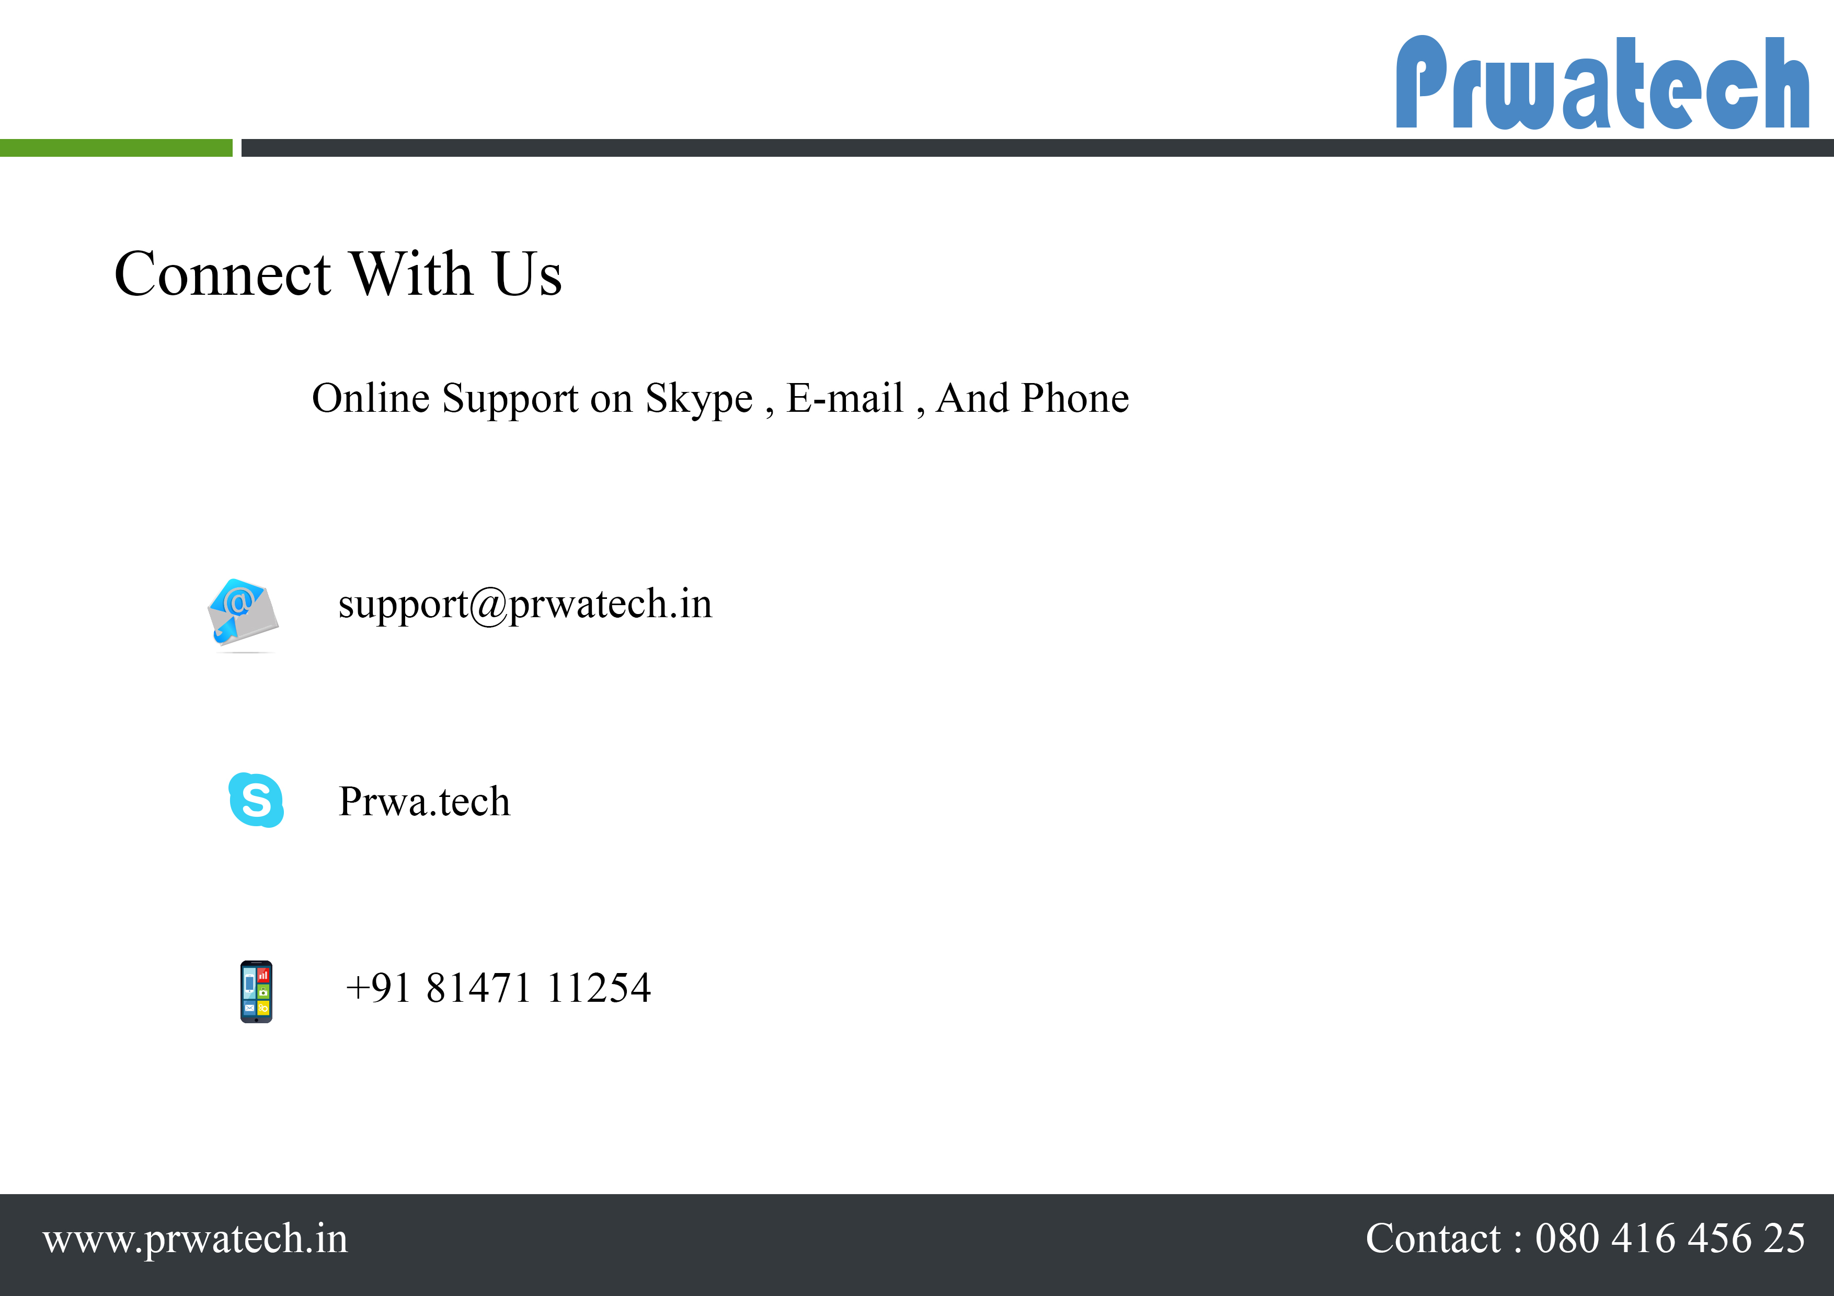

Slide 3






Development
Product Design
System Integration Testing
Production
User Acceptance Testing

Slide 4




BUSINESS REQUIREMENT & USE CASES

Slide 5

Upstream Source
INTELLIGENCE UNIT
Sqoop
Oracle
HDFS
SLOWLY CHANGING DIMENSION
CHANGING DATA CAPTURE
Surrogate Key
HUE
FRONT END
PUBLISH PHASE
Business Users

Slide 6
IU OVERVIEW :
A]. Upstream source inserts new data and updates existing data continuously.
B]. Oracle database is downstream source, which linked with upstream source, and writing all the data into tables.
C].Sqoop extracts or pool the table information from one database(oracle) to another database(hdfs).
D].Top of the HDFS, MapReduce or any high level programming language can be written and creates a hash value pair, with unique identifier which known as surrogate keys.
E].Changing data capture phase identifies the duplicate records and throws it to different directory to keep the uniqueness.
F].Each phase output is input for next phase.
G].Slowly Changing dimension phase has a two subdirectory in target path active and closed, active subdirectory is keeping old records as well as new records, closed subdirectory doesn’t has any new records.
H].SCDType output stores into publish phase, which is a hive phase.
I].Business users can fire a query on hive, according to their requirement.

Slide 7

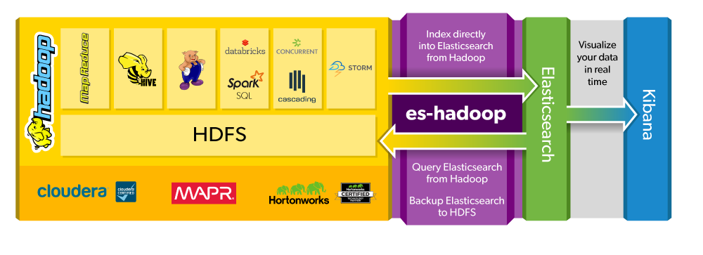
Elasticsearch is a search server based on Lucene. It provides a distributed, multitenant-capable full-text search engine with an HTTP web interface and schema-free JSON documents. Elasticsearch is developed in Java.

Slide 8

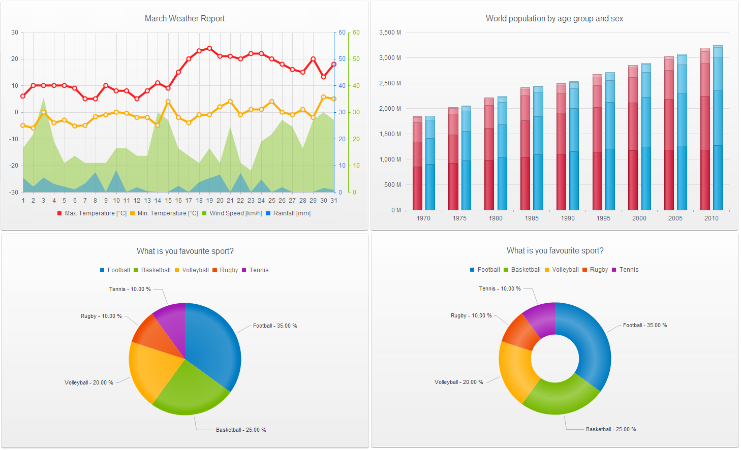

Slide 9

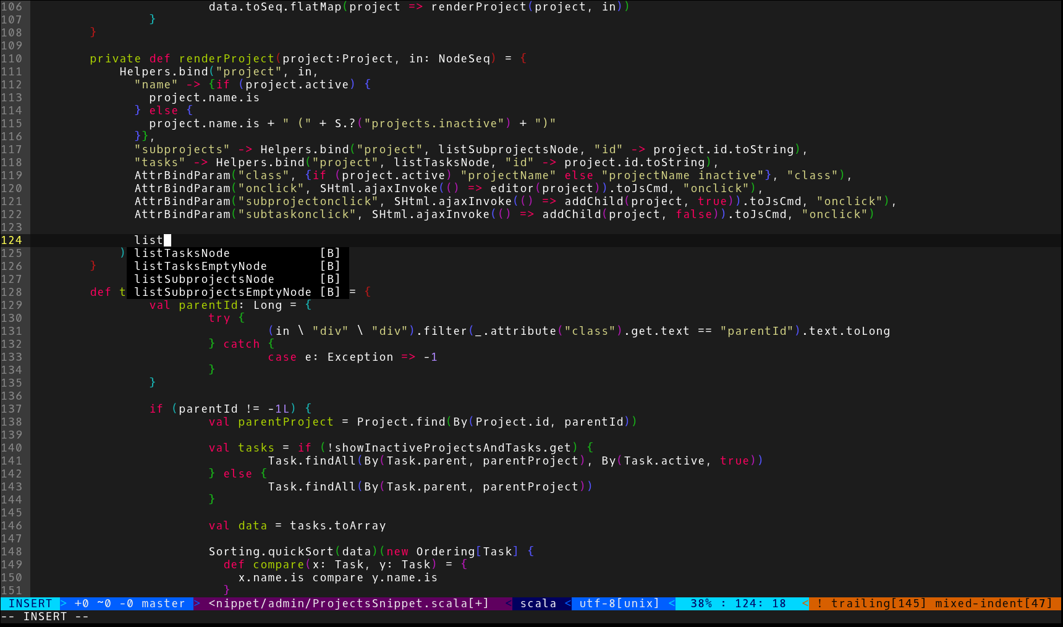

Slide 10

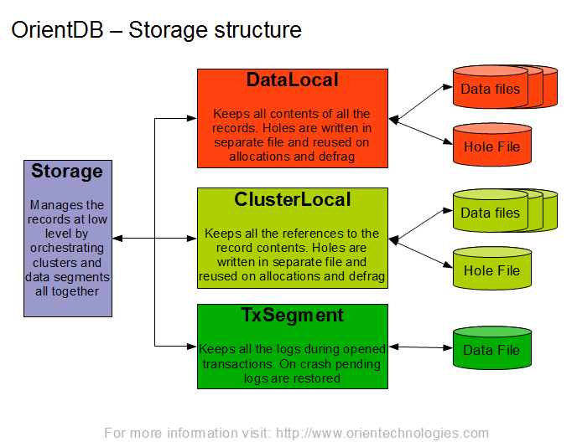
Orient DB Analysis
OrientDB is a 2nd Generation Distributed Graph Database with the flexibility of Documents in one product. It is a unique, true multi-model DBMS equipped to tackle today’s big data challenges and offers multi-master replication, sharding as well as more flexibility for modern, complex use cases.

Slide 11
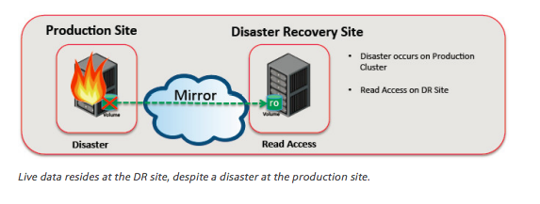

Data Recovery Stage
Production Challenges
A].No memory left on device while extracting records from RDBMS to HDFS..
B].Huge records needs multiple mappers.
C].Hive Sasl error while querying.
D].Scala/Spark jobs not able to find memory, jobs are in unassigned state.

