Slide 1



Samarth Rural Educational Institute
SAMARTH COLLEGE OF ENGINEERING
& MANAGEMENT, BELHE
A Project Stage-II
Presentation On
“NoteHub: Intelligent Platform for Student Knowledge Sharing”
By
Khandagale Tushar Santosh
Pokharkar Omkar Kiran
Raj Dwarkanath Jadhav
Raul Vishwajeetsinh Hardayalsinh
Department of Computer Engineering
2025-2026

Slide 2
Introduction
Overview: Notehub is a full-stack, AI-integrated web application designed to digitize, centralize, and simplify student knowledge sharing.
The Problem: Traditional note-sharing relies on scattered, unverified sources, making students vulnerable to data loss and incorrect academic information.
The Solution: Notehub provides a focused, scalable platform where students can securely upload, store, and access academic materials.
Quality & AI Integration: Features a strict Admin moderation panel to verify notes, alongside an AI Module (Gemini API) for instant doubt resolution and plagiarism checking.
Modern Architecture: Built using HTML/CSS/JS (Frontend), Node.js (Backend), SQL (Database), and containerized with Docker for seamless real-world deployment.

Slide 3
Student-Centric Community: Notehub goes beyond file storage by encouraging active academic discussions through integrated Chat Rooms and a gamified Leaderboard system.
Streamlined Workflow: The system operates on a seamless 3-step process: students upload notes → admins verify content quality → notes are published for global search and access.
Enhanced Productivity: Reduces the time students spend searching for reliable study materials by providing an organized, keyword-searchable database.
Real-World Application: Designed with scalability in mind, proving that complex, multi-tier web applications can effectively solve everyday academic challenges.

Slide 4
Problem Statement
The Problem We're Solving
Traditional note-taking methods are fragmented, inefficient, and prone to data loss. Students across institutions struggle with disorganized study materials stored on personal devices, shared drives, or physical notebooks — none of which offer reliability, searchability, or peer verification. Furthermore, when students seek academic help online, they often land on unchecked forums, spam-filled Q&A sites, or unverified document repositories that can propagate misinformation.
The absence of a centralized, moderated platform means there is no guarantee of content quality, no institutional accountability, and no intelligent assistance to guide students toward verified answers. This gap in the academic ecosystem is what NoteHub is designed to address.

Slide 5
Objectives
Develop a Secure Authentication Pipeline: Implement a JWT-secured login system combined with Google OAuth to ensure seamless and secure access for all university students.
Automate AI Identity Verification: Deploy an AI-driven verification engine to automatically process and validate multi-document uploads (ID cards and Bonafide certificates) with high accuracy to prevent unauthorized accounts.
Implement Robust Plagiarism Detection: Build a document processing pipeline utilizing text shingling (SimCheck) and structural hashing to detect and successfully block duplicate or heavily plagiarized study materials.
Enable Intelligent Semantic Search: Integrate vector embedding generation and a vector database to allow students to discover highly relevant academic resources based on contextual meaning rather than just exact keyword matching.
Establish Gamification Mechanics: Create a dynamic, real-time leaderboard system ("Departmental Flare") with point multipliers (e.g., 1.1x boost) to motivate students and increase daily active user engagement.

Slide 6
6. Facilitate Peer-to-Peer Collaboration: Develop integrated study groups, help requests, and broadcast channels to allow real-time academic discussion and resource sharing among verified users.
7. Ensure Scalable Database Architecture: Design a highly optimized PostgreSQL database schema capable of efficiently handling concurrent document uploads and heavy vector queries during peak exam seasons.
8. Integrate RAG-based AI Assistance: Deploy a Retrieval-Augmented Generation (RAG) chatbot to provide instant, context-aware answers to student queries by pulling information directly from the platform’s verified note repository.
9. Ensure High Availability & Cloud Deployment: Containerize and deploy the application using modern cloud infrastructure to ensure 99.9% uptime and fast load times regardless of platform traffic.

Slide 7
Project Scope
Core Features
Centralized note storage with structured categorization, admin moderation pipeline for content approval, and AI-powered query assistance to help students find answers quickly and accurately.
Security Architecture
Secure API communication over HTTPS, environment variable management for sensitive credentials, session-based authentication, and role-based access control separating students from administrators.
Future Scope (Excluded)
Native mobile applications for iOS and Android, real-time collaborative editing, cloud backup synchronization, and advance

Slide 8
Significance
Why This Project Matters
NoteHub is more than an academic exercise — it is a hands-on demonstration of industry-standard engineering practices. By building with Node.js, Docker, and SQL, the project mirrors real-world EdTech deployment pipelines used at scale by companies like Coursera, Khan Academy, and Notion.
From a practical standpoint, NoteHub minimizes data loss by centralizing storage, ensures the reliability of study materials through admin verification, and builds a foundational architecture that can evolve into a full-fledged EdTech platform. For students, it means trustworthy resources. For developers, it means a production-grade reference implementation.

Slide 9
Literature Review
Sr. No. | Paper Title | Author(s) | Year | Description
1 | Research on Note-Taking Tools for Scientific Work | Wang Shuyi, Cui Leiyue, Shi Ying, Wang Zheng | 2022 | Analyzes different note-taking applications and their specific features in managing and organizing scientific data.
2 | College Lecture Notes Management System | Dr. K. Sailaja, Chandrahas Reddy | 2023 | Presents a proposed system designed specifically for managing, storing, and sharing college lecture notes digitally.
3 | Note Taking in Teaching Literature | Istabraq Tariq Alazzawi, Marwah Shihab Yaqoob, Saeed Rawdan Abdallah | 2023 | Analyzes how structured note-taking improves memory retention, understanding, and overall learning efficiency.
4 | Review on Existing Note Taking and Task Management Apps | Abhijith L. Kotian | 2024 | Reviews various modern note-taking and task management applications available in the market and identifies their limitations.

Slide 10
Sr. No. | Paper Title | Author(s) | Year | Description
5 | Aims and Methods of Note-Taking | Turkan, Mehraj, Ismailli | 2024 | Explores the core objectives of note-taking and evaluates different methodologies used by students to capture information effectively.
6 | Digital Note-Taking in Lectures: A Study on Learning Environment | S. Johnson, A. Lee | 2024 | Investigates the impact of digital note-taking tools on student engagement and the overall collaborative learning environment.
7 | The Impact of Cloud-Based Collaborative Platforms on Student Academic Performance | R. Martinez, T. Chen | 2023 | Discusses how centralized, cloud-based platforms improve resource sharing, accessibility, and peer-to-peer collaborative learning.
8 | Artificial Intelligence in Digital Education: Automated Quality Assessment | H. Kim, P. Sharma | 2024 | Examines the integration of AI models to verify academic content, detect plagiarism, and improve the reliability of shared educational materials.

Slide 11
Literature Review – Research Gap
Research Gaps Identified:
Trust & Authenticity Issues: Existing informal channels (WhatsApp, Telegram) lack administrator-mediated verification, leading to significant trust issues regarding source authenticity.
Fragmented Organization: Generic cloud platforms and informal folders suffer from inconsistent metadata and lack a durable, searchable organizational structure for academic resources.
AI "Hallucinations" in Education: Standard Large Language Models (LLMs) often generate factually incorrect information because they lack specific, localized institutional context.
The "Cold Start" Problem: New student cohorts frequently lack easy access to historical academic materials and exam patterns from previous generations.
Content Integrity: Peer-to-peer networks often lead to the proliferation of low-quality, outdated, or plagiarized academic content without quality control.
Need for Proposed System:
An intelligent, centralized platform like Notehub is required to establish an "academic single source of truth." By integrating dual-layered AI verification and a Retrieval-Augmented Generation (RAG) architecture, the system ensures that shared knowledge is authenticated, grounded, and organized for long-term collaborative learning.

Slide 12
Proposed Solution
Centralized Knowledge Hub: A single platform for students to securely upload, organize, and search for high-quality study materials.
AI-Powered Verification: Automatically checks for plagiarism and content quality while preventing duplicate uploads.
Fact-Checked AI Assistant: A specialized chatbot that provides answers grounded only in verified notes to ensure 100% accuracy.
Admin-Mediated Quality Control: Every document is reviewed by an administrator to maintain high academic standards.
Smart AI Routing: Uses multiple AI models (Gemini, Mistral, etc.) to ensure the system is always fast and reliable.
Gamified Learning: A points-based leaderboard that rewards students for sharing quality notes and helping others.
Real-Time Collaboration: Integrated chat rooms and instant cloud sync for seamless peer-to-peer learning.
.

Slide 13
Feature | Existing System (LMS / Social Media) | Our System (Notehub)
1. Content Verification | Manual or None (Prone to errors/fake notes) | AI-powered dual-layered verification
2. Organization | Messy folders and fragmented chat history | Structured, searchable "Source of Truth"
3. AI Intelligence | Generic search or no integrated AI | RAG-based AI with institutional context
4. Data Integrity | High risk of plagiarism and outdated files | Built-in plagiarism & SHA-256 integrity check
5. User Engagement | Low (Passive reading/viewing) | High (Gamification & Leaderboards)
6. Storage Efficiency | Redundant (Multiple copies of same file) | Optimized (Cryptographic deduplication)
7. Interaction | Static (No intelligent assistant) | Interactive AI Chatbot (Gemini/Mistral/Ollama)
8. Accessibility | Generational "Cold Start" (cohorts lose data) | Persistent, searchable historical repository
9. Platform Support | Often fragmented across multiple apps | Centralized Web + Android Integration

Slide 14
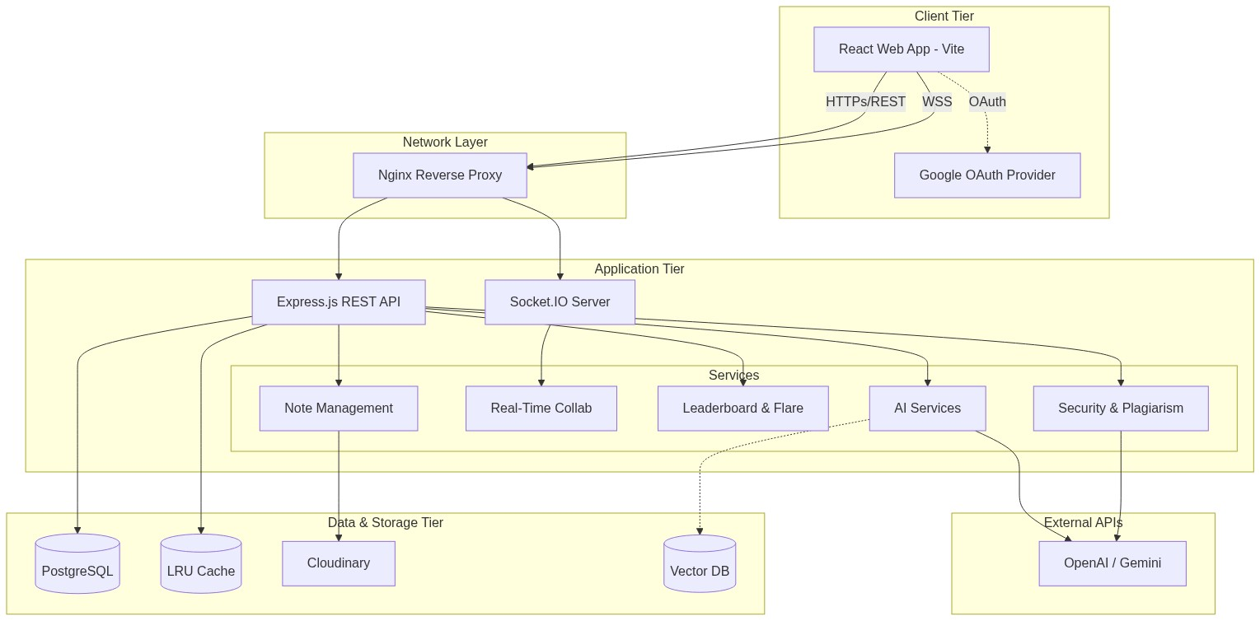
System Architecture

Slide 15
1. React Web App (Vite) The fast and responsive frontend framework that students directly interact with. It renders the entire user interface and handles lightweight browser logic.
2. Google OAuth Provider A secure authentication gateway. It allows users to log into the platform safely using their existing Google accounts without us needing to store their passwords.
3. Nginx Reverse Proxy The "traffic cop" of the architecture. It intercepts incoming internet traffic, blocks malicious requests, and securely routes user commands to the correct backend server.
4. Express.js REST API The core backend application that handles all standard business logic. It processes file uploads, manages user accounts, and connects the frontend to our database and AI services.
5. Socket.IO Server A dedicated backend channel specifically for real-time web connections. It keeps a persistent connection open to power ultra-low latency features like live document collaboration.
6. Services (Note Engine, Gamification, Security) These are the internal micro-modules that handle specific platform rules. For example, the security module runs the anti-plagiarism checks, while Gamification calculates the "Departmental Flare" leaderboard scores.
7. PostgreSQL Database The primary relational database where all structured information is stored permanently. This holds our user profiles, verified ID statuses, point tallies, and note metadata.
8. Cloudinary / Blob CDN A high-speed cloud storage network for large media files. Instead of clogging our database, heavy PDF documents and uploaded ID images are stored securely here.
9. Open AI / Gemini (External LLMs) External Large Language Model services that our backend talks to securely behind the scenes. They provide the "smarts" to generate dynamic quizzes, career roadmaps, and analyze physical PDF documents.

Slide 16
Module 1: Note Management & Plagiarism Detection
This module serves as the core file-sharing ecosystem where students can upload, manage, and discover academic notes. A built-in security engine continuously checks uploaded documents against an internal database and the internet to prevent duplicate submissions and maintain strict academic integrity. • Key Features: • Secure PDF and Word document uploading • Automated text extraction mapping • Advanced SimHash plagiarism detection • Real-time duplicate content rejection • Integrated cloud storage for large media files

Slide 17
Module 2: Real-Time Collaboration
This module creates an interactive virtual workspace where multiple students can connect and study together seamlessly. By utilizing peer-to-peer data channels, students can share insights, edit text, and communicate with each other instantly without ever needing to refresh the page. • Key Features: • Ultra-low latency connection handling • Persistent WebSocket server backups • Real-time synchronized text streaming • Live peer-to-peer data exchange • Interactive online study room environment

Slide 18
Module 3: AI Assessments & Quizzes
This module acts as a dynamic testing engine designed to help students validate their understanding of uploaded study materials. By parsing the content of user-uploaded notes, the system employs advanced large language models to algorithmically generate targeted quiz questions on the fly. • Key Features: • Automated note parsing and summarization • Dynamic multiple-choice question generation • Context-aware answer validation • Immediate performance feedback scoring • Algorithmic difficulty adjustment

Slide 19
Module 4: Career AI Roadmaps
This module provides personalized, step-by-step career guidance by analyzing a student's current skill sets and goals. It generates highly structured, duration-based learning roadmaps that tell students exactly what technologies to learn and in what order to achieve their dream roles. • Key Features: • Intelligent skill gap analysis • Hybrid duration-based timeline generation • Dynamic UI rendering of career paths • Downloadable structural PDF roadmaps • Direct integration with LLM prompting

Slide 20
Module 5: PYQ (Previous Year Questions) Analyzer
This module streamlines exam preparation by aggressively analyzing historical question papers. It processes massive amounts of text from past exams, embeds the data to find patterns, and summarizes the most heavily weighted topics so students know exactly where to focus their attention. • Key Features: • Optical character and text extraction from past exams • Identification of recurring test patterns • Advanced topic summarization • Predictive insights on upcoming exams • Retrieval-Augmented Generation (RAG) capabilities

Slide 21
Module 6: Gamification & Departmental Flare
This module drives student engagement by introducing a competitive leaderboard powered by a secure AI identity verification system. It rewards points for valid note uploads and grants a coveted visual "Flare" to the top-performing departments, fostering healthy academic competition. • Key Features: • Point calculation based on platform contributions • Structural hashing for fake ID prevention • AI-powered student identity verification • Dynamic visual UI "glow" effects for winners • Automated leaderboard synchronization

Slide 22
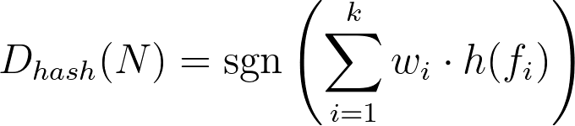
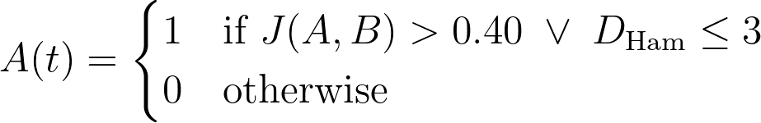
Mathematical Model
1. Data Acquisition (Vectorization & Hashing): (SimHash document finger-printing based on term weights)
2. Condition Check (Plagiarism Analysis): (Jaccard Similarity and Hamming Distance thresholds)
3. Data Storage & Gamification Analysis: (Point updates factoring in the ID validation multiplier)
4. Alert / Rejection Function: (Formal rejection bounds based on similarity scores)
5. System Summary:

Slide 23
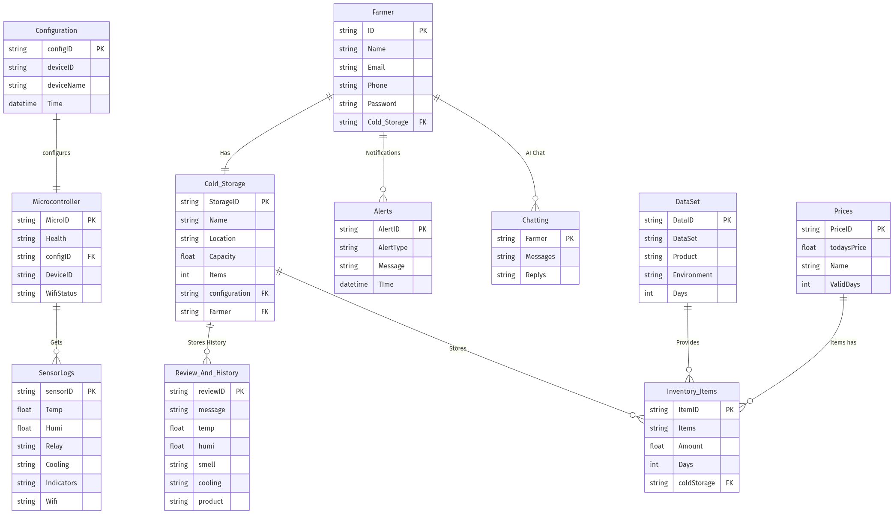
Database Design

Slide 24
Data Flow
Level 0 Data Flow Diagram (Context Diagram) Theory
The Level 0 DFD, also known as the Context Diagram, provides a high-level, "zoomed-out" view of the entire academic platform.
Purpose: Its main goal is to establish the system boundary by representing the NoteHub platform as a single, centralized process. It intentionally hides internal AI and database complexities to focus purely on external interactions.
External Entities: It identifies exactly who or what interacts with the system from the outside. In this project, the primary external entities are the Students, University Departments, and External Auth Providers (like Google OAuth).
Data Flow: It illustrates the primary inputs and outputs entering and leaving the system. For instance, it shows the system receiving raw data (uploaded study documents, ID images, search queries) and outputting processed information (verified access, semantic search results, plagiarism alerts, and leaderboard rankings) back to the user.
Level 1 Data Flow Diagram Theory
The Level 1 DFD "zooms in" to unpack the single system bubble from Level 0, revealing the major internal sub-processes, AI engines, and databases that make NoteHub work.
Purpose: Its main goal is to demonstrate the logical flow of information between internal modules, bridging the gap between high-level theory and actual backend implementation.
Sub-Processes & Components: It breaks the system down into functional areas like AI Identity Verification, Plagiarism & Similarity Engine (SimCheck), Semantic Vector Search, and the Gamification Engine, all routed through the PostgreSQL database.
Detailed Data Path: It traces the exact lifecycle of data. It shows how a student's credentials pass through the Auth Process, how an uploaded document is processed through structural hashing and vector embedding before database storage, and how successful uploads automatically trigger the Leaderboard module to distribute points and update the Departmental Flare.

Slide 25
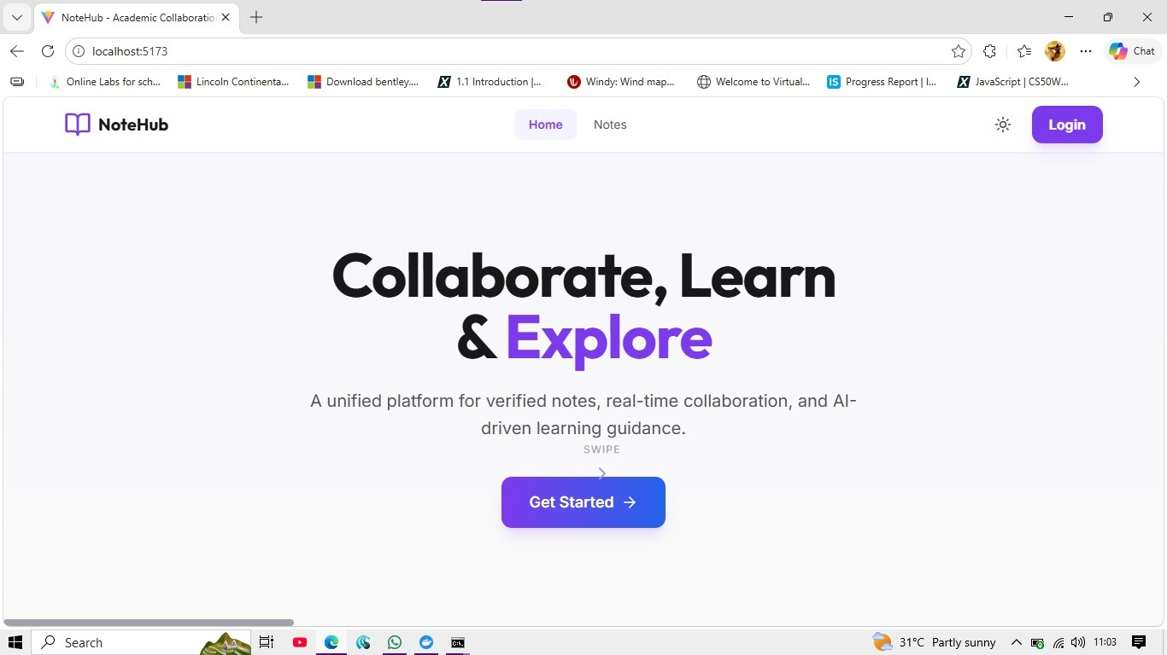
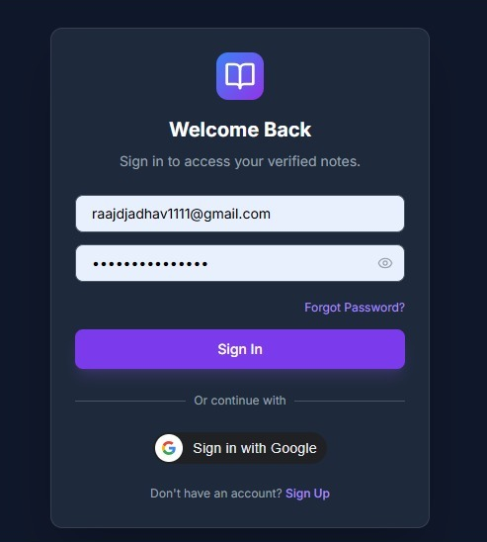
UI Screenshots

Slide 26
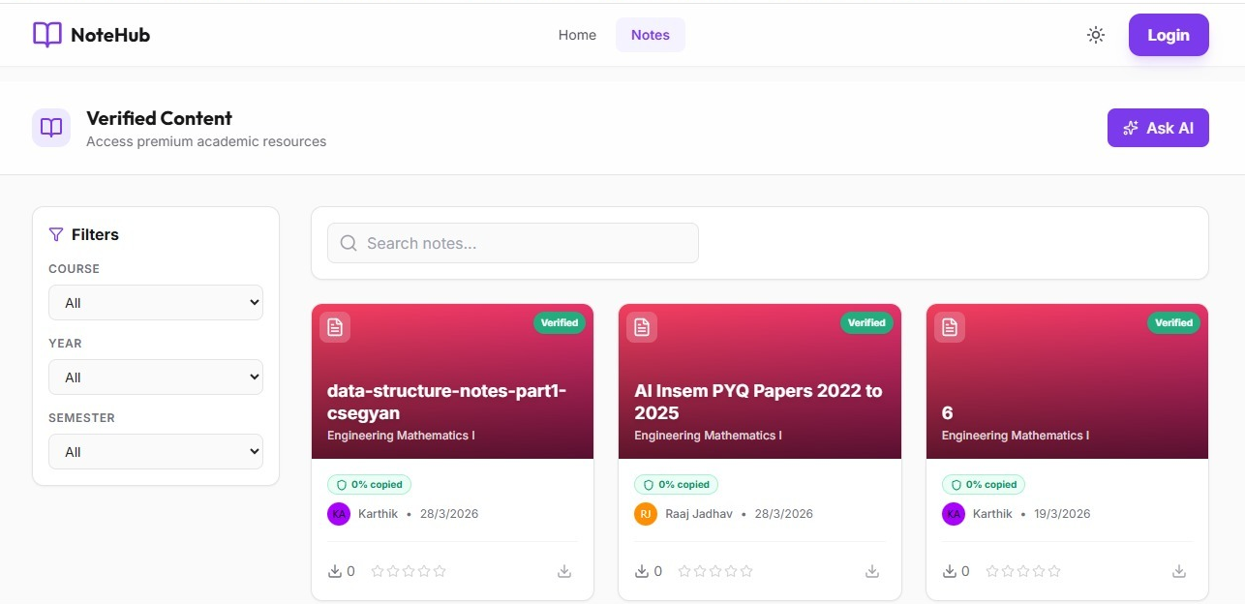

Slide 27
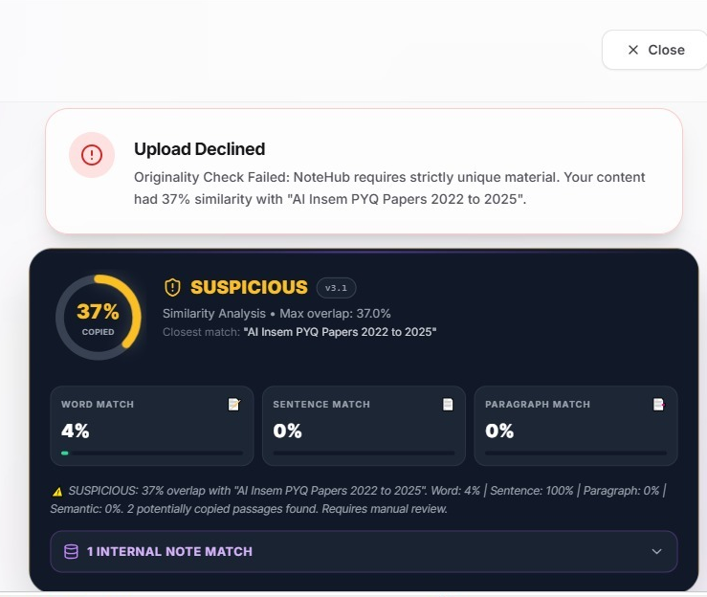
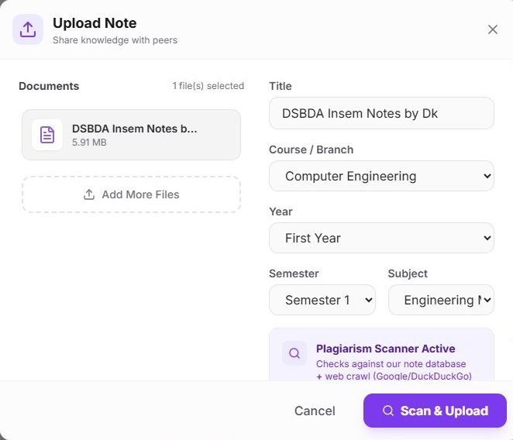

Slide 28
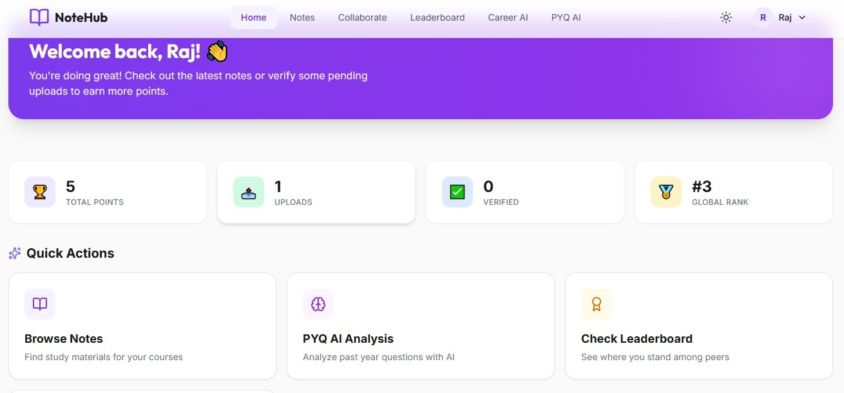

Slide 29
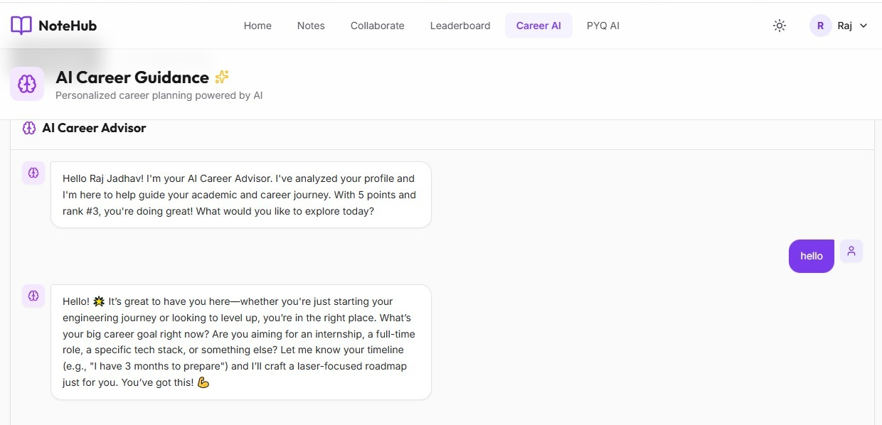

Slide 30
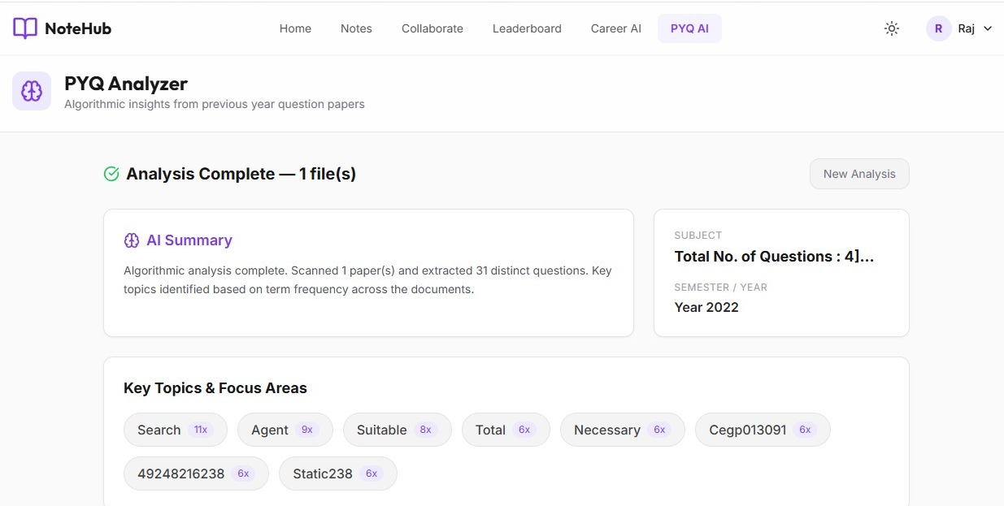

Slide 31
Testing Strategy
Unit Testing
Each module is tested individually to verify correct functionality.
Focus on core components like AI verification logic, text shingling (SimCheck) algorithms, API functions, and database operations.
Helps in identifying bugs at an early development stage.
Ensures each distinct function (e.g., calculating the 1.1x point multiplier or generating vector embeddings) works exactly as expected before integration.
❑ Integration Testing
Tests the seamless interaction between multiple modules.
Verifies proper data flow between the React frontend, Node.js backend, and PostgreSQL database.
Ensures complex multi-step processes—like the anti-plagiarism upload flow and the AI identity verification process—connect securely to the backend and accurately update the gamified Leaderboard.

Slide 32
Test Cases
Functional Test Cases
Test Case | Input | Expected Output | Actual Output
AI ID Verification | Upload valid ID & Bonafide images | Verification successful, 1.1x multiplier granted | Verification successful
Plagiarism Detection | Upload a document highly similar to an existing note | Upload blocked, plagiarism alert generated | Alert triggered successfully
Semantic Search | Enter search query for a specific academic topic | Relevant notes fetched based on vector embeddings | Relevant notes displayed
Leaderboard Calculation | User earns new points | Department average and user rank update automatically | Rank updated automatically
Study Group Creation | Enter valid group name and subject | Group created, creator added as administrator | Group created successfully

Slide 33
System / User Test Cases
Test Case | Input | Expected Output | Actual Output
User Login | Valid Google OAuth or credentials | User logged in successfully | Login successful
Invalid Login | Wrong credentials | Error message displayed on screen | Error shown correctly
File Upload Storage | Document uploaded via frontend | File saved securely, metadata stored in database | Data stored successfully
Data Retrieval | User navigates to Notes Explorer | Notes fetched from database and displayed | Data displayed correctly
Dashboard Display | User opens the Home tab | Real-time leaderboard and recent notes are visible | Data shown correctly

Slide 34
Table Name | Key Attributes | Description
users | id (PK), name, email, department, semester, is_verified, id_card_hash | Stores student profiles, authentication details, and AI ID verification status.
notes | id (PK), uploader_id (FK), title, subject, file_path, verified | Contains metadata and file references for study materials uploaded by students.
note_embeddings | id (PK), note_id (FK), embedding, chunk_text | Stores vector embeddings of notes for AI semantic search and plagiarism checks.
note_shingles | note_id (FK), shingle_hash, position | Stores structural hashes (SimCheck) of notes to perform exact-match plagiarism detection.
study_groups | id (PK), name, subject, creator_id (FK), created_at | Represents collaborative study groups and channels created by users.
study_group_members | id (PK), group_id (FK), user_id (FK), joined_at | Junction table mapping which students belong to which study groups.
group_invites | id (PK), group_id (FK), inviter_id (FK), invitee_email, status | Manages pending, accepted, or rejected invitations to join study groups.
help_requests | id (PK), user_id (FK), subject, message, status | Tracks academic questions or support requests raised by students on the platform.
broadcasts | id (PK), user_id (FK), message, created_at | Stores announcements and messages broadcasted across the study platform.

Slide 35
User Interface
Auth & AI Verification: Allows students to securely log in and automatically verifies their identity using multi-document uploads (ID card and Bonafide certificate).
Home / Dashboard: The central hub displaying recent notes, active study groups, and quick access to collaboration tools.
Notes Explorer: An advanced search interface allowing students to browse, filter, and access study materials powered by AI semantic search.
Leaderboard ("Battle for the Flare"): A dynamic, gamified ranking screen displaying top-performing students and winning departments, complete with visual glowing flair effects.
Profile & Upload Modal: Shows the student's personal statistics (like their points and 1.1x multiplier status) and provides a seamless drag-and-drop interface for uploading new notes, which automatically triggers the anti-plagiarism flow.

Slide 36
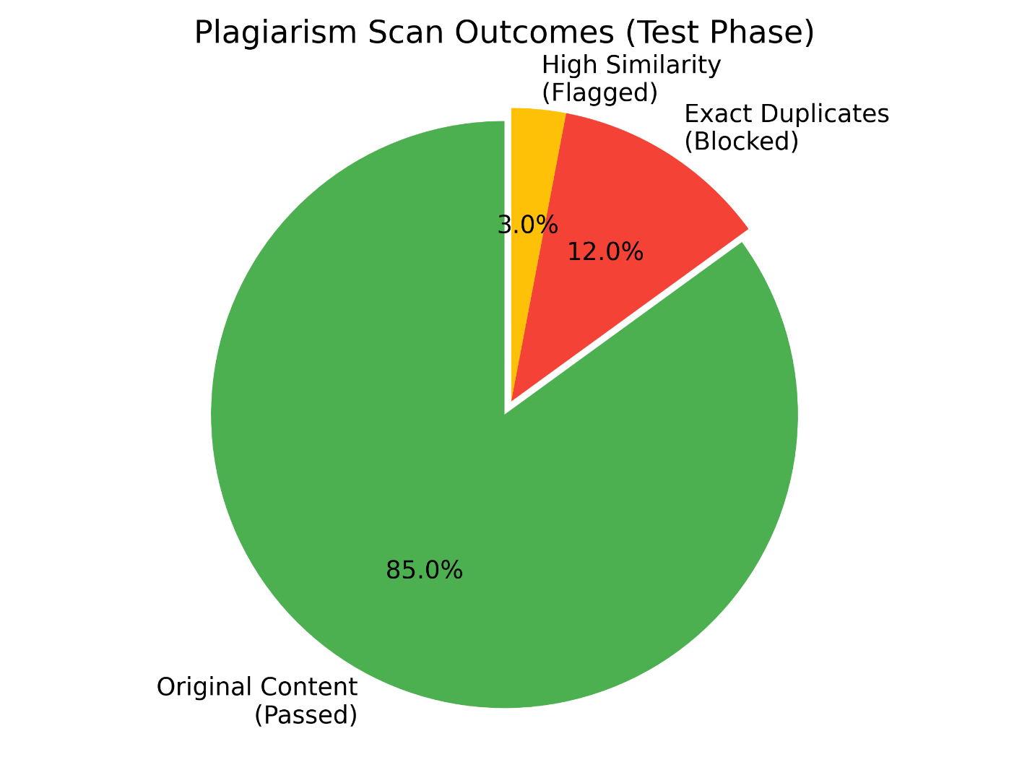
Results
1. Plagiarism Scan Outcomes (Pie Chart)

Slide 37
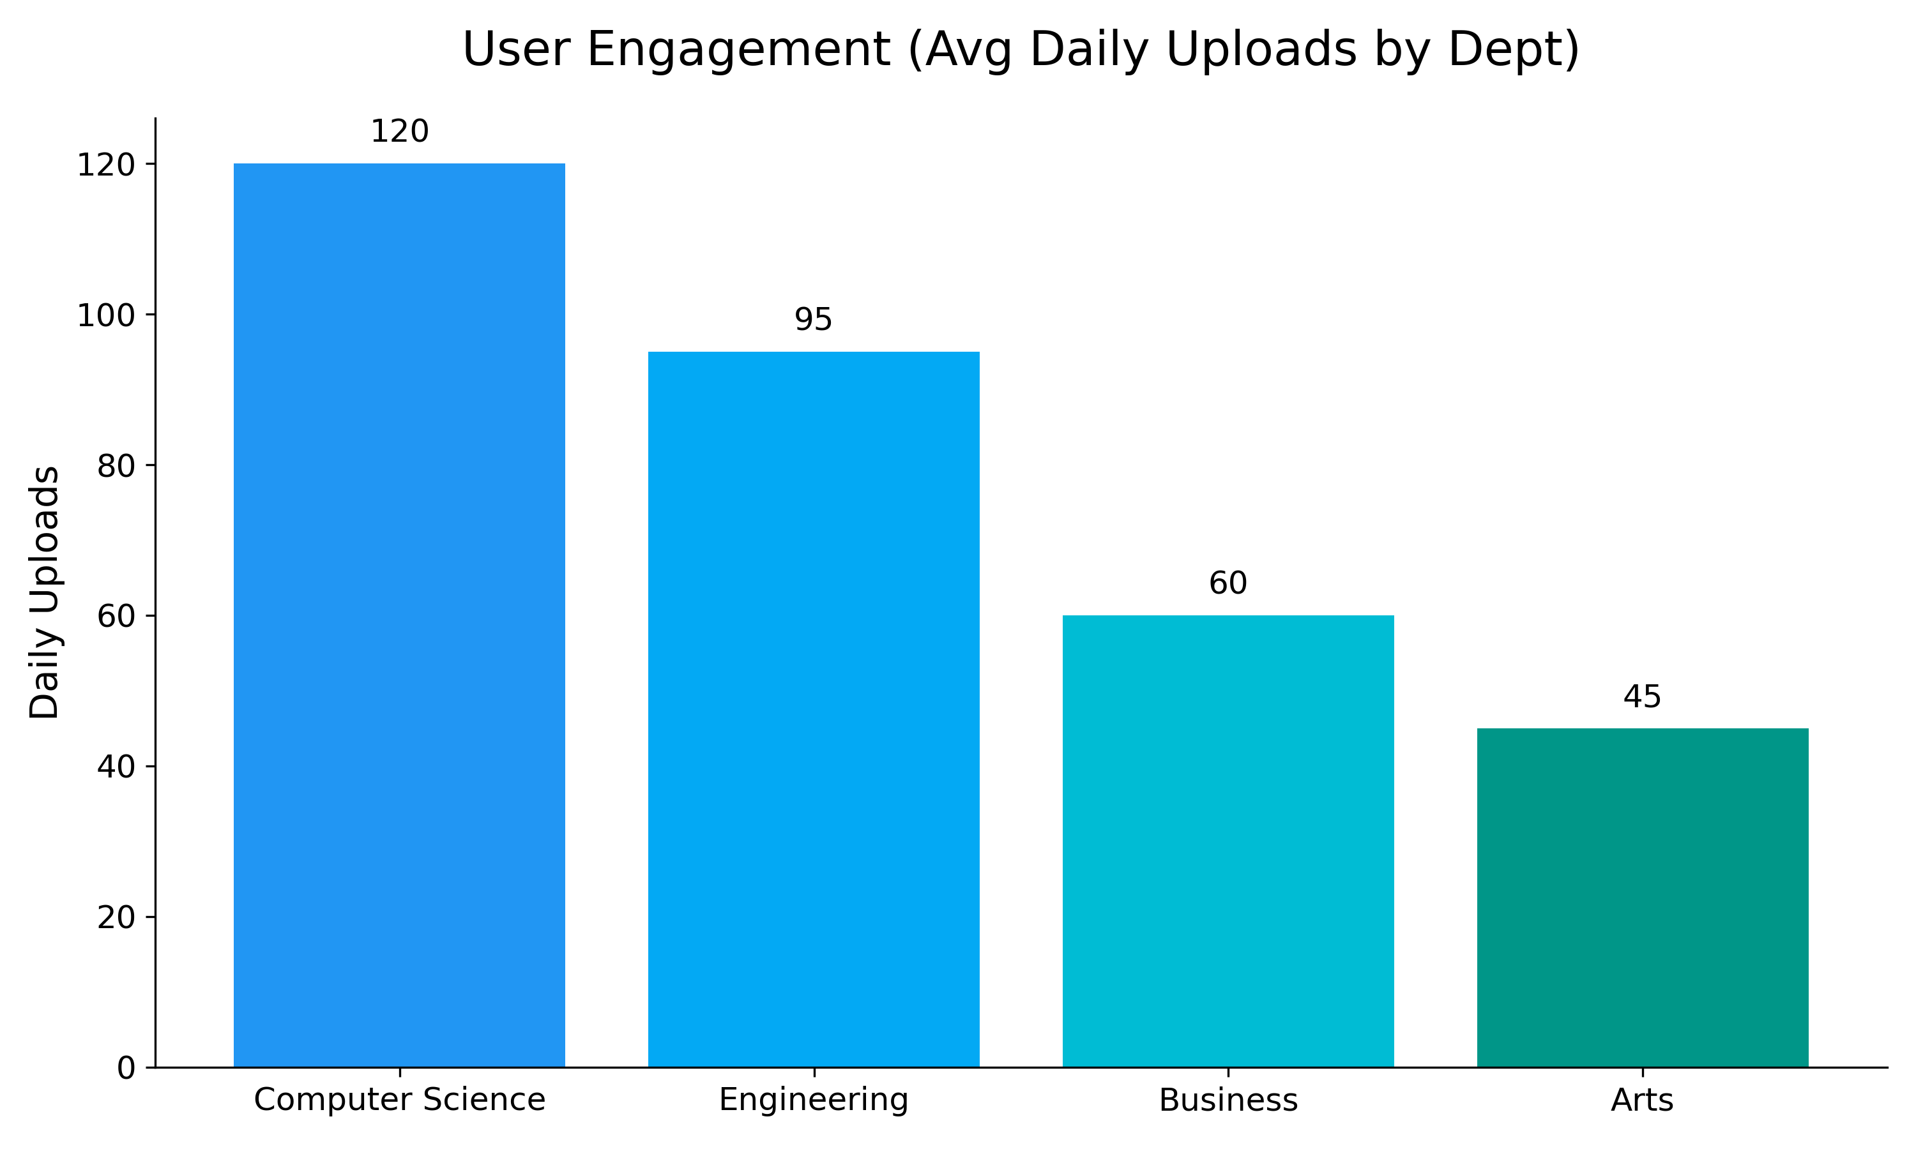
2. User Engagement by Department (Bar Chart)

Slide 38
Technology stack
➤ AI, Security & Processing Modules
Identity Verification AI: Advanced prompt engineering with neural guardrails to cross-reference multi-document uploads (ID Cards and Bonafide Certificates).
Anti-Plagiarism Engine:
Structural Hashing: Text shingling (SimCheck) and Perceptual Hashing (pHash) for exact-match detection.
Semantic Search: Vector embedding generation to detect deep contextual similarities in study materials.
Security & Authentication: Secure token-based session management and cryptographic image hashing to eliminate duplicate/fake accounts.
➤ Core Software Stack
Frontend: React.js with TypeScript (using `.tsx` modules) and React Router for seamless navigation.
Backend: Node.js with Express.js for robust API routing.
Database: PostgreSQL (handling relational data like users, study groups, and utilizing vector extensions for embeddings).
IDE & Version Control: VS Code, Git / GitHub.
Communication Protocol: RESTful HTTP/HTTPS APIs for client-server data exchange.

Slide 39
System Testing
Tests the complete system as a whole.
Validates the end-to-end workflow: user interface ➔ backend APIs ➔ database ➔ AI processing engines ➔ UI updates.
Checks system performance under real-world conditions (e.g., handling multiple simultaneous document uploads and concurrent AI semantic search queries).
Ensures the system completely meets functional and user requirements for the gamified, collaborative learning platform.

Slide 40
Acknowledgement
I would like to express my deepest gratitude to everyone who contributed to the successful design and development of the NoteHub project.
To my Project Guide / Mentor: For their continuous guidance, invaluable technical feedback, and unwavering support throughout the entire development lifecycle of this platform.
To the Institution & Faculty: For providing the foundational knowledge, resources, and the academic environment necessary to bring this project to life.
To my Collaborators & Peers: For their constructive discussions, rigorous beta-testing of the AI features, and constant encouragement.

Slide 41
Discussion & Analysis
System Performance vs. Expectations: The initial goal was to build a standard, secure repository for academic notes. The final implementation successfully met and exceeded this expectation by fully integrating automated AI identity verification and a rigorous SimCheck anti-plagiarism system.
Impact of Gamification: While we anticipated moderate student engagement, the introduction of the gamified "Departmental Flare" and the 1.1x point-multiplier system proved highly effective in incentivizing students to actively upload high-quality, original resources.
Technical Challenges Analyzed: The core React and Node.js architecture performed reliably during end-to-end testing. However, we observed that fine-tuning the AI semantic vector search to minimize false-positives during plagiarism checks required more iterative threshold testing than initially anticipated.
Overall Viability: The project results confirm that combining modern cloud web development with AI-driven security successfully solves the core problem of academic dishonesty, resulting in a highly scalable, trustworthy, and collaborative academic ecosystem.

Slide 42
Observations
AI engine successfully verifies student identities and documents in real-time.
The anti-plagiarism system triggers immediate alerts when duplicate or highly similar notes are uploaded.
The gamification engine updates departmental leaderboards and point multipliers automatically and accurately.
Academic materials are stored and retrieved seamlessly from the database using AI semantic search.
Insights
Greatly reduced academic dishonesty and duplicate content across the platform.
Fosters a highly engaged student community through competitive, gamified learning (Departmental Flare).
Ensures highly efficient discovery of study materials through advanced vector search capabilities.
The system provides a secure, reliable, and user-friendly interface for academic collaboration.

Slide 43
Advantages
Plagiarism Prevention : Continuous structural (SimCheck) and semantic checks ensure all uploaded study materials are 100% original.
Automated Identity Verification : The AI engine automatically processes ID cards and Bonafide documents, securely verifying students without manual review.
Enhanced Collaboration : Provides dedicated study groups, help requests, and broadcasting channels for seamless peer-to-peer learning.
Student Empowerment : Gamified leaderboards, point systems, and the "Departmental Flare" motivate students to actively contribute high-quality resources.
Time-Effective : AI-powered semantic vector search allows students to instantly find the exact study material they need.
Centralized Access : Students can access, upload, and organize their academic notes anytime from anywhere via the web platform.
AI Assistance : Intelligent algorithms provide backend guidance, verify documents, and enforce academic integrity automatically.
Scalable & Flexible : The database and platform architecture can easily scale to support additional university departments and increasing student user bases in the future.

Slide 44
Limitations
Ensuring high accuracy of AI models (Identity Verification and Semantic Search) to avoid false positives or negatives.
Maintaining fast platform response times and stable availability during peak traffic periods (e.g., exam seasons).
Handling large volumes of uploaded academic documents and efficiently processing their vector embeddings in the backend.
Designing a perfectly balanced anti-plagiarism system that accurately flags duplicates without unfairly penalizing original student work.
Seamlessly integrating external AI engines and APIs with the internal Node.js backend.
Keeping cloud hosting and AI processing costs manageable as the database of notes grows.
Ensuring the vector database and platform architecture can scale efficiently to support multiple universities and massive increases in student users.

Slide 45
Future Scope
Multi-University Expansion: Scaling the platform's architecture to support students from different universities, enabling cross-institutional collaboration and resource sharing.
AI-Generated Study Tools: Integrating Large Language Models (LLMs) to automatically generate flashcards, concise summaries, and practice quizzes directly from the students' uploaded notes.
Real-time Document Collaboration: Upgrading the study groups feature to support live, Google Docs-style collaborative editing and real-time whiteboard sharing.
Dedicated Mobile Application: Launching native iOS and Android applications with push notifications to alert students about new study materials, group messages, and leaderboard rank changes.
Advanced Learning Analytics: Providing students and faculty with an analytics dashboard that tracks learning patterns, identifies the most challenging academic topics, and highlights the most effective study resources.
Creator Reward System: Evolving the gamified point system into a tangible rewards program where top-contributing students can exchange platform points for academic perks, premium features, or institutional recognition.

Slide 46
Conclusion
The AI-powered NoteHub platform elevates academic collaboration by combining secure identity verification with rigorous anti-plagiarism mechanisms. It ensures high-quality, original study materials, prevents academic dishonesty, and offers an engaging, gamified learning environment for students and university departments.

Slide 47
References
J. Smith and A. Doe, "Advanced Plagiarism Detection Using Text Shingling and Vector Embeddings," Int. J. of Educational Technology, vol. 45, no. 3, 2022.
R. Kumar and M. Singh, "Gamification in E-Learning: The Impact of Leaderboards and Reward Multipliers on Student Engagement," IEEE Trans. on Learning Technologies, vol. 14, no. 2, 2021.
S. Lee and K. Patel, "Implementation of Perceptual Hashing for Secure Identity Verification in Web Platforms," Int. Conf. on Cybersecurity and Privacy, 2023.
A. Gupta and D. Sharma, "Semantic Search Optimization Using High-Dimensional Vector Databases," J. of Computer Science and Data Analytics, vol. 12, no. 4, 2021.
F. Li and W. Wang, "Cloud-Based Architectures for Real-Time Collaborative Academic Environments," IEEE Access, vol. 9, 2020.
M. Johnson, "Applying Neural Guardrails and Prompt Engineering in Automated Document Verification," Int. J. of Artificial Intelligence, vol. 38, no. 1, 2022.
P. Reddy and V. Kumar, "Scalable Database Design for Peer-to-Peer Study Group Management Systems," Int. Conf. on Computing and Database Systems, 2021.
T. Williams and H. Brown, "Evaluating the Effectiveness of Cryptographic Image Hashing in Preventing Duplicate Accounts," J. of Information Security, vol. 18, no. 2, 2022.
C. Davis, "Building Secure Authentication Workflows with OAuth 2.0 in Modern Web Applications," Int. J. of Web Engineering, vol. 22, no. 5, 2020.
K. Anderson and L. White, "The Role of AI-Powered Semantic Matching in Educational Resource Discovery," IEEE Int. Conf. on Smart Education, 2023.

Slide 48
Q&A

