Slide 1


Slide 2



Digital Marketing Campaign Conversion Prediction
By : Raj Javiya

Slide 3
Introduction
This project aims to enhance campaign effectiveness in the digital marketing sector by accurately predicting customer conversions.
By leveraging machine learning, the project seeks to identify potential converters and optimize marketing strategies.
The objective is to develop a robust machine learning model that predicts customer conversions based on various demographic and engagement factors, enabling improved campaign targeting, increased conversion rates, and maximized return on advertising spend (ROAS).

Slide 4
Steps
Read Dataset
Dataset overview cum preprocessing
EDA
Feature engineering
Model Building
Model Comparison
Deployment

Slide 5

Read Dataset
Read Dataset using pandas library.
As we have csv file we read using pd.read_csv.

Slide 6
Dataset overview cum preprocessing
In this process we find out about columns in dataset and their types, null values, duplicates, outliers ,categorical features and numeric features.
Key find-out over here are there are no null values or duplicates and no outliers in Dataset. There total of 20 Columns including Target and 8000 rows.
Data in two columns are confidential so we removed it.

Slide 7
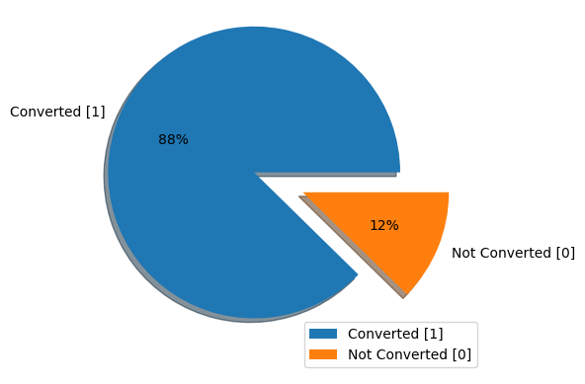
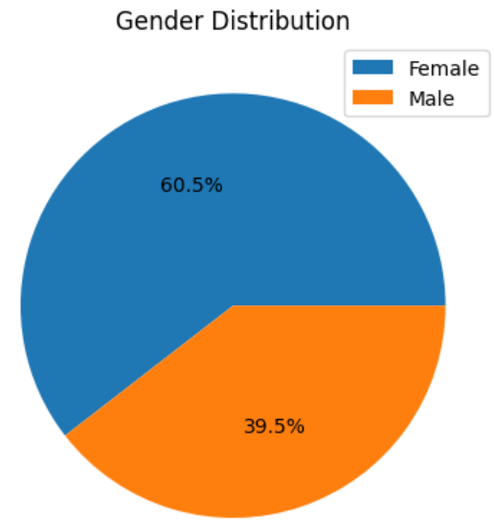
Exploratory Data Analysis (EDA)
In EDA we did univariate and Bivariate analysis. We plot histogram of all numeric features and bar plot of categorical features.
The Key finding in univariate analysis is gender and Conversion are imbalanced.
So we have more female customer we can focus on marketing strategy such that more female can convert.

Slide 8
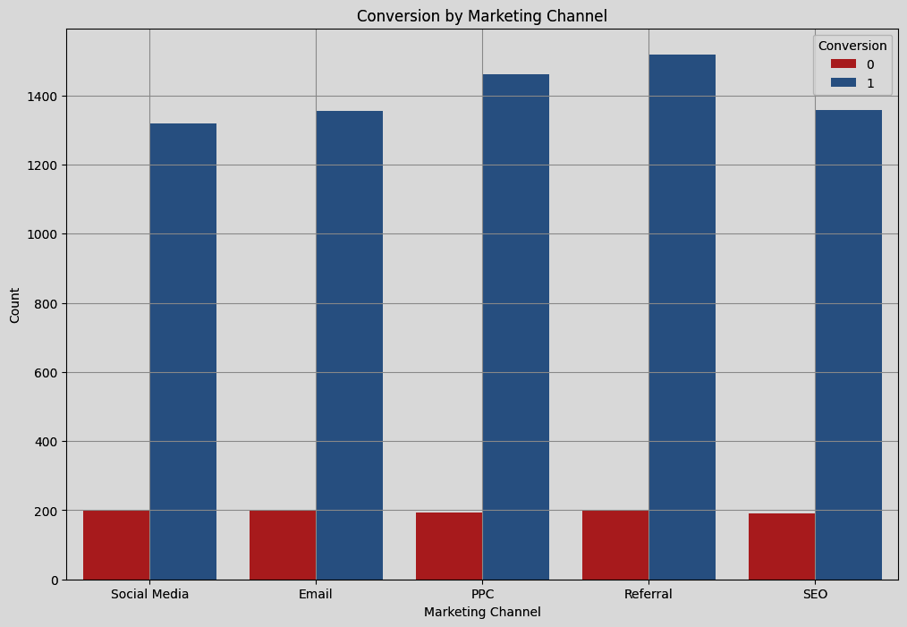
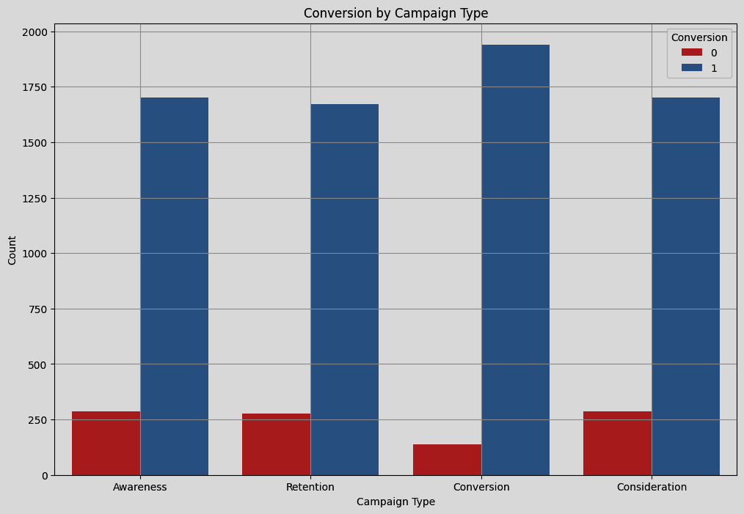
Exploratory Data Analysis (EDA)
Marketing Channel
Campaign Type

Slide 9
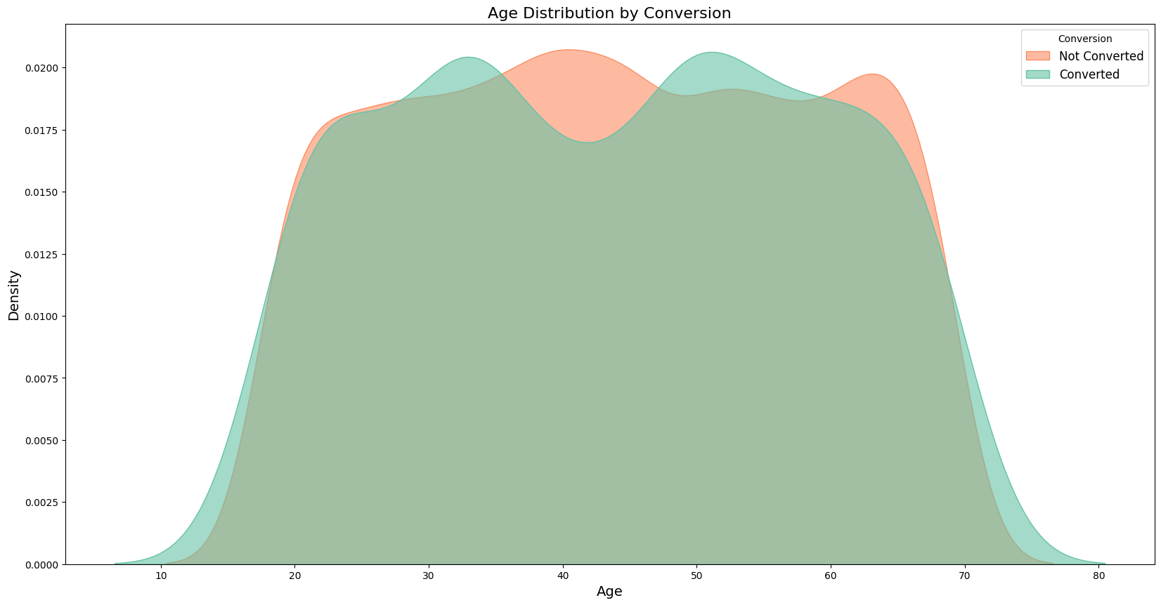
Exploratory Data Analysis (EDA)
Here we have KDE (Kernel Density Estimate) graph of Age and Conversion as we can see in figure.
Thing to notice over here is we have low conversion in age range 35 to 45 and 60 to 70.
we can plan marketing accordingly.

Slide 10
Feature Engineering
Feature Engineering is a critical step that involves finding relevant features , form new features from exiting ones and convert into a format suitable for modeling. This step ensures that the machine learning model can effectively learn from the data without being misled by inconsistencies, missing values, or irrelevant information.
We convert categorical Data type into numerical so that the algorithm can understand the data and standardize or normalize numerical data for better and fast learning.

Slide 11
We have used Label Encoder which gives each category within a feature a distinct number from zero, based on their position in the vocabulary, which makes possible for algorithm to interpret and comprehend the Data
Standardize numerical features like Age, Income, AdSpend, ClickThroughRate, ConversionRate, WebsiteVisits, etc., to have a mean of 0 and a standard deviation of 1. This is especially important for algorithms like Decision Tree and Random Forest Classsification which are sensitive to the scale of the features.

Slide 12
TRAIN TEST SPLIT
Split the dataset into training and testing sets, typically with a 70-30 or 80-20 ratio. This allows you to train the model on one portion of the data and evaluate its performance on unseen data
This step ensures that the model's performance is generalizable and not just specific to the data it was trained on
After split used oversampling technique smotetomek for handling target imbalance in Dataset so model will learn better and chances of overfitting reduced.

Slide 13

Model Selection
Models Considered:
Logistic Regression
Support Vector Machine
Decision Tree
Random Forest
Gradient Boosting
Ada Boost
Bagging Classifier

Slide 14
Logistic Regression
Logistic Regression is a statistical method used for binary classification tasks, where the goal is to predict one of two possible outcomes
Support Vector Machine (SVM)
Its a powerful supervised machine learning algorithm used for classification and regression tasks. It is particularly effective for high-dimensional spaces and cases where the data is not linearly separable.
Decision Tree
Supervised machine learning used to categorize or make predictions based on how a previous set of questions were answered.
Random Forest
Random Forest is a robust supervised algorithm suitable for both regression and classification tasks.

Slide 15
Gradient Boosting Method
It is a technique that combines weak models to create a more accurate predictive model.
AdaBoost
It is a ensemble learning algorithm that combines the predictions of several weak classifiers to form a strong classifier.
Bagging Classifier
it is a ensemble machine learning algorithm designed to improve the stability and accuracy of models, particularly high-variance ones like Decision Trees. It works by training multiple versions of a model on different subsets of the data and then aggregating their predictions.

Slide 16
EVALUATION
Accuracy
Accuracy is a metric that measures how often a model correctly predicts an outcome
Precision
Precision is a metric in machine learning that measures how well a model makes positive predictions.
Recall
Recall is a metric that measures how well a model correctly identifies positive instances in a dataset.
F1 score
It is a metric used in machine learning (ML) to evaluate the performance of a model by combining precision and recall into a single score.

Slide 17
Accuracy Precision Recall F1 score
Logistic Regression
Support Vector Machine
Decision Tree
Random Forest
Gradient Boosing
Ada Boost
Bagging Classifier
76 % 76% 75 % 75%
84% 84% 85 % 84%
84% 86% 82% 84%
96% 95% 96% 95%
91% 88% 95% 91%
82% 82% 83% 83%
92% 93% 91% 92%

Slide 18
Conclusion
Random Forest performs the best overall with the highest accuracy (0.9538) and balanced performance across both classes. It provides a good trade-off between precision and recall for both positive and negative classes.
Bagging Calssifier has high accuracy (0.9181) but struggles with low recall for class 0, which may be problematic if identifying negative cases is crucial.
Logistic Regression has the lowest accuracy (0.7619) and performs well in identifying positive cases but poorly in identifying negative cases. It may be less effective for balanced performance across all classes.
In conclusion, Random Forest is the most well-rounded model in this comparison, showing the highest accuracy and a good balance in performance metrics across both classes. It is likely the best choice for this particular dataset if overall classification performance is the primary criterion.

Slide 19
Thank you

