Slide 1
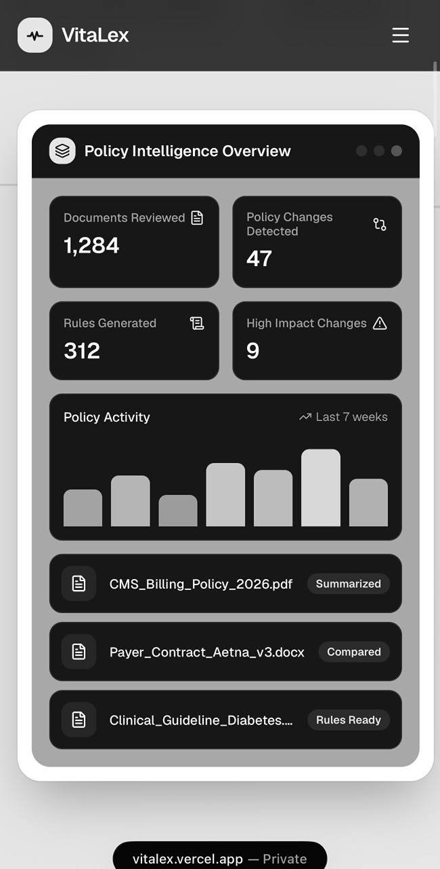
VitaLex: Healthcare Content Management and Policy Intelligence
Turning healthcare policies, contracts, and guidelines into summaries, comparisons, and usable rules
RAJ KUNDUR · CALIFORNIA STATE UNIVERSITY, LONG BEACH
Cotiviti Internship Assessment

Slide 2

The Problem: Too Much Policy, Too Little Clarity
Healthcare organizations manage massive volumes of billing policies, coding rules, clinical guidelines, payer-provider contracts, and reimbursement requirements. These documents are long, frequently updated, and manually interpreted by different teams — creating delays, claim errors, compliance risk, and inconsistent decisions.
Delays
Claim Errors
Manual review slows operational decisions
Inconsistent interpretation drives rework
Compliance Risk
Outdated rules expose organizations to audit findings

Slide 3
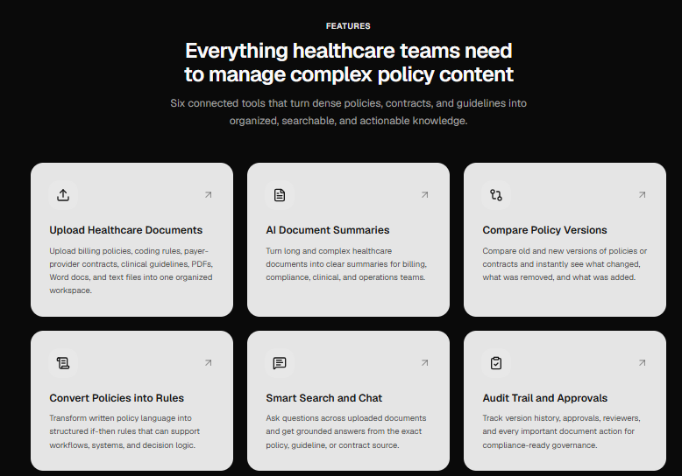

TOPIC OVERVIEW
Content Management Is More Than Document Storage
True healthcare content management means organizing complex documents, summarizing key points, comparing versions, and converting written policy language into structured, actionable rules.
Organize
Summarize
Structure complex healthcare documents with metadata
Extract key policy points using AI
Compare
Operationalize
Detect changes between document versions
Convert text into structured, usable rules

Slide 4
Trends and Opportunities
Key Industry Trends
Where the Opportunity Lies
Rising administrative burden on payors and providers
Increasingly complex payer and coding policies
Faster Policy Review
Better Change Detection
Reduce turnaround time for policy analysis
Surface version differences automatically
Focus on interoperability and prior authorization modernization
Growth of AI summarization and document intelligence
Consistent Rule Interpretation
Improved Workflows
Standardize how teams apply policy
Strengthen billing, coding, and compliance operations
Demand for explainable, auditable automation

Slide 5
Risks and Safeguards
Responsible AI in healthcare requires acknowledging limitations and building guardrails into every layer of the system.
⚠️ Risks to Manage
✅ Built-In Safeguards
AI-generated summaries may be incomplete or inaccurate
Source References
Approval Workflow
Every output links back to original text
Rules require human sign-off before use
Incorrect rules can cause claim errors or compliance problems
Audit Activity
Role-Based Access
Healthcare teams require full traceability and human review
Full activity logs for compliance traceability
Controlled permissions by user role

Slide 6
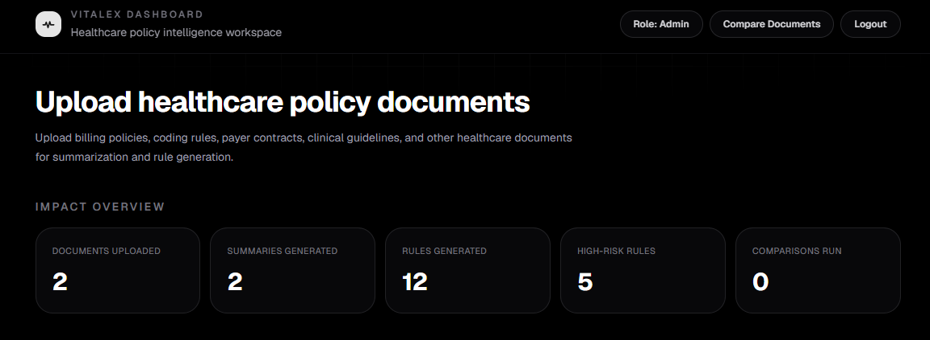
VitaLex POC: A Working Proof of Concept
VitaLex demonstrates how healthcare policy content can be transformed into governed, explainable, and actionable intelligence — all within a single platform.
Document Upload
AI Summarization
Structured Rules
Supports PDF, DOCX, and TXT healthcare documents with metadata storage
Generates concise summaries from policy text using Google Gemini
Converts written policy language into structured, exportable rules

Slide 7
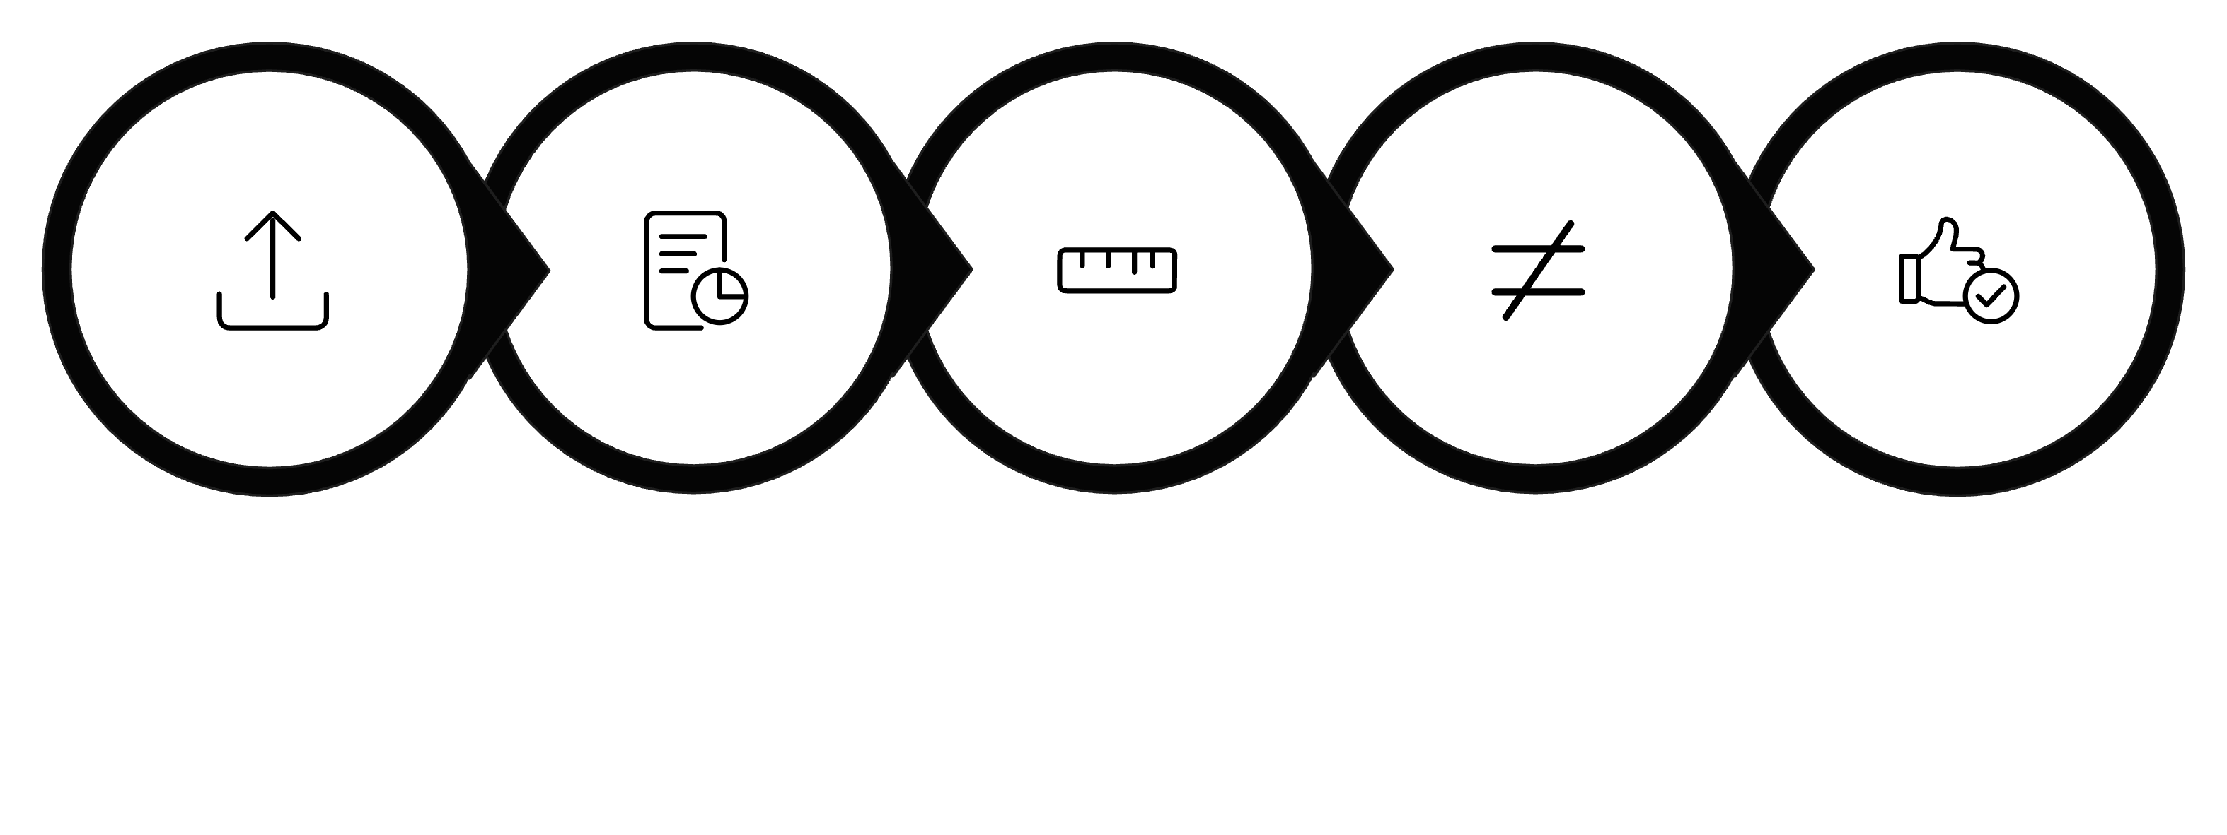
Demo Workflow
From document upload to governed rule output — VitaLex streamlines the entire policy intelligence lifecycle in six steps.
Generate Rules
Upload
AI Summary
Compare
Approve
Key outputs are tracked, auditable, and can move through human review before rules are finalized.

Slide 8
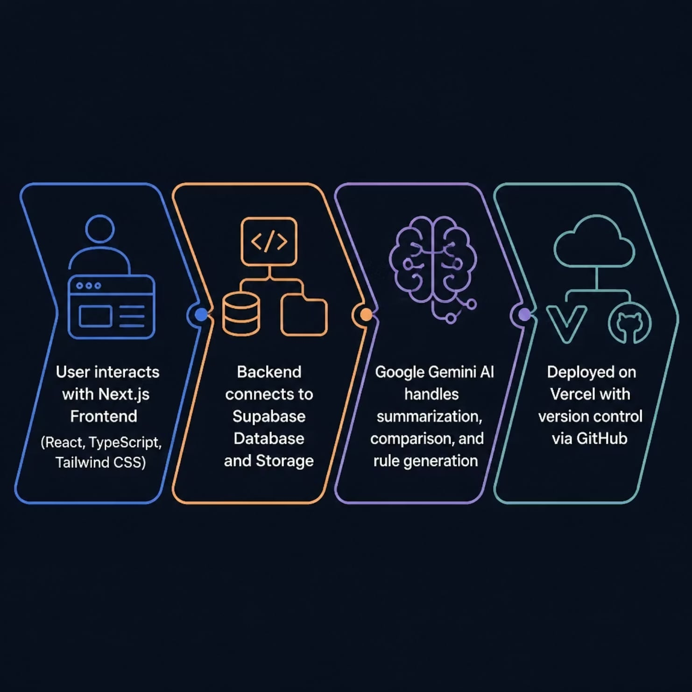
Architecture & Tech Stack
Technology Choices
Frontend
Backend & Storage
Next.js, TypeScript, Tailwind CSS
Supabase database and file storage
AI Engine
Deployment
Google Gemini API for summarization, comparison, and rule generation.
Vercel deployment and GitHub for version control

Slide 9
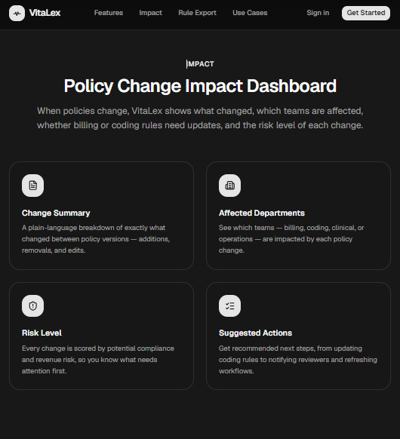

Strategic Value for Cotiviti
VitaLex demonstrates how healthcare policy content can become governed, explainable, and actionable intelligence — directly supporting Cotiviti's mission.
Faster Policy Analysis
Accelerate review of payer policies and contracts
Payment Accuracy
Strengthen billing and coding logic with consistent rule generation
Audit Readiness
Full traceability and approval workflows support compliance
Team Alignment
Bridge policy experts, analysts, and engineering teams
The opportunity: Transform healthcare content from static documents into governed, explainable, and actionable rules.

Slide 10
Thank You
Live Demo: https://vitalex.vercel.app
GitHub Repository: https://github.com/RajK158/VitaLex
Raj Kundur, California State University, Long Beach

