Slide 1
PROJECT TITLE
CAPSTONE PROJECT
Presented By:
1. Raj Kiran Acharyya – MCKV Institute Of Engineering – Computer Science & Engineering

Slide 2
OUTLINE
Problem Statement
Proposed System/Solution
System Development Approach (Technology Used)
Algorithm & Deployment
Result (Output Image)
Conclusion
Future Scope
References

Slide 3
Problem Statement
Problem statement No.39 – Predictive Maintenance of Industrial Machinery
Example: This project aims to predict equipment failures in industrial machines before they happen using sensor data. By analyzing real-time parameters like temperature, torque, and tool wear, a classification model is built to identify issues like tool wear, overheating, or power failure. This helps enable proactive maintenance, minimizing downtime and operational costs.

Slide 4
Proposed Solution
The proposed system aims to address the challenge of predicting potential machine failures in industrial environments before they occur. This involves leveraging data analytics and machine learning techniques to accurately forecast failure patterns based on operational data. The solution will consist of the following components:
Data Collection:
Gather historical sensor data from industrial machines, including parameters like temperature, torque, rotational speed, and tool wear.
Focus solely on the available sensor readings from the dataset without relying on external contextual inputs.
Data Preprocessing:
Clean and preprocess the raw sensor data to handle missing values, outliers, and inconsistencies.
Perform feature engineering to derive relevant indicators (e.g., rate of temperature change, wear thresholds) that may signal upcoming failures.
Machine Learning Algorithm:
IBM watsonx.ai's AutoAI generated a Snap Random Forest Classifier (Batched Tree Ensemble) that achieved a cross-validation accuracy of 99%. This ensemble model aggregates multiple decision trees to classify failure types accurately based on input sensor data.
The model pipeline was automatically enhanced using Feature Engineering (FE) and Hyperparameter Optimization (HPO) to improve accuracy and robustness. Real-time features like air temperature, process temperature, torque, and tool wear were key inputs for classification.

Slide 5
Deployment:
IBM Watsonx.ai Studio is used to deploy the trained Snap Random Forest Classifier, enabling real-time predictions via an easy-to-use interface that accepts JSON or CSV inputs.
IBM's hybrid pipeline, which provides quick, scalable, and dependable access to real-time machine failure predictions, powers the model. It also has a public REST API.
Evaluation:
During AutoAI training in IBM Watsonx.ai Studio, accuracy metrics and cross-validation were used to evaluate the model's performance.
Accuracy metrics and cross-validation were used to evaluate the model's performance during AutoAI training in IBM Watsonx.ai Studio.
Result: The deployed model accurately predicts failure types such as tool wear, power failure, and overheating, enabling proactive maintenance

Slide 6
System Approach
This section outlines the overall strategy and methodology for developing and implementing the Predictive Maintenance System using IBM watsonx.ai Studio. Here's a suggested structure for this section:
System requirements: To build and deploy the predictive maintenance classification model, the following components were required:
IBM watsonx.ai Studio for AutoAI pipeline generation and deployment.
IBM watsonx.ai Runtime for inferencing and model training.
Watson Machine Learning services for deployment and scalability.
Online deployment environment with a REST API endpoint for real-time prediction.
10–20 Capacity Unit-Hours (CUH)
Compute environments (1–4 vCPUs, 4–16 GB RAM)

Slide 7
Library required to build the model: Key libraries and tools used in the AutoAI pipeline and backend processing:
AutoAI – Automated data preprocessing, feature engineering, and model selection
Snap Random Forest Classifier – Chosen as the top-performing algorithm
Pandas & NumPy – For initial dataset formatting
Sklearn metrics (internally used) – For model evaluation (accuracy, precision, recall, F1)
Deployment Space on watsonx.ai – For real-time online predictions via JSON input
API reference & testing interface – Provided by IBM watsonx.ai for integration

Slide 8
Algorithm & Deployment
The Snap Random Forest Classifier, chosen by IBM watsonx.ai's AutoAI for its high accuracy, it was deployed to deliver real-time failure predictions in the maintenance system. Its robust performance made it ideal for production use.
Algorithm Selection:
The model chosen by IBM watsonx.ai’s AutoAI was the Snap Random Forest Classifier, which emerged as the best-performing algorithm during experimentation.
This ensemble-based tree classifier is well-suited for handling tabular sensor data and performs well in classifying different failure types. Its ability to manage non-linear relationships and categorical variables makes it ideal for predictive maintenance tasks.
Data Input:
The model uses key sensor inputs—machine type, air and process temperatures, rotational speed, torque, and tool wear—to assess equipment health and predict failures.
These features reflect the machine’s operational state and help the model detect early signs of issues before they escalate.

Slide 9
Training Process:
Training was done via IBM watsonx.ai AutoAI, which automatically handled feature engineering, cross-validation, and hyperparameter tuning.
It generated multiple pipelines, with the best one (Snap Random Forest) achieving ~99.5% accuracy.
Prediction Process:
It accepts input as a structured JSON or CSV format through the online deployment interface in watsonx.ai.
The model then returns the predicted failure type, enabling preventive action before actual breakdowns occur.
Once deployed, the trained Snap Random Forest model classifies real-time operational data into potential failure categories.

Slide 10
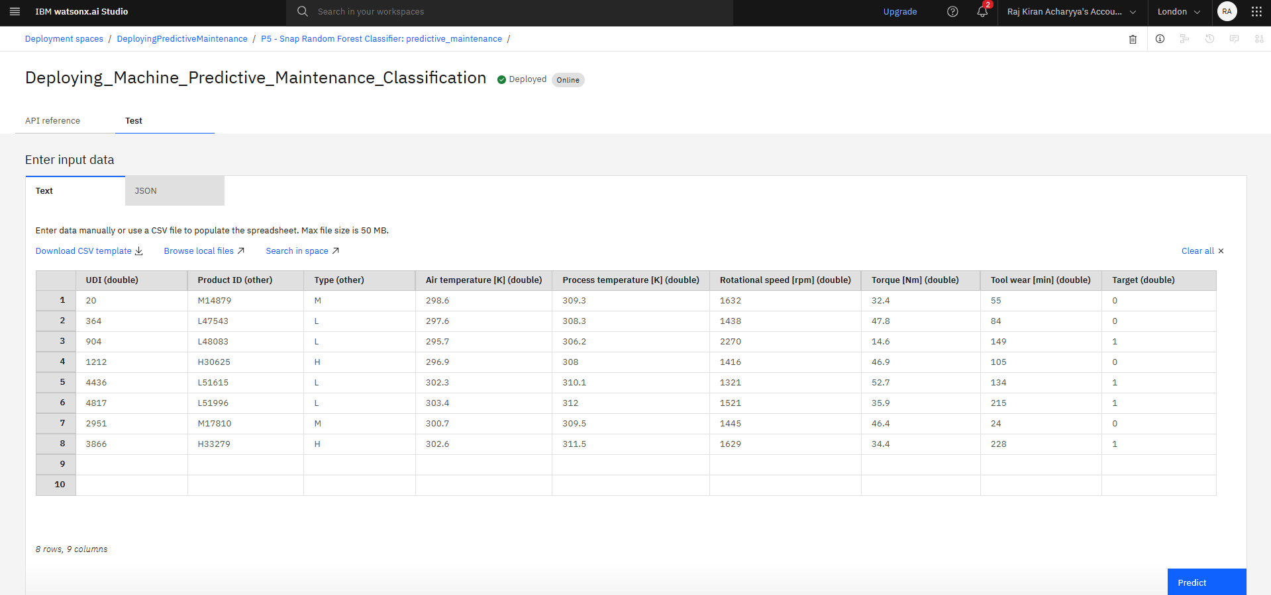
Result

Slide 11
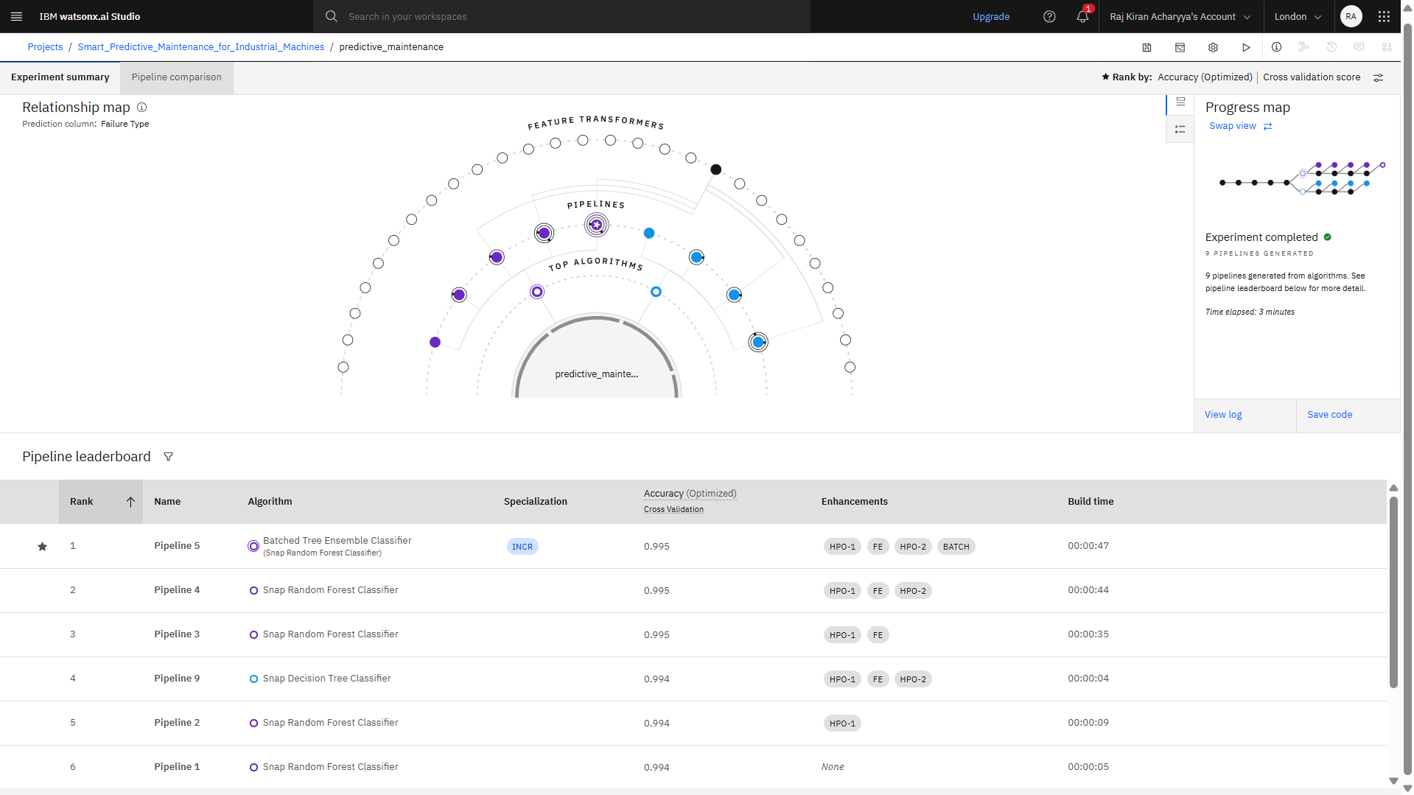

Slide 12
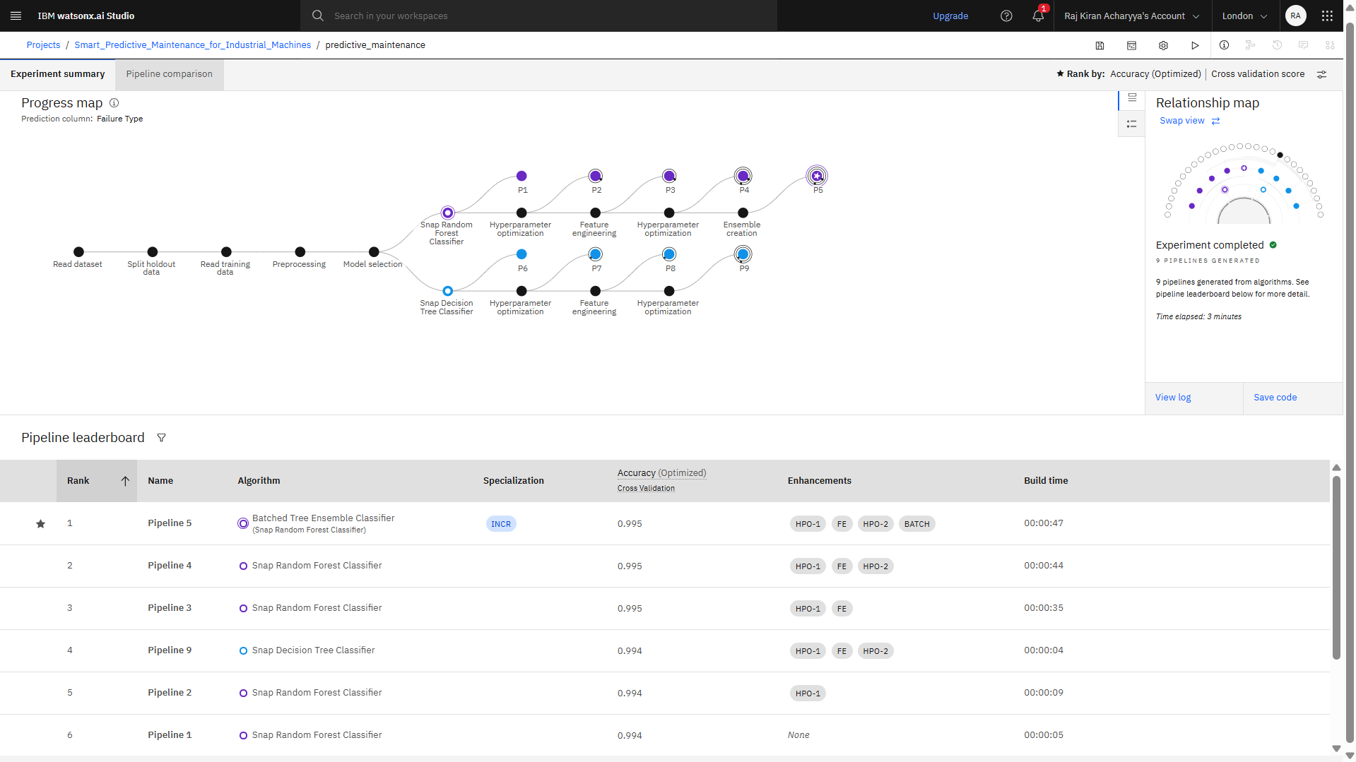

Slide 13
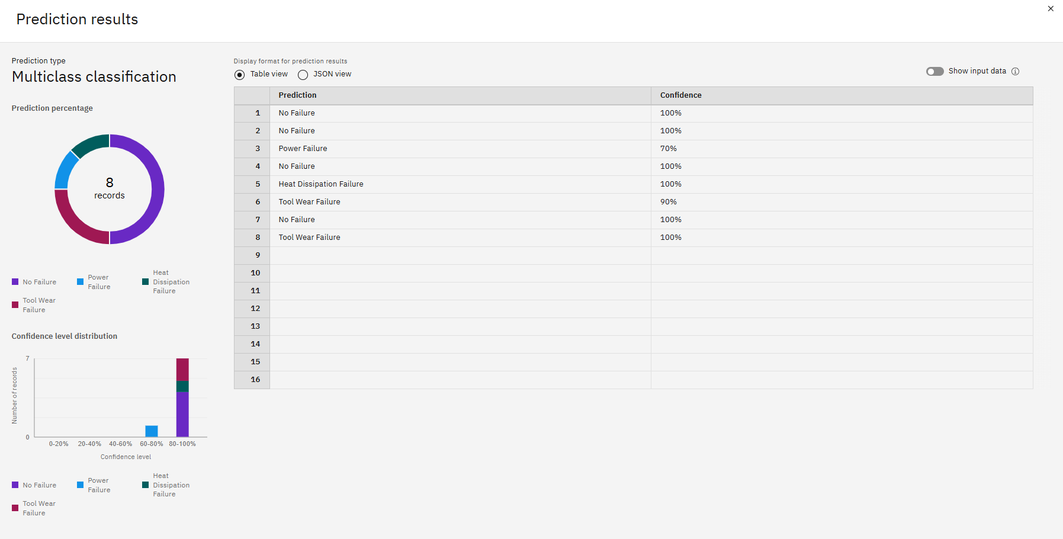

Slide 14
Conclusion
In this project, I developed a predictive maintenance model for industrial machinery using IBM watsonx.ai Studio and AutoAI. By working with real-time sensor data and applying the Snap Random Forest Classifier, I was able to accurately classify failure types such as tool wear, overheating, and power failure. The model showed strong predictive performance, making it suitable for proactive maintenance that can reduce downtime and operational costs.
Through this work, I’ve seen firsthand how AI can play a powerful role in improving machine reliability and efficiency. This project helped me understand the value of predictive analytics in industrial settings and how intelligent systems can support smarter decision-making.

Slide 15
Future scope
Integration with IoT Platforms: Real-time sensor data can be streamed using IoT devices to enhance live monitoring and quicker failure detection.
Model Enhancement with Deep Learning: Future versions can use LSTM or CNN models for improved accuracy, especially on sequential or time-series data.
Expansion to Other Industries: The model can be adapted for predictive maintenance in sectors like aviation, automotive, and manufacturing.
Automated Alert System: Integration of the model with maintenance scheduling systems can trigger alerts and maintenance tickets automatically.
Edge Computing Deployment: For faster, on-site processing without relying on cloud latency, models can be deployed on edge devices.
Continuous Learning Loop: With more data, the model can be retrained periodically to improve performance and adapt to new failure patterns.
Incorporating Cost Analysis: Adding a cost-benefit layer to prioritize maintenance actions based on economic impact.

Slide 16
References
Kaggle dataset link – https://www.kaggle.com/datasets/shivamb/machine-predictive-maintenance-classification
IBM Cloud Documentation -- https://www.ibm.com/cloud/watsonx-ai

Slide 17

IBM Certifications
Screenshot/ credly certificate( getting started with AI)

Slide 18

IBM Certifications
Screenshot/ credly certificate( Journey to Cloud)

Slide 19

IBM Certifications
Screenshot/ credly certificate( RAG Lab)

Slide 20
THANK YOU

