Slide 1
IBM University Engagement Project Submission
“Exploring the Power of Agentic AI with IBM Granite and LangFlow”

Slide 2

Project Tile – Startup Blueprint Generator Agent
Domain of Project – Agentic AI(Business Strategy And Planning)
Student Name | Recent Passport Photo | Email ID | Mobile number [WhatsApp]
Raj Kiran Acharyya |  | rajkiranacharyya@gmail.com | 9474643821

Slide 3
Problem Statement No.20 – Startup Blueprint Generator Agent
Problem Statement
Entrepreneurs often struggle with the ambiguity of early-stage planning. The Startup Blueprint Generator Agent addresses this by utilizing RAG (Retrieval-Augmented Generation) to convert raw concepts into precise, actionable business roadmaps. By synthesizing market research, competitor data, regulatory landscapes, and funding avenues, the agent provides comprehensive guidance—ranging from Business Model Canvases and financial forecasting to go-to-market strategies—significantly accelerating the startup launch lifecycle.
Project Objectives
The goal is to engineer an AI-driven agent capable of producing data-backed, strategic business frameworks. Core functionalities include:
Holistic Business Architecture: Automated generation of detailed 19-section business plans, featuring executive summaries and SWOT analysis.
Contextual Market Intelligence: Intelligent summarization of industry-specific compliance requirements, government schemes, and localized funding opportunities.
Dynamic Financial Modeling: Tailored budget projections and unit economics adjusted to the specific scale of the venture.
Investor-Ready Tooling: Automated drafting of professional pitch decks and Business Model Canvases (BMC).
Documentation & Visualization: A responsive dashboard for real-time progress tracking and data visualization, alongside one-click professional PDF report generation.

Slide 4
Proposed Solution - AI-Powered Startup Blueprint Generator Agent
The proposed solution is an autonomous, AI-driven Startup Blueprint Generator designed to dismantle the significant knowledge and financial barriers hindering entrepreneurship. By leveraging IBM watsonx.ai and IBM Granite models, the platform provides comprehensive, real-time strategic guidance for new ventures.
Core Methodology
The system architecture utilizes a Retrieval-Augmented Generation (RAG) framework to ensure strategic outputs are grounded in verified, real-world data. By pulling accurate insights from authoritative economic and institutional sources—including current market trends, government schemes, and legal regulations—the Granite foundation models deliver contextually precise and reliable business strategies.
Operational Logic: The Four Virtual Agents
The system logic is divided into four specialized agents:
Market Research Agent: Identifies target audience demographics, performs deep competitor analysis, and tracks industry-specific market trends.
Financial Planning Agent: Develops estimated budget breakdowns, pricing strategies, unit economics, and scalable revenue models customized to the startup’s scale.

Slide 5
Compliance & Legal Agent: Maps out critical legal frameworks, mandatory business registrations, and region-specific government incentive programs (e.g., Startup India or SBA).
Go-To-Market & Pitch Agent: Generates actionable 30-60-90 day execution roadmaps, Business Model Canvases (BMC), and professional investor pitch templates.
Technical Architecture
The platform features a modern, responsive web dashboard—built with Flask, Bootstrap, and JavaScript—which facilitates secure user input and displays the detailed 19-section blueprint. Backend workflows are managed through Flask and Gunicorn, while the watsonx.ai ecosystem ensures enterprise-grade deployment, scalability, and robust AI governance. A server-side PDF export engine allows for seamless, one-click document sharing.
Conclusion
Ultimately, this platform functions as an end-to-end intelligent incubation assistant, enabling aspiring founders to convert concepts into investor-ready, legally compliant, and financially robust business strategies.

Slide 6
Technology Used
Flask & Gunicorn (Python) – For designing, routing, and orchestrating the complex generation workflows and securely handling backend API requests.
IBM Granite model (ibm/granite-3-8b-instruct) – For deep natural language understanding, business logic reasoning, financial planning, and personalized text generation.
IBM Cloud – Provides the underlying infrastructure to build, deploy, and scale the Startup Agent efficiently. IBM Cloud enables a reliable, secure, and scalable environment for enterprise deployment.
RAG (Retrieval-Augmented Generation) Framework – To dynamically fetch required business structures, country-specific government schemes, and market definitions before generating intelligent answers, making the Startup Blueprint highly trustworthy and actionable.
IBM Watsonx.ai – For enterprise-grade model access, API deployment, and robust AI governance.
FPDF2 & Bootstrap 5 – For dynamic, server-side PDF document rendering and building a highly responsive, interactive frontend UI visualization.

Slide 7
Architecture Components Used -
1) User Input Interface – A modern, responsive web form where users enter their raw startup idea, target industry, operating country, and initial budget.
2) IBM watsonx AI Agent – Processes the founder's input using IBM Granite models to autonomously research and generate a comprehensive 19-section strategic business plan.
3) Name of IBM Granite model – ibm/granite-3-8b-instruct → Highly efficient, enterprise-grade model optimized for complex business logic, financial reasoning, and strategic planning.
4) Interactive Output Dashboard – Elegantly displays the AI-generated responses (such as the Business Model Canvas, SWOT analysis, and Go-to-Market strategy) in a structured, tabbed web interface.
5) PDF Export Component (FPDF2) – Instantly compiles and formats the generated text into a downloadable, professional A4 PDF document ready for investor pitches.
6) Python Backend Router (Flask) – Manages user sessions and dynamically splits massive data requests to bypass AI token limits, ensuring seamless, high-speed document generation.

Slide 8

Role of Agentic AI in the Startup Blueprint Generator
Agentic AI enables the Startup Blueprint Generator to function as an intelligent, autonomous business strategist rather than a simple chatbot. Using IBM watsonx.ai and IBM Granite models, it coordinates a complex, multi-step reasoning process to deliver a comprehensive 19-section business plan.
The AI performs highly specialized roles—such as retrieving target market demographics, formulating competitive analyses, structuring financial revenue models, and identifying country-specific legal compliance. By breaking down a massive strategic task into specialized cognitive steps, this agentic approach ensures efficient execution and highly accurate results.
Agentic AI also brings deep context awareness, deeply understanding specific user constraints like their initial budget, operating country, and target industry to generate hyper-tailored recommendations. It bypasses standard generic advice and applies real-world economic logic.
Additionally, the system formats and structures the output dynamically, ensuring that the generated financial models align perfectly with the proposed go-to-market strategies for cohesive decision-making.
Overall, Agentic AI makes the system proactive, analytical, and goal-driven, acting like a smart digital startup incubator that helps aspiring founders launch successfully.

Slide 9
Novelty and Uniqueness
The proposed Startup Blueprint Generator stands out by combining Agentic AI, dynamic financial modeling, and automated document formatting into a single intelligent incubation system.
Autonomous Strategic Reasoning – Instead of a simple Q&A chatbot, the system autonomously reasons through 19 complex business dimensions (from SWOT to Go-To-Market) to deliver a cohesive, end-to-end business strategy.
RAG-Based Accuracy – Integrates targeted retrieval of country-specific legal frameworks and government incentive schemes, significantly reducing AI hallucinations and ensuring compliant, realistic business plans.
Hyper-Personalization – Tailors the entire business model, pricing strategy, and target audience based entirely on the founder's specific industry, operating country, and initial budget.
Instant Professional Export – Features a built-in server-side PDF rendering engine, allowing founders to instantly download formatted, investor-ready documents with a single click.
Dynamic Web Dashboard – Provides a seamless, interactive UI with animated generation tracking and tabbed reading, offering a vastly superior user experience compared to standard terminal-based AI tools.
Financial Literacy Focus – Goes beyond basic startup advice to provide actual unit economics, estimated budget allocations, and scalable revenue models for first-time founders.
Scalable & Enterprise-Ready – Built on IBM watsonx.ai with IBM Granite models, ensuring enterprise-level reliability, data privacy, and governance.

Slide 10
GitHub Link
Github URL: https://github.com/RajKiranAcharyya/AICTE_IBM_EDUNET_INTERNSHIP_Startup_Blueprint_Generator
Live Web App URL: https://startupplan-generator-edunet-foundation.onrender.com
Demo Video: https://docs.google.com/videos/d/1r0zR4eqxMDFpNzph_9MeQwZTrGSSQXVg3asL4nH2F_A/play
·

Slide 11
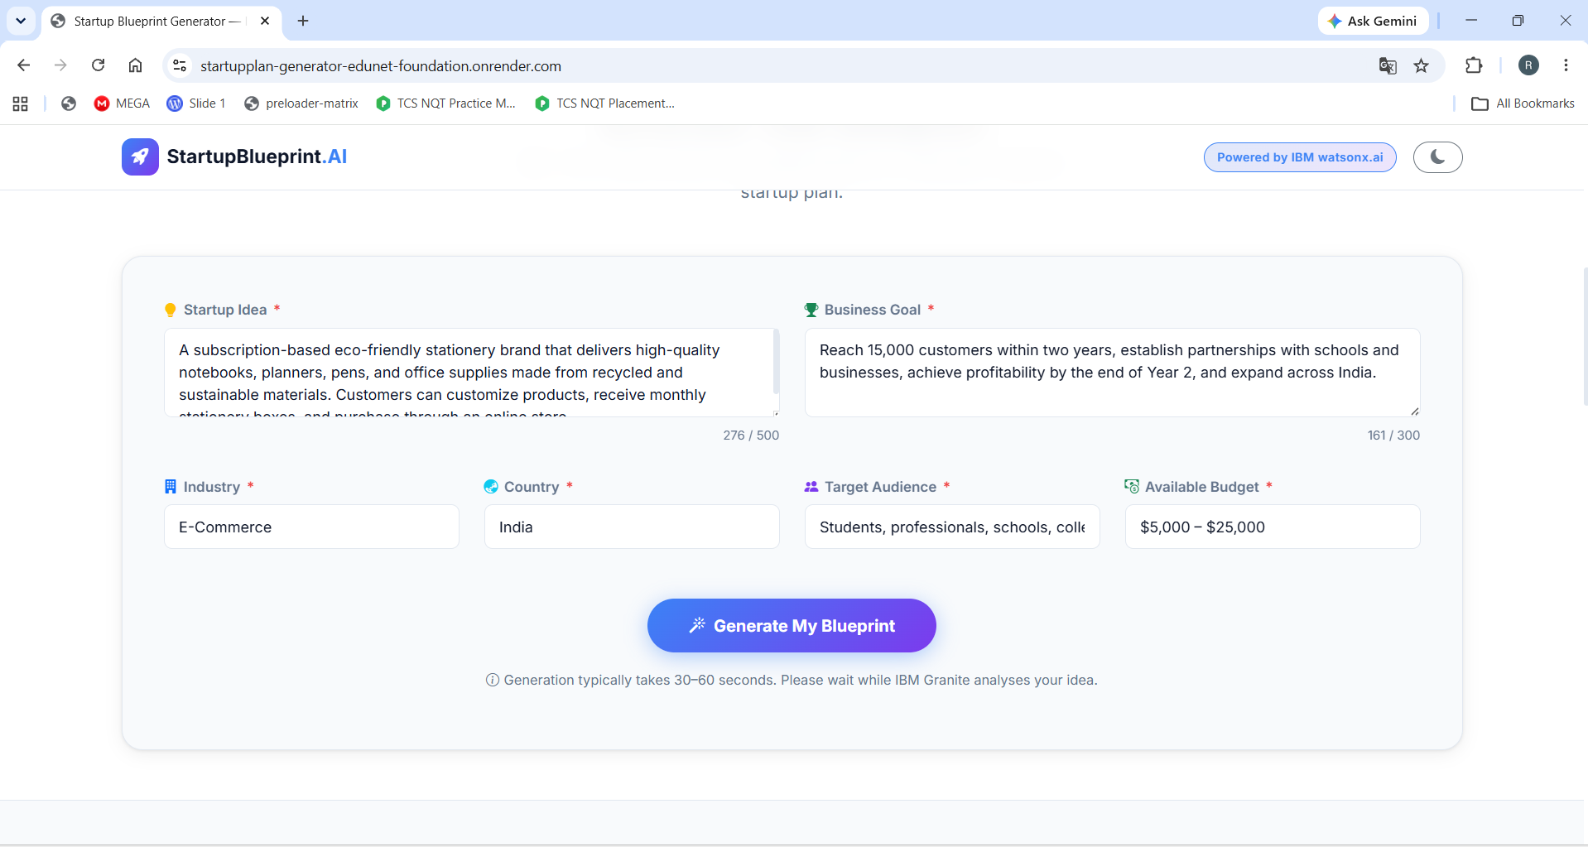
Project Screenshots
·

Slide 12
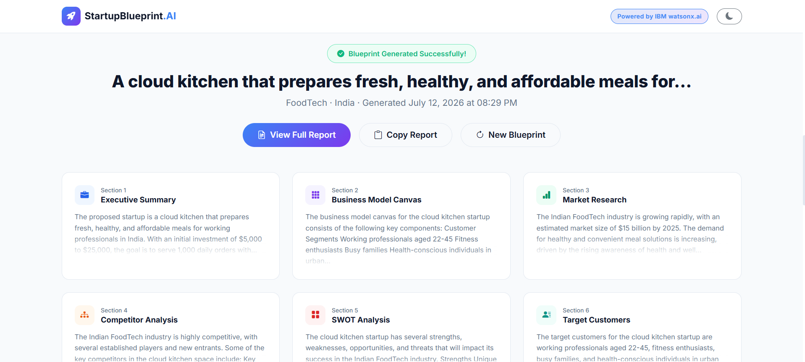
Project Screenshots
·

Slide 13
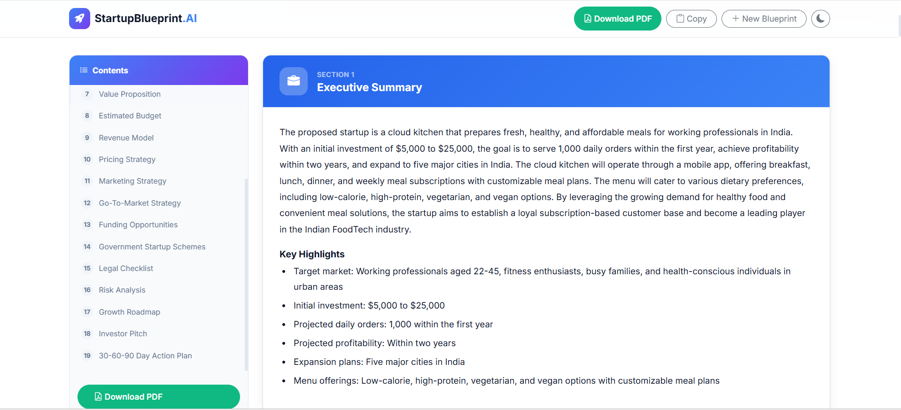
Project Screenshots
·

Slide 14
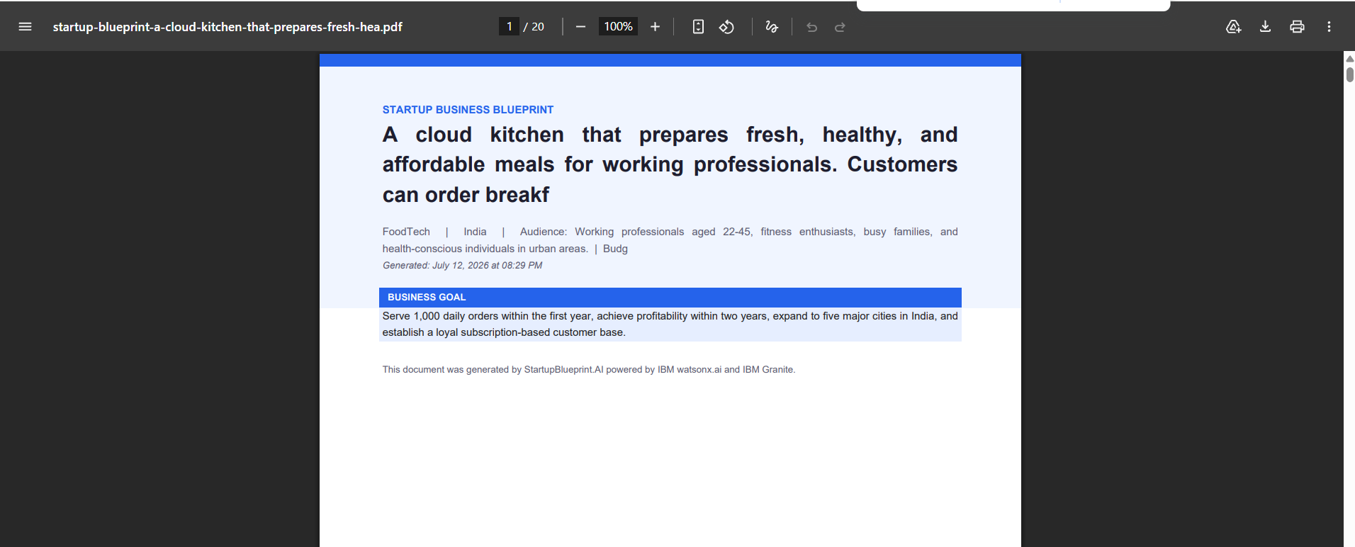
Project Screenshots
·

Slide 15
Future Scope
1. Integration with Real-Time Financial APIs & Live Market Data – The system can be integrated with live financial APIs (like Bloomberg or Yahoo Finance) and government business registry databases to fetch real-time economic conditions, live competitor pricing, and active grant availability. This will enable the Startup Agent to provide highly dynamic, data-backed financial forecasts and live market trends rather than static estimates.
2. AI-Powered Pitch Deck Generator & Multilingual Support – Enhancing the system to automatically generate full PowerPoint (.pptx) investor pitch decks based on the blueprint, along with support for multiple languages. This will allow founders to seamlessly pitch to international investors in their native languages, making the solution globally inclusive and vastly accelerating the fundraising process for non-English speakers.

Slide 16
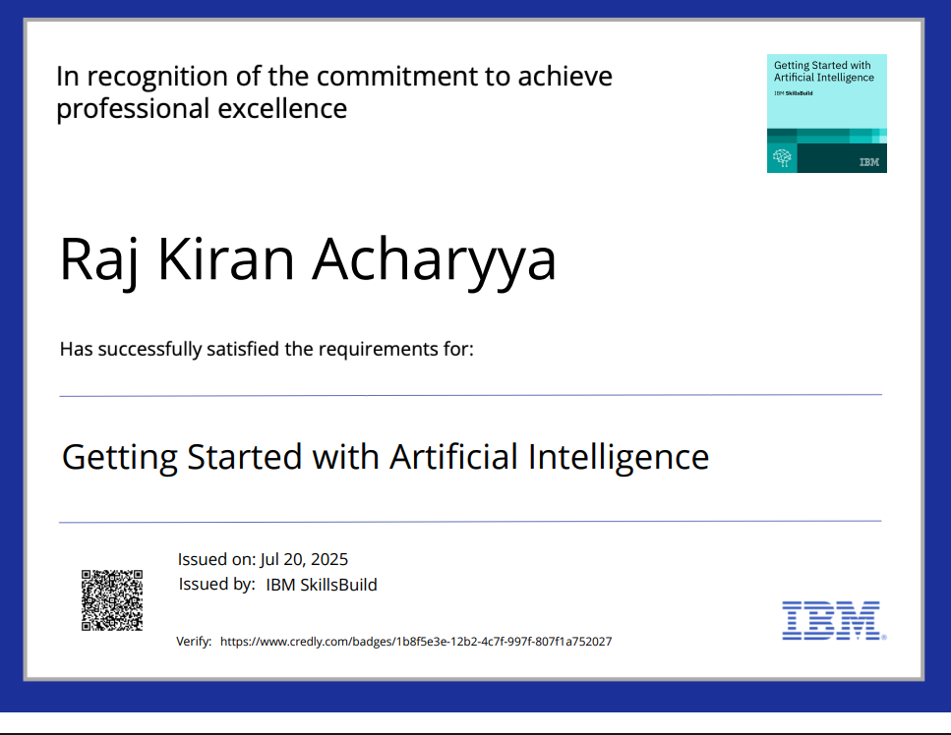
Certificates Earned:
Getting Started with Artificial Intelligence credly certificate

Slide 17
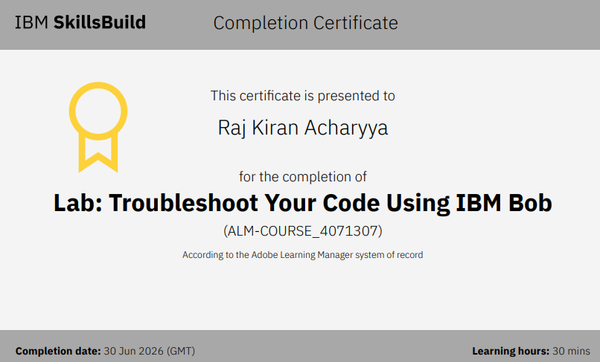
Certificates Earned:​
IBM BOB Certificate

Slide 18


