Slide 1
INNOVATIVE IDEA
Presented By BRAINIACS

Slide 2
Title Of The Project
Alert Mechanism for Smart Toilet Technology

Slide 3
INTRODUCTION
THE PROBLEM
TILL DATE RESEARCH DONE
OVERVIEW
SOLUTION
PROS AND CONS
CONCLUSION

Slide 4
INTRODUCTION
The advent of smart toilet technology has sparked discussions surrounding hygiene, efficient maintenance, and timely alerts during system failures. Maximizing the benefits of this technology necessitates addressing these concerns. A pivotal aspect is implementing effective alert mechanisms to promptly notify relevant individuals of system failures.It delves into existing research on alert mechanisms for smart toilets, with a focus on malfunction detection. For instance, an automatic flash system utilizing microcontroller and IR sensor technology detects water purity changes using a pH sensor, activating the flushing system accordingly. Currently, there is no disagreement in this area, but the absence of an effective alert mechanism poses challenges. Smart toilets lack a robust alert mechanism to notify users of malfunctions detected by sensors.

Slide 5

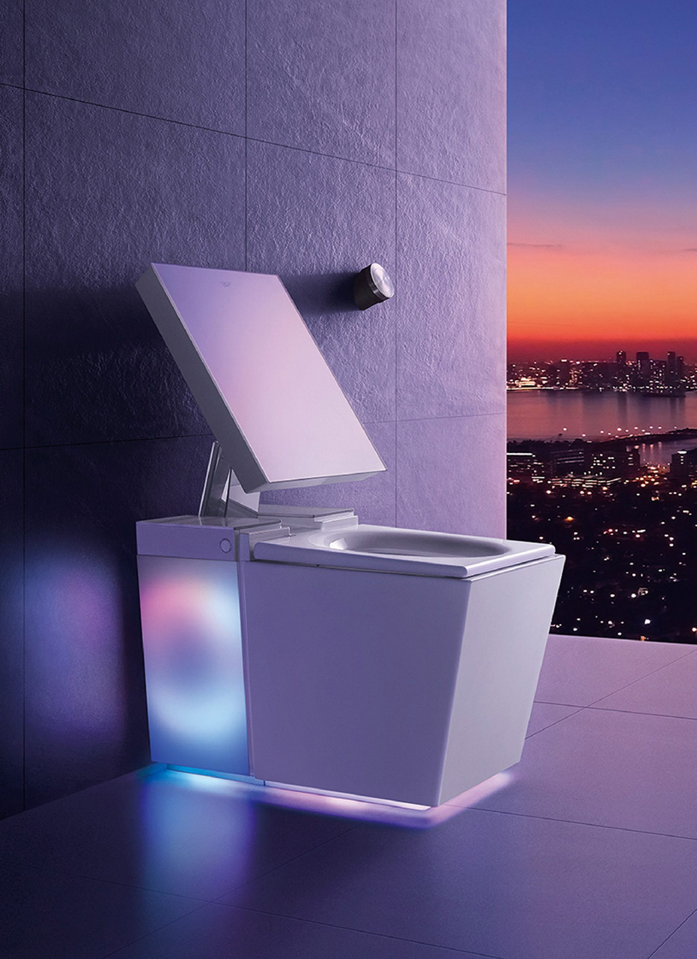
Problem Statement
Currently,smart toilets lack an effective alert mechanism to notify if any malfunction detect
through sensors.Several challenges faced if a smart toilet mechanism
malfunction detected then the user have to face several problem.

Slide 6
Till Date Research Done
There exists an automatic flash system for sanitation using micro-controller and IR sensor
technology.The system is designed to use pH sensor for identifying the change in the purity of water
and activates the controller flushing system.
Tsai et al designed and implemented an auto flushing
device with ultra-low standby power consumption. The system consumes 10 mW which is very low in
comparison to the other systems with 0.5 to 1 W of power consumption when no user is present for
24 hours a day.

Slide 7






SOLUTIONS
Water Level Sensor
Data Processing And
Decision Making
Detects abnormal water levels indicating potential leaks or malfunctions and notify the individual before using the toilet.
The CPU processes malfunction data from sensors to make decisions. For instance, if water level sensors detect a malfunction, the CPU recognizes and addresses the issue.
Maintenance Alerts
Sensor for User Presence Detection
The toilet could detect when parts need to be replaced or serviced and send an alert to the user or maintenance personnel.
Check infrared rays emitted from the human body to trigger alerts.
Communication Module
Temperature Sensor
Enables the system to send alerts to designated recipients through
audio/visual alerts like triggers local alarms or lights to indicate malfunctions within the washroom.
Detects unusual temperature changes suggesting component
overheating

Slide 8
PROS & CONS
PROS
CONS
Regular maintenance is essential for optimal performance, adding to ongoing upkeep costs and responsibilities.
Timely detection minimizes inconvenience
It can be integrated with smart home systems enhances overall automation and control
Dependency on technology may lead to occasional false alarms or errors, requiring user attention and potential troubleshooting.
The alert mechanism in smart toilet technology enhances safety by promptly notifying users of potential hazards, such as leaks or blockages
Implementation costs may be higher compared to traditional systems,potentially limiting adoption.

Slide 9
Conclusion and Recommendations:
- Summarize findings, strengths, and weaknesses.
- Provide recommendations for improvement and future research.
This methodology ensures comprehensive evaluation of smart toilet alert mechanisms,
considering technical, user-centric, and practical aspects

Slide 10
THANK YOU

