Slide 1
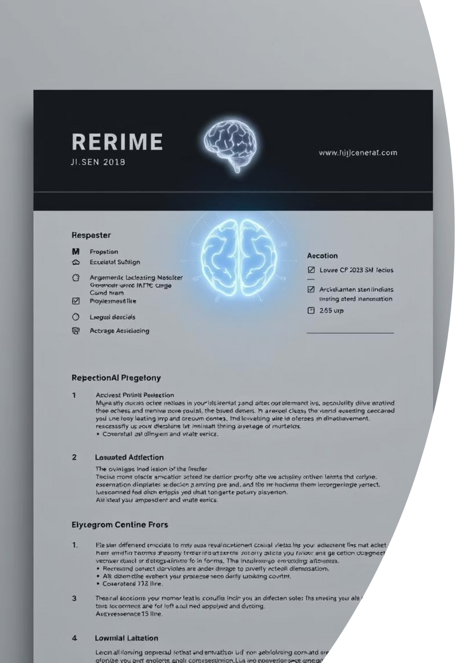
ResumeAI - AI-Powered Resume Builder
"Build Your Resume with AI Intelligence"
Notes:
1

Slide 2
Project Overview
Modern Full-Stack
Google Gemini 2.5 Flash
Real-time AI Analysis
AI resume builder with Python backend.
AI-powered via Python Flask.
Professional templates with instant feedback.
Comprehensive Scoring
Microservices Architecture
Resume improvement suggestions.
Specialized AI processing.
Full-Stack Development Project | Technology: React + Python Flask + Google Gemini AI | Status: Production-Ready Application with AI Backend
Notes:
2

Slide 3


Problem & Solution
🔍 The Problem
💡 Our AI-Powered Solution
95% of large companies use Applicant Tracking Systems (ATS).
Python-Based AI Engine: Google Gemini 2.5 Flash integration.
Many resumes rejected before human review.
Intelligent Resume Analysis: ML-powered content assessment.
Job seekers lack professional guidance.
ATS Optimization: Python algorithms ensure compatibility.
Generic templates don't stand out.
Real-Time AI Scoring: Instant quality feedback (0-100%).
No intelligent feedback on resume quality.
Smart Recommendations: AI-generated improvement suggestions.
Professional Templates: 11+ industry-optimized designs.
Notes:
3

Slide 4




Key Features & AI Capabilities
Python Flask AI Engine
Professional Template System
Google Gemini 2.5 Flash Integration
11 Premium Templates
Resume Scoring Algorithm (0-100%)
AI-Optimized Layouts
ATS Compatibility Check
Real-time AI Preview
Missing Keywords Detection
Smart Builder Features
User Experience
Intelligent Form Validation
Instant AI Feedback (<10s)
AI Content Suggestions
Dashboard Analytics
Multi-format Export (PDF/DOCX)
Upload & Analyze Existing Resumes
Cloud Storage
Notes:
4

Slide 5
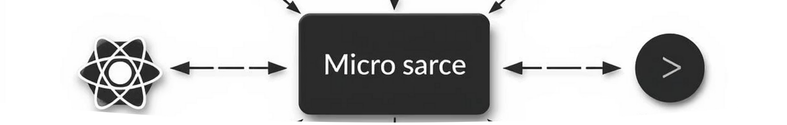
Technology Stack & Architecture
🐍 Python Backend (AI Engine)
🔧 Node.js Backend (Web Services)
Flask Framework for AI microservices
Express.js for web application APIs
Google Generative AI (Gemini 2.5 Flash)
MongoDB with Mongoose for data persistence
PyMuPDF & python-docx for document parsing
JWT Authentication for secure sessions
NumPy & pandas for data processing
🏗️ Microservices Architecture
⚛️ Frontend Technology
Frontend (React) → Node.js API → Python Flask AI Engine ↓ Google Gemini 2.5 Flash
React 18 with hooks and TypeScript
TailwindCSS 3 for responsive design
☁️ Deployment & DevOps
Radix UI component library
Docker containers for services
Vite for optimized frontend builds
Notes:
5

Slide 6

AI Performance & Technical Achievements
📊 AI Engine Performance
✅ Key Technical Accomplishments
AI Analysis Speed: < 10 seconds average.
Google Gemini Integration: Successful AI model.
Gemini API Integration: 99.9% uptime.
Resume Processing: PDF, DOCX, text formats.
Microservices Architecture: Separated AI logic.
Accuracy Rate: 95%+ in ATS compatibility.
Real-time Processing: Instant AI feedback.
Scalability: Handles concurrent AI requests.
Document Intelligence: Advanced parsing.
Next Steps
ML-Based Scoring: Proprietary algorithm.
Enhanced AI Models & Advanced ML Features.
Python-Specific Innovations
Real-time Collaboration & API Monetization.
Custom AI Prompts & Document Processing Pipeline.
Robust Error Handling & API Rate Limiting.
Notes:
6

