Slide 1

MATHEMATICAL PROBLEM SOLVER

Slide 2
Group Info :
Team :
Sammit Devgonda Khade
Swapnil Annasaheb lokhande
Rajvardhan udaykumar patil
Swaroop sanjay patil
Guide :
Prof. v. s. shinde
Co-Ordinator :
Prof .t. s. Kambale
HOD :
Prof. s. r. arlimatti

Slide 3
Contents
Introduction
Objective
Working
Development
Involvement
Specification
Conclusion

Slide 4
Introducing Software Program
Mathematical problem solver helps to solve the matrix, statistics and some basic arithmetic operations.
It provides solution after performing certain operation in system.
This system helps students to know correct answer of their questions and help them identify their mistakes.
It is user-friendly as it guide the user for certain input which required therefore it helps to get correct digits and operator and it can be use to solve simple mathematical equations.

Slide 5
Objective
As nowadays many children or students uses mobiles, laptops, computers for entertainment except that these devices can be used to for learning purpose as well.
Sometimes some parents may be less educated and they might not know to guide their children.
We have chosen the project mathematical equation solver so that students would get facility to check the answer of their equations without depending on others.
If they can check that the solution is correct or not they can move to solve other equations with confident. If the students are not sure about the correct solution then they might get demotivated and leave the work.

Slide 6
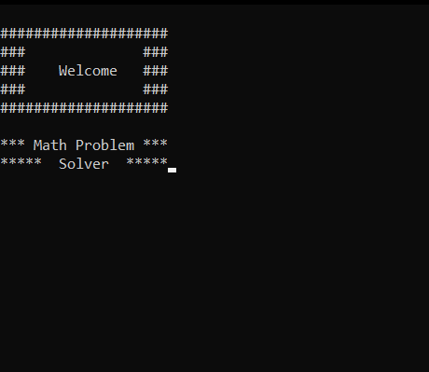
How the program will work
Start with welcome barrier.
Automatically second window(main menu) appear.
Gives options for operating such as calculator, matrices, statistics, etc.
Giving the input to system as user required.
Solution of problem.

Slide 7
Flow diagram
Start
Banner
Main Menu
Exit
Calculator
Matrix
Stats
Solution

Slide 8
Operational Specification :
Operations
Calculator
Matrix
Statistics
Addition +
Addition
Summation
Subtraction -
Subtraction
Fit straight line
Multiplication *
Multiplication
Line of regression
Division /
Rank
Reminder %
Eigen Value
Coefficient of corelation
Factorial !
Determinant
Numerical Integration
Power ^
Minors

Slide 9
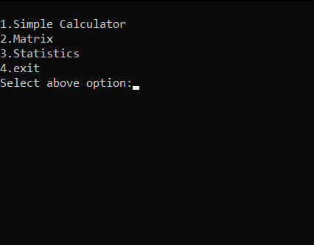
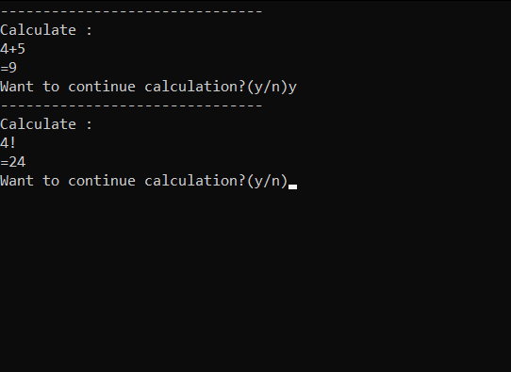
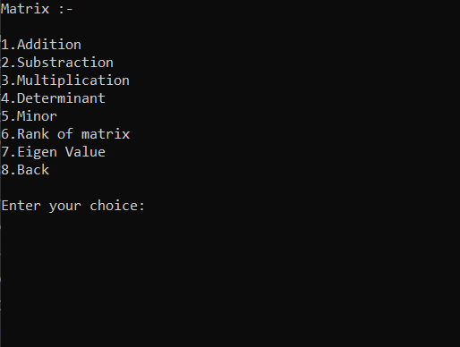
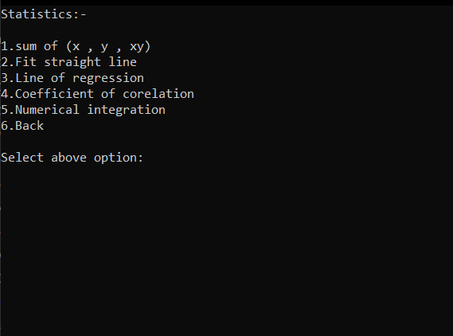
Main menu
Calculator
Matrix menu
Statistics menu

Slide 10
Software Development Process
Identifying User Requirement :
The user gave the information as per software required and this info is given to planning team which does the rough sketch accordingly.
In this, the coder or analysing team has to analyse given requirement of user or indirectly just have to survey requirements of user.
Design :
In this stage of designing we just simply combined first two steps of planning and analysis and just formed layout as per software of code required.

Slide 11
Development/coding :
We write the code of program on basis of layout and design as per used requirement. This one of important stage in this life cycle as this code execute everything.
Testing :
For testing we gave the program to test to friends. And ask them to give review on program.
Implementation :
We corrected the calculation errors in code found by testing for better output. And make the program user friendly.

Slide 12
Involvement
So we gathered information from 11th,12th and First-Year students about their difficulties in mathematics.
Our project team wrote code as per requirements.
For testing purposes, we gave program to friends and teachers ask them to give review and minor calculation errors.
Then we implemented our program and gave it to use.

Slide 13
Technical Specification
Software Requirement :
Operating System: Windows XP/2003/Vista/2008, Windows 7, Windows 8,Windows 10,Windows 11
Borland C++
Dev C++
Codeblocks
Microsoft Visual Studio 2019
Hardware Requirement :
An Intel processor is recommended for better performance.
Minimum system requirements:
1 GB RAM
Windows XP
1 GHz Processor
Hard Disk Drive 128 GB

Slide 14
Conclusion
Hence we can simply conclude the project helps the students to identify their mistakes and correct them.
The overall conclusion of project is done and future scope of project will be live relative example for better understanding for the students.

Slide 15
THANK YOU

