Slide 1
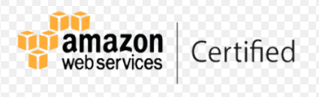
AWS
DevOps Training Demo

Slide 2
What is Cloud Computing?
Cloud computing is the on-demand availability of computer system resources, especially data storage and computing power, without direct active management by the user. The term is generally used to describe data centers available to many users over the Internet.
Using cloud Computing,users are able to access Software
and applications from wherever they need,
while it is being hosted by an outside party -
in “the Cloud”.

Slide 3
Types of Cloud Computing?
The most common and widely adopted cloud computing services are:
Infrastructure as a Service (IaaS).
Platform as a Service (PaaS).
Software as a Service (SaaS).

Slide 4
Software as a service (SaaS)
Software as a service (SaaS) is a software licensing and delivery model in which software is licensed on a subscription basis and is centrally hosted. It is sometimes referred to as "on-demand software", and was formerly referred to as "software plus services" by Microsoft.
SaaS applications are also known as Web-based software, on-demand software and hosted software.
SaaS Providers:
• Google – mail, calendar, docs, presentations etc..
• Microsoft – mail, MS word, paint etc..
• Twitter
• Facebook
• Flipkart
• GoTomeeting

Slide 5
Platform as a service (PaaS)
Platform as a Service (PaaS) or Application Platform as a Service (aPaaS) or platform-based service is a category of cloud computing services that provides a platform allowing customers to develop, run, and manage applications without the complexity of building and maintaining the infrastructure typically associated with developing and launching an app.
PaaS Providers:
• AWS Beanstalk
• Google App Engine
• Force.com from Salesforce
• Windows Azure Cloud Services.
• Red Hat OpenShift

Slide 6
Infrastructure as a service (IaaS)
Infrastructure as a service (IaaS) are online services that provide high-level APIs used to dereference various low-level details of underlying network infrastructure like physical computing resources, location, data partitioning, scaling, security, backup etc.
IaaS Providers:
▪ Amazon AWS
▪ Windows Azure
▪ Google Compute Engine.
▪ Rackspace Open Cloud.
▪ Alibaba cloud
▪ IBM Smart Cloud Enterprise.

Slide 7
What is AWS ?
Amazon Web Services is a subsidiary of Amazon that provides
on-demand cloud computing platforms and APIs to individuals,
companies, and governments, on a metered pay-as-you-go basis.

Slide 8


Slide 9
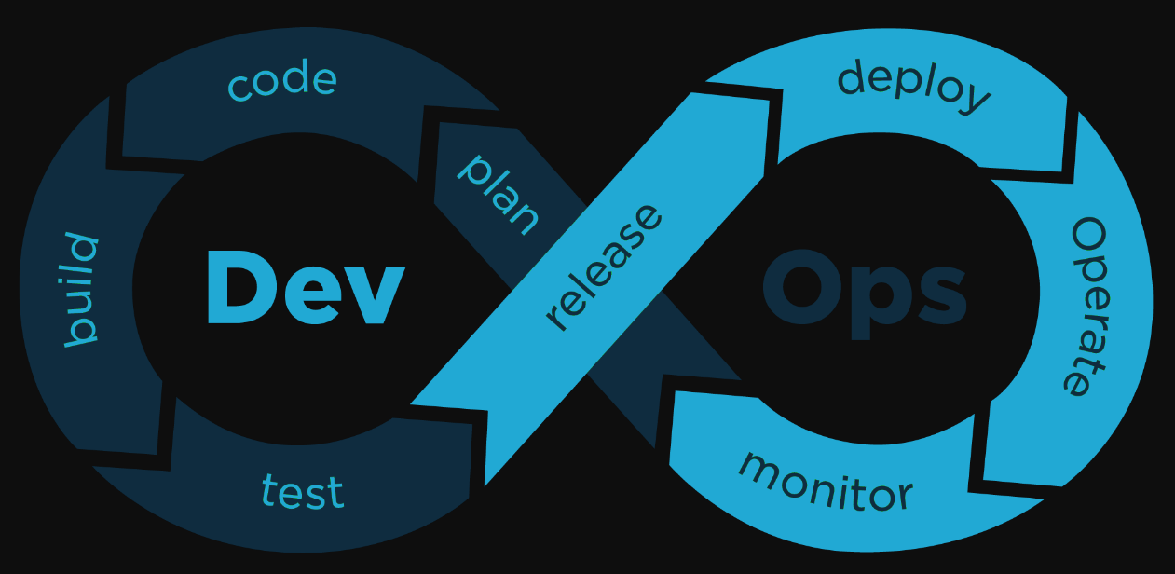
What is DevOps ?
DevOps is a set of practices that combines software development
and information-technology operations which aims to shorten the
systems development life cycle and provide continuous delivery
with high software quality.

Slide 10
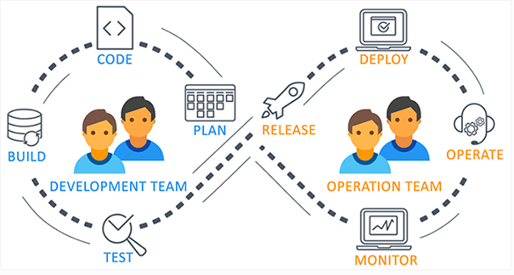

Slide 11
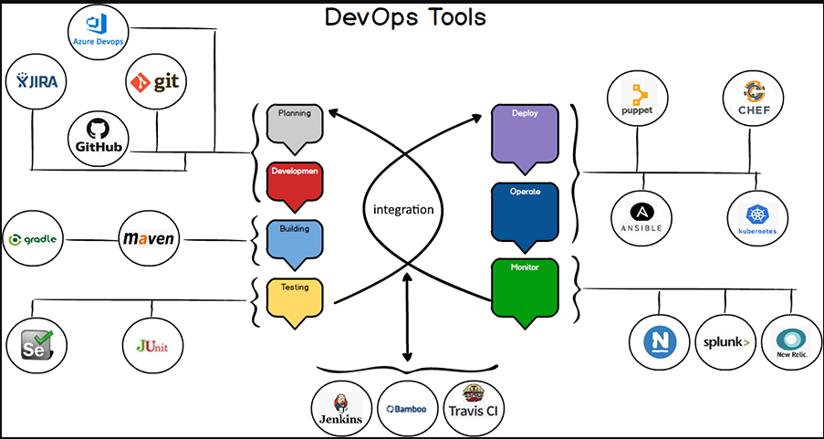

Slide 12
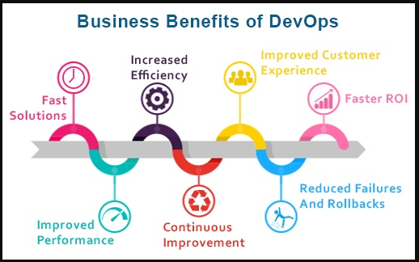

Slide 13
Why DevOps ?
DevOps describes a culture and set of processes that bring
development and operations teams together to complete software
development. It allows organizations to create and improve
products at a faster pace than they can with traditional
software development approaches.
And, it's gaining popularity at a rapid rate.
DevOps fulfills all the below requirements and helps in achieving
seamless software delivery.
Increase deployment frequency
Lower failure rate of new releases
Shortened lead time between fixes
Faster mean time to recovery in the event of new release
crashing.

Slide 14
Thank you

