Slide 1

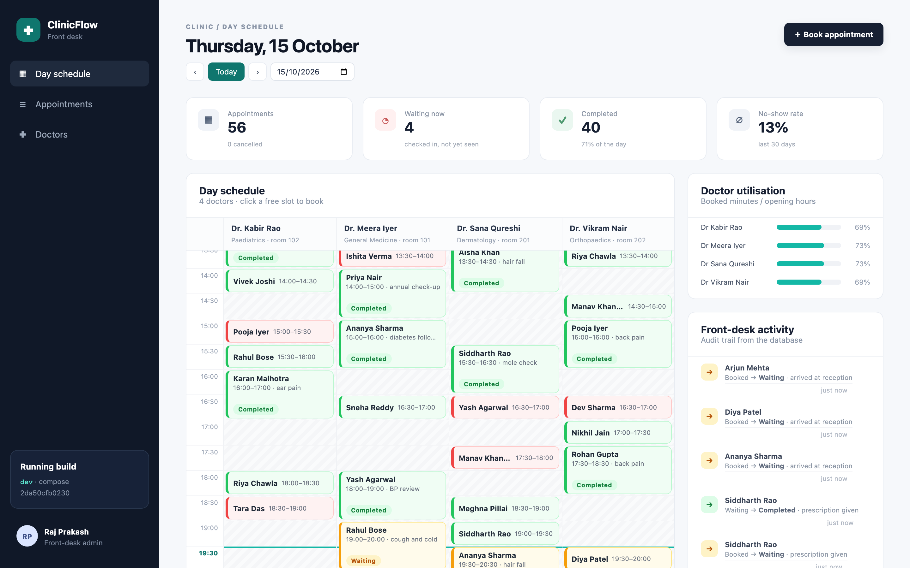
ClinicFlow
From a laptop to a monitored Kubernetes cluster: a DevSecOps capstone
Raj Prakash · 24BCS10328 · Session 21 final project
github.com/RajPrakash681/devsecops-python
Notes:
Hi, I'm Raj Prakash, enrollment 24BCS10328. This is my Session 21 capstone, ClinicFlow. It's a front-desk application for a clinic, taken all the way from my laptop to a monitored Kubernetes cluster, with every DevOps stage from the course in between.

Slide 2
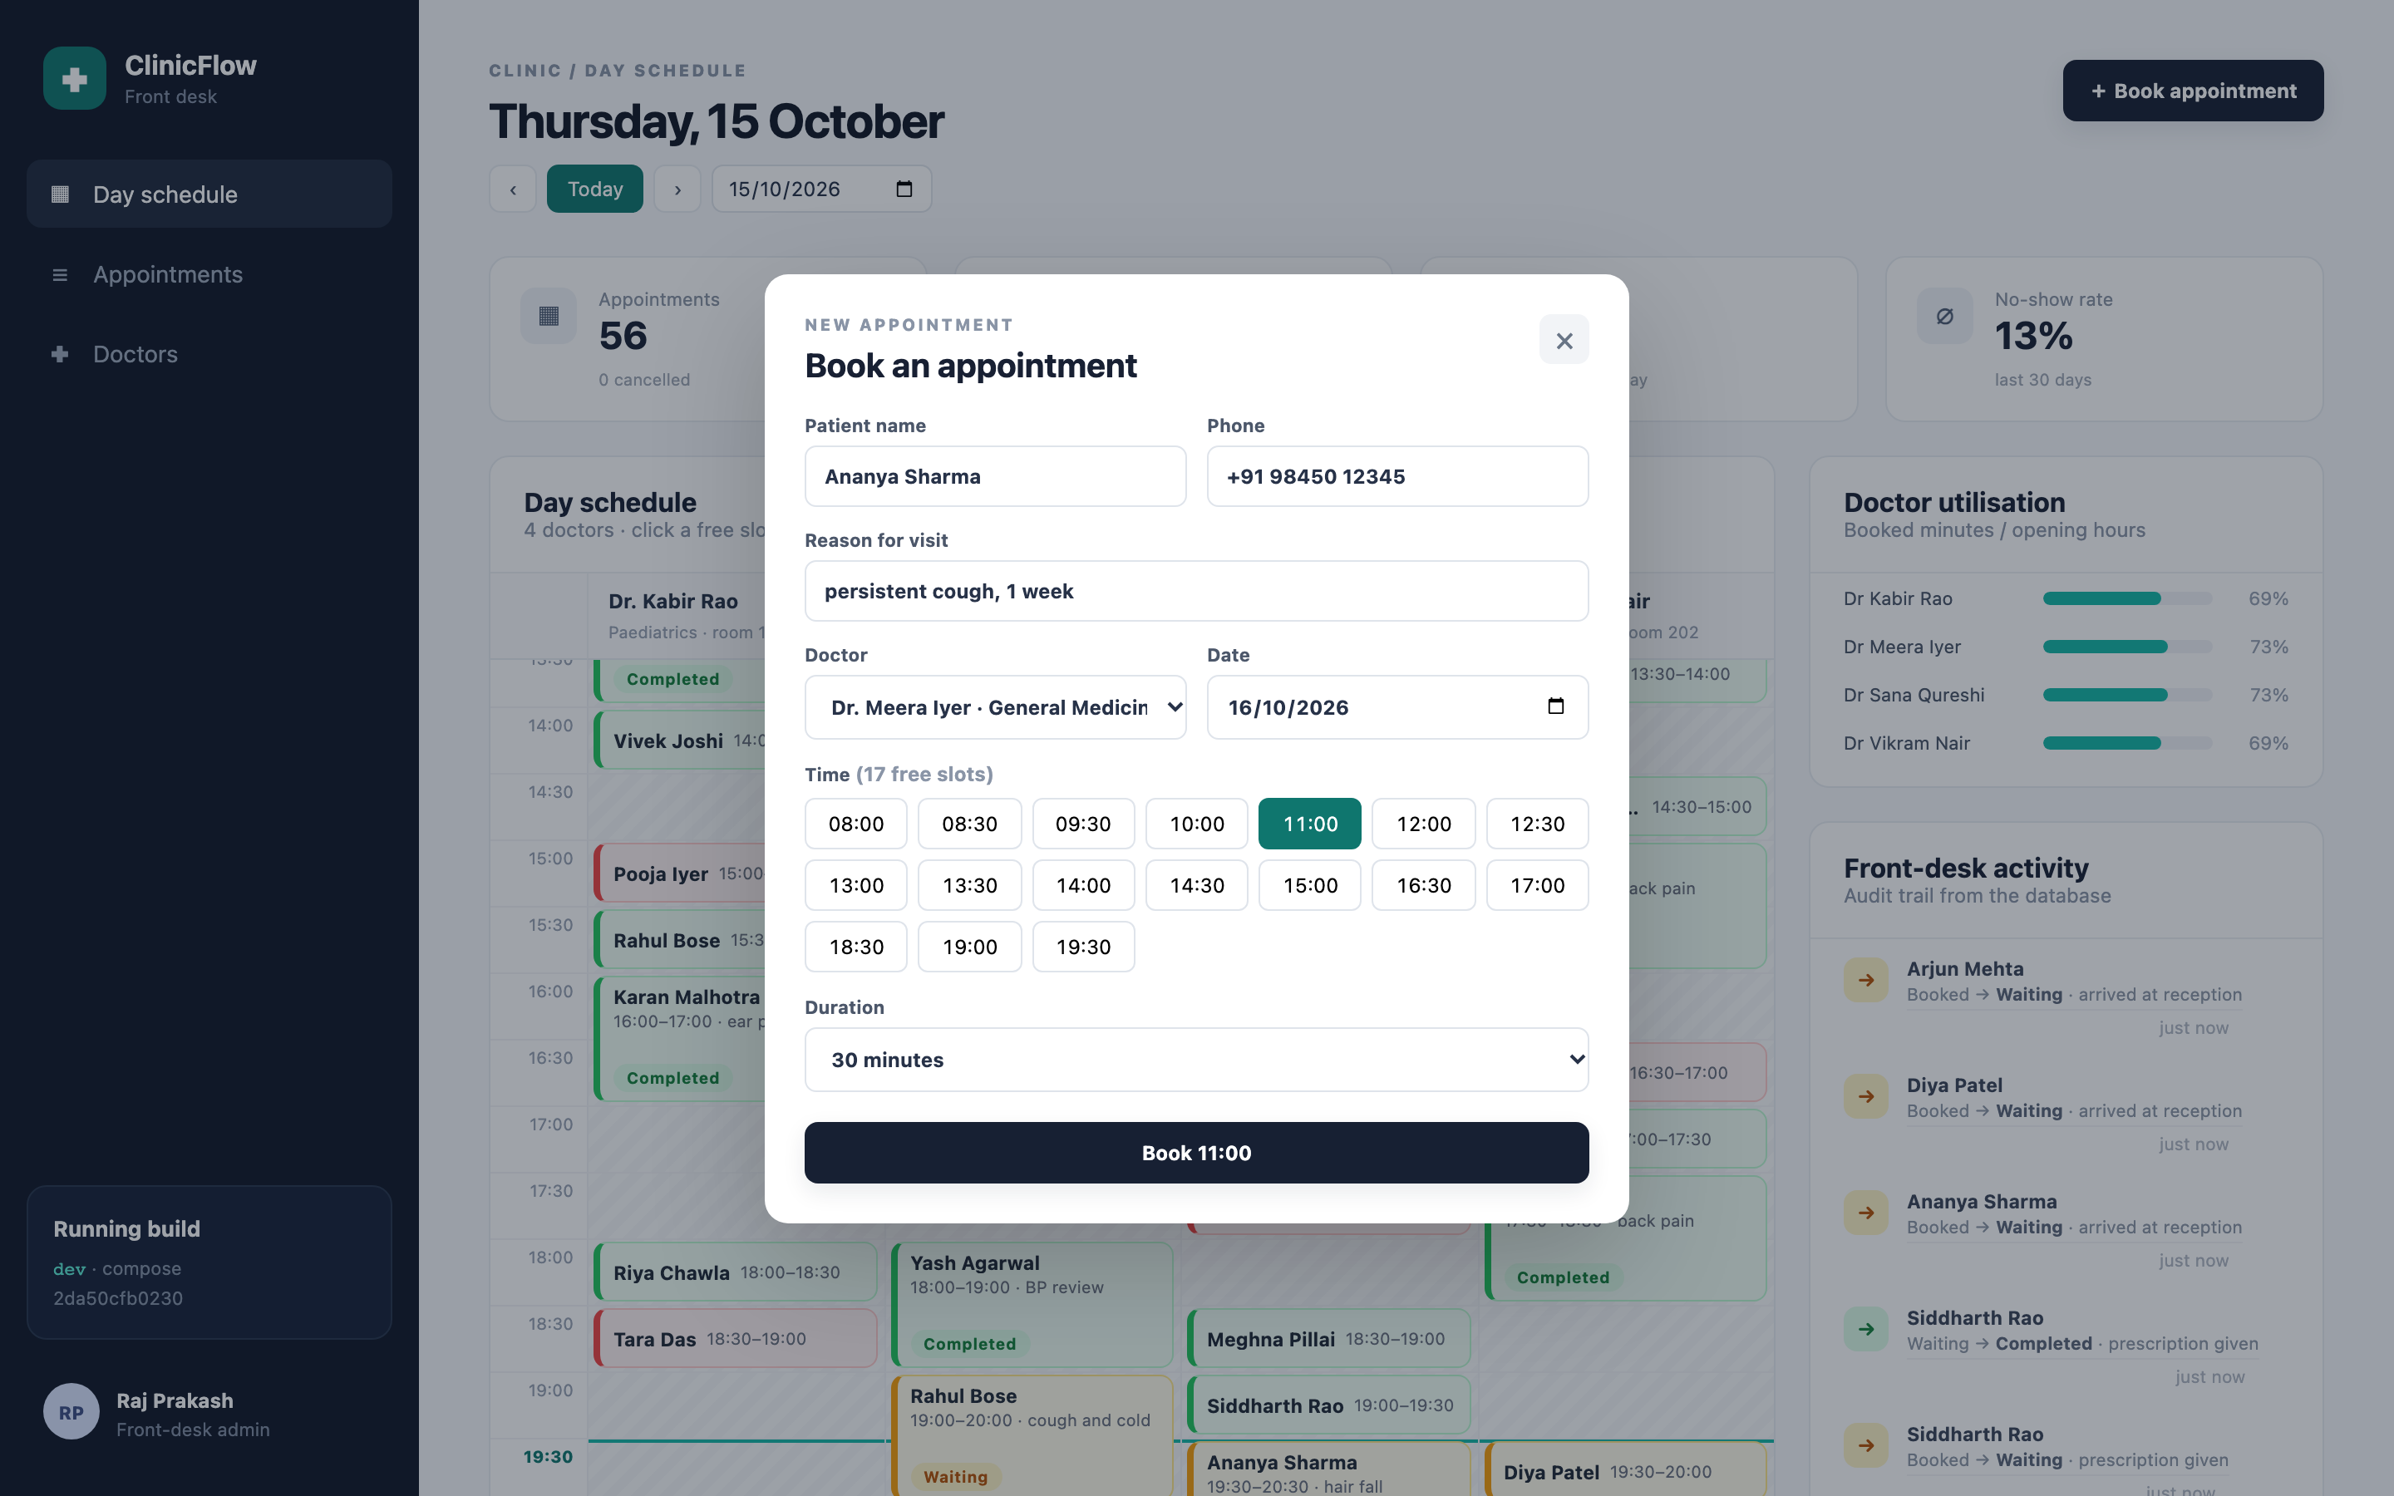



A front desk for a multi-doctor clinic
Book without double-booking
Free slots per doctor; overlaps rejected under a row lock (409)
Check-in workflow with an audit trail
Booked → Waiting → Completed, or Cancelled / No-show; illegal moves refused
Live clinic KPIs
Waiting room, doctor utilisation and the 30-day no-show rate
Domain is my own; the DevOps layer follows the course's TaskBoard architecture.
Notes:
ClinicFlow is for a clinic with several doctors. Reception books a patient into a doctor's free slot, and the system refuses a double booking. When the patient arrives they are checked in, and the visit ends as completed, cancelled or a no-show. Every step goes into an audit trail. The dashboard shows the waiting room, how busy each doctor is, and the no-show rate. The domain is my own; the DevOps layer follows the course's TaskBoard architecture.

Slide 3








Tech stack
Application
Testing
Containers
CI/CD
React 19 · FastAPI · PostgreSQL 17
pytest · 32 cases · 92% coverage
Multi-stage builds · non-root
GitHub Actions · GHCR · SHA tags
Security
Infrastructure
Platform
Observability
Trivy · Gitleaks · Bandit · PSS
Terraform · AWS VPC + EKS
Kubernetes · Helm · Argo CD
Prometheus · Grafana · alerts
Notes:
The stack: React, FastAPI and PostgreSQL for the application, and pytest with thirty-two test cases. Docker images that run as non-root. GitHub Actions pushing to the GitHub Container Registry. Trivy, Gitleaks and Bandit for security. Terraform for AWS, and Kubernetes with Helm and Argo CD, monitored by Prometheus and Grafana.

Slide 4
Architecture
Developer
GitHub repo
GitHub Actions
test · scan · build · push · deploy · promote
GHCR
clinicflow-*:<sha>
promote: commit SHA to gitops/
polls main
Kubernetes (kind, 3 nodes)
image pull
Argo CD
Prometheus · Grafana
namespace clinicflow
frontend ×2
nginx · UID 101
Browser
Ingress
clinicflow.local
Terraform → AWS ap-south-1
VPC · 2 public + 2 private subnets · NAT
EKS 1.34 + node group
(applied on the moto emulator)
backend ×2–6
FastAPI · HPA
PostgreSQL
StatefulSet + PVC
Notes:
Here is the architecture. A push to GitHub starts the pipeline: it tests, scans, builds, pushes images tagged with the commit SHA, deploys to a throwaway cluster, and then commits that SHA back into the gitops folder. Argo CD watches the repository and syncs the cluster. The browser reaches one hostname; the Ingress sends the API to the backend and everything else to the frontend. Prometheus scrapes the backend, and Terraform describes the AWS network and EKS cluster.

Slide 5
Application: correctness lives in the database too
17
3
32
No double booking
Booking locks the doctor's row (SELECT … FOR UPDATE) and checks for overlap, so two replicas can't both take the same slot.
Database guard rails
CHECK (ends_at > starts_at), a status CHECK, RESTRICT on doctors with history, CASCADE for the audit trail.
Safe migrations
A Postgres advisory lock makes replicas migrate one at a time.
endpoints (14 under /api)
Alembic migrations
pytest cases on a throwaway DB
BOOKED
CHECKED_IN
COMPLETED
NO_SHOW
CANCELLED
Any other move → 409, naming the allowed ones. Every change is written to appointment_events.
Notes:
Correctness is enforced in the database as well as the API. There are seventeen endpoints and three Alembic migrations. Appointments follow a state machine, and an illegal move returns 409. A booking locks the doctor's row before checking for overlaps, so two replicas can never give away the same slot. Migrations run under a Postgres advisory lock.

Slide 6
CI/CD: eleven jobs from push to production
Test & lint
Build ×2
Trivy gate ×2
Push GHCR ×2
Deploy
Promote
pytest · migrations race
frontend · Gitleaks
Bandit · helm lint
backend + frontend
built once
fixable HIGH/CRITICAL
fails the build
the scanned bytes
tag = commit SHA
kind + helm install
smoke: 201 then 409
SHA committed to
gitops/ → Argo CD
11/11
3m 01s
0
Why SHA tags
Every image traces back to its commit; nothing is ever "latest".
Scan what you ship
The image is saved after the scan and pushed unchanged, so no rebuild can slip in.
jobs green on the first run
from push to promoted image
registry passwords stored (GITHUB_TOKEN)
ghcr.io/rajprakash681/clinicflow-backend:8baee138a443…
Notes:
The pipeline has eleven jobs. Five test and lint jobs run in parallel. Then both images are built once and scanned by Trivy, and only the scanned image is pushed, tagged with the commit SHA, never latest. The deploy job installs the chart on a kind cluster and runs a smoke test: a booking gets 201, and the same booking again gets 409. Finally the promote job hands the new SHA to Argo CD. The first run was green in three minutes.

Slide 7





DevSecOps: the gate blocked a real CVE
Gitleaks
whole Git history, no credentials
CVE-2026-4775
HIGH · libtiff 4.7.1 → fixed in 4.7.2 · code execution or DoS via a crafted TIFF
Bandit + npm audit
Python SAST, dependency CVEs
ClinicFlow never reads TIFF: libtiff came in through nginx's image-filter module → libgd
The image already ran apk upgrade, but Docker reused a stale cached layer
Fix: delete the four nginx modules the app never loads
Trivy
both images; fixable HIGH/CRITICAL fails
Runtime
non-root, read-only FS, no capabilities
exit 1 → 0
70 → 31
Admission
restricted Pod Security on both namespaces
Trivy gate, before vs after
packages in the frontend image
Notes:
The security gate is real. The first frontend image failed on CVE 2026 4775, a high-severity bug in libtiff. ClinicFlow never reads TIFF files; libtiff came in through an nginx module we do not use. The image already ran apk upgrade, but Docker reused a stale cached layer. So I removed the unused modules. The package count dropped from seventy to thirty-one, and the gate went from exit one to exit zero.

Slide 8
Infrastructure as code: AWS VPC + EKS
VPC 10.21.0.0/16 · ap-south-1
Internet gateway
23
0
ap-south-1a
ap-south-1b
resources in the plan
left after destroy
public 10.21.0.0/24
NAT gateway + EIP
public 10.21.1.0/24
load balancers
Plain resources, no modules: every object is visible in main.tf
Credentials from aws configure; only tfvars.example is committed
Cost: one NAT for both AZs; enable_nat_gateway=false if no spare EIP
private 10.21.10.0/24
EKS node · t3.medium
private 10.21.11.0/24
EKS node · t3.medium
Honest scope: no AWS account, so init / plan / apply / destroy ran against the moto emulator. Same code; real AWS needs only credentials.
EKS 1.34 control plane (managed) · node group 1–3 · IAM roles
Notes:
Terraform defines a VPC in Mumbai with two public and two private subnets across two availability zones, a NAT gateway, and an EKS cluster with a managed node group in the private subnets. That's twenty-three resources. I don't have an AWS account, so I ran init, plan, apply and destroy against the moto AWS emulator. The code is the same; a real run only needs credentials.

Slide 9
Kubernetes, Helm and GitOps
Deployments
git push
CI: test · scan · push
backend + frontend, 2 replicas each, probes, maxUnavailable 0
Services + Ingress
ClusterIP; clinicflow.local: / → frontend, /api → backend
next change
StatefulSet + PVC
Argo CD syncs the cluster
promote SHA to gitops/
PostgreSQL, UID 70, 1 Gi
HPA + PDBs
backend 2–6 at 60% CPU; one pod per tier may be evicted
Staging: helm upgrade --install (helm list)
Production: Argo CD auto-sync · prune · self-heal
Nobody runs kubectl apply on production.
Guard rail
no image tag = no render: every deploy names a SHA
Notes:
On Kubernetes, the Helm chart deploys two replicas of each tier, ClusterIP services, an Ingress, PostgreSQL as a StatefulSet, an autoscaler and disruption budgets. Staging is installed with helm upgrade install. Production is GitOps: Argo CD syncs whatever SHA the pipeline promoted, prunes what was removed and reverts manual edits.

Slide 10
Proved under load: autoscaling and migrations
4 → 6
replicas within 30 s; CPU about 720% of target
→ 2
about 75 s after the load stopped
Migration race test
3 pods, empty database, same moment: one migrates, two wait on the advisory lock, all exit 0.
Notes:
I tested it under load. With sixteen workers hitting the Ingress, CPU went to about seven times the target, and the autoscaler went from four to six replicas within thirty seconds, then back to two about seventy-five seconds after the load stopped. I also raced three migration pods against an empty database: one migrated, two waited, all three exited cleanly.

Slide 11
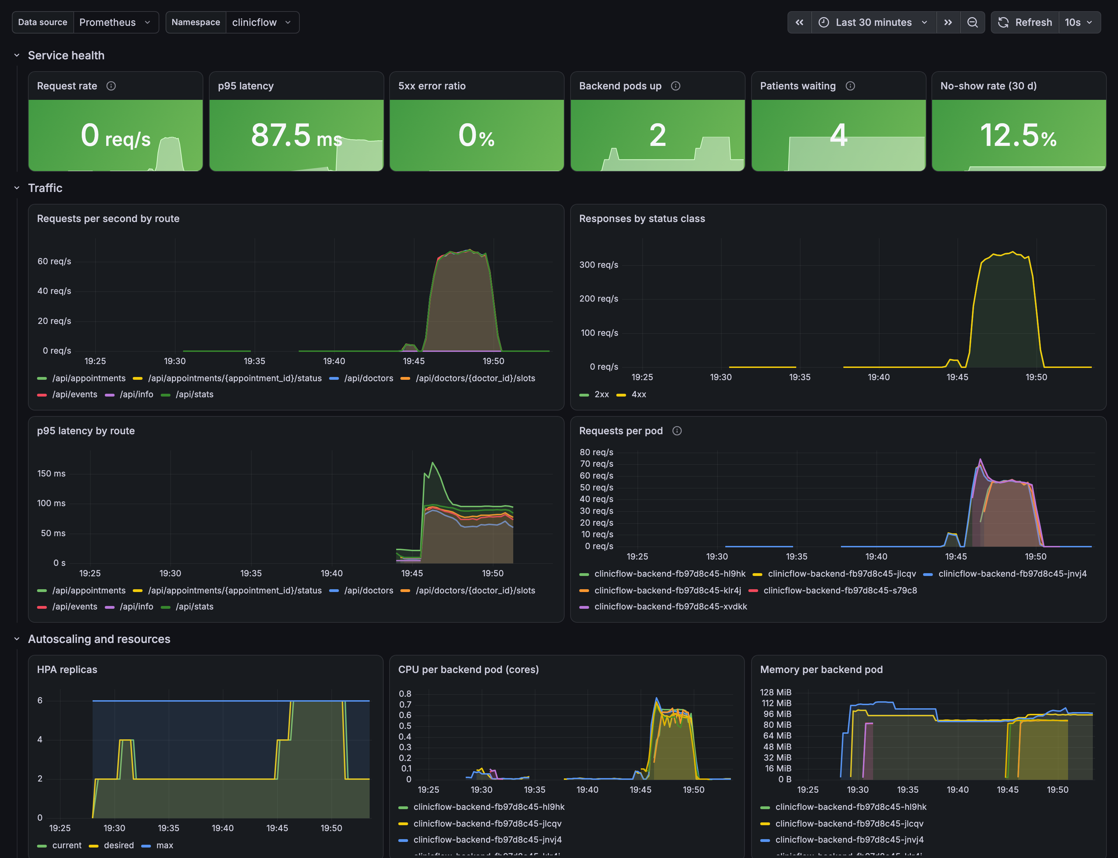
Observability: from HTTP latency to no-show rate
/metrics: requests and latency per route, buckets from 5 ms
Clinic gauges read from the DB at scrape time: today by status, patients waiting, 30-day no-show ratio
ServiceMonitor → Prometheus scrapes every pod (6/6 UP under load)
7 alerts: backend down, 5xx, p95, HPA at max, no-show rate, waiting room, double-booking bursts
19-panel Grafana dashboard shipped in the chart as code
Notes:
For observability, the backend exposes request and latency metrics, plus clinic metrics read from the database: appointments by status, patients waiting, and the thirty-day no-show rate. Prometheus scrapes every pod. Seven alert rules cover availability and the clinic itself, and the Grafana dashboard ships inside the chart.

Slide 12




Key learnings
A gate is only as fresh as its cache
Git is the deploy interface
apk upgrade sat in a cached layer; removing the dependency was the real fix.
CI writes the SHA, Argo CD applies it. Argo renders Helm without a Helm release, so staging is the one that shows up in helm list.
One owner per field
Check what the dashboard says
The HPA owns replicas; Argo CD ignores them. The API owns opening hours; the UI reads them.
A stacked panel turned a few expected 409s into an apparent flood of errors.
Notes:
What I learned. A security gate is only as fresh as its layer cache. Git is the deploy interface: the pipeline writes, and Argo CD applies. Every field should have exactly one owner. And a dashboard can mislead: a stacked panel made a few expected 409s look like a flood of errors.

Slide 13
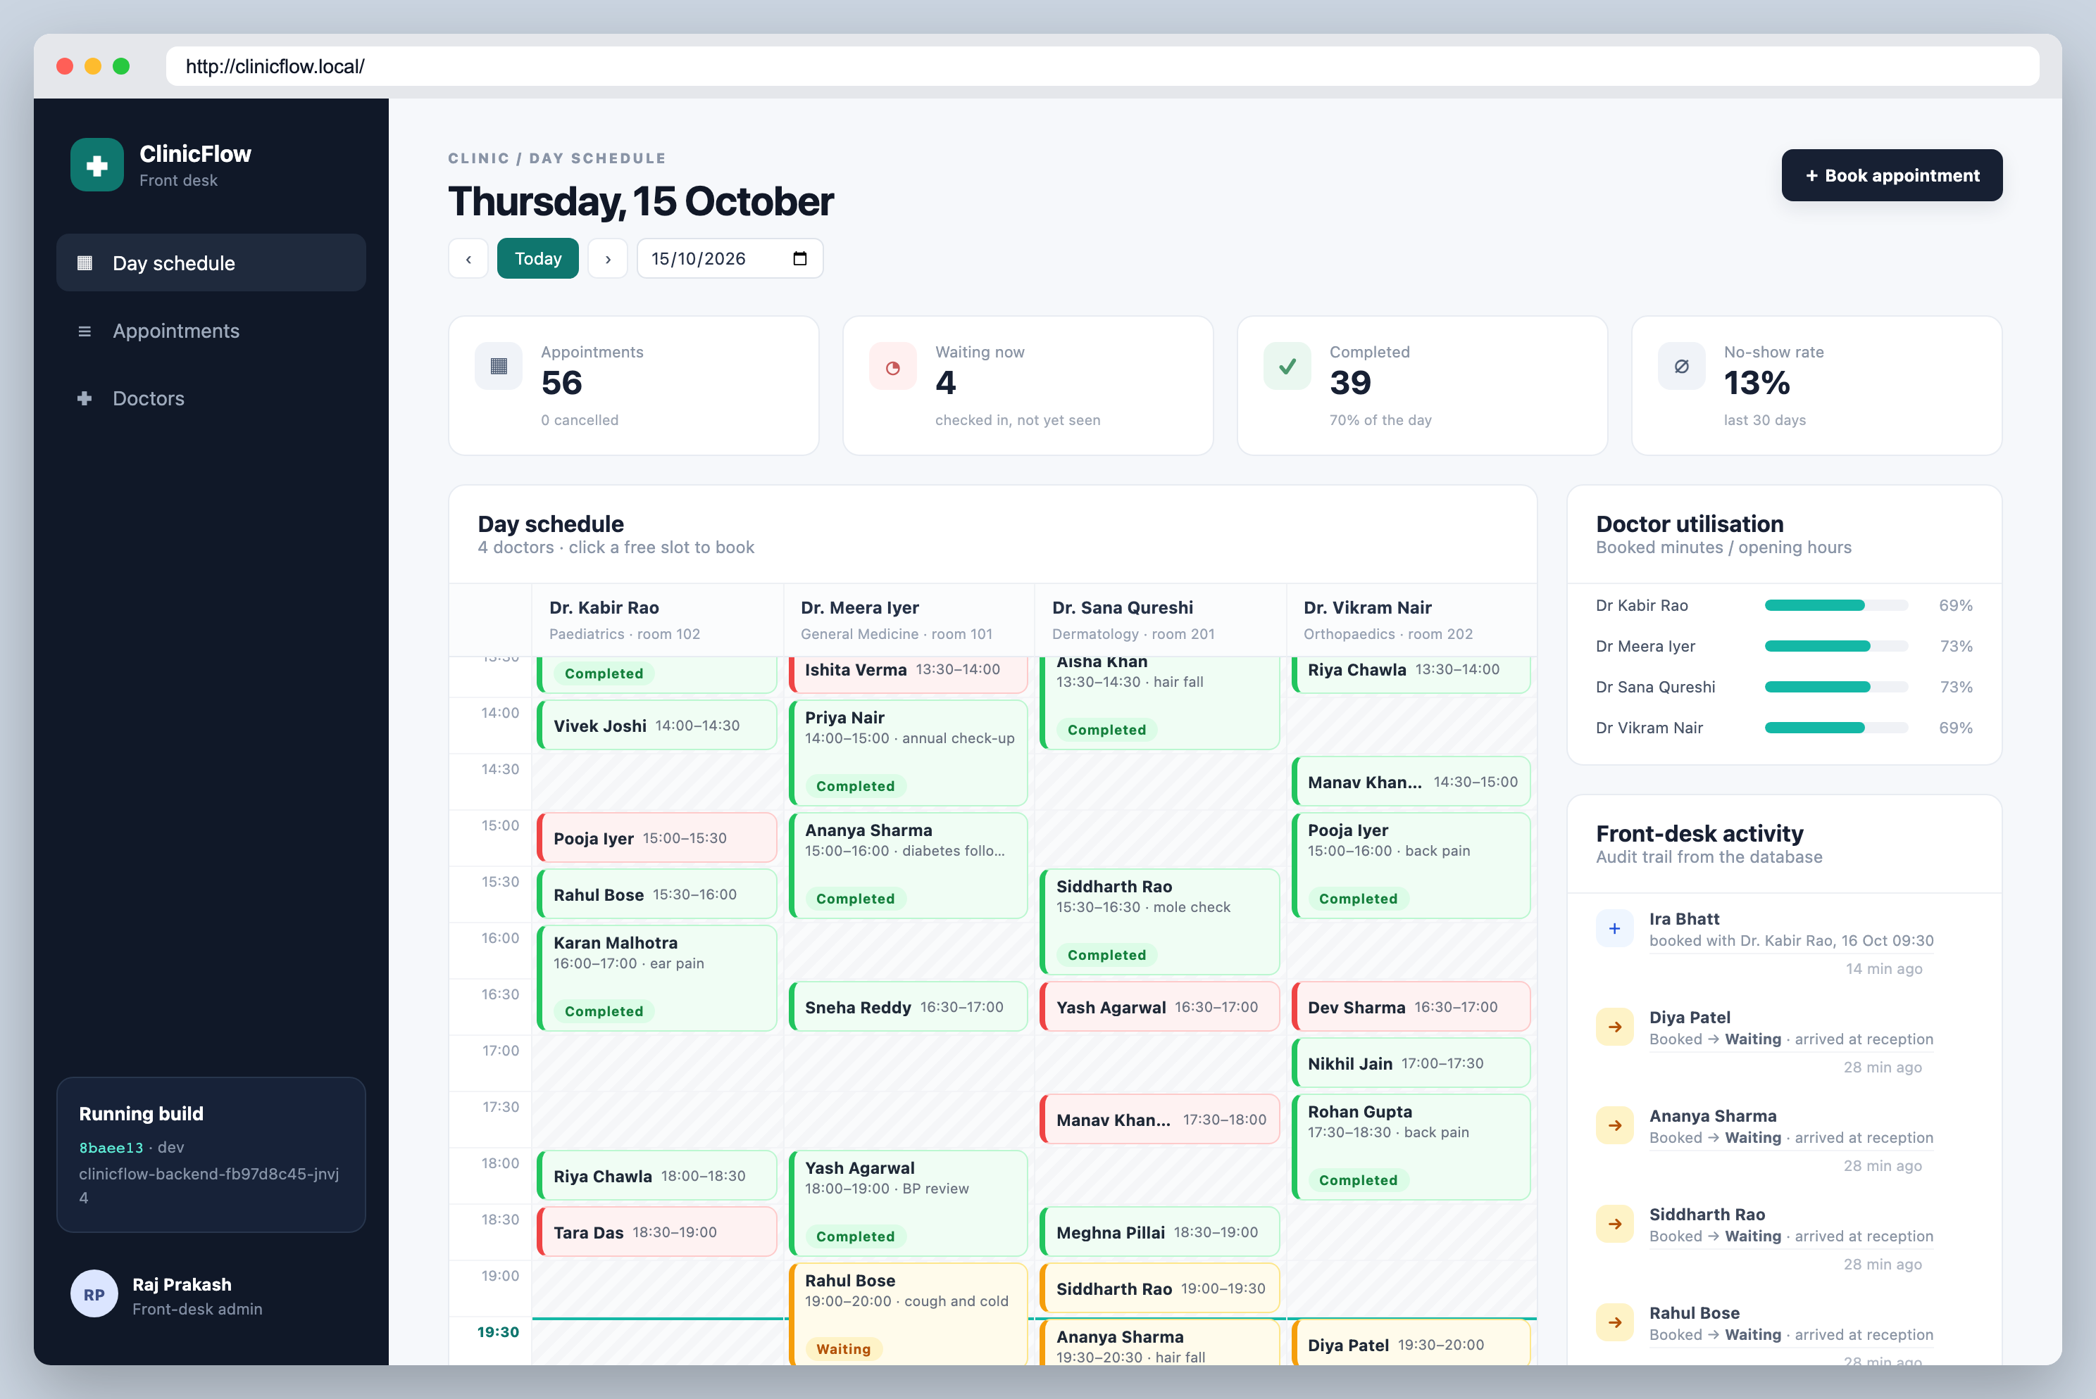
Limitations and next steps
1
No real AWS run
Terraform ran on moto; the next step is a real apply with credentials, then destroy
2
No authentication
Patient data needs OIDC at the Ingress and TLS before any real use
3
Single PostgreSQL
No backups; production values expect Amazon RDS
4
Polling GitOps
Running today: kind cluster, Argo CD-managed, build shown in the sidebar
Argo CD checks GitHub every 60 s; a webhook needs a reachable cluster
Notes:
The limitations are honest ones. There was no real AWS run, there is no authentication yet, the database is a single instance, and GitOps polls every minute. Next would be a real EKS apply, single sign-on at the Ingress, and a managed database.

Slide 14
Thank you
Repository
github.com/RajPrakash681/devsecops-python
Demo video
demo/ClinicFlow-demo.mp4
Evidence
README.md, 34 screenshots from real runs
Pipeline
GitHub Actions, CI/CD - ClinicFlow
Raj Prakash · 24BCS10328
Notes:
Thank you. Everything is in the repository, with the README mapping each rubric item to evidence. Now let me show it running live.

