Slide 1

Presentation On
Mathematical Morphology in Medical Image Processing
Submitted By
Raj Rajeshwari Kayan
For the award of
Diploma in Medical Image Processing
Under the Supervision Of
Dr. K.F. Rahman

Slide 2
Mathematical Morphology
Morphology generally denotes a branch of biology that deals with structure and form of animals and plants
Mathematical Morphology originated in 1960s with the works of Matheron and Serra from geometric point of view.
It initally dealt with binary images and was later generalized to gray scale images in mid-1980s.

Slide 3
Mathematical Morphology
Used in pre and post processing techniques, such as morphological filtering, thinning and pruning.
Is a useful tool for:
Region shape extraction
Edge detection
Skeletons
Convex hulls
Extraction of connected components
Thinning
Thickening, etc.

Slide 4
Mathematical Disciplines
Set Theory
Order Theory
Algebra
Topology

Slide 5
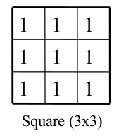
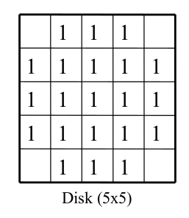
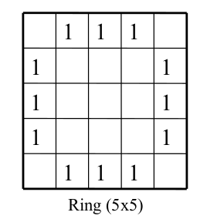
Structure Elements
Fundamental component of mathematical morphology.
Swept over image.
Directly determines the geometric information to be analyzed and processed.
SE can be: Square, ring or disk.
Origin which is the centre pixel of SE, identifies the pixel being processed.

Slide 6
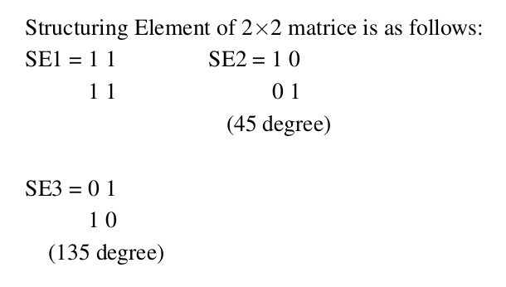
Structure Element
Horizontal SE: sensitive to vertical edges
Vertical SE: sensitive to horizontal edges
Small SE: weak ability to detect noise but can detect edge details efficiently
Large SE: detects noise well but the edges detected are thicker than actual edge

Slide 7
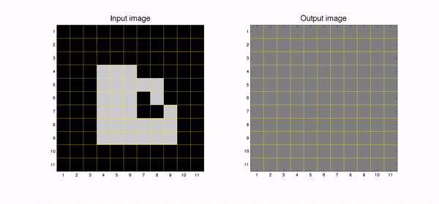
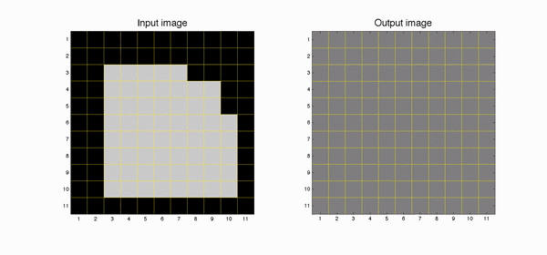
Working of SE
Dilation
Erosion

Slide 8
Morphological Operations
Basic Operations
Dilation (expands features)
Erosion (shrinks features) Dilation and Erosion are duals.
Opening
erosion followed by dilation(smooths the contour, breaks narrow isthumuses, and eliminates thin protrusions)
Closing
dilation followed by erosion(also smooths the contours, but fuses narrow breaks and long thin gulfs, eliminates small holes, and fills contour gaps)

Slide 9
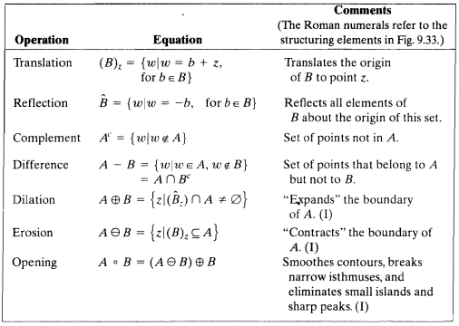
SUMMARY OF MORPHOLOGICAL OPERATIONS AND THEIR PROPERTIES

Slide 10
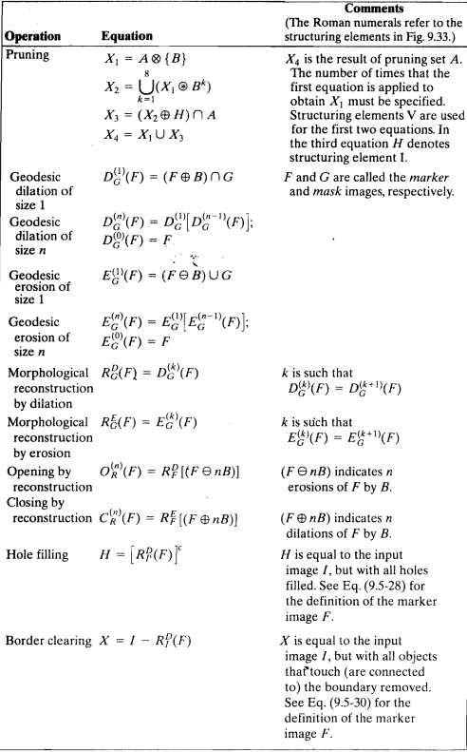
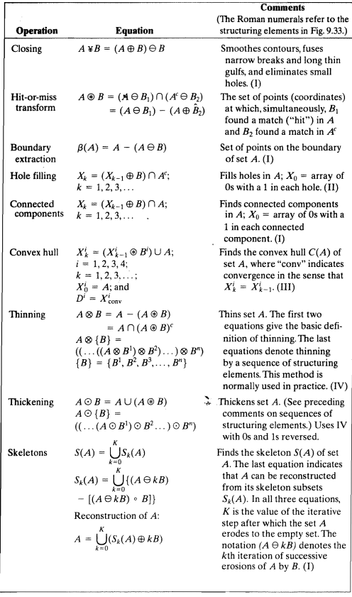

Slide 11
Some Concepts
Order morphology is the generalization of mathematical morphology.Order morphology becomes general morphology by introducing sequential statistics based on basic mathematical morphology, which is an application of limited data ordering.
In the mathematical morphology theory, images are treated as sets.
Morphological transformations, derived from Minkowski addition and subtraction are used to extract features in images.

Slide 12
Some Concepts(cont.)
Some traditional operators are as below:
1. First order derivative / gradient methods:
Roberts operator
Sobel operator
Prewitt operator
2. Second order derivative:
Laplacian
Laplacian of Gaussian
Difference of Gaussian
3. Optimal edge detection:
Canny edge detection

Slide 13
Some Concepts
Discrete wavelet transform (DWT) is a configuration of a set of discrete wavelets where set of discrete wavelet form an orthogonal basis function to decompose signal i.e. discrete wavelet transform disintegrate discrete time signal into discrete wavelet representation. DWT has many important properties which made it different from other techniques, these properties are:
Flexibility
Easier to filter in and out from a non-stationary data
Good compression ratio without loss of original information
Provides influential vision in time and frequency appearances of the image

Slide 14
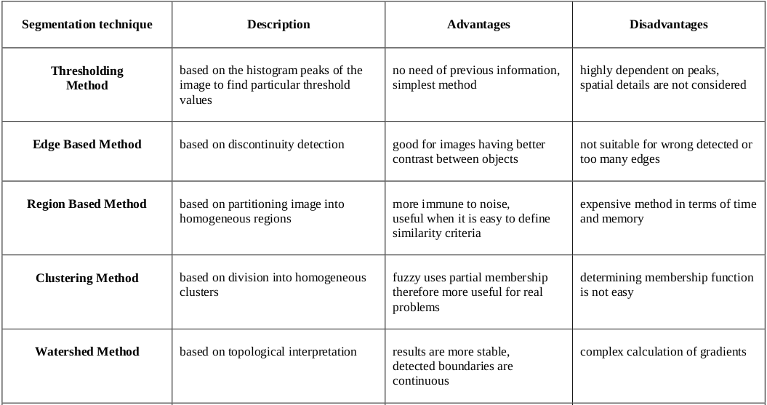
Comparision of Various Techniques

Slide 15
Advantages of using Mathematical Morphology
* better image information retaintion
* efficient noise suppression
* easy and simple implementation
* parallel computing
* least possible processing time
* efficient and accurate feature extraction

Slide 16
Literature Review
B. Devkota et al. proposed a method for early stage brain tumor detection using mathematical morphology. Mathematical morphological based segmentation was performed on pre-processed images, instead of directly performing FCM algorithm as proposed by Dandil.
The proposed methodology is implemented on a set of 19 mri brain images affected by tumor (Glioma, Metastatic_Adenocarcinoma, Meningioma or Sarcoma) of varying sizes.
Conclusion:
* MM operations preserve image details and information better than FCM.
* Faster as less computational time is involved; 10 times faster than FCM which use iteative approach.
* Accuracy 92% only.
* Cannot classify the cancerous tumors into different stages(I,II,III,IV).
* Futher enhancement needed in terms of pre-processing results and elimination of false objects.
* Cannot effectively distinguish between large and small masses.
* Tested on limited image set; not tested on larger data set with ample variations which could skew the conclusion.

Slide 17
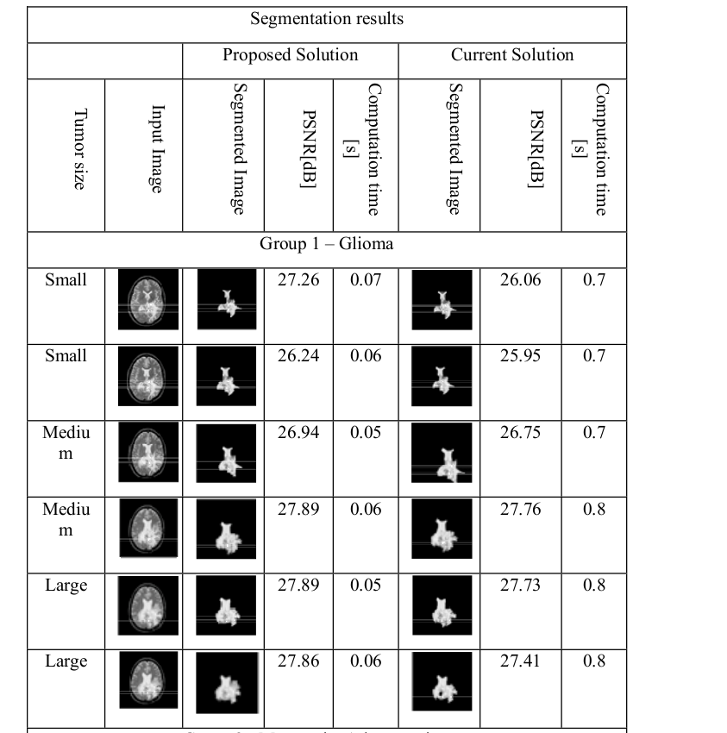
Result of B. Devkota,et al. Method

Slide 18
Literature Review
Kittipol Wisaeng,et al. Proposed a novel exudate detection methodology using histogram matching is carried out to adjust the values of the original image to that of the reference image(requires manual interference, hence work can done in the direction of making it real-time).
Then local contrast enhancement followed by median filtering is appplied to enhance and denoise the image.(authors have tried to counter the effect of enhancement of noise by median filter; an alternative can be proposed for denoising first and then carring out the enhancement process).Further the researcher had empirically decided upon 49x49 as the window size for contrast enhancement (other values for the window size might give better results).
The color space is decided which is best suited for detection of exudates followed by the final pre-processing step- detection of the optical disc(since optical disc can be wrongly cassified as an exudate).
The authors give a thorough analysis of detection of exudates(on a set of 200, 700x500 pixel, 24bit-JPEG retinal images) using Naive Bayesian classifier, Support Vector Machines and the fuzzy c means clustering method(FCM requires predetermined parameters which makes its accuracy prone to error with new images), whose output is subjected to mathematical morphological operations(dilation, erosion, opening and closing) to enhance the overall accuracy(97.45%), sensitivity(97.12%) and specificity(97.89%) of the the suggested method.

Slide 19
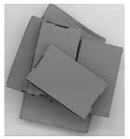
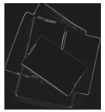
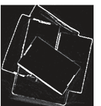
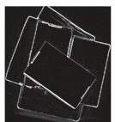
Literature Review
Hong-xin Zhang, et al. Proposed a method for edge detection based on fusion of wavelet transformation and modified mathematical morphology with adaptive structural elements. Gray scale adaptive thresholding is applied on fused image. The algorithm can effectively
Restrain noise
Detect weak edges better
Retain image information
However, it has only been tested on gray scale images. The effeciency of algorithm has not been tested on medical images and is an area of research.
Original image
Wavelet transform
Improved morphological
Proposed method

Slide 20
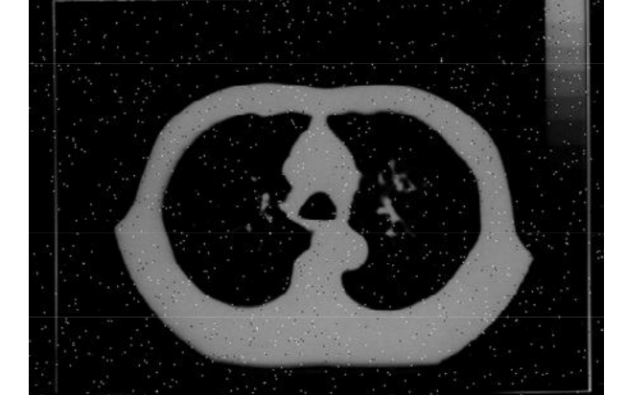
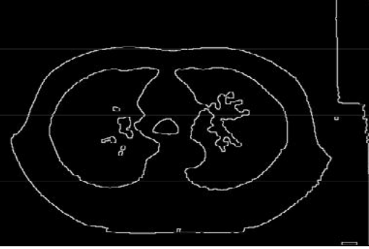
Literature Review
Sivappriya T, et al. Proposed a method for detection of cancer cells in lung CT and MRI images induced with salt and pepper noise. Opening-closing operation is used filter noise. Then smoothening is carried out by first closing and then dilation. The perfect image edge will be got by performing the difference between the processed image by above process and the image before dilation. Mathematical operators are used to detect the edges, opening is used to detect foreground and closing to detect background in the image. Finally, binary gradient technique was applied to detect the cancerous cell.

Slide 21
Literature Review
Hailong Huang, et al. Proposed a method edge detection in liver CT using improved multiple order morphology transformation, which have the ability to filter noise more effectively as compared to simple multiple order morphology transform. Authors have also analyzed the influence of SE and Different percentiles. Multiple order morphology transformation is an expansion of basic mathematical morphology transformation. Analysis is done by observing the influence of different structuring elements and different percentiles using entropy, variance and SNR on edge detection.

Slide 22
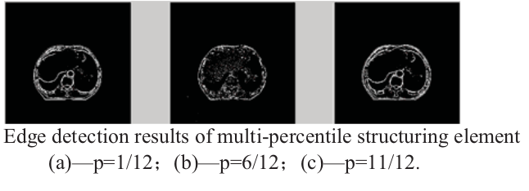
Literature Review
Structuring element of different origin position * improve efficiency and precision * saves memory space and operation time.
Multiple order morphology transformation using: -small percentile narrow the detect target, the edge detected is inner edge. -big percentile expand the detect target, so the edge detected is outer edge.
The proposed methodology however, requires manual interference for setting the percentile and the type of multi structural element to be used, work can be carried on in the direction to make it automated.

Slide 23
Literature Review
Shilpi Gupta, et al. Proposed a method of edge detection using modified discrete wavelet transform(DWT) with HAAR wavelet. Then double thresholding is performed to find edges in multi-scale edge detector. Finally, iterative morphological thinning is performed to retain image information and remove foreground pixels. Due to presence of noise some pixels are miss map in the process of edge detection using DWT. The algorithm was tested on only 2 gray scale images of 128x128 resolution.

Slide 24
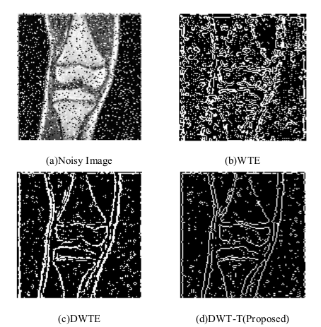
Literature Review
Result of method proposed by Shilpi Gupta, et al.

Slide 25
Literature Review
Xinghui Zhang, et al. Proposed an adpative algorithmof color edge detection based on multiple structure and multi-scale elements in HSI color space. Firstly, morphological edge detection is performed using different structure and different scale elements to hue, saturation and intensity respectively. Then, according to the weight derived from information entropy, the color edge information is obtained by combining component's edge information. The proposed algorithm makes full use of the hue, saturation and intensity information to effectively eliminate the noise and adaptively extract complete edge information. The proposed method effectively eliminates the problem of oversegmentation. The method is studied over non medical images only, but a study can be carried forward to test it’s accuracy for medical images.

Slide 26
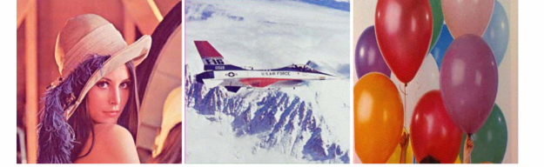
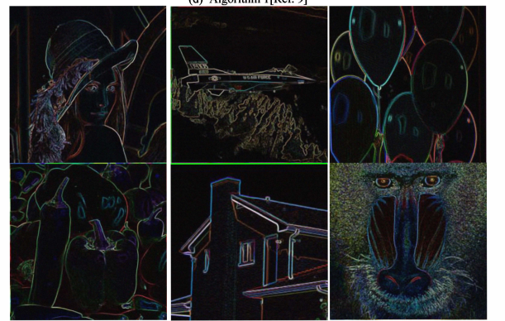
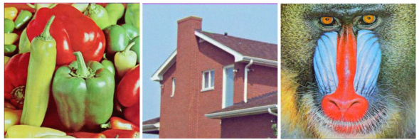
Literature Review
Results of the proposed method

Slide 27
Refernces
Jean-Charles Pinoli, Mathematical Foundations of Image Processing and Analysis 1.
Jiri Jan, Medical Image Processing, Reconstruction and Restoration Concepts and Methods.
Gonzalez and Woods, Fundamentals of Digital Image Processing.
Devkota, B., Alsadoon, A., Prasad, P. W. C., Singh, A. K., & Elchouemi, A. (2018). Image segmentation for early stage brain tumor detection using mathematical morphological reconstruction. Procedia Computer Science, 125, 115-123.
Wisaeng, K., & Sa-Ngiamvibool, W. (2018). Improved fuzzy C-means clustering in the process of exudates detection using mathematical morphology. Soft Computing, 22(8), 2753-2764.
Zhang, H. X., Li, J. Y., Wang, M. Z., & Li, H. (2016, August). Image edge detection based on fusion of wavelet transform and mathematical morphology. In 2016 11th International Conference on Computer Science & Education (ICCSE) (pp. 981-984). IEEE.
Sivappriya, T., & Muthukumaran, K. (2014, March). Cancer cell detection using mathematical morphology. In International Journal of Innovative Research in Computer and Communication Engineering (Vol. 2, No. 1, pp. 3717-3725).
Rani, S., Bansal, D., & Kaur, B. (2014). Detection of edges using mathematical morphological operators. open transactions on information processing, 1(1), 17-26.
Huang, H., & Guo, J. (2014, December). Application of multiple order morphology transformation on edge detection for liver CT image. In 2014 IEEE 7th Joint International Information Technology and Artificial Intelligence Conference (pp. 107-110). IEEE.
Gupta, S., & Sunkaria, R. K. (2017, December). Real-time salt and pepper noise removal from medical images using a modified weighted average filtering. In 2017 Fourth International Conference on Image Information Processing (ICIIP) (pp. 1-6). IEEE.

