Slide 1
Download and install python
https://www.python.org/

Slide 2
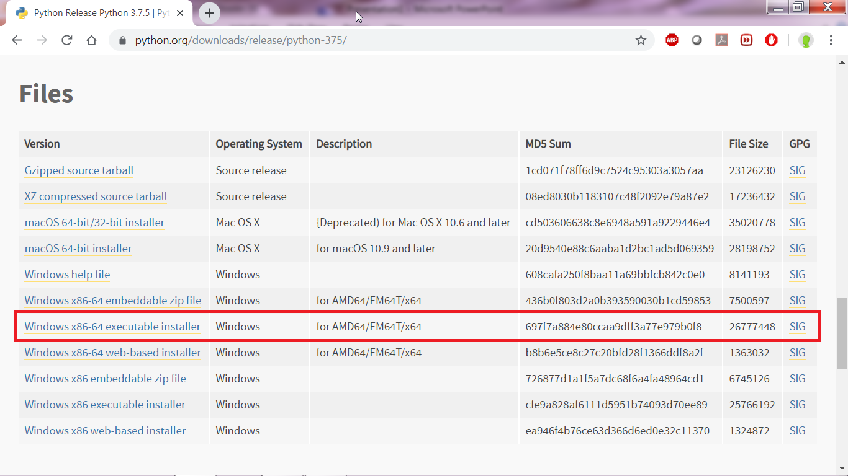
https://www.python.org/downloads/release/python-375/
Click the URL
Click the above link

Slide 3
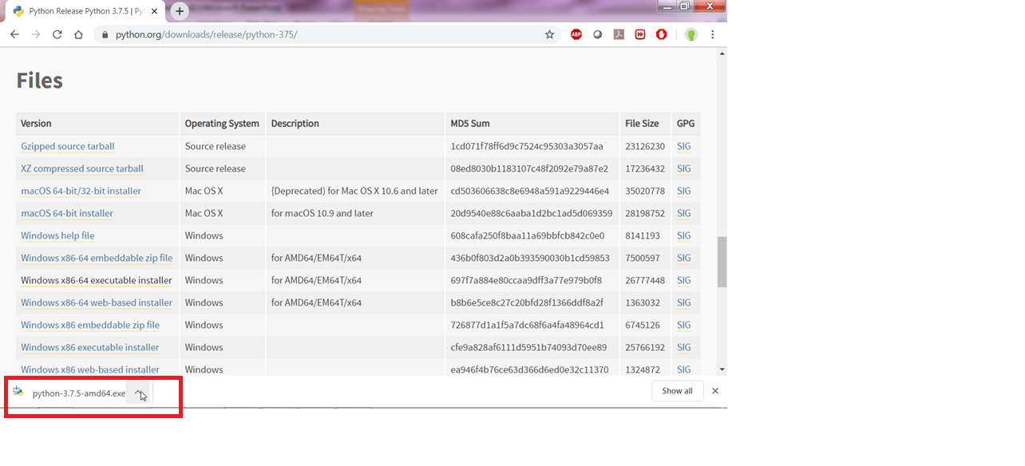

Slide 4
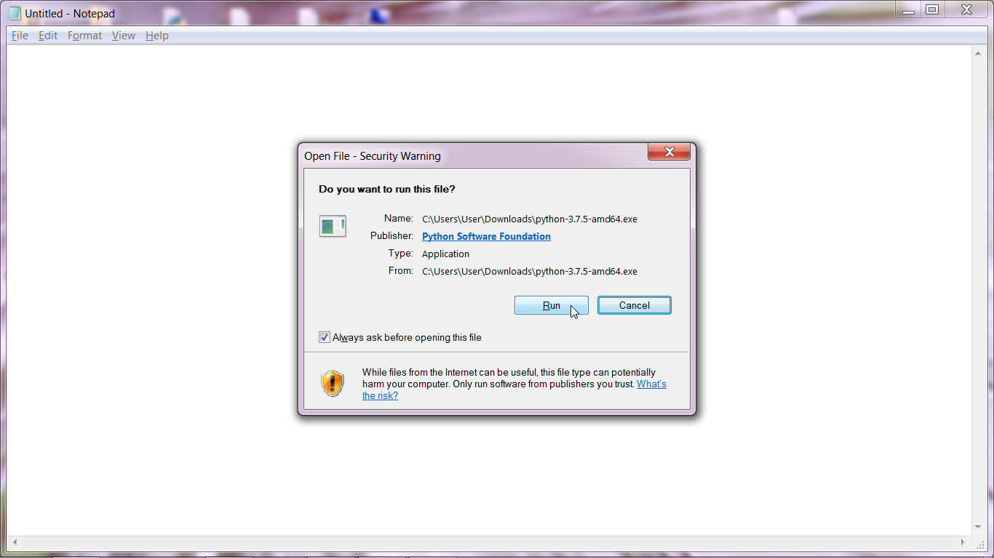
Click Run button

Slide 5
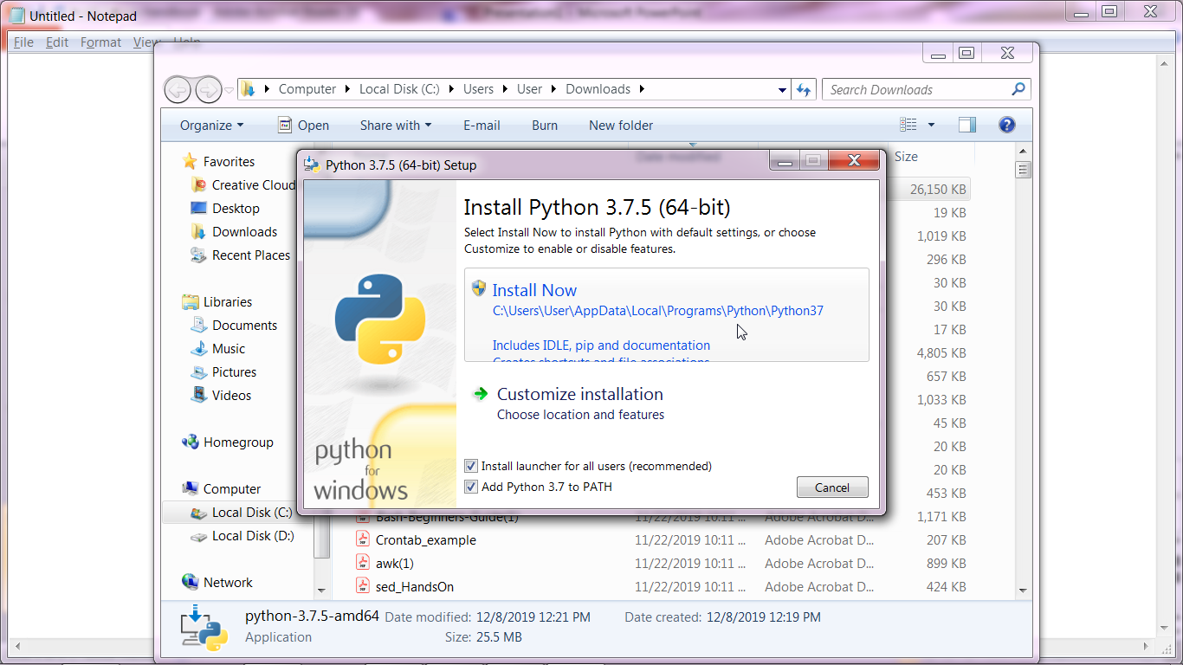
Select Install Now
Select both check boxs

Slide 6
Test your python version
C:\Users\User>python -V
Python 3.7.5
C:\Users\User>python --version
Python 3.7.5
C:\Users\User>
After completion of successful installation, open a new command prompt
and type the above commands.

Slide 7
Linux
sudo yum install python3
( oracle Linux and RHL )
sudo apt-get install python3
( ubuntu )
root@hostname~]# python3 {Press Enter}

Slide 8
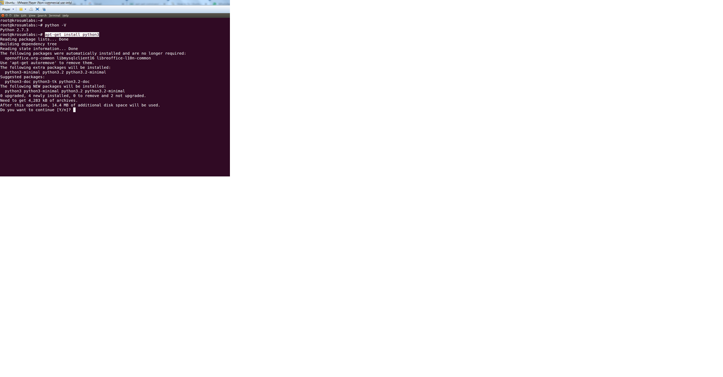

Slide 9
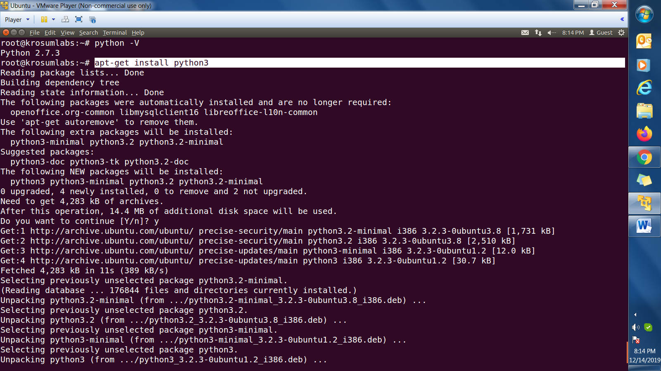

Slide 10
Test Python Version
root@krosumlabs:~# python -V
  Python 2.7.3
root@krosumlabs:~# python3 -V
  Python 3.7.5
root@krosumlabs:~#

