Slide 1
Python-json

Slide 2
JavaScript Object Notation
JSON is text, written with JavaScript object notation.
JSON is a syntax for storing and exchanging data.
JSON is a text-based format which facilitates data interchange between diverse applications.
For example, to transmit and receive data between a server and web application in JSON format.

Slide 3
JSON
The most common JSON entity that you will encounter is an object: a set of key-value
{
"firstName": "Jane",
"lastName": "Doe",
"hobbies": ["running", "sky diving", "singing"],
"age": 35,
"children": [
{
"firstName": "Alice",
"age": 6
},
{
"firstName": "Bob",
"age": 8
}
]
}
JSON supports primitive types, like strings and numbers, as well as nested lists and objects.

Slide 4
Python Supports JSON
Python has a built-in package called json, which can be use to work with JSON data.
Import the json module
import json

Slide 5
The process of encoding JSON is usually called serialization.
This term refers to the transformation of data into a series of bytes (hence serial) to be stored.
deserialization is the reciprocal process of decoding data that has been stored or delivered in the JSON standard.
encoding is for writing data to disk, while decoding is for reading data into memory.

Slide 6
Parse JSON - Convert from JSON to Python
We can parse json string by using the json.loads() method.
The result will be a Python dictionary.
>>> import json
>>> v='{"name":"root","passwd":"Password"}'
>>> type(v)
<class 'str'>
>>>
>>> json.loads(v)
{'name': 'root', 'passwd': 'Password'}
>>>
>>> type(json.loads(v))
<class 'dict'>
>>>

Slide 7
Convert from Python to JSON
We can convert python object into a JSON string by using the json.dumps() method.
>>> import json
>>> mydict={"name":"root","dept":"Admin"}
>>> type(mydict)
<class 'dict'>
>>>
>>> # convert into json
...
>>> json.dumps(mydict)
'{"name": "root", "dept": "Admin"}'
>>>
>>> type(json.dumps(mydict))
<class 'str'>

Slide 8
Python objects are translated to JSON
Python | JSON
dict | object
list, tuple | array
str | string
int,float | number
True | true
False | false
None | null

Slide 9
We can convert following python objects of the following types, into JSON strings
dict
list
tuple
string
int
float
True
False
None

Slide 10
Convert Python objects into JSON strings, and print the values:
>>> import json
>>> print(json.dumps({"name": "John", "age": 30}))
{"name": "John", "age": 30}
>>> print(json.dumps(["apple", "bananas"]))
["apple", "bananas"]
>>> print(json.dumps(("apple", "bananas")))
["apple", "bananas"]
>>> print(json.dumps("hello"))
"hello"
>>> print(json.dumps(42))
42
>>> print(json.dumps(31.76))
31.76
>>> print(json.dumps(True))
true
>>> print(json.dumps(False))
false
>>> print(json.dumps(None))
null
>>>

Slide 11
Convert a Python object containing all the legal data types
import json
x = {
"name": "John",
"age": 30,
"married": True,
"divorced": False,
"children": ("Ann","Billy"),
"pets": None,
"cars": [
{"model": "BMW 230", "mpg": 27.5},
{"model": "Ford Edge", "mpg": 24.1}
]
}
print(json.dumps(x))

Slide 12
File Handling
with open("data_file.json", "w") as write_file: json.dump(data, write_file)
Note that dump() takes two positional arguments:
(1) the data object to be serialized, and
(2) the file-like object to which the bytes will be written.

Slide 13
json_string = json.dumps(data)
Notice that the file-like object is absent since you aren’t actually writing to disk.
Other than that, dumps() is just like dump().

Slide 14
indent
indent keyword argument to specify the indentation size for nested structures.
>>> json.dumps(data)
>>> json.dumps(data, indent=4)

Slide 15
separators
separators keyword argument.
By default, this is a 2-tuple of the separator strings (", ", ": "), but a common alternative for compact JSON is (",", ":").

Slide 16
import json
import requests
response = requests.get("https://jsonplaceholder.typicode.com/todos")
todos = json.loads(response.text)

Slide 17
Example
# Define a function to filter out completed TODOs
# of users with max completed TODOS.
def keep(todo):
is_complete = todo["completed"]
has_max_count = todo["userId"] in users
return is_complete and has_max_count
# Write filtered TODOs to file.
with open("filtered_data_file.json", "w") as data_file:
filtered_todos = list(filter(keep, todos))
json.dump(filtered_todos, data_file, indent=2)

Slide 18
Parsing single json value
{
"maps": [
{
"id": "blabla",
"iscategorical": "0"
},
{
"id": "blabla",
"iscategorical": "0"
}
],
"masks": {
"id": "valore"
},
"om_points": "value",
"parameters": {
"id": "valore"
}
}
import json
from pprint import pprint
with open('data.json') as f:
data = json.load(f)
pprint(data)
data["maps"][0]["id"]
data["masks"]["id"]
data["om_points"]

Slide 19
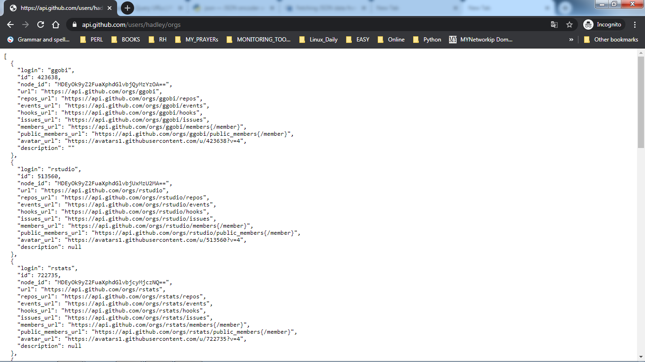
https://api.github.com/users/hadley/orgs

Slide 20
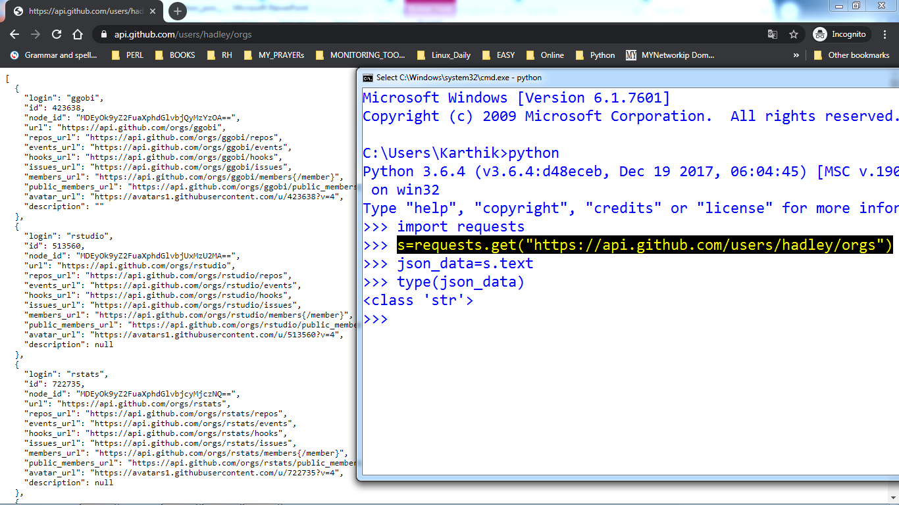

Slide 21
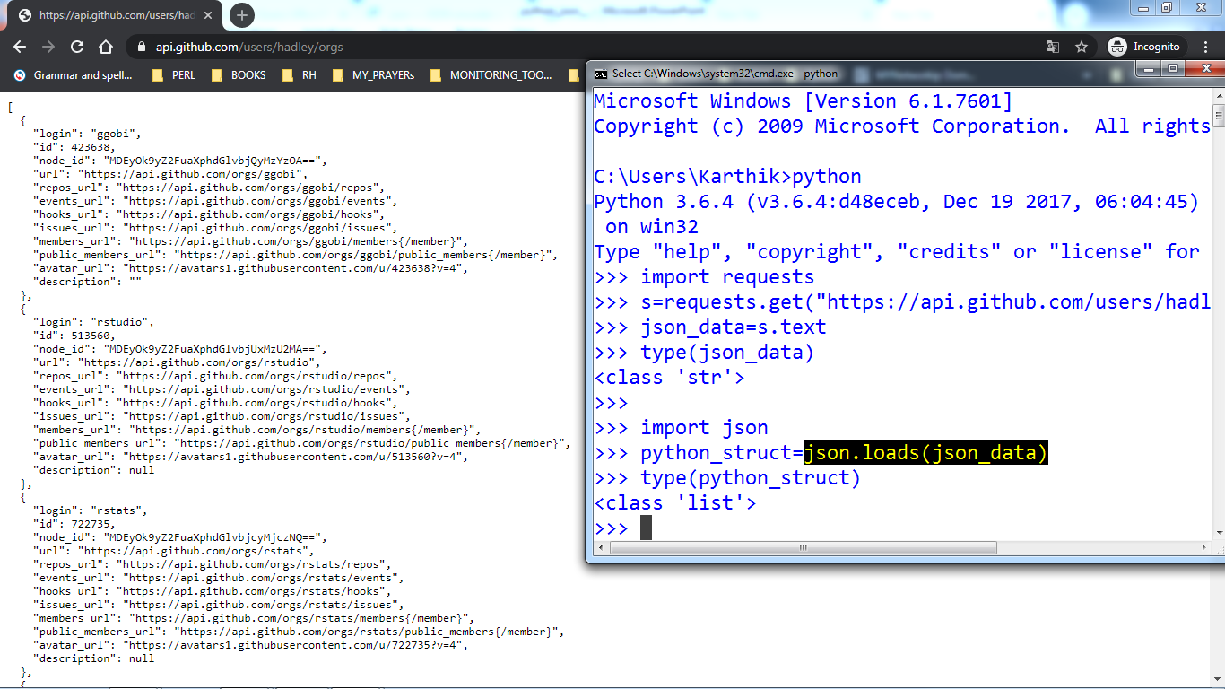

Slide 22
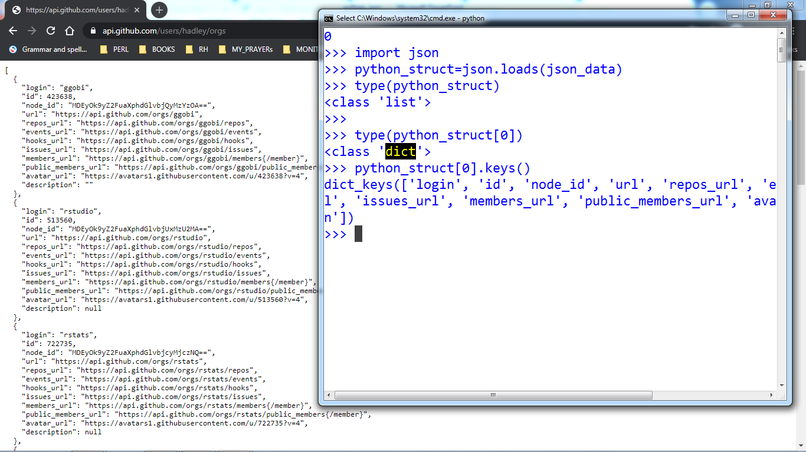

Slide 23
