Slide 1







Current and Future Trends for Programming Languages
Raj Vijay Shethna
August 10, 2024

Slide 2



OUTLINE
Executive Summary
Introduction
Methodology
Results
Visualization – Charts
Dashboard
Discussion
Findings & Implications
Conclusion
Appendix

Slide 3

EXECUTIVE SUMMARY
Programming Languages are gaining a lot of attention in recent times as the technology is advancing at an exponential rate.
The research shows the impact these languages have over time with the flexibility to analyze the demographics at the same time.
The report focusses on the following aspects:
Current Technology Usage
Future Technology Trend
Demographics of the Respondents

Slide 4

INTRODUCTION
This is a research project and it gives the descriptive analysis of usage and demand of the top programming languages globally.
The analysis is done using various charts and graphs focusing on the key metrics.
The project also give an in-depth knowledge of the demographics of the survey respondents.

Slide 5

METHODOLOGY
The project uses the following datasets for the analysis purpose:
The analysis is done using correlating specific metrics using different chart types and emphasizing on the important information using word clouds and tree maps.

Slide 6
RESULTS
Using the research and analysis, the top 10 programming languages and the change in the demand next year was identified.
Similarly, top Databases, Platforms, and Web Frames were also identified for the past and the future.
Lastly, to understand the data better, demographics of the survey respondents showed demands in different countries, age groups, gender, along with their educational backgrounds.

Slide 7
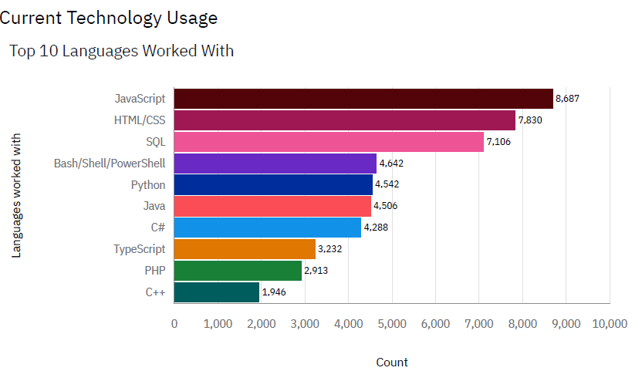
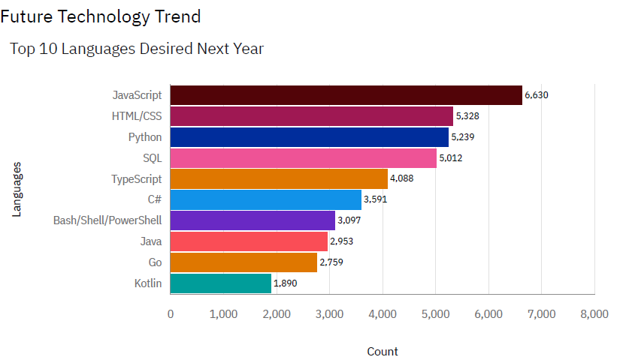
PROGRAMMING LANGUAGE TRENDS
Current Year
Next Year

Slide 8
PROGRAMMING LANGUAGE TRENDS - FINDINGS & IMPLICATIONS
Findings:
The analysis shows that the top 3 programming languages currently in use are: JavaScript, HTML/CSS, and SQL (in ranking order).
It is predicted that the third position will be taken up by Python by the next year.
Implications:
JavaScript is currently and is also predicted to be on the top of the most desired programming languages.
Demand for Python is rising.

Slide 9
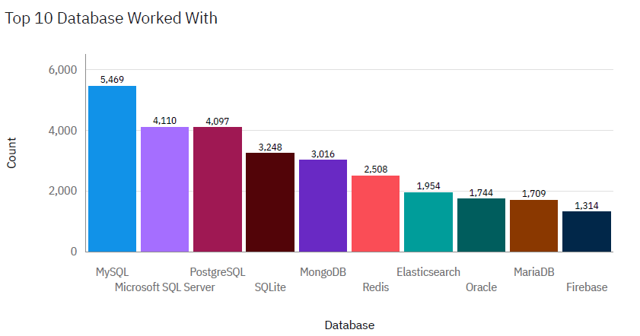
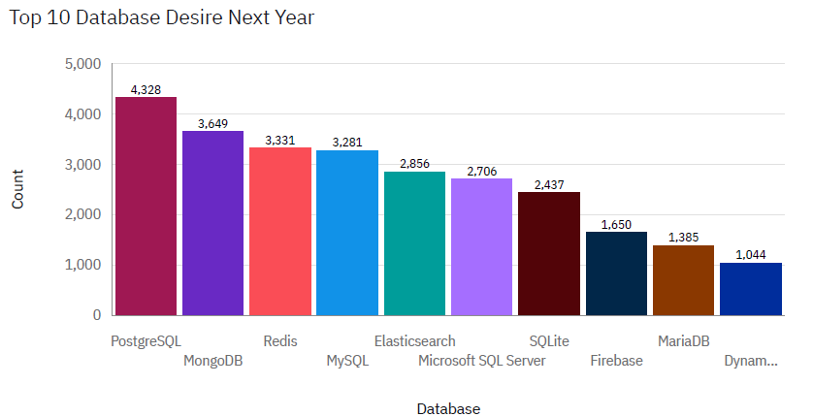
DATABASE TRENDS
Current Year
Next Year

Slide 10
DATABASE TRENDS - FINDINGS & IMPLICATIONS
Findings:
The top 3 database currently in use are: MySQL, MS SQL Server, and PostgreSQL (in ranking order).
This ranking is predicted to change as the following: PostgreSQL, MongoDB, and Redis.
Implications:
PostgreSQL is currently in the top 3 database and is predicted to stay at the top in the coming year.
MongoDB and Redis may rise in demand by next year.

Slide 11

DASHBOARD
Link to the dashboard:
Programming Languages Dashboard Link

Slide 12
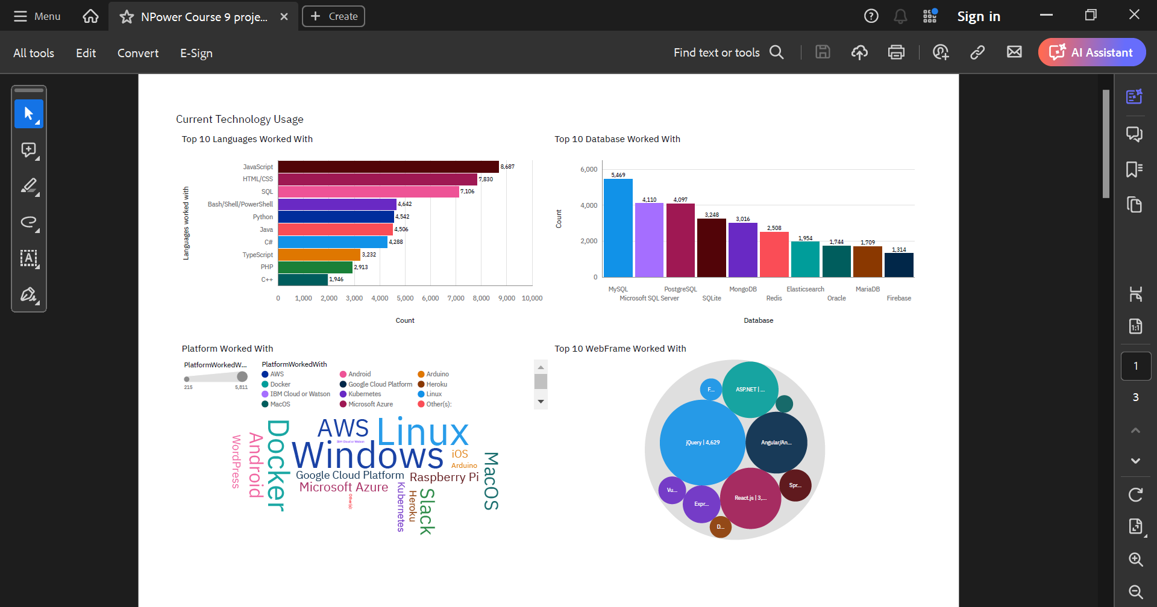
Current Technology Usage

Slide 13
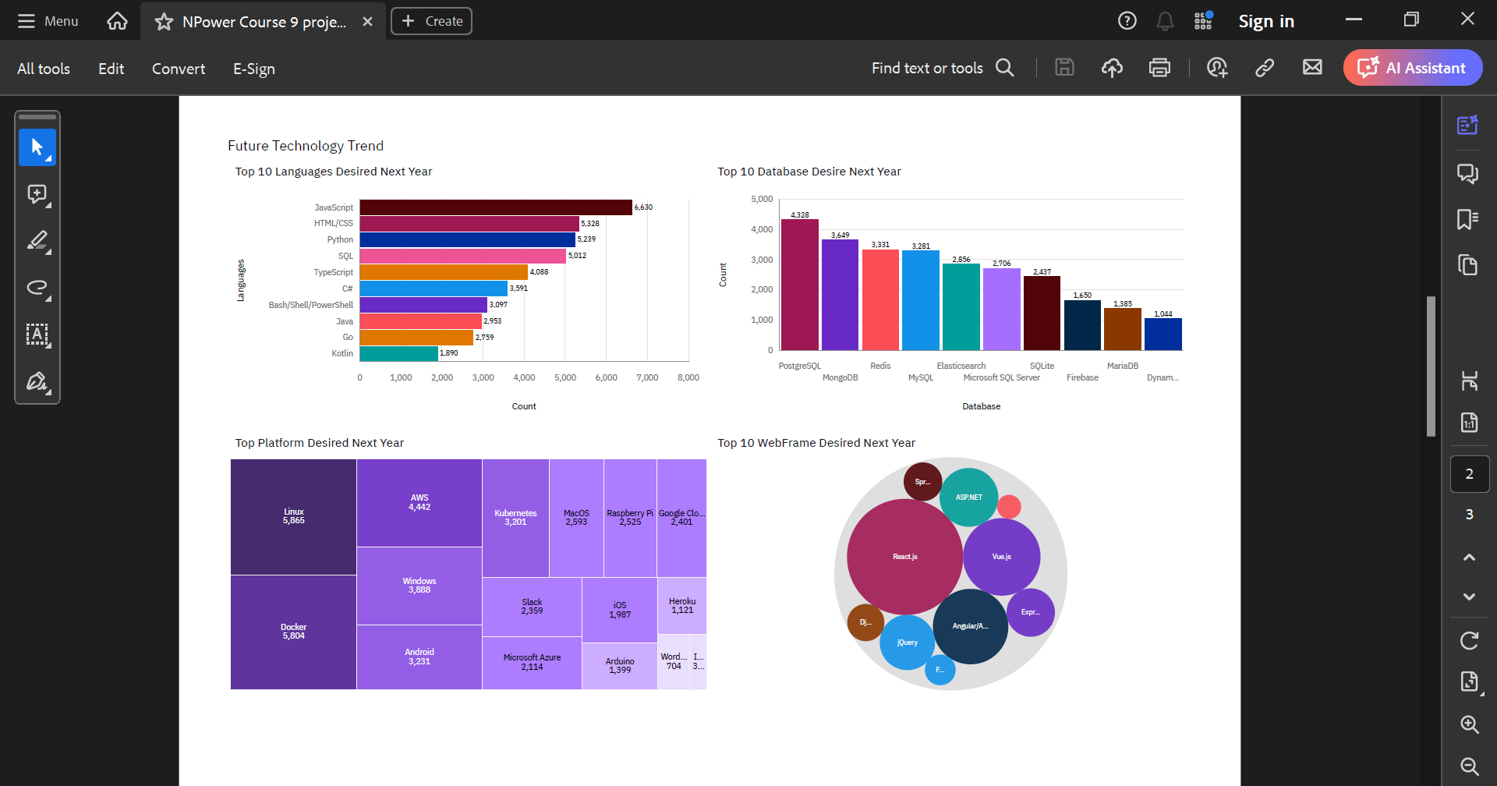
Future Technology Trend

Slide 14
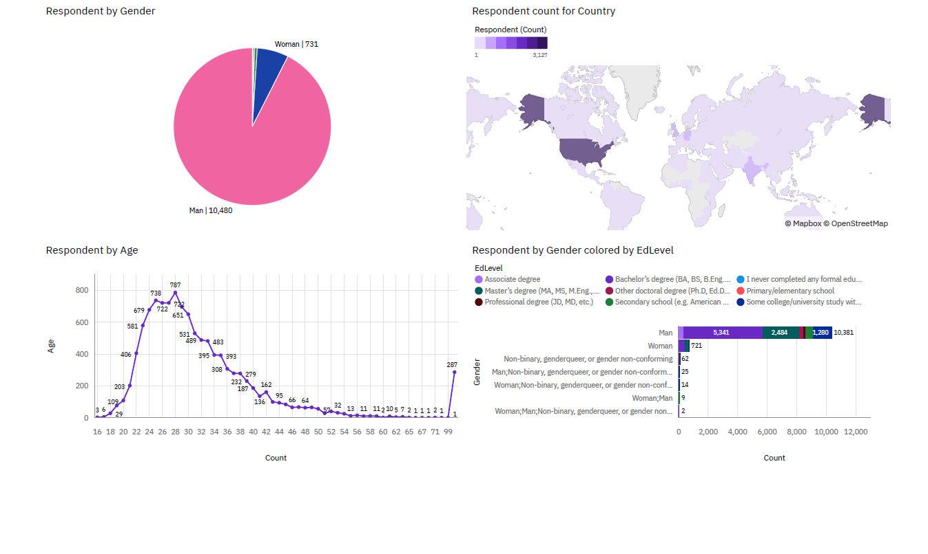
Demographics

Slide 15
DISCUSSION
Do you think learning a new language would help you in the job market or just excelling at the current language you know is enough?
What are some of the changes you need to bring at your workplace to advance your business or company goals in the future?

Slide 16
OVERALL FINDINGS & IMPLICATIONS
Findings:
JavaScript is the most used language.
PostgreSQL is currently and may remain in the top 3 databases.
Implications:
Learning JavaScript can help in expanding job scope.
Working in PostgreSQL can help to stay up-to-date with the current market demands.

Slide 17

CONCLUSION
The analysis shows that the top 3 programming languages currently in use are: JavaScript, HTML/CSS, and SQL (in ranking order); It is predicted that the third position will be taken up by Python by the next year.
The top 3 database currently in use are: MySQL, MS SQL Server, and PostgreSQL (in ranking order); This ranking is predicted to change as the following: PostgreSQL, MongoDB, and Redis.
Charts also show that the top platform currently in use are Windows, Linux, Docker, AWS, and Android. These would not change much in the coming year.
Further analysis show that the top Web Frame currently in use are jQuery, React.js, and ASP.NET. These are predicted to remain the popular ones with Vue.js rising to this group of popular languages.

Slide 18

APPENDIX
This project was completed as a part of the final Capstone Project included in the IBM Data Analyst Professional Certificate specialization on Coursera (Click here for the Link).
The above-mentioned course was part of the NPower Canada – Junior Data Analyst program.

