Slide 1
Remote Procedure Call (RPC)
Kathan Adhyaru (121022)
Raj Thakkar (121041)
Urja Patel (121058)

Slide 2
Problem Statement
Write a program using RPC mechanism that maintains a log file of the modifications of the predefined files spread across the network.

Slide 3
Introduction
RPC is a powerful technique for constructing distributed, client-server based applications.
It is based on extending the notion of conventional, or local procedure calling, so that the called procedure need not exist in the same address space as the calling procedure. The two processes may be on the same system, or they may be on different systems with a network connecting them.
Programmer has to write essentially the same code whether the subroutine is local to the executing program, or remote.

Slide 4
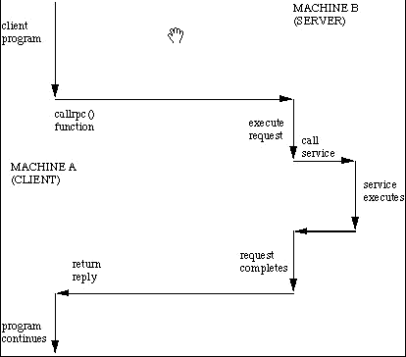
Flow of a typical RPC
The client makes a procedure call that sends a request to the server and waits. The thread is blocked from processing until either a reply is received, or it times out. When the request arrives, the server calls a dispatch routine that performs the requested service, and sends the reply to the client. After the RPC call is completed, the client program continues.

Slide 5
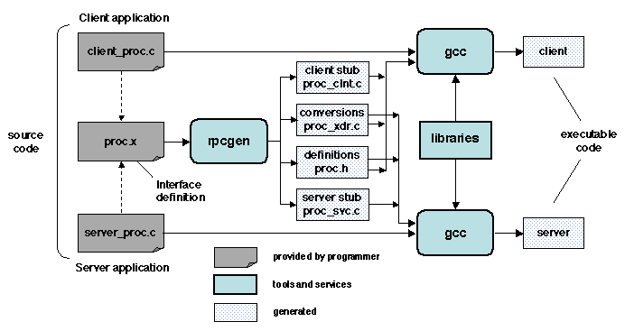
How RPC mechanism works?

Slide 6
Getting Started
Linux kernel by default does not provide any support for RPC. So we start by installing rpcgen compiler:
sudo apt-get install rpcbind
sudo apt-get install libc6-dev-bin
List of files we have to create:
prog.x - This is our IDL file that begins with some type definitions and defines the remote procedure to pass a string. We use rpcgen to compile this file
clnt.c - The calling program that calls the remote procedure
srvr.c - This is the actual program that acts as the called program ,implements the logic to perform the given task and actually establishes the RPC service

Slide 7
RPCGEN Output Files
a header file prog.h which expresses the interface information and must be included by both the client, mc.c, and the server, mc_svc_proc.c
a c file, prog_clnt.c , that will be linked with the client. It contains calls to the ONC function clnt_call which performs the calls to the remote procedures and interfaces with the XDR representation standard. This is called the Client Stub.
a c file, pro_xdr.c, that will be linked with both the client and the server, and contains code for placing/ removing information from the network messages in accordance to the XDR format. This is called the Server Stub.

Slide 8
Compile Steps
cc -o client clnt.c prog_clnt.c
cc -o server srvr.c prog_svc.c
./server
./client localhost

Slide 9
References and Bibliography
1.http://www.cs.cf.ac.uk/Dave/C/node33.html
2.http://sardes.inrialpes.fr/~krakowia/MW-Book/Chapters/Intro/intro.html
3.http://en.wikipedia.org/wiki/Remote_procedure_call
http://www.codeproject.com/Articles/4837/Introduction-to-RPC-Part

Slide 10
Thank You

