Slide 2
Introduction
OPENSUSE is a general-purpose operating system built on top of the Linux kernel, developed by the community-supported openSUSE Project and sponsored by SUSE and a number of other companies
The initial stable release from the openSUSE Project was SUSE Linux 10.0, released on October 6, 2005.
Latest: openSUSE 13.2 was released on November 4, 2014, and includes updates to Plasma 4.11, KDE Applications 4.14, GNOME 3.14.1, Firefox 33.0 and LibreOffice 4.3.2.2
The openSUSE project aims to release a new version every eight months.

Slide 3
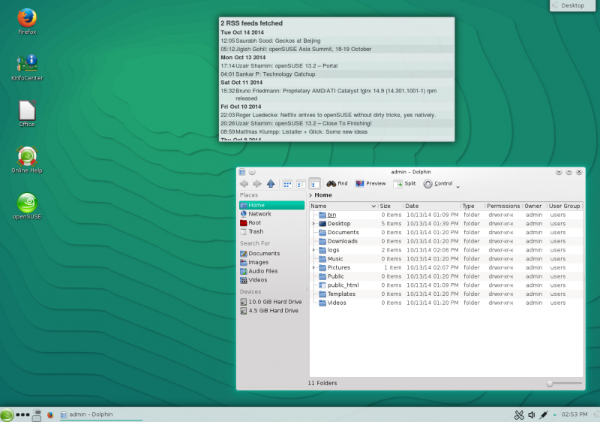
Cleaner Interface

Slide 4
Why openSUSE?
Fedora does awesome in pushing forward the Linux stack and testing new technologies.
Ubuntu does great simplifying and making things easy to use for basic tasks.
openSUSE is for those who need to "get work done: longer release cycle and more focus on stability than Fedora; better tools (OBS, Studio, YaST) and much more flexibility than Ubuntu.
Essentially, other distributions are less significant.
OpenSUSE is a bottom-up open community that maintains a German-engineering culture associated with directness and high quality standards
Notes:
From a community point of view openSUSE is far more open than Fedora, Ubuntu, Debian and many other distribution. Other distributions tend to be more tightly controlled by corporate sponsors or community governance processes that leverage technical boards, community committees, self appointed benevolent dictators (<- that's Mark Shuttleworth in his own words) and lots of bureaucracy.

Slide 5
Current Technologies
Linux kernel 3.16
The system operates with the 3.16 kernel patch. Linux 3.16 comes with improvements for Nouveau the open source driver for NVIDIA cards as well as more features for Intel and AMD graphics. This new kernel improves the performance of Btrfs, as the default file system for the root partition, and XFS.
Changes In Filesystems
Btrfs is now the new default filesystem for root, and XFS for the /home directory. The use of Btrfs, together with Snapper allows the user to recover the previous status of the system using snapshots. Also, this new version adds the ability to boot right into a snapshot to recover from corruption of important files on the system (like bash).

Slide 6
Advantages
One of the greatest advantages of using openSUSE is that you can run almost all the Desktop Environments on the same OS.
YaST (Yet another Setup Tool) - no other distribution provides such a comprehensive and integrated tool for installing, configuring and administrating the distribution.
It has rolling release called Tumbleweed. It keeps the entire system and all the softwares up-to- date without needing any re-install or traditional OS upgrade
OpenSUSE crashes lesser than Ubuntu and it's a better option if your want to install and run various software on your system.
The software.opensuse.org online portal works more or less like the Google Play store or Apple's App Store.
Notes:
A key differentiator here is YaST (Yet another Setup Tool) - no other distribution provides such a comprehensive and integrated tool for installing, configuring and administrating the distribution which handles hard disk partitioning, system setup, RPM package management, online updates, network and firewall configuration, user administration and more in an integrated interface.
The software.opensuse.org online portal works more or less like the Google Play store or Apple's App Store. It offers the most awesome interface in the world to search and install all the great software available including multiple database servers, web servers, development environments, desktop Environments, text editors, video and audio editors, 3D modelers, DTP tools and so on.
It has rolling release called Tumbleweed. It keeps the entire system up-to- date without needing any re-install or traditional OS upgrade - whether it be the desktop environments such as Plasma or Gnome, applications like LibreOffice or the kernel, everything gets updated to the newest version as soon as possible.

Slide 7
References and Bibliography
http://en.wikipedia.org/wiki/OpenSUSE
https://en.opensuse.org/Features
https://en.opensuse.org/openSUSE:Strategy
https://en.opensuse.org/openSUSE:OpenSUSE_and_other_distributions
http://www.itworld.com/article/2889020/half-a-dozen-reasons-why-opensuse-is-a-great-os-for-your-pc.html

Slide 8
Thank You.

