Slide 1
Data Analysis on Indian Commodity Market Data
Presenters:
Dishen Gajera (92500584033)
Raj Vadaviya (92500584046)
Notes:
Good morning everyone. Today, my partner Raj and I are excited to present our data analytics project on the Indian Commodity Market. We'd like to thank our internal guide, Prof. Rushika Patt, for her support throughout this process.

Slide 2
Agenda
• Introduction & Objectives
• Dataset Overview & Preprocessing
• Analysis: Trading Volumes
• Analysis: Price Trends
• Key Insights & Results
• Limitations & Conclusion
Notes:
Over the next 10 to 15 minutes, we will walk you through our project objectives, how we handled the data, and dive into four specific analytical problem statements we solved. We will wrap up with our core insights and future recommendations.

Slide 3
Introduction to the Project
• Focuses on price fluctuations, trading volumes, and historical trends of major commodities in India.
• Identifies key market behaviors and economic impacts of Gold, Silver, Crude Oil, and Copper.
• Utilizes Python's powerful data visualization libraries.
Notes:
Commodity trading is a massive economic indicator. Our project studies the historical behavior of major assets like Gold, Silver, and Crude Oil to understand how domestic and global events shape market prices over time.

Slide 4
Objectives of the Analysis
• Assess Prices: Analyze Open, High, Low, and Close levels across multiple years.
• Identify Trends: Understand the distribution of trading volumes.
• Temporal Analysis: Track year-wise and month-wise fluctuations.
• Visual Discovery: Uncover hidden patterns using Python libraries like Pandas, Matplotlib, and Seaborn.
Notes:
Our main goal was to move beyond raw numbers. We wanted to assess historical price volatility, track temporal trends, and use visual storytelling to make complex market dynamics easy to interpret.

Slide 5
Dataset Overview
• File: commodities_indian_units.csv
• Source: Public financial databases and Kaggle.
• Key Features:
- Date
- Commodity (Categorical)
- Open, High, Low, Close (Float)
- Volume (Integer)
Notes:
We used a structured dataset sourced from public financial databases. It contains daily records detailing opening and closing prices, daily highs and lows, and the total volume of trades executed for various commodities.

Slide 6
Data Preprocessing - Cleaning
• Missing Values: Replaced missing data in critical price columns using interpolation to maintain time-series continuity.
• Dropped Data: Removed dates where complete trading data was unavailable (e.g., market holidays).
• Outliers: Filtered out unrealistic spikes caused by reporting errors to maintain accuracy.
Notes:
Before analyzing, we had to clean the data. This meant handling missing values through interpolation to keep our time-series intact, dropping market holidays, and filtering out extreme reporting errors.

Slide 7
Data Preprocessing - Transformation
• Standardization: Converted string dates into Pandas Datetime objects (YYYY-MM-DD).
• Feature Engineering:
- Year and Month extracted for seasonal grouping.
- Price_Range calculated as (High - Low) to measure volatility.
- Daily_Change calculated as (Close - Open).
Notes:
To make analysis easier, we extracted 'Year' and 'Month' from the date strings. We also engineered new features, calculating the 'Price Range' and 'Daily Change' to better measure daily market volatility.

Slide 8
Introduction to Core Analysis
• Transitioning from data preparation to exploratory data analysis (EDA).
• Showcasing 4 primary problem statements focusing on Volume, Data Distribution, and Price Momentum.
Notes:
With our data cleaned and transformed, we moved into the core analysis. We solved numerous problem statements, but today we will highlight four major ones that perfectly capture volume dynamics and price trajectories.

Slide 9
Problem - Objective (Total Volume)
• Problem: Find and visualize the total Volume traded for each commodity.
• Goal:
- Calculate total trading volume.
- Analyze market liquidity.
- Highlight the most actively traded market assets.
Notes:
For our first highlighted analysis—Problem 2—we wanted to find the total volume traded for each commodity. This tells us which assets have the highest liquidity and investor interest historically.

Slide 10
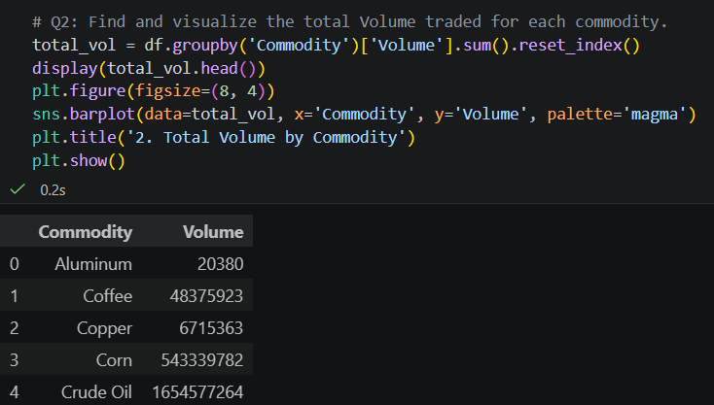

Slide 11
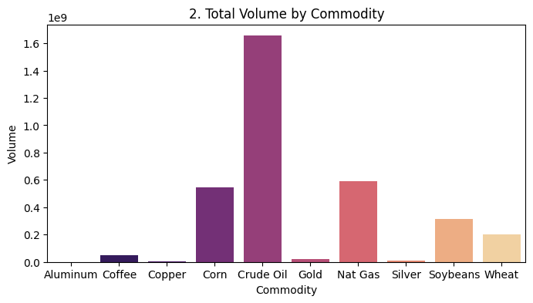

Slide 12
Problem - Objective (Data Distribution)
• Problem: Count the total number of records available for each commodity.
• Goal:
- Analyze data completeness.
- Compare tracking history across different assets.
Notes:
Next, in Problem 5, we wanted to verify the balance of our dataset. We needed to count the total available records for each commodity to ensure no single asset was disproportionately represented.

Slide 13
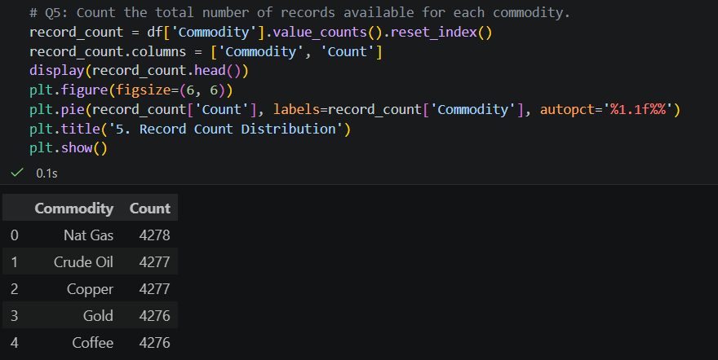

Slide 14
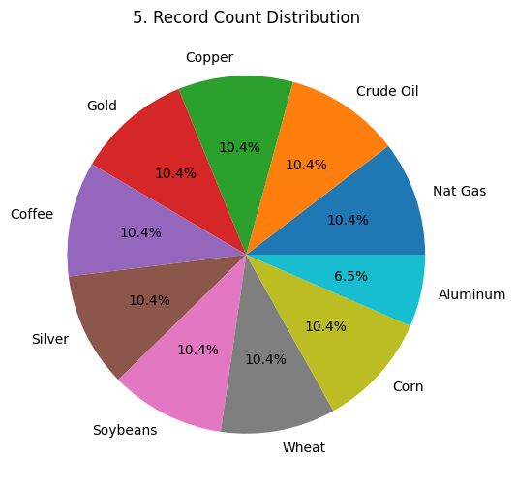

Slide 15
Problem - Objective (Gold Yearly Trend)
• Problem: Show the yearly trend of the Close price for Gold.
• Goal:
- Track historical price appreciation of Gold over time.
- Analyze long-term investment trends.
- Highlight performance as a safe-haven asset.
Notes:
Moving from volume to price, Problem 8 isolates Gold. We wanted to track its historical closing prices over the years to evaluate its reputation as a reliable, long-term safe-haven asset.

Slide 16
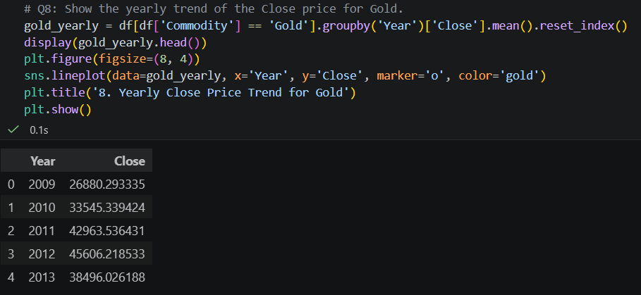

Slide 17
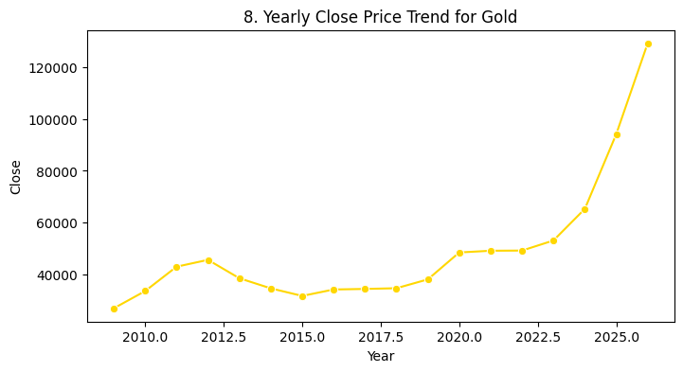

Slide 18
Problem - Objective (Market-Wide Trends)
• Problem: Show the trend of average Close price across all commodities.
• Goal:
- Compare the trajectory of final closing prices simultaneously.
- Analyze parallel market behaviors and sector growth.
Notes:
While Gold is interesting on its own, Problem 10 looks at the bigger picture. We wanted to plot the average closing price of *all* commodities on the same timeline to spot parallel behaviors and market shifts.

Slide 19
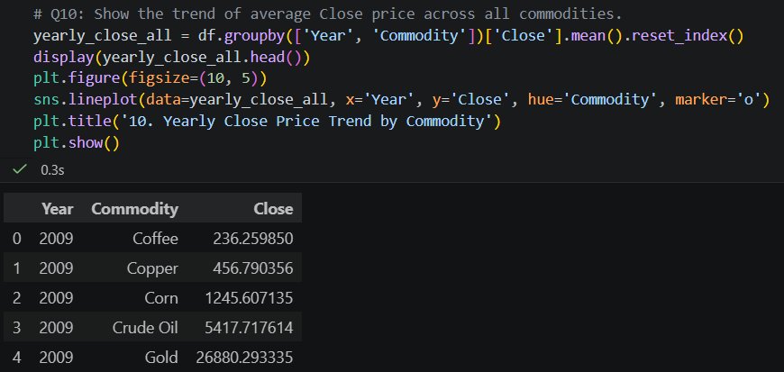

Slide 20
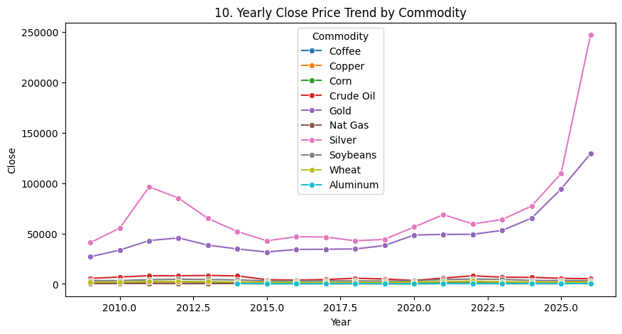

Slide 21
Overall Market Insights
• Macroeconomic Impact: Outlier years highlight the extreme impact of global economic crises (panic buying/sell-offs).
• Sector Behavior: Industrial metals align closely with economic cycles, contrasting with the panic-driven spikes of precious metals.
Notes:
Our analysis proves that outlier years usually map directly to global economic events. When panic hits, precious metals spike. When economies boom, industrial metals rise with demand.

Slide 22
Limitations of the Project
• External Variables: The dataset is limited to price and volume; it does not factor in breaking global news or sudden regulatory changes.
• Currency Impacts: We did not factor in USD/INR currency exchange rate fluctuations, which heavily impact domestic pricing.
Notes:
It is important to acknowledge our limitations. Our models rely purely on historical price action. We do not account for live geopolitical news, nor did we factor in the USD to INR currency fluctuations which play a major role in Indian markets.

Slide 23
Future Scope & Recommendations
Real-Time Data: Connecting to live APIs (NSE/MCX) for dynamic tracking.
Predictive Modeling: Implementing Machine Learning (ARIMA/LSTM) to forecast future prices.
Macro Overlay: Combining this data with inflation indices and currency rates for fundamental analysis.
Notes:
For future iterations, we recommend integrating real-time API feeds from the MCX, and utilizing Machine Learning algorithms like LSTM to actually forecast future prices based on these historical trends.

Slide 24
Conclusion
• The project successfully visualized extensive market data to empower investors and portfolio managers.
Thank You!
Any Questions?
Notes:
In conclusion, visualizing this data allows stakeholders to make highly informed entry and exit decisions based on historical realities. Thank you for your time. Raj and I would now be happy to answer any questions you might have.

