Slide 1
PELASER TRACING SYSTEM
LOGISTIC SOLUTION
POWERED BY - HACKATHON

Slide 2
EXISTING SYSTEM
Item 1
Order 1
Item 2
Item 3
Pallet 1

Slide 3
“I want to know where is Order number 25502?”
Item 1
Item 4
Order 1
Order1It
Item 2
Item 5
Item 6
Item 3
Pallet 1
Pallet 3

Slide 4
“Where is pallet number 45?”
Ready for shipping
Waiting area 1
Incomplete
Floor

Slide 5

UPDATING THE DATABASE WHENEVER CHANGES OCCUR
Order 1
Pallet 1
Pallet 3

Slide 6
OUR SOLUTION
Order 1
Pallet 1
Pallet 3

Slide 7
IMPLEMENTATION
ERP
FACTORY FLOOR
ERP+FACTORY FLOOR

Slide 8
Back-End
JAVA
Postgres
RestFul web service
Javasript
Hibernate

Slide 9
INFO SYSTEM
Order info
Pallet info
Item info
Production Station

Slide 10
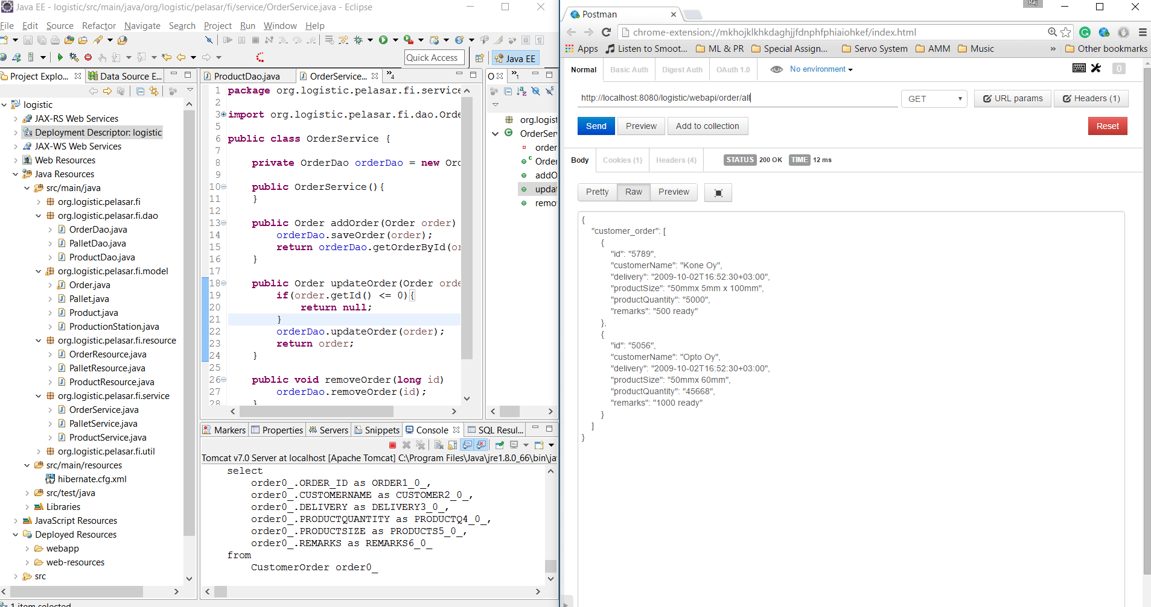

Slide 11
BENEFITS
NO Papers with critical information.
Work flow is more optimized.
Possible to manage the factory floor from ERP level.
Reducing the wastage and avoiding missing of any products.

