Slide 1

N3MO
9×
Navigate Any Codebase.
Instantly.
faster indexing
vs baseline
Code Intelligence Engine for Engineering Teams
Raj Shekhar | raj_shekhar@n3mo.shop | n3mo.shop

Slide 2



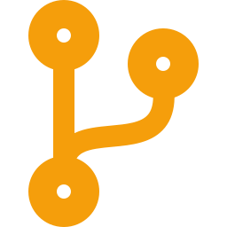
The Problem
Developers are flying blind in large codebases.
Orientation Tax
Change Fear
Context Switching
New engineers spend days tracing call chains before writing a single line.
Refactors stall because teams cannot confidently predict the blast radius of a change.
Developers bounce between editors, GitHub, and grep to answer simple structural questions.

Slide 3
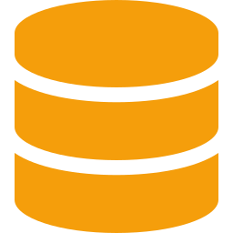



The Solution
N3MO maps any codebase in minutes and answers dependency queries in under 150ms.
Deep Indexing
Blast Radius Engine
Tree-sitter parses symbols, types, and call edges across 100K+ LOC repositories.
Recursive CTEs traverse dependency graphs returning impact queries in <150ms.
Live Reindexing
Ships Everywhere
Webhook-driven incremental updates keep the graph fresh on every push.
MCP server (Cursor, Windsurf), PyPI package, and REST API. One install, everywhere.

Slide 4
Production-Grade Performance
Benchmarked on Django — a real production codebase.
3,021
43K+
181K+
Files Indexed
Symbols Mapped
Call Edges
2.5min
9×
<150ms
Cold Index Time
Speedup Achieved
Impact Query Time

Slide 5

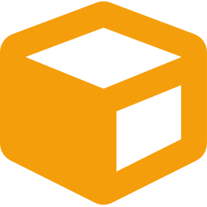



Shipped. Distributed. Live.
N3MO is not a prototype — it's in production.
PyPI Package
GitHub App
MCP Server
pip install n3mo
Webhook reindexing on push
Cursor · Claude Desktop · Windsurf
PulseMCP Listed
SaaS Pricing
Early Traction
Google AI Overview indexed
3/$10 · 10/$25 · Unlimited/$98
8 active users · 10 GitHub stars

Slide 6

Market Opportunity
Every engineering team is a potential customer.
Individual Devs
TAM
$28B
Open source contributors, freelancers, and solo builders navigating unfamiliar repos.
SAM
$4B
SOM
$200M
Startup Eng Teams
5–50 engineers onboarding fast, shipping faster, terrified of legacy code.
Enterprise
1000+ engineer orgs where a single blind refactor can cost millions.

Slide 7
Business Model
SaaS — repository-count tiers. Simple pricing, instant value.
Starter
Pro
Unlimited
$10/mo
$25/mo
$98/mo
3 repos
10 repos
Unlimited
Solo devs & contributors
Startup engineering teams
Large teams & enterprises
MOST POPULAR

Slide 8

The Founder
Solo-built N3MO end-to-end: architecture, backend, DevOps, and distribution.
Why Antler?
N3MO is built and live — I need co-founder chemistry and enterprise intros, not ideation.
Research Intern at ISRO — selected for mission-critical systems work.
Antler's network accelerates the path from 8 active users to 100 paying teams.
B.Tech Electrical Engineering, DTU (2027).
Looking for a GTM or design co-founder to pair with my engineering depth.
Deep systems engineering background: C, C++, Python, PostgreSQL, Linux.
Target: $10K MRR within 6 months of the program.
Prior GSoC attempt revealed the exact developer pain point N3MO solves.
n3mo.shop | raj_shekhar@n3mo.shop

