Slide 1
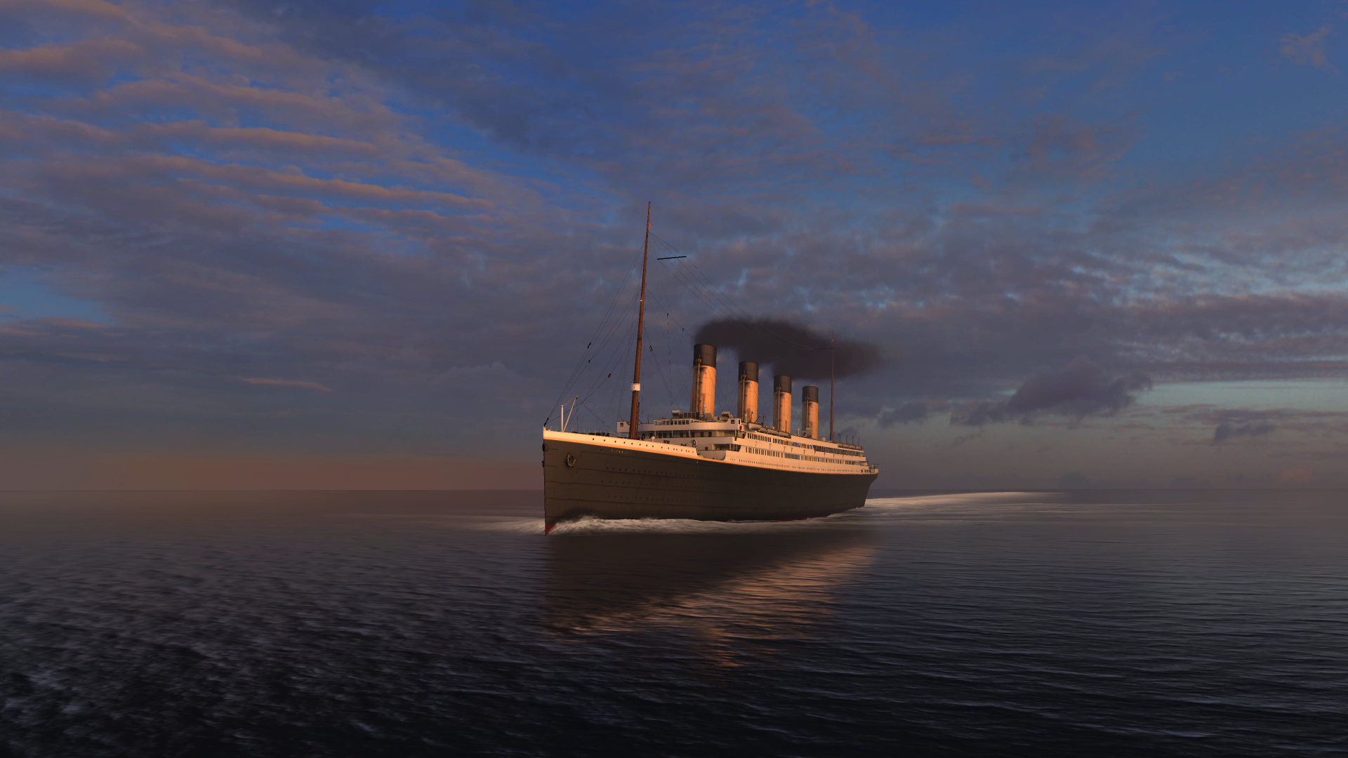
Titanic Survival Prediction
By Raja Vignesh P

Slide 2
Problem Statement
The Titanic disaster is one of the most infamous maritime disasters in history, resulting in the loss of over 1,500 lives. The goal of this project is to predict which passengers survived the sinking of the Titanic using machine learning algorithms.

Slide 3
Solution
The goal of this project is to predict which passengers survived the sinking of the Titanic using machine learning algorithm by analyzing passenger details such as name, sex, age, class, and other relevant factors.
The project involves data preprocessing, feature selection, and model evaluation to achieve high accuracy in predicting survival outcome

Slide 4
Technologies used
Python: The primary programming language for data preprocessing, modeling, and analysis.
Pandas: For data manipulation and preprocessing tasks, such as handling missing values, encoding categorical variables, and preparing data for modeling
Machine Learning Algorithm : Used Logistic Regression algorithm
Scikit-learn: A comprehensive library for machine learning in Python, providing tools for model training, evaluation, and preprocessing (e.g., train-test split, feature scaling, model selection).
Seaborn and Matplotlib: For data visualization, including creating plots and charts to explore data distributions, relationships, and model evaluation.
Jupyter Notebook or IDEs (PyCharm, VS Code): Interactive environments for code development, experimentation, and documentation of results.

Slide 5
Benefits
The Titanic Survival Prediction project provides valuable insights that can be used to enhance safety and risk management in the shipping industry.
The insights gained from this project can also be applied to other transportation sectors to improve passenger safety and emergency response procedures..

Slide 6
Dataset Description
The Titanic dataset captures information about passengers on the RMS Titanic voyage, including their survival status, passenger class, sex, age, siblings/spouses, parents/children, ticket details, fare, and port of embarkation. The dataset reflects socio-economic status through passenger class (1st = upper, 2nd = middle, 3rd = lower), while age is fractional for infants. Family relations are denoted by sibsp (siblings/spouses) and parch (parents/children). The embarkation ports are Cherbourg (C), Queenstown (Q), and Southampton (S), representing different socio-economic backgrounds and influencing survival outcomes.

Slide 7
Data Collection
Dataset Source: The Titanic dataset was obtained from Kaggle, a popular platform for hosting various datasets and machine learning projects.
Dataset Columns: The dataset consists of 12 columns in total, including both numerical and categorical features:
Numerical Columns: PassengerId, Survived, Pclass, Age, SibSp, Parch, Fare
Categorical Columns: Name, Sex, Ticket, Cabin, Embarked.
Dataset Size: The dataset has 891 entries, with 12 columns in total

Slide 8
Data Cleaning
The dataset initially contained missing values in the 'Age' and 'Embarked' columns, with 177 missing values in 'Age' and 2 missing values in 'Embarked’.
The missing values in the 'Age' column were replaced with the mean age of the passengers to maintain data integrity and ensure a complete dataset for analysis.
For the 'Embarked' column, the missing values were filled with the most frequent port of embarkation (mode) to address the missing data effectively.

Slide 9
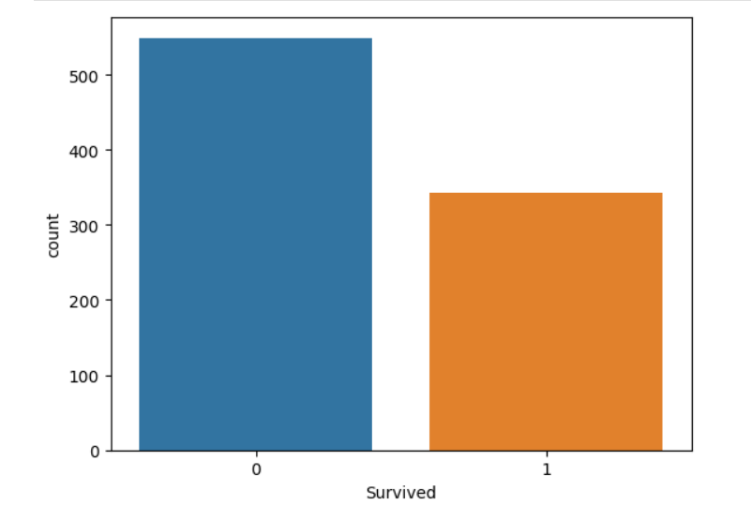
Data analysis on Survived column
This plot shows the distribution of passengers who survived (Survived = 1) and those who did not (Survived = 0). This visual representation provides a clear understanding of the survival rates within the Titanic dataset.

Slide 10
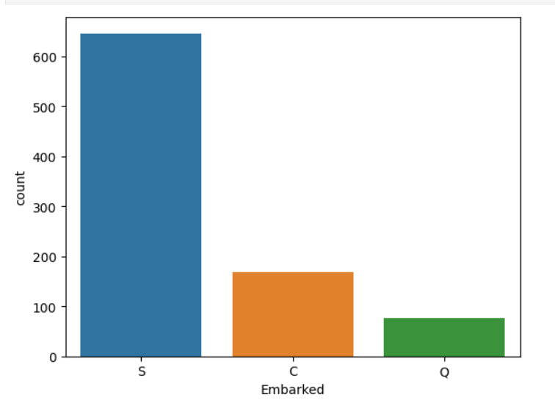
Data analysis on Embarked column
This plot shows the distribution of passengers based on their embarkation port. The majority of passengers (646, or 72.5%) embarked from the port of Southampton (S), followed by Cherbourg (C) with 168 passengers (18.9%), and Queenstown (Q) with 77 passengers (8.6%).

Slide 11
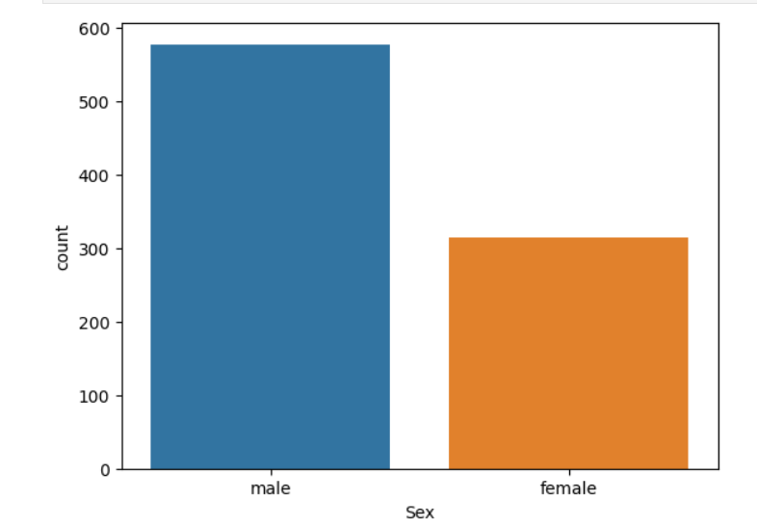
Data analysis on Sex column
This plot shows the distribution of passengers based on their gender. The dataset contains 577 (64.8%) male passengers and 314 (35.2%) female passengers. The gender distribution may have a significant impact on passenger survival rates, as historical records suggest that women and children were prioritized for rescue during the Titanic disaster. This information can be further analyzed to understand the relationship between gender and survival probability.

Slide 12
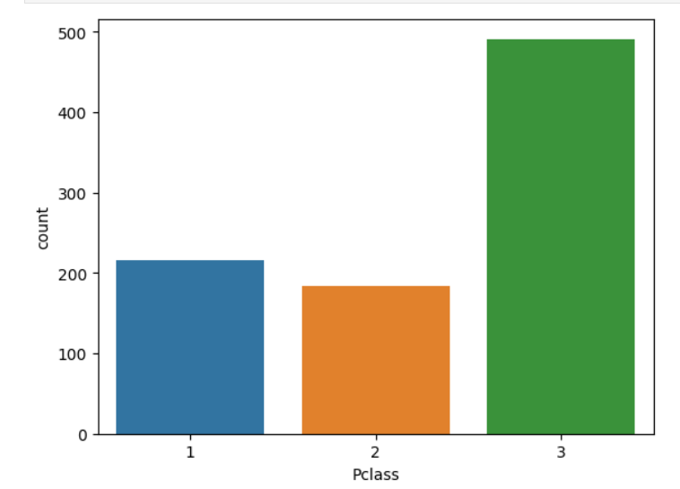
Data analysis on Pclass column
The bar plot shows the distribution of passengers based on their passenger class. The dataset contains 491 (55.1%) passengers from third-class, 216 (24.4%) passengers from first-class, and 184 (20.5%) passengers from second-classfirst-class passengers were more likely to have access to lifeboats and other resources that increased their chances of survival. This information can be further analyzed to understand the relationship between passenger class and survival probability.

Slide 13
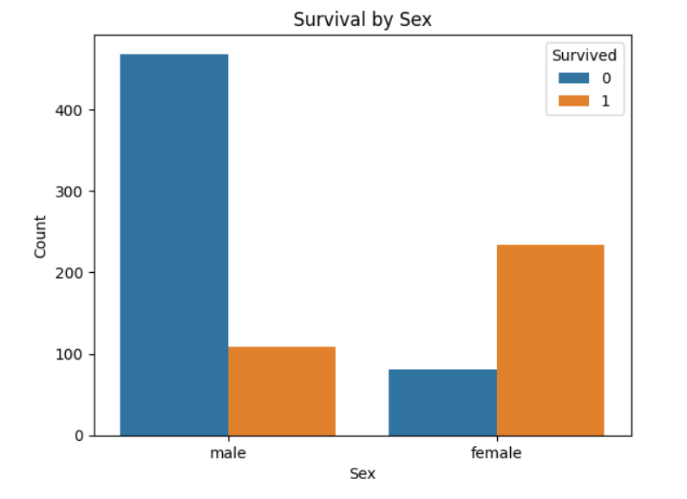
Data analysis on Survival based on sex
This plot shows gender-wise survival plot highlights the disproportionate survival rates between males and females in the Titanic disaster, with women having a clear advantage in terms of being rescued and surviving the sinking of the ship. This finding aligns with historical accounts and social norms of the time, where the principle of "women and children first" was often followed in maritime disaster

Slide 14
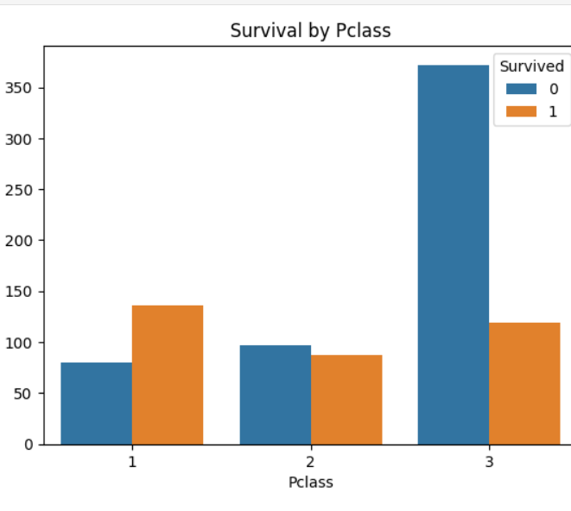
Data analysis on Survival based on Pclass
The number of non-survivors was similar in first and second classes, with around 100 passengers in each class not surviving. However, in third class, the number of non-survivors was significantly higher, with around 375 passengers not surviving the sinking of the Titanic. These insights highlight the stark differences in survival rates among the various passenger classes, with first and second-class passengers having a clear advantage over third-class passengers in terms of surviving the Titanic disaster

Slide 15
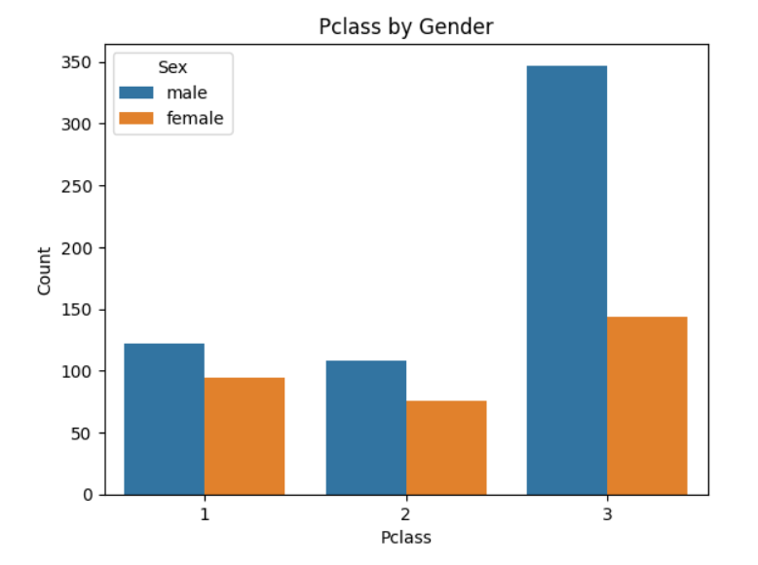
Data analysis on Pclass based on Sex
Pclass 1: In first-class, 125 males and 90 females traveled on the Titanic, indicating a higher proportion of females compared to males.
Pclass 2 and Pclass 3: In second-class, 110 males and 75 females traveled, and in third-class, 350 males and 150 females traveled, with a higher proportion of males in both classes compared to females

Slide 16
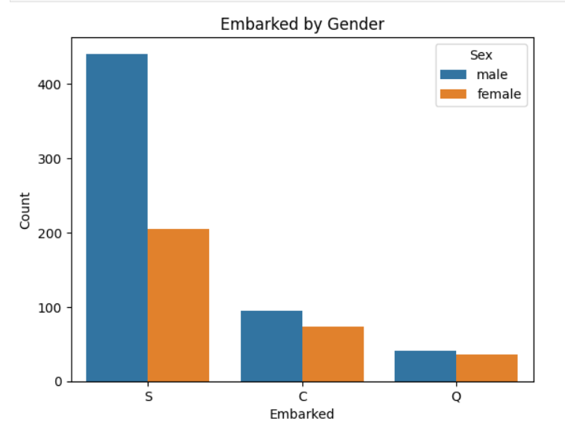
Data analysis on Embarked by Sex
Southampton (S): Approximately 450 males and 200 females embarked from Southampton.
Cherbourg (C): Around 80 males and 60 females boarded the Titanic from Cherbourg.
Queenstown (Q): Approximately 50 males and 40 females were passengers who embarked from Queenstown.

Slide 17
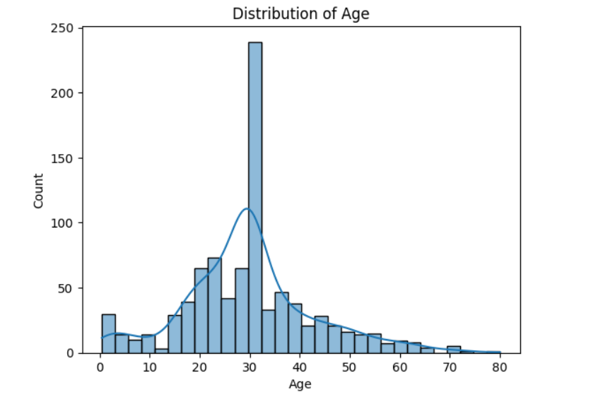
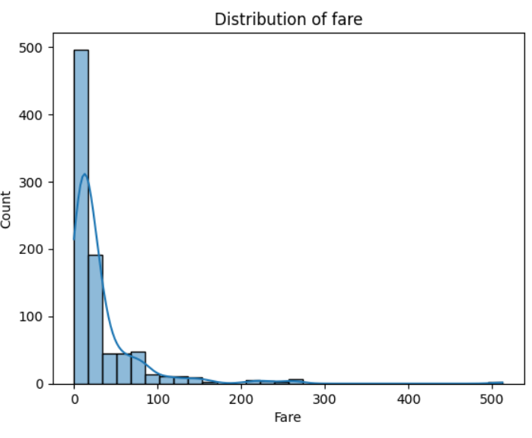
Distribution of Age and fare

Slide 18
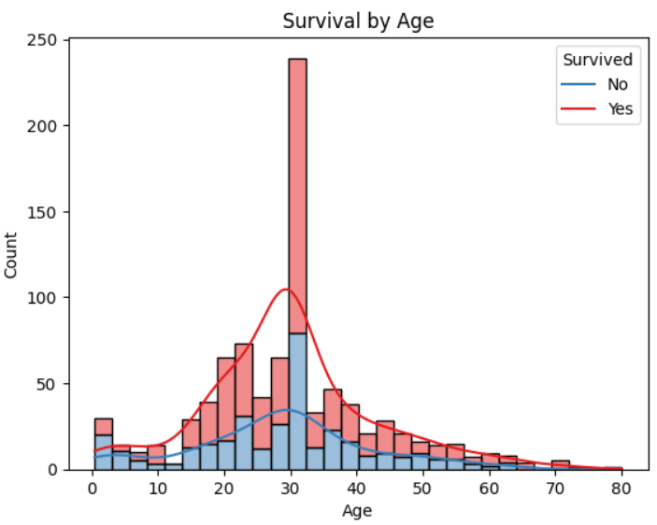
Data analysis on Suvival by age
Age Distribution: The age distribution among Titanic passengers shows that younger passengers (children) had a higher survival rate, while the elderly had lower survival chances. Middle-aged individuals, especially males, formed the bulk of casualties.
Age Groups: The age distribution is further broken down into specific age groups, with children (0-9 years old) and women (all ages) having a much higher proportion of survivors, supporting the notion of women and children being given preferential treatment over men

Slide 19
Data Preprocessing
Categorical Encoding: The code snippet utilizes Label Encoder to transform the 'Sex' column into numerical values, representing male as 1 and female as 0, and similarly encodes the 'Embarked' column to numerical labels for further analysis and modeling.
Data Transformation: By applying Label Encoder, the categorical columns 'Sex' and 'Embarked' are converted into a format that machine learning algorithms can interpret, facilitating the processing of categorical data in the Titanic dataset for predictive modeling tasks.

Slide 20
Model Training
Dataset Sizes: The training set contains 712 samples, and the testing set contains 179 samples, providing a suitable balance for model evaluation and prediction.
Train-Test Split: The dataset is split into training (80%) and testing (20%) sets using the train_test_split() function, ensuring that the target variable distribution is maintained in both sets.

Slide 21
Model Training
Model Selection: A Logistic Regression model is created using the LogisticRegression() class from the scikit-learn library.
Model Training: The Logistic Regression model is trained on the training data using the fit() method, which learns the relationship between the features (X_train) and the target variable (y_train).
This setup prepares the data for the Logistic Regression model training, ensuring a proper split of the dataset and creating the necessary components for the subsequent model evaluation and prediction steps.

Slide 22
Model Validation
Accuracy Calculation: The test accuracy score is calculated using the accuracy_score() function, comparing the predicted values (y_pred) with the actual values (y_test).
Model Selection: With an accuracy percentage of 80.45%, logistic regression proves to be the best model for this dataset, showcasing its effectiveness in predicting the survival outcomes of Titanic passengers with a high level of accuracy

Slide 23
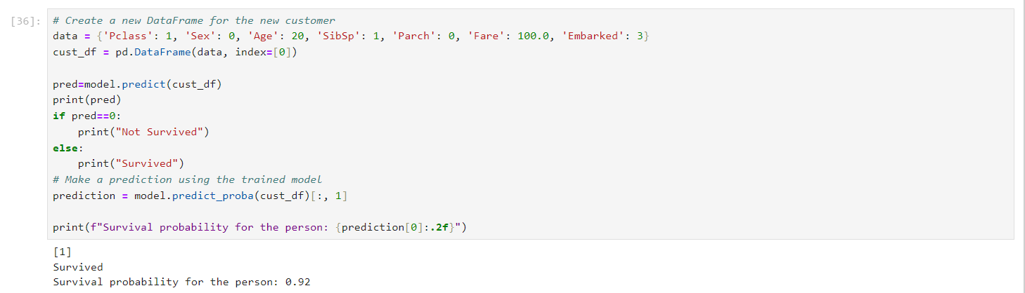
Prediction

Slide 24
Model Deployment
Streamlit Deployment: The Titanic survival prediction model is deployed as a web application using Streamlit, allowing users to interact with the model and get predictions through a user-friendly interface.
Link for Titanic survival prediction : click to webpage

Slide 25
Prescriptive Analysis
Gender and Survival: Women had a significantly higher survival rate than men. This suggests that social norms and practices like "women and children first" were followed during the evacuation, prioritizing the rescue of female passengers.
Passenger Class and Survival: First-class passengers had a higher survival rate compared to second and third-class passengers. This indicates that socio-economic status played a role in survival chances, with higher-class passengers potentially having better access to resources and information during the disaster

Slide 26
Prescriptive Analysis
Age Distribution and Survival: Younger passengers (children) had a better survival rate, while the elderly had lower survival chances. Middle-aged individuals, especially males, formed the bulk of casualties. This pattern highlights the vulnerability of certain age groups and the need for targeted evacuation strategies.
Family Size and Survival: Solo travelers and those with a small family size (1-3 members) had better survival outcomes than larger families. This suggests that family dynamics and responsibilities may have influenced the ability to access and utilize limited resources during the evacuation

Slide 27
Prescriptive Analysis
To improve survival outcomes in similar situations, it is crucial to develop and implement comprehensive emergency response plans that prioritize the safety of all passengers, regardless of gender, age, or socio-economic status. Ensuring equal access to resources, providing clear evacuation instructions, and conducting regular safety drills can help mitigate the impact of such disasters.

Slide 28
Thank You

