Slide 1

AstroSage Analysis
by
- A. Raja Vishwanath
(25/10/2025)

Slide 2

Goal of the Analysis
AstroSage has received a 1 crore investment and aims to optimize its call center operations. The goal is to determine how to allocate this investment to maximize operational efficiency, customer satisfaction, and profitability. The analysis will consider historical call data, performance metrics, and market trends to make informed decisions.

Slide 3
About AstroSage
AstroSage is India’s leading online astrology platform offering real-time consultations via chat and call. It provides services like horoscope generation, kundli matching, tarot reading, numerology, and palmistry.
The platform allows both free and paid sessions, with per-minute billing and wallet-based payments. A “first chat free” feature helps new users experience the service before paying.
Over 700,000 astrologers are registered with AstroSage. The system integrates AI to improve horoscope accuracy, automate simple queries, and personalize recommendations.
Users can rate and review astrologers after each session, helping maintain quality and trust. Combining traditional astrology with modern technology, AstroSage makes spiritual guidance accessible, efficient, and user-friendly for millions worldwide.

Slide 4
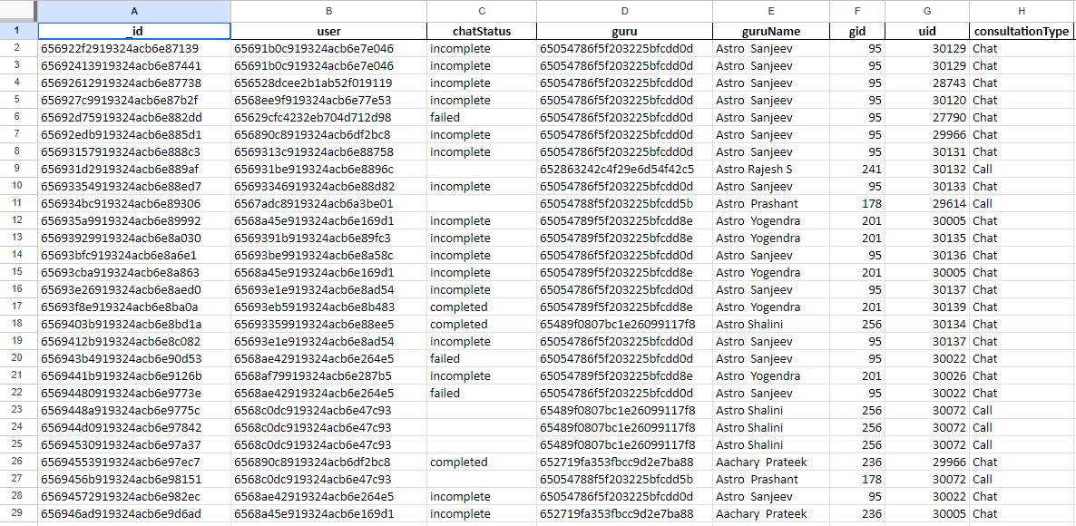
Data Set provided:

Slide 5
Attributes:
_id: Unique identifier for each record. 28028 unique values.
user: User ID associated with the record. 10344 unique users
chatStatus: Status of the chat (e.g., incomplete, failed, completed, started, pending, on call).
guru: Unique identifier for the guru. Total 133 gurus
guruName: Name of the guru.
gid: Guru ID. Total 133 integer values assigned to gurus
uid: User ID. Total 10344 integer values assigned to users
consultation Type: Type of consultation (e.g., Chat, Call, conference, public call).
website: Source of the consultation (e.g., gurucool, app, dashboard).
Refund Status: Indicates if the session is refundable or not (e.g., no-refund).
is WhiteList User: Boolean indicating if the user is whitelisted.
chat Seconds: Duration of the chat in seconds.

Slide 6
Attributes (continued):
queue: Boolean indicating if the session was queued.
FreeCall: Boolean indicating if the call was free.
Free Chat: Boolean indicating if the chat was free.
CreatedAT: Original creation date and time.
updatedAt: Original update date and time.
__v: Version key.
statementEntryId: Identifier for the statement entry.
chatStartTime: Start time of the chat.
chatEndTime: End time of the chat.
timeDuration: Undefined, some technical data as per app. (Don’t use it as the duration of chat/call)
callChannel: Channel used for the call.

Slide 7
Attributes (continued):
calIvrType: IVR type used during the call.
callStatus: Status of the call.
CallSid: Unique identifier for the call session.
amount: Amount charged for the session.
astrologerCallStatus: Status of the astrologer during the call.
astrologerOnCallDuration: Duration of the astrologer's call.
astrologersEarnings: Earnings of the astrologer from the session.
netAmount: Net amount after deductions.
region: Region of the user.
userCallStatus: Status of the user's call.
userOnCallDuration: Duration of the user's call.
rating: Rating assigned based on the session's status. (Scale: 0-5 for call, 0-8 for chat)

Slide 8
Data Cleaning:
Interestingly there were no duplicates.
Filled ‘N/A’ where there is no need for data to be present, like call related attributes for chat records and vice versa.
Filled ‘Missing’ where data should have been present but is not present.
Filled 0’s in numeric columns like ‘amount’ and ‘earnings’ where the value is sure to be zero because of session being a free call or free chat, or if the status is cancelled, failed or incomplete etc.

Slide 9
Data Processing:
Using createdAt column, extracted:
createdAt Date : using =INT(createdAt)
createdAt Year : using =TEXT(R2,"yyyy")
createdAt Month : using =TEXT(R2,"mmm")
createdAt year-month : using =TEXT(R2,"yyyy-mmm")
createdAt weekday : using =TEXT(R2, "ddd")
createdAt Hour : using =Value(TEXT(Q2,"h"))

Slide 10
Data Processing (continued) :
Using chartStartTime created chartStartTime_formated using formula: =IF(OR(AB2="N/A", AB2="Missing"), AB2, VALUE(SUBSTITUTE(SUBSTITUTE(AB2,"T"," "),"Z",""))
Using chatEndTime created chatEndTime_formated using formula: =IF(OR(AD2="N/A", AD2="Missing"), AD2, VALUE(SUBSTITUTE(SUBSTITUTE(AD2:AD28028,"T"," "),"Z","")))
Created column updatedAt_formatted using Array formula:
= ARRAYFORMULA(IF(X2:X28028="","", VALUE(SUBSTITUTE(SUBSTITUTE(X2:X28028,"T"," "),"Z",""))))

Slide 11
Data Processing (continued):
Created column Satisfaction Level using Two formulas :
Applied filter consultationType = “not chat” then applied formula :
=IF(AS9<2,"Poor",IF(AS9<4,"Average","Excellent"))
Applied filter consultationType =”chat” then applied formula:
=IF(AS2<3,"Poor",IF(AS2<6,"Average","Excellent"))
Created column user_frequency using:
=IF(COUNTIF($B$2:$B$28028,B2)>1,"Repeated","Unique")

Slide 12
Exploratory Data Analysis

Slide 13
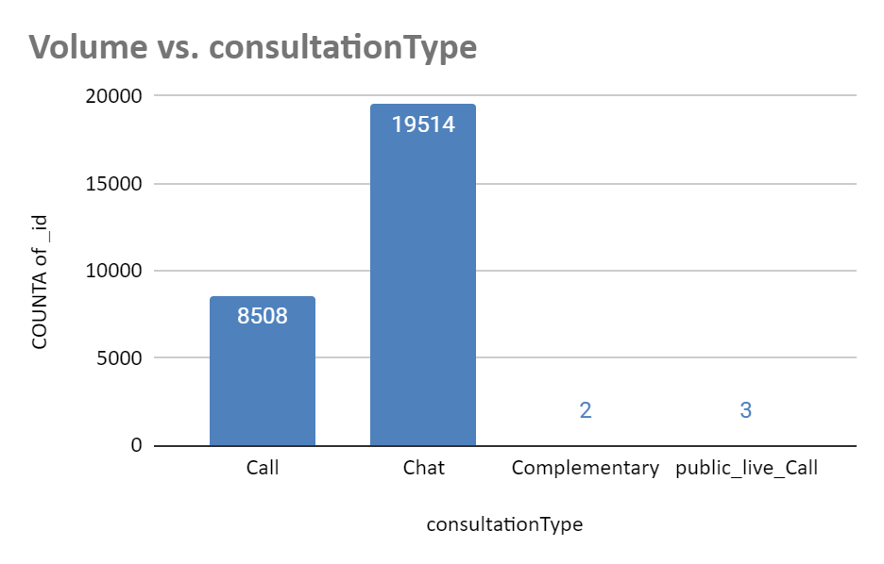
Key Attributes :
ConsultationType is the most important column in the data, using FILTER on it we can separate chat, call and other category records from each other
Out of 28027 rows, there are total 8508 call, 19514 chat , 2 complementary & 3 public live call records.
Using CountUnique function, we find, user column has 10344 unique user ids and guru column has 133 unique guru ids. We can use Vlookup to match the names with ids of users and gurus.

Slide 14
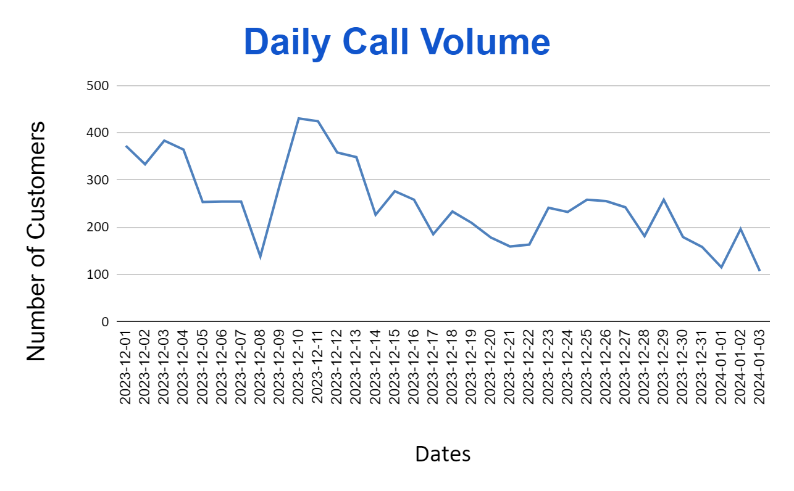
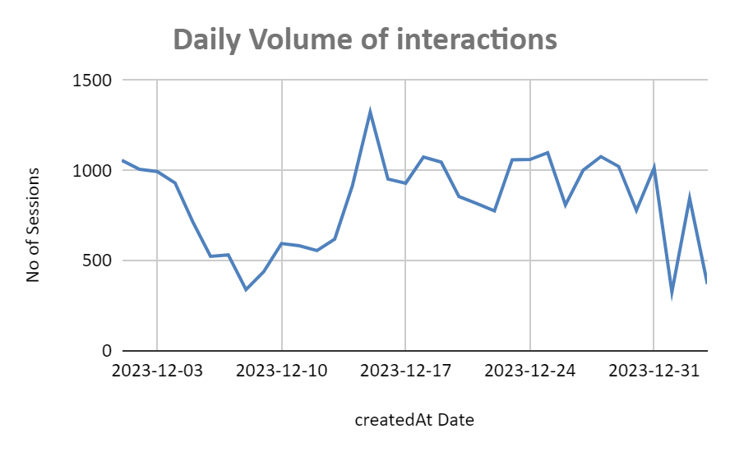
Volume trends :
By using pivot table, we find that average daily call volume is 250.24 calls per day.
We can see in the chart that the number of calls are dropping day by day.
Also we can see that on an average, a guru handles 1.88 calls per day.
Average no of chats per day for each guru is 4.32. That gives total average of 6.2 interactions/ per guru per day.
Conclusion:
We don’t need to hire more agents. But we have to do something about dropping volume of sessions.

Slide 15
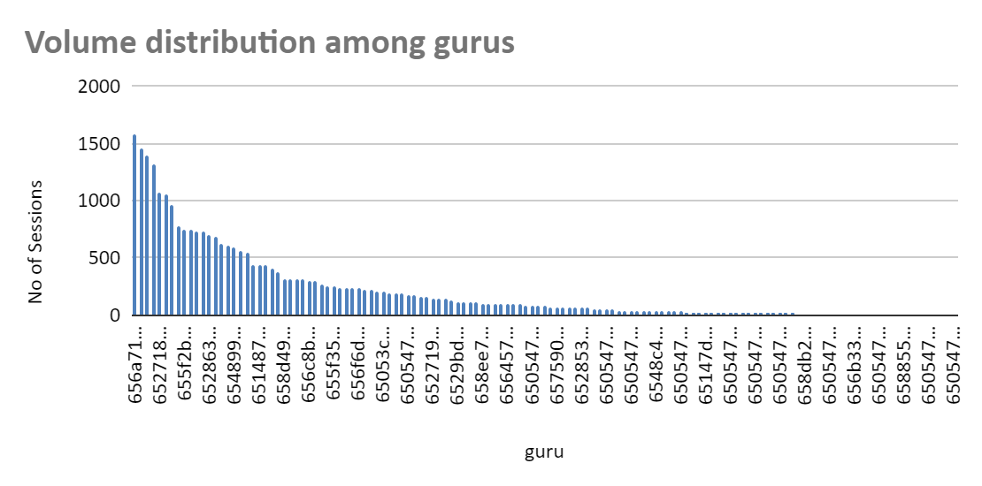
Distribution of Volume among gurus :
We can see that volume of sessions( chat & call) is highly unevenly distributed among gurus, with top gurus handling 1000+ interactions in month, and bottom gurus nearly handling in single digit.

Slide 16
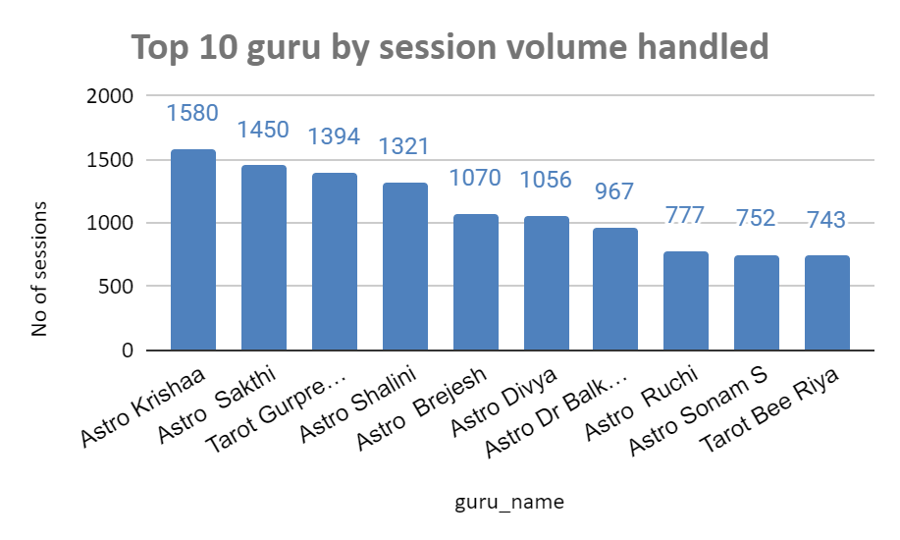
Distribution of Volume among gurus (continued) :
Conclusion: Possibly some gurus are more famous by preference & top gurus are usually working full time and bottom ones are just doing part time.

Slide 17
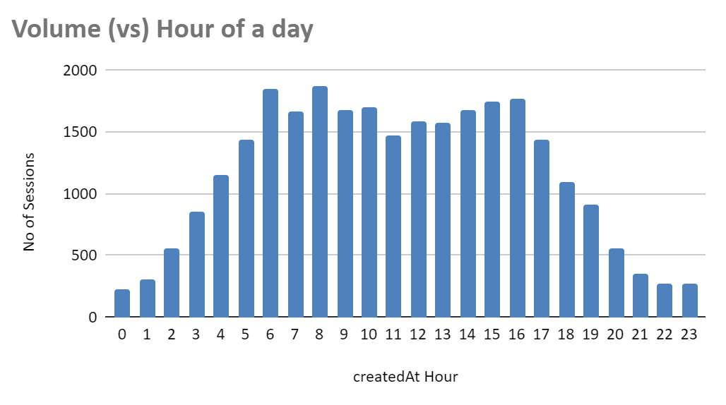
Volume Distribution with Hour :
Taking Volume/ hour > 1000 as peak hour we have time from 4:00 to 18:00.
After calculating, we get interactions/ per guru in a day is 5.29.
As we can see the value at peak hour is 8.40. Which means 35.48% more volume at peak hour.
Conclusion: To make it less burden on top gurus, tech should diversify & divert traffic to well rated, low user_count gurus.
Average interactions per guru at peak hour per day | 8.40
Average interactions per guru per day | 6.20

Slide 18
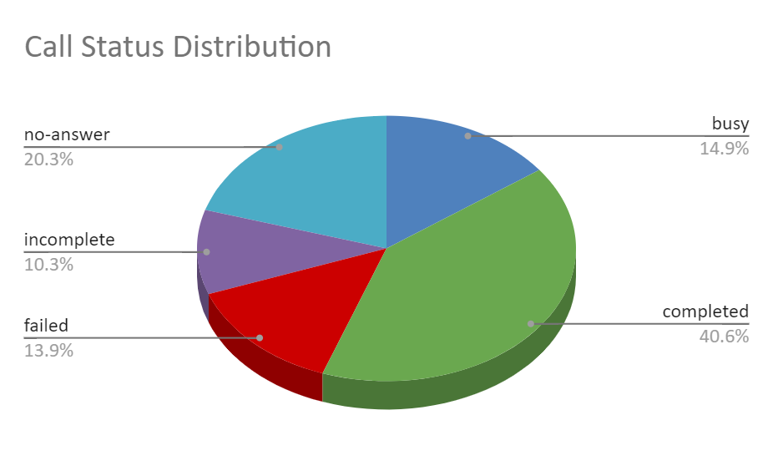
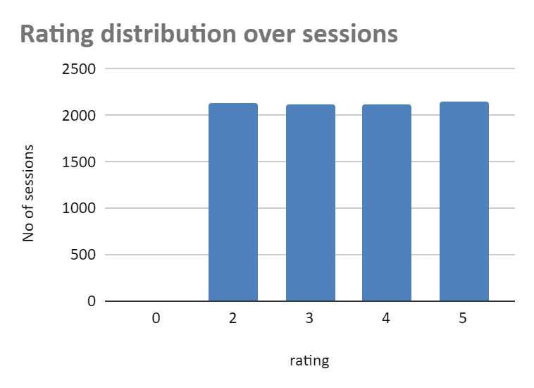
Call Status & Ratings :
Call ratings have range 0 to 5, & are almost evenly distributed between ratings 2 to 5.
We have 13.9% call failure rate, that is a concern.
Only 40.6% calls are marked complete.

Slide 19
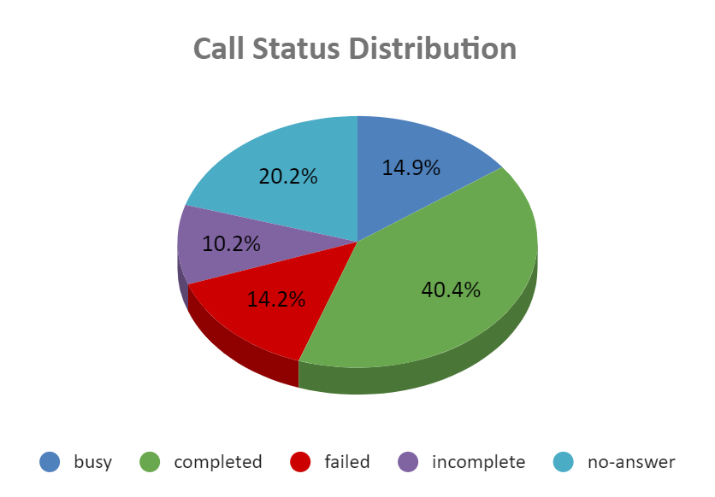
Call Status & Ratings (continued) :
Conclusion: Focusing on personalized training, technological advancements, efficient call routing, and data-driven workforce optimization can substantially enhance operational efficiency, reduce call failures, and elevate the overall customer experience for AstroSage users.

Slide 20
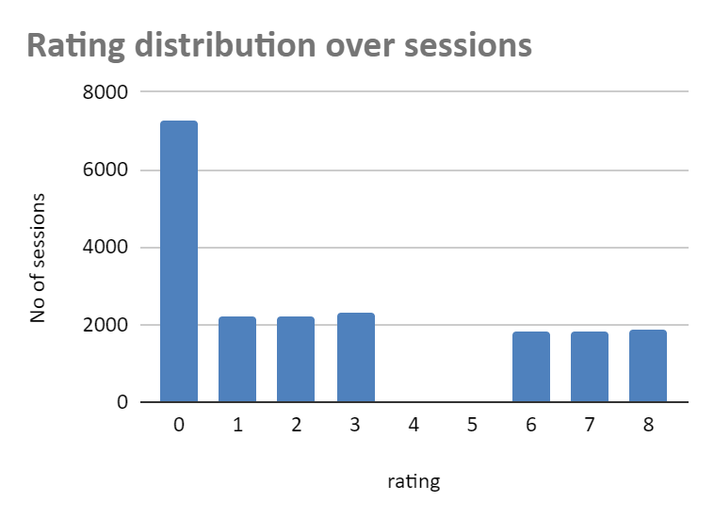
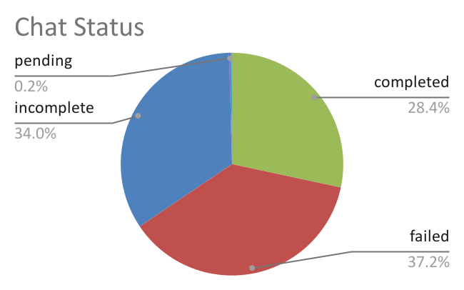
Chat Status & Ratings :
Only 28.4% are marked complete.
Interesting point to be noted is all 7255 ratings of value 0 are originating from only 7255 chat records, where the status is failed. This 0 rating is skewing our overall chat ratings.
Also there are missing values of 4,5 ratings.
Average rating without failed is 4.28, not bad.

Slide 21
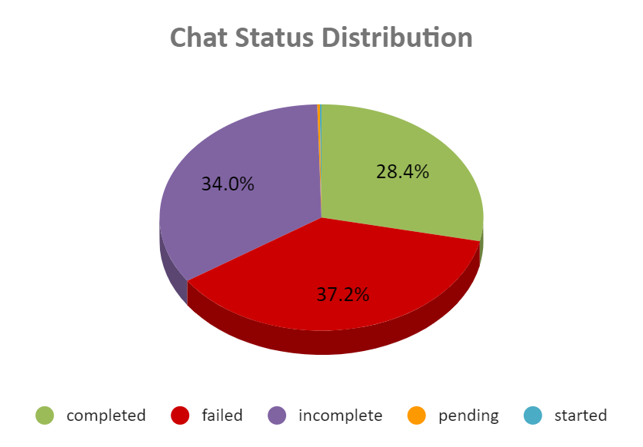
Chat Status & Ratings (continued) :
Conclusion :
The reason is unclear, may be the tech that defines & decides what a chat status is, is not upto mark. Rating might be automatically taking as 0 when user leaves without ending a conversation ,or finishing rating his chat.
Implementing AI chatbots could ensure lower response times & lower failed/Incomplete rates.

Slide 22
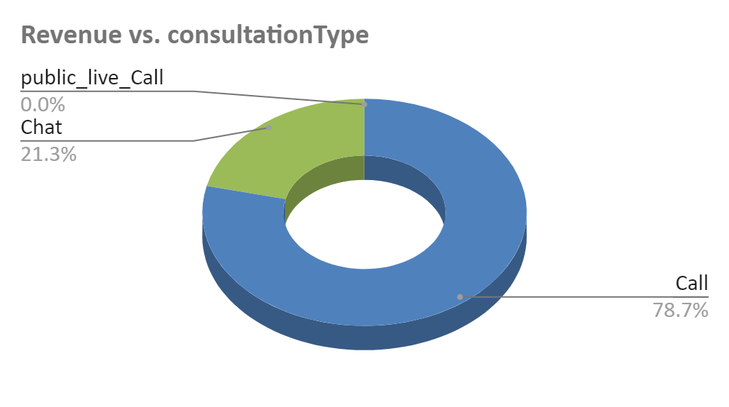
Revenue :
Even though calls account for 30.36% of total volume, they contribute to 78.72% of the total revenue.
Guesstimate : If 10344 users created Rs. 213K in Revenue & Rs. 115K profit in 1 month, 11 Million active users could generate a Rs. 24 Cr in revenue and Rs. 12.23 Cr in profit per month.
consultationType | SUM of netAmount
Call | 168442.04
Chat | 45494.68
Complementary | 0
public_live_Call | 50.60
Grand Total | 213987.32

Slide 23
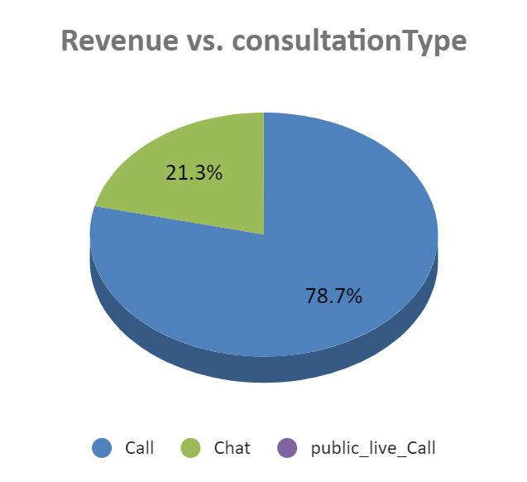
Revenue (continued) :
Chat needs to be optimized because it takes time to type our queries and every second is money, so maybe that is why people are choosing call over chat for a paid consultation.
Conclusion: The chat monetization system should be different, may be include “charge per words count” of the session, especially for AI gurus it works well.

Slide 24
DASHBOARD & IT’S METRICS

Slide 25
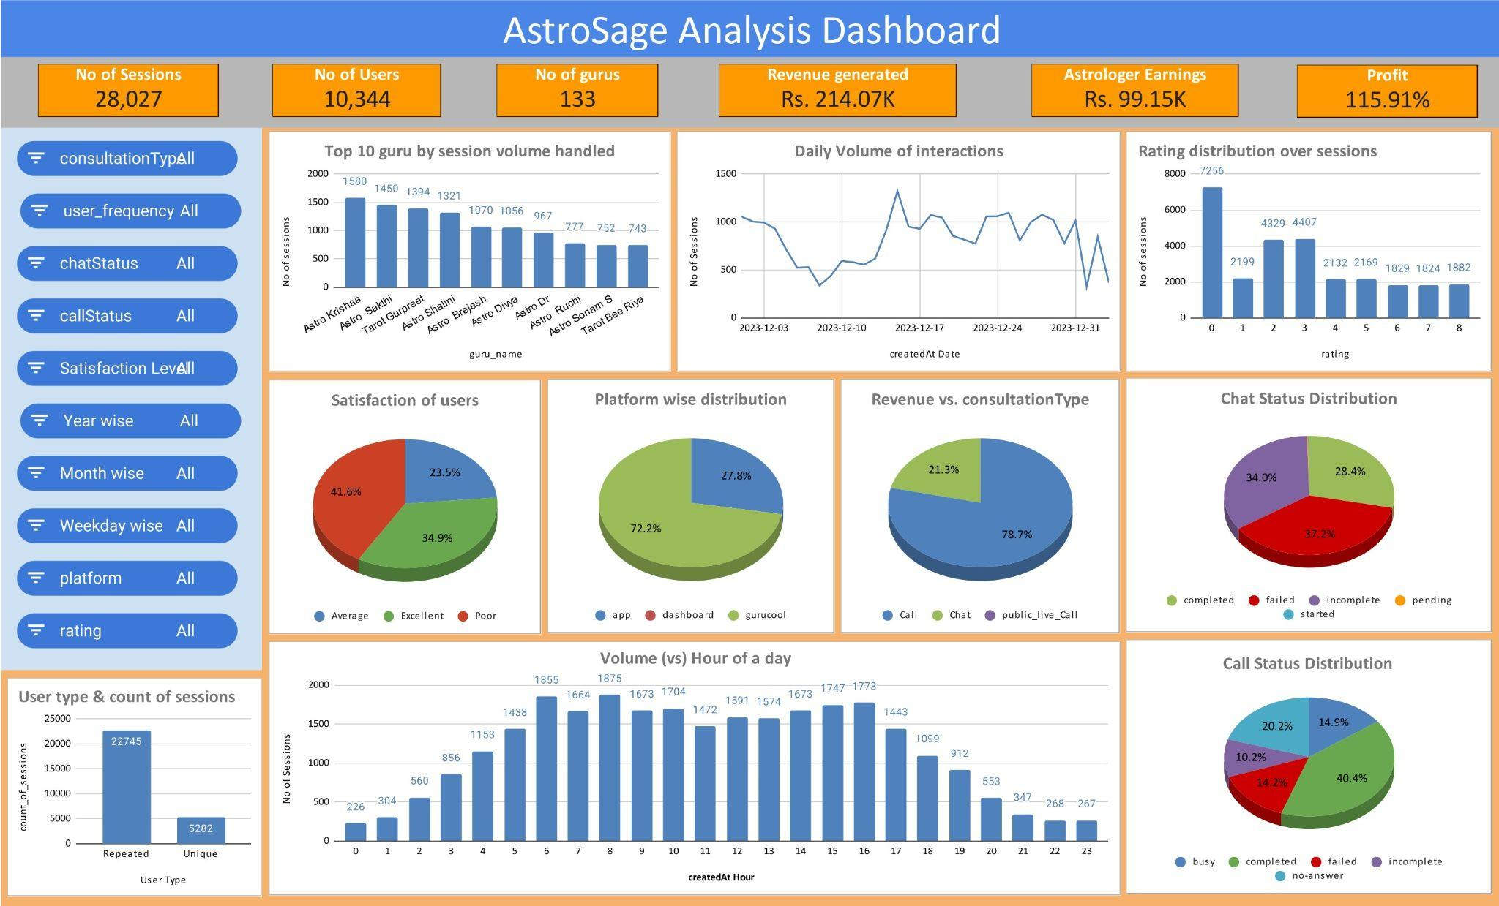

Slide 26
1. Key Performance Indicators
Metric | Description | Decision Insight
No. of Sessions | Total customer interactions (calls + chats) | Indicates overall workload and engagement volume.
No. of Users | Total unique customers who interacted | Measures user base size and retention growth.
No. of Gurus (Astrologers) | Total astrologers handling consultations | Reflects manpower availability and coverage.
Revenue Generated | Total revenue from consultations | Shows business performance and income generation.
Astrologer Earnings | Total payout to astrologers | Helps assess profitability and partner compensation fairness.
Profit (%) | Revenue minus payouts and costs | Indicates business sustainability and margin strength.

Slide 27
2. Interaction and Volume Metrics
Metric | Chart Type | Purpose
Daily Volume of Interactions | Line Chart | Identifies peak and low activity days; useful for resource planning.
Top 10 gurus by session Volume | Bar Chart | Highlights top-performing astrologers and workload imbalance.
Volume by Hour of the Day | Column Chart | Shows busiest hours — helps optimize shift scheduling and staffing.
Platform(website) | Pie Chart | Shows platform choice of users-helps decide which platform needs more investment/ development

Slide 28
3. Quality and Satisfaction Metrics
Metric | Chart Type | Purpose
Rating Distribution Over Sessions | Bar Chart | Monitors service quality and user satisfaction trends.
Satisfaction of Users (Poor/Average/Excellent) | Pie Chart | Provides overall satisfaction overview — vital for service improvement.
4. Operational Efficiency Metrics
Metric | Chart Type | Purpose
Chat Status Distribution | Pie Chart | Tracks chat success rate and identifies technical or behavioral issues.
Call Status Distribution | Pie Chart | Evaluates call handling efficiency and technical connectivity.
Revenue vs. Consultation Type (Call vs. Chat) | Pie Chart | Helps assess which mode drives higher revenue, guiding platform investment.

Slide 29
5. User Behavior Metrics
Metric | Chart Type | Purpose
User Type & Count of Sessions | Bar Chart | Indicates customer retention — crucial for marketing and loyalty investment.
User Frequency / Platform / Weekday Filters (via Slicers) | Filter Controls | Allow dynamic segmentation for deeper analysis (e.g., platform-wise revenue).

Slide 30
Conclusion:
No need for new astrologer hires unless expanding to other countries. Maintain existing gurus for they are free word of mouth publicity agents. May not pay monthly salary but a commission per interaction.
Training for existing gurus needed. User focused material of how to get most out of an interaction would help rectify data handling mistakes from user end.
Invest in AI, to take up generic queries & reduce load on gurus, particularly in peak hours.
Technology upgrade is necessary to resolve failed/incomplete and other statuses. AI comes into picture.

Slide 31
Solution to the goal:
Training and Quality Improvement — ₹25 Lakhs (25%):
Targeted to low rating / under performing gurus. Soft-skill and customer-psychology modules to improve trust and reduce drop-offs.
Technology and AI Integration — ₹40 Lakhs (40%) :
Upgrade backend call/chat infrastructure to address the current ~14% call failure rate & 37.2% chat failure rate seen in the data.
Build Chatbots/AI Agents for FAQ’s, Skill & traffic based routing.
Aim for Sharper response times and lower wait periods, improved completion rates.

Slide 32
Solution to the goal ( continued ):
3. Customer Experience & Self-Service Platforms — ₹15 Lakhs (15%)
IVR, WhatsApp bots, website chat widgets.
Implement AI-driven recommendations for guru selection
4. Marketing, Retention & Engagement — ₹10 Lakhs (10%)
Run campaigns promoting high-rated human astrologers, AI astrologers and customer success stories.
Introduce loyalty programs and subscription models for repeat users.
Use insights from slicers and pivot data to target campaigns by region, consultation type, and user behavior patterns.

Slide 33
Solution to the goal ( continued ):
5. Data Analytics, Monitoring & Contingency — ₹10 Lakhs (10%)
Strengthen data collection pipelines for real-time performance monitoring.
Allocate a buffer fund for A/B testing AI tools, unforeseen technical expenses, or data protection compliance.
Use continuous feedback loops to refine the dashboard metrics and investment priorities.

Slide 34


