Slide 1
Prediction of Critical Temperature for Super Conductivity
Group 10
Shivam Thakur
Nupur Bhavesh Shah
Rajaragunanthan Palinasamy
Pengxiang Zhuo

Slide 2



Introduction
A superconductor conducts current with zero resistance only at or below its superconducting critical temperature (Tc).
In this study, we take an entirely data-driven approach to create a statistical model that predicts (Tc) based on its chemical formula.
After some data preprocessing, 21,263 superconductors are used.
The FEATURES ARE EXTRACTED ON THE BASES OF THERMAL CONDUCTIVITY, ATOMIC RADIUS, VALENCE, ELECTRON AFFINITY, AND ATOMIC MASS CONTRIBUTE THE MOST TO THE MODEL’S PREDICTIVE ACCURACY.

Slide 3
Data description
Total observations – 21263
Total features – 81
Input features
Main features - Atomic mass, atomic radius, first ionization energy, density, electron affinity, fusion heat, thermal conductivity, valence
Derived features
Target – critical temperature

Slide 4
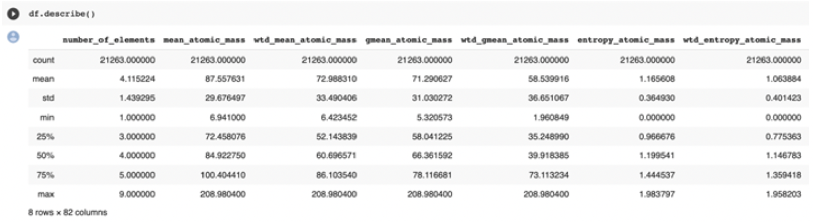
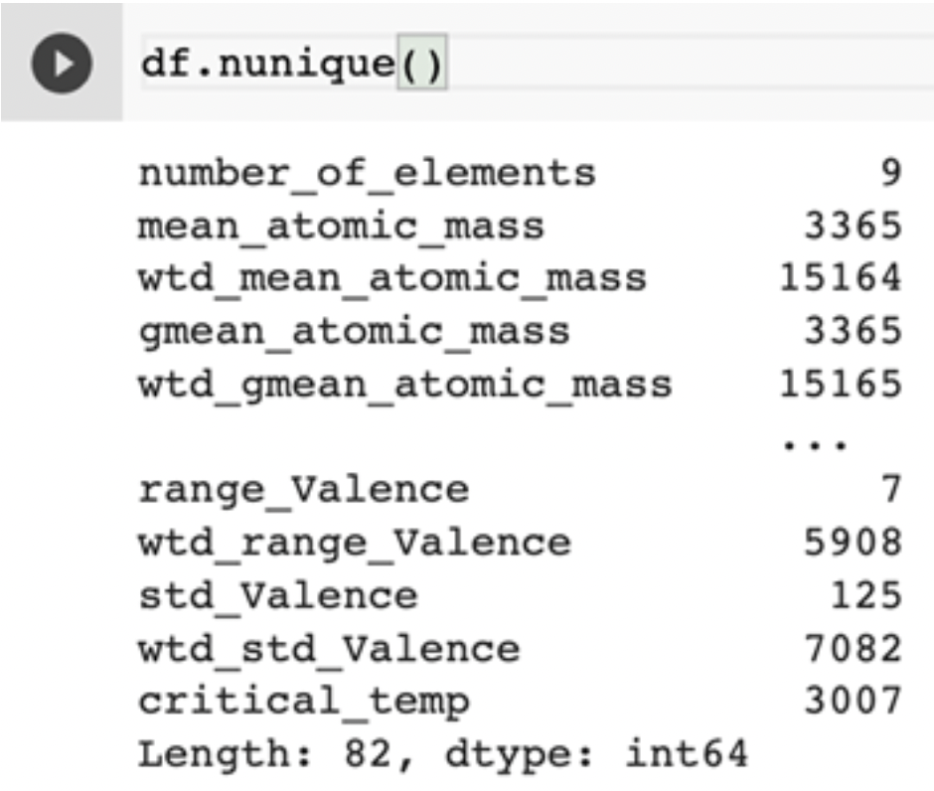
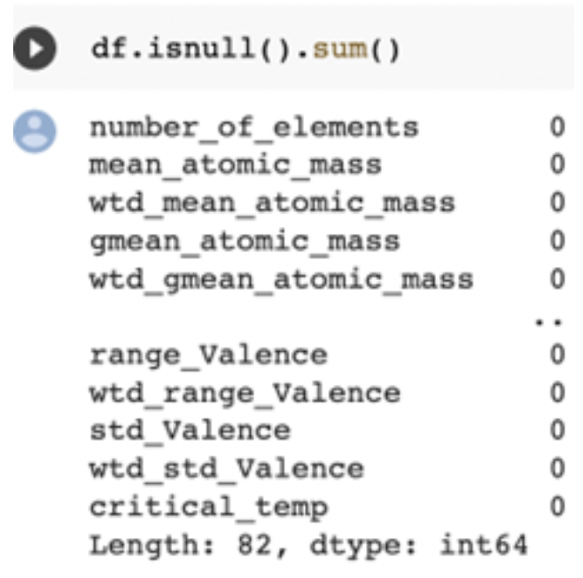
Data Exploration and Visualization

Slide 5
Pre-processing
Removed null records
Checked for categorical data to encode them with one-hot encoding
Standardized to have feature values between 0 and 1
Dimension reduction – using the below chart that plots number of principal components against cumulative variance, 15 principal components are chosen as optimal.

Slide 6
Models explored
Linear regression
With ridge regularization
With lasso regularization
Decision trees
Random forests

Slide 7
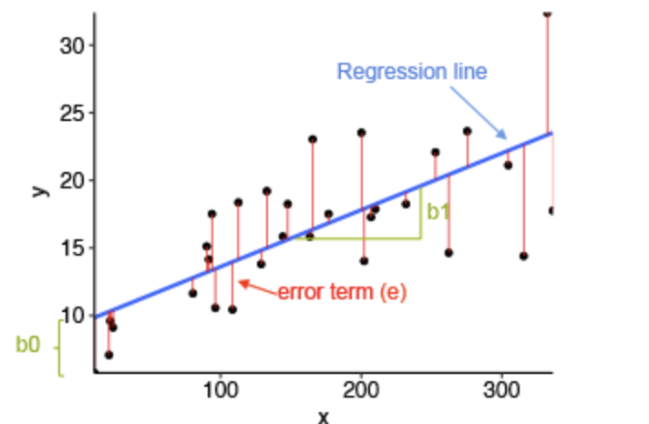
Linear Regression
assumes a linear relationship between the input variables (x) and the single output variable (y).
minimize the residual sum of squares between the observed targets and the predicted Value by the linear approximation.
Regularization: reduce the complexity of the model to avoid Overfitting.

Slide 8


Performance for Linear Regression
Gradient descent: learning = 0.00001, tolerance = 0.00005
Normal Equation:

Slide 9
Decision trees
Decision trees build classification or regression models in the form of a tree structure.
It breaks the dataset into smaller and smaller subsets while incrementally developing tree.
The final result is a tree with decision nodes and leaf nodes.
It is more flexible compared to linear models. Can reduce bias considerably.

Slide 10
procedure
Split – for each feature and for each possible split, computes rss, and chooses the feature and split that minimizes rss as current node.
Allocation – The observations that are less than the threshold goes to the left node and others to the right node.
Tree growth – the above two steps are repeated until all the leaf nodes have a minimum specified observations count or maximum tree depth is reached.
Prediction – based on the split rules on each nodes, test observation are continuously passed through the branches that obey the rules, and once they reach the leaf, prediction is the mean of all the training observations available in that leaf.
Result:
Input- 15 Principal components
RMSE – 18.5

Slide 11


Slide 12
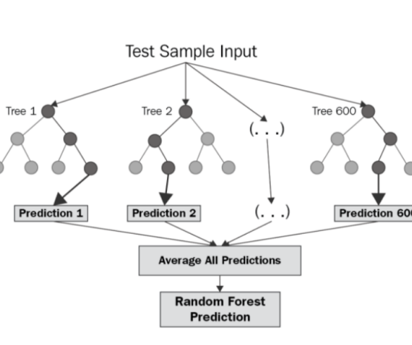
Random Forest Regression
Pick at random k data points from the training set.
Build a decision tree associated to these k data points.
Choose the number N of trees you want to build and repeat steps 1 and 2.
For a new data point, make each one of your N-tree trees predict the value of y for the data point in question and assign the new data point to the average across all of the predicted y values.
The number of trees was set to 2 and MSE calculated was 177.23

Slide 13

Conclusion
The winner among all the regression model was random forest regression with calculated mse of 177.23
We had to use PCA to decrease the number of significant columns from 81 to 15.

