Slide 1
APPLICATION FLOW + TECHNICAL DETAILS / 01
Armo Reputation Risk
Screening Platform
Six-screen workflow and implementation handover
26 September 2026
Functional demo
Fictional data; in-memory case edits
ARMO / Application handover
01
Notes:
Source: user screen1-screen6 references; current README.md. Prepared 26 September 2026. This deck documents the working mock application, not an authorized bank policy or live risk report.

Slide 2
WORKFLOW / 02
Six states form one review journey
01
02
03
04
05
06
Search
→
Confirm
→
Overview
→
Screen
→
Assess
→
Memo
Name or GCIF
Correct entity
Profile + group
Run provider
Review findings
Explain + print
Result: a draft memo containing only the findings the reviewer includes.
The sample workflow has no final approval, submission, or case-save action.
ARMO / Six states form one review journey
02
Notes:
Sources: app/page.tsx; features/entity-search/entity-search.tsx and entity-result.tsx; features/case-workspace/case-workspace.tsx. Each state maps to one supplied screenshot. The workspace uses tabs rather than separate routes for overview, assessment and memo.

Slide 3
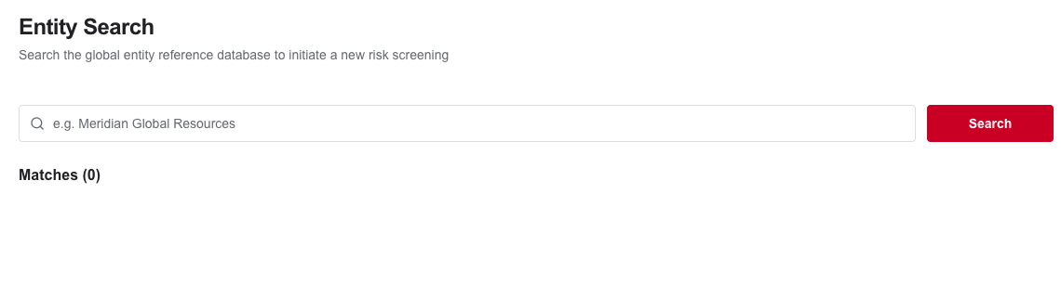
01 / ENTITY SEARCH / 03
Start with an entity name or GCIF
User action
System response
Enter Meridian or ENT-001, then select Search.
Validate the query and request matching reference records.
ARMO / Start with an entity name or GCIF
03
Notes:
Sources: features/entity-search/entity-search.tsx; schema.ts; entity-data.ts. Initial state displays Matches (0). Screenshot captured from the local implemented app, not a redesign. Input is trimmed, validated to 1-120 characters, and disallows remaining control characters.

Slide 4
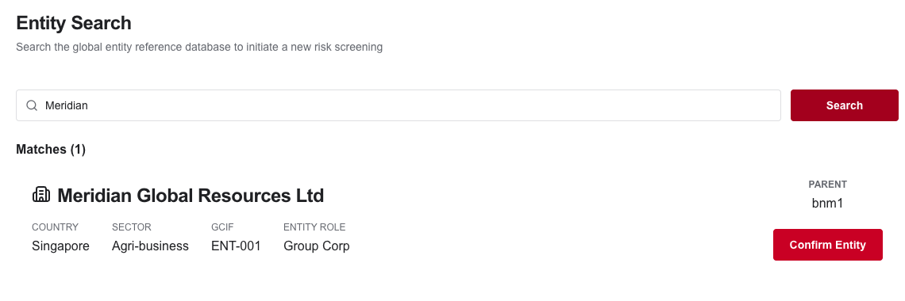
02 / SEARCH RESULTS / 04
Confirm the correct reference entity
Check country, sector, GCIF, role, and parent before choosing Confirm Entity.
ARMO / Confirm the correct reference entity
04
Notes:
Sources: entity-result.tsx; services/entity-api.ts; app/api/entities/route.ts. Matching checks name, legalName, gcif and groupName case-insensitively. Confirm Entity navigates to /entities/ENT-001. The parent value bnm1 is preserved from the source photo.

Slide 5
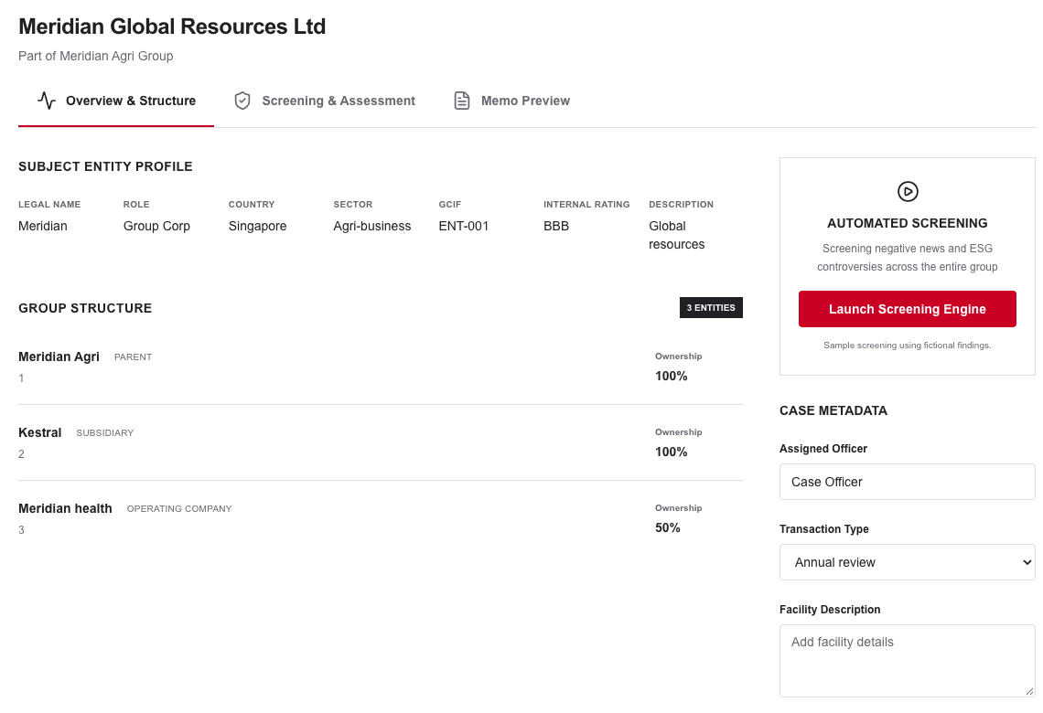
03 / OVERVIEW & STRUCTURE / 05
Review the subject and its group
Before screening
Check the legal profile and ownership structure.
Enter officer, transaction type, and facility details.
Launch Screening Engine when ready.
ARMO / Review the subject and its group
05
Notes:
Sources: overview-panel.tsx; entity-data.ts. The three entities are Meridian Agri (Parent, 100%), Kestral (Subsidiary, 100%) and Meridian health (Operating company, 50%). Case metadata: assigned officer, transaction type, facility description. No save call is made.

Slide 6
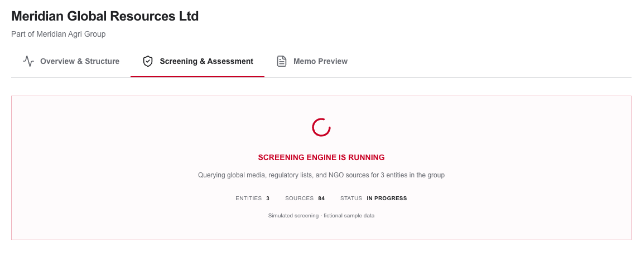
04 / SCREENING IN PROGRESS / 06
Screening runs asynchronously
Launch selects the assessment tab and displays progress.
Current demo: 1.8-second simulated provider response; no live source queries.
ARMO / Screening runs asynchronously
06
Notes:
Sources: screening-progress.tsx; case-workspace.tsx; services/screening-service.ts. Current adapter waits 1.8 seconds and returns fixtures. The 84-source count is illustrative; no external sources are queried. Duplicate launches are guarded. Browser requests are aborted on unmount.

Slide 7
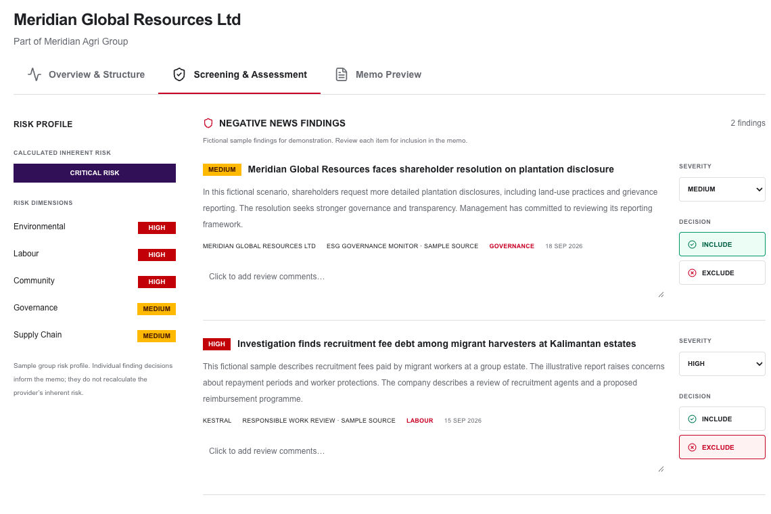
05 / SCREENING & ASSESSMENT / 07
Review each negative-news finding
Reviewer decisions
Read the group risk and each finding.
Adjust severity and add review notes.
Choose Include or Exclude for the memo.
ARMO / Review each negative-news finding
07
Notes:
Sources: assessment-panel.tsx; finding-card.tsx; screening-service.ts. The first fictional finding concerns disclosure governance; the second concerns recruitment-fee debt in an illustrative labour scenario. There are two fixtures. Severity is independently editable per finding.

Slide 8
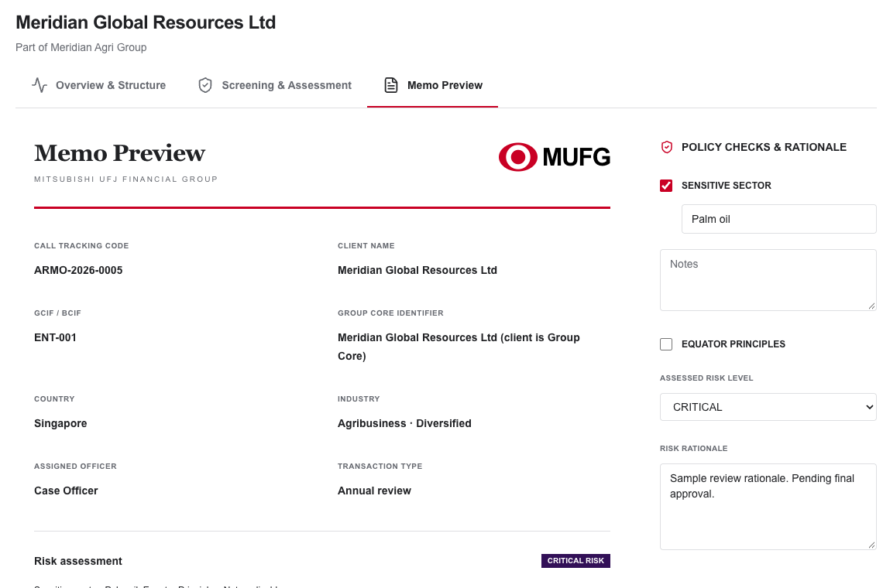
06 / MEMO PREVIEW / 08
Build a memo from reviewed findings
Draft output
Confirm client details and included findings.
Complete policy checks and risk rationale.
Print the memo or save PDF using the browser.
ARMO / Build a memo from reviewed findings
08
Notes:
Sources: memo-panel.tsx; policy-checks.tsx; case-state.ts. Memo reflects entity data, metadata, included findings, reviewer notes, policy notes and rationale. Sensitive sector defaults to Palm oil, Equator Principles is unchecked. Assessed risk starts at provider Critical and can be changed. Print uses window.print(); there is no document submission or approval endpoint.

Slide 9
WORKFLOW / 09
Review decisions control memo content
Pending
Include
Exclude
The finding has no final inclusion decision.
The finding, severity, and review notes appear in the memo.
The finding stays visible in assessment but is absent from the memo.
Pending items keep a draft reminder visible.
Selecting Include again returns it to Pending.
Selecting Exclude again returns it to Pending.
Provider inherent risk stays unchanged. Memo assessed risk is separately editable.
ARMO / Review decisions control memo content
09
Notes:
Sources: finding-card.tsx; case-state.ts getIncludedFindings/getPendingFindingsCount; memo-panel.tsx. Provider inherent risk does not recalculate after include/exclude or severity changes.

Slide 10
WORKFLOW / 10
Errors keep the next action clear
Condition | Visible behavior | Next action
Invalid search | Field-level validation message | Correct the query
No match | Matches (0) + empty-state text | Try another name or GCIF
Search API failure | Recoverable error message | Search again
Screening failure | Error state + Retry screening | Retry the provider request
Unknown entity | Not-found page | Return to Entity Search
ARMO / Errors keep the next action clear
10
Notes:
Sources: entity-search.tsx; case-workspace.tsx; app/error.tsx; app/not-found.tsx. Error messages are generic. Screening failure can be retried without discarding metadata.

Slide 11
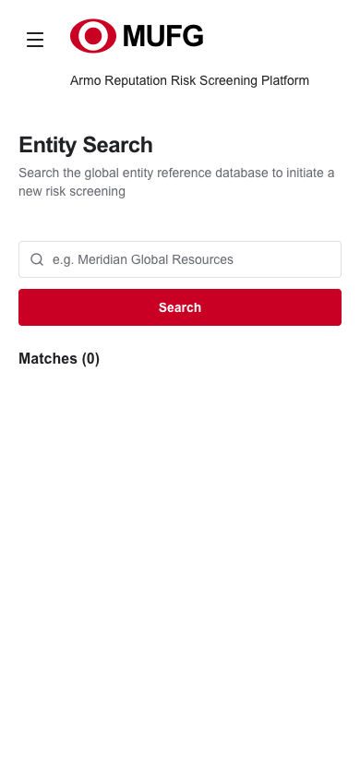
WORKFLOW / 11
Use the same workflow on mobile
Responsive behavior
Desktop navigation can collapse; mobile navigation expands in place.
Search controls stack, panels reflow, and case tabs scroll horizontally.
Keyboard tabs support Left, Right, Home, and End.
ARMO / Use the same workflow on mobile
11
Notes:
Sources: components/layout/app-shell.tsx; case-tabs.tsx; app/globals.css; responsive Tailwind classes in feature panels. Sidebar routes: Dashboard, Search Entity, Case Queue, Reference. Mobile screenshot captured at 390px.

Slide 12
IMPLEMENTATION / 12
Separate the UI from data providers
Pages + features
API clients
Route handlers
Server adapters
→
→
→
React components
Typed fetch boundary
Validation + responses
Mock data today
Replace the server adapters when connecting real data.
Preserve the request/response contracts so the UI does not need to be redesigned.
ARMO / Separate the UI from data providers
12
Notes:
Sources: app directory; features directory; services/entity-api.ts, entity-service.ts, screening-api.ts and screening-service.ts. Pages fetch the entity on the server. Interactive events call API clients. Services marked server-only are not imported into client bundles.

Slide 13
IMPLEMENTATION / 13
Each module has a focused responsibility
Application structure
Behavior and integration
app/ owns routes, metadata, loading, error, and not-found boundaries.
services/ separates browser API clients from server-only provider adapters.
components/ owns the responsive shell, branding, Button, and Input.
Zod schemas validate API data at runtime.
features/ owns search and the composed case workspace.
A typed case reducer handles lifecycle and review edits.
ARMO / Each module has a focused responsibility
13
Notes:
Sources: README.md architecture map; app/layout.tsx; components; features/entity-search; features/case-workspace; services. No extra state library or unnecessary custom hooks.

Slide 14
IMPLEMENTATION / 14
Routes keep the workspace predictable
Route | Responsibility
/ | Entity Search and result confirmation
/entities/[id] | Server lookup + Overview / Assessment / Memo tabs
/dashboard | Start a screening or explore the sample case
/cases | Open the fixed demonstration case
/reference | Workflow guidance and demo limitations
/api/entities; /api/screenings | Search and screening API boundaries
ARMO / Routes keep the workspace predictable
14
Notes:
Sources: app/page.tsx; app/entities/[id]/page.tsx; app/dashboard/page.tsx; app/cases/page.tsx; app/reference/page.tsx; app/api routes. Entity route is keyed by entity ID to reset case state when switching entities.

Slide 15
IMPLEMENTATION / 15
Search has a small validated contract
GET /api/entities
Boundary behavior
Request: ?q=Meridian
Trim input; require 1–120 characters; reject control characters.
Response: { query, entities }
Validate returned entity fields and ownership percentages.
Matching is case-insensitive across name, legal name, GCIF, and group name.
400 invalid query; 503 unavailable service. Private, no-store responses.
ARMO / Search has a small validated contract
15
Notes:
Sources: app/api/entities/route.ts; features/entity-search/schema.ts, entity-data.ts, types.ts; services/entity-api.ts. Browser uses URLSearchParams and validates returned data; generic error messages avoid internal detail.

Slide 16
IMPLEMENTATION / 16
Screening returns a typed report
POST /api/screenings
Current mock response
Request: { entityId: "ENT-001" }
Case: ARMO-2026-0005
Report: ID, entityId, generatedAt, overallRisk, categories, and findings.
3 group entities; 84 illustrative sources; 2 fictional findings.
Client verifies the schema and that the response entity matches the request.
Provider inherent risk: Critical. The response is marked sample: true.
ARMO / Screening returns a typed report
16
Notes:
Sources: services/screening-api.ts; screening-service.ts; features/case-workspace/types.ts. Server delay 1800ms; no external queries. Counts are fixture properties.

Slide 17
IMPLEMENTATION / 17
The screening API rejects invalid requests
HTTP | Condition | Boundary
400 | Malformed JSON or invalid shape | Strict request schema
403 | Origin differs from expected origin | APP_ORIGIN or protocol + Host
404 | Entity ID is not in the directory | Server entity lookup
413 | Read body exceeds 2,048 characters | Local size check
415 | Content type is not application/json | Content-type check
500 | Provider throws unexpectedly | Generic failure response
ARMO / The screening API rejects invalid requests
17
Notes:
Source: app/api/screenings/route.ts. Request is a strict object with entityId string length 1–100. The body limit is checked after request.text() and counts characters, not a streaming byte limit. An upstream request limit is still needed. Missing Origin is accepted; origin checking is not authentication.

Slide 18
IMPLEMENTATION / 18
Three data groups drive the workspace
Entity
Screening report
Case assessment
ID, name, legal name, country, sector, GCIF, role, parent, and rating.
Case ID, entity ID, timestamp, sample flag, counts, and inherent risk.
Assigned officer, transaction type, and facility description.
Group name and members with ownership percentages.
Categories plus findings, severity, decision, and reviewer notes.
Sensitive sector, policy notes, Equator Principles, assessed risk, and rationale.
ARMO / Three data groups drive the workspace
18
Notes:
Sources: features/entity-search/types.ts and schema.ts; features/case-workspace/types.ts. Case metadata and policy fields are local browser state; no persistence endpoint exists.

Slide 19
IMPLEMENTATION / 19
Case state follows a clear lifecycle
Event | State effect | Visible result
Launch | idle → running; select assessment | Progress panel
Provider succeeds | running → complete; store report | Findings available
Provider fails | running → error; keep metadata | Retry action
Switch tab / edit | Update reducer state in memory | Memo reflects decisions
Reload / leave case | Discard the local workspace state | Fresh case on return
ARMO / Case state follows a clear lifecycle
19
Notes:
Sources: case-state.ts; case-workspace.tsx. Reducer guards running duplicates. A useRef request guard prevents duplicate client requests. AbortController cleanup runs on unmount. State transitions do not save to disk, localStorage, sessionStorage or a backend.

Slide 20
IMPLEMENTATION / 20
Field limits constrain demo inputs
Field | Limit or allowed values
Search query | 1–120 characters after trimming
Assigned officer / sensitive sector | Maximum 120 characters each
Facility description | Maximum 1,000 characters
Review notes / policy notes / rationale | Maximum 2,000 characters each
Finding severity | Low / Medium / High
Assessed risk | Low / Medium / High / Critical
ARMO / Field limits constrain demo inputs
20
Notes:
Sources: features/entity-search/schema.ts; case-workspace/overview-panel.tsx; finding-card.tsx; policy-checks.tsx. Entity search is validated server-side and client-side. Case editing fields are local only; HTML maxLength constrains their UI entry. Production save endpoints must revalidate them server-side.

Slide 21
IMPLEMENTATION / 21
Security controls have explicit limits
Implemented
Needed for real data
Server-only adapters, runtime validation, escaped React text, and generic errors.
Server authentication and tenant/entity authorization.
No client credentials or sensitive browser storage.
Rate limits, audit records, persistent storage, and upstream request limits.
Security headers and a same-origin browser request check.
Deployment-specific CSP, trusted proxy configuration, and operational monitoring.
ARMO / Security controls have explicit limits
21
Notes:
Sources: next.config.ts; app/api routes; services/*-service.ts; README.md Security section. Headers include X-Content-Type-Options nosniff, X-Frame-Options DENY, Referrer-Policy, Permissions-Policy, and baseline CSP. Missing authentication means this remains a public fictional-data demo.

Slide 22
IMPLEMENTATION / 22
Rendering stays lean and accessible
Server rendering
Client boundaries
Accessible controls
Pages and metadata run on the server.
AppShell controls navigation.
Labels, visible focus, status announcements, and a skip link.
Entity data is loaded before the interactive workspace renders.
EntitySearch handles form events; CaseWorkspace owns review interaction.
Semantic tabs with keyboard navigation.
Supporting pages can be prerendered.
System fonts and SVG icons avoid external asset requests.
Text accompanies risk colors; reduced motion and print styles are included.
ARMO / Rendering stays lean and accessible
22
Notes:
Sources: app/layout.tsx; app/entities/[id]/page.tsx; components/layout/app-shell.tsx; case-tabs.tsx; app/globals.css. Client components are used only where interaction is required. Accessibility testing is not a claim of complete WCAG conformance.

Slide 23
VERIFICATION / 23
Verification covers behavior and layout
9
6
Build checks
Unit tests
Browser specs
Production build
TypeScript checks
ESLint
Passed during implementation verification.
Query validation, fixture isolation, report schemas, lifecycle, and memo inclusion.
Desktop/mobile flow, API failures, invalid requests, keyboard tabs, and selected axe checks.
ARMO / Verification covers behavior and layout
23
Notes:
Sources: tests/entity-search.test.ts (5 unit cases); tests/screening.test.ts (4); tests/workflow.spec.ts (6). Implementation verification on 25 September 2026 passed build, typecheck and lint. The six browser specs passed across an initial run and targeted re-run after correcting origin validation. Fresh screenshots in this deck were captured on 26 September; a new full-suite execution was not needed for this documentation task.

Slide 24
OPERATIONS / 24
Run and verify the application locally
Install and start
Check and build
Node.js 20.9 or later.
npm run typecheck
npm run lint
npm test
npm run test:e2e
npm ci
npm run dev
npm run build
npm start
Open http://127.0.0.1:3000
Search Meridian or ENT-001.
Stop the development server before starting production on the same port.
ARMO / Run and verify the application locally
24
Notes:
Sources: package.json; README.md; playwright.config.ts. Playwright uses the configured local Chrome if available; otherwise run npx playwright install chromium, or set PLAYWRIGHT_CHROMIUM_EXECUTABLE.

Slide 25
OPERATIONS / 25
Dependencies are pinned for reproducibility
Layer | Pinned version / implementation
Framework | Next.js 16.3.6 with App Router
UI runtime | React and React DOM 19.3.0
Styling | Tailwind CSS 4.3.3
Type checking | TypeScript compiler 7.0.2
Tooling compatibility | TypeScript 6.0.2 API alias
Validation | Zod 4.6.5
ARMO / Dependencies are pinned for reproducibility
25
Notes:
Source: package.json and package-lock.json, inspected 26 September 2026. These are project versions, not a fresh claim of latest stable releases. TypeScript 7 compiler is aliased as @typescript/native; typescript aliases @typescript/typescript6 for the programmatic API used by tooling. README links Microsoft’s side-by-side guidance.

Slide 26
PRODUCTION HANDOFF / 26
Connect real services without changing the UI
Keep the contracts
Add durable operations
Replace entity-service.ts with the authorized entity directory.
Use screening jobs with polling and server-side idempotency.
Replace screening-service.ts with a real provider adapter.
Store case decisions, metadata, policy fields, and audit history.
Validate upstream responses and remove sample-only labels and schema restrictions.
Enforce access controls on every server data operation.
ARMO / Connect real services without changing the UI
26
Notes:
Sources: README.md API integration; server-only service adapters; case-workspace/types.ts sample literal. This slide is a proposed integration plan, not implemented functionality.

Slide 27
HANDOFF NOTES / 27
Read the demo with these assumptions
Reference ambiguity | Implementation decision
Different GCIF values in photographs | Use ENT-001 consistently
Unreadable news/source text | Use explicitly fictional sample findings
Seven findings shown during loading | Provide the two visible sample findings
Critical report vs Low memo screenshot | Start memo risk at Critical; allow reviewer edits
MUFG brand asset not supplied | Use an SVG approximation pending approved artwork
ARMO / Read the demo with these assumptions
27
Notes:
Sources: original six user photographs and README.md assumptions. No institutional policy or legal/financial conclusions are asserted. References in the source photographs were not queried or verified against external sources.

Slide 28
NEXT STEPS / 28
Use the full journey to review the handover
Walk through the demo
Continue with the source
Search Meridian and confirm the entity.
README.md contains setup, design assumptions, and integration guidance.
Review the group and launch screening.
IMPLEMENTATION.md contains the complete file-by-file source.
Include one finding, exclude another, then inspect the memo.
Agree the real data, identity, storage, and approval requirements before deployment.
ARMO / Use the full journey to review the handover
28
Notes:
Sources: README.md; IMPLEMENTATION.md; actual local application. All sources are project-local; no external research was required for this deck. Screenshots are fresh captures of the implemented local app. Suggested walkthrough is demonstrative and uses fictional records only.

