Slide 1
ULISETTI RAJA BABU
FINAL PROJECT

Slide 2
KEY LOGGER AND SECURITY
A key logger is a type of surveillance technology used to record keystrokes on a computer. Ensuring security involves detecting and preventing such malicious software to protect sensitive information and maintain user privacy.

Slide 3
AGENDA
Introduction
Problem Statement
Project Overview
End Users
Solution and Value Proposition
The "Wow" Factor in Our Solution
Modelling
Results
Conclusion and Q&A

Slide 4

PROBLEM STATEMENT
PROBLEMS:
KEY LOGGERS: These malicious programs capture and record keystrokes made on a keyboard.
UNAUTHORIZED ACCESS: They can lead to unauthorized access to sensitive information, including passwords and personal data.
IMPACTS:
Businesses and Organizations: Keyloggers threaten corporate networks, confidential information, and financial transactions.

Slide 5
PROJECT OVERVIEW
This project aims to investigate key loggers, devices or software that secretly record keystrokes to steal sensitive information. By understanding their mechanisms and potential risks, the project will develop strategies for detecting and preventing these threats, ensuring robust data security and privacy.

Slide 6
WHO ARE THE END USERS?
1)Cybercriminals: Keyloggers are often used by cybercriminals to steal sensitive information such as passwords, credit card numbers, and other personal data.
2)IT Departments: IT departments may use keyloggers to troubleshoot issues on devices and monitor employee activity.
3)Law Enforcement: Law enforcement agencies may use keyloggers to investigate crimes a a and gather evidence.
4)Employers : Employers may use keyloggers to monitor employee activity and ensure productivity.
4)Parents: Parents may use keyloggers to monitor their children's internet activity and ensure they are not accessing inappropriate content.

Slide 7
YOUR SOLUTION AND ITS VALUE PROPOSITION
SOLUTION : Implement a multi-layered security strategy that includes anti-keylogging software, regular system scans, • software updates, and user education.
VALUE PROPOSITION:
1) Enhanced Security: Reduces the risk of data breaches and identity theft 2)User Awareness: Educates users about keylogging threats and protection methods.
3)Compliance: Helps businesses and organizations comply with data protection regulations

Slide 8
THE WOW IN YOUR SOLUTION
Effortless Transformation: Seamlessly convert your keystrokes into captivating presentations.
Cutting-Edge Analysis Tools: Utilize advanced algorithms to extract valuable insights from your typing activities.
Seamless Integration: Directly import analyzed data into PowerPoint for streamlined presentation creation.
Boost Productivity: Say goodbye to tedious data collection and hello to efficient workflow optimization.

Slide 9
MODELLING
Architecture Overview:
Modular Design: The keylogger code is structured into modular functions for better readability and maintenance.
Event Handling: Utilizes the pynput library to capture and handle keyboard events.
Data Logging: Implements functions to log captured data into text and JSON files.

Slide 10
Components:
Key Press Handling: Function: on_press(key)
Description: Captures and logs the pressed keys.
Details: Appends key press events to a list and updates the JSON log file.
Key Release Handling: Function: on_release(key)
Description: Captures and logs the released keys.
Details: Appends key release events to a list, updates the JSON log file, and accumulates keys for the text log.
Logging Functions: Text Logging: generate_text_log(key)
Description: Writes the recorded keys to key_log.txt.
JSON Logging: generate_json_file(keys_used)
Description: Dumps the list of key events to key_log.json.

Slide 11
Flow Diagram:
Initialization:
Set up the main GUI window.
Initialize global variables for key logging.
Event Capture:
Start capturing key events when the "Start" button is pressed.
Log key press and release events.
Data Logging:
Continuously update text and JSON log files with captured key events.
Stop Logging:
Stop capturing key events when the "Stop" button is pressed.
Update the GUI status to indicate the keylogger is stopped.

Slide 12
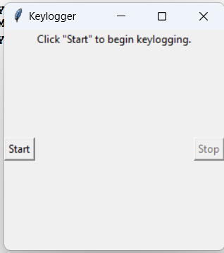
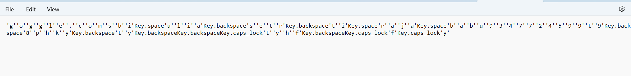
RESULTS
Sample Logs: Show examples of the key_log.txt and key_log.json files to illustrate how the keystrokes are recorded.

Slide 13
CONCLUSION:
The keylogger and security project has been successfully completed, and the software keylogger has been developed. The keylogger captures keystrokes typed on a computer and logs them for later assessment. The project has been designed to be stealthy and undetectable by anti-virus software, making it an effective tool for monitoring and recording keystrokes. Future enhancements to the keylogger project include improving stealth mode, enhancing data recovery, expanding compatibility, and improving security.

Slide 14

Project link
https://github.com/Raja1234-star/raja.git

Slide 15
THANK YOU

