Slide 1

IMPLANABLE ANTENNA IN MEDICAL DEVICES
Presented By:
Alnoor Parveen 05351202819
Prince Sareen 04551202819
Raja 04951202819
Jatin 04351202819
Vikram Kumar 04851202819
Guided By:
DR. Rajiv Nehra

Slide 2
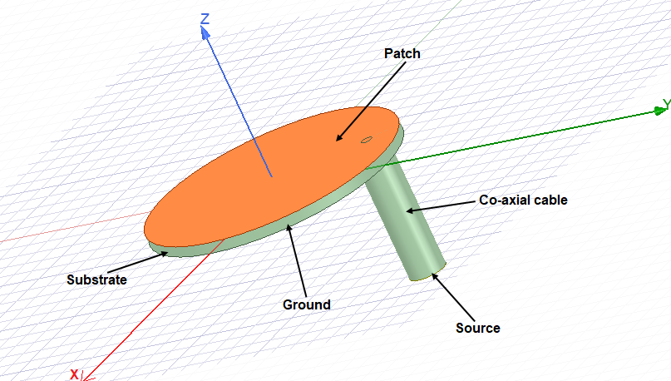
CONTENTS
INTRODUCTION
OBJECTIVE
METHODOLOGY
APPLICATIONS
RESULT
COMPARISON TABLE
CONCLUSION
REFERENCES
Figure 1: structure of antenna

Slide 3
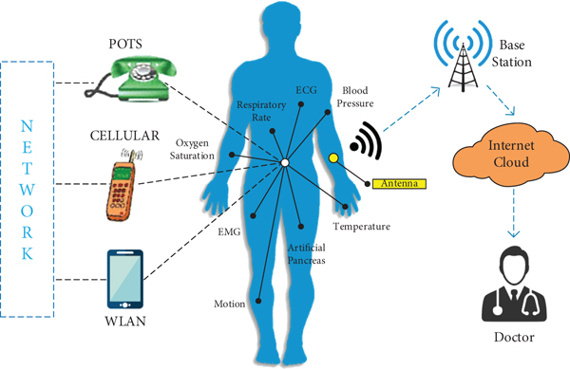
INTRODUCTION
The implantable patch antenna makes the easy communication between doctor and patient.
An implantable antenna, is necessary to reduce wave decline in complex human environment. While designing wearable antenna, more attention must be paid on miniaturization.
The developed implant antenna is categorized based on design aspects, such as miniaturization of antenna dimension, bandwidth enlargement technique SAR reduction and biocompatibility technique.
Figure 2: Linkage of Devices

Slide 4
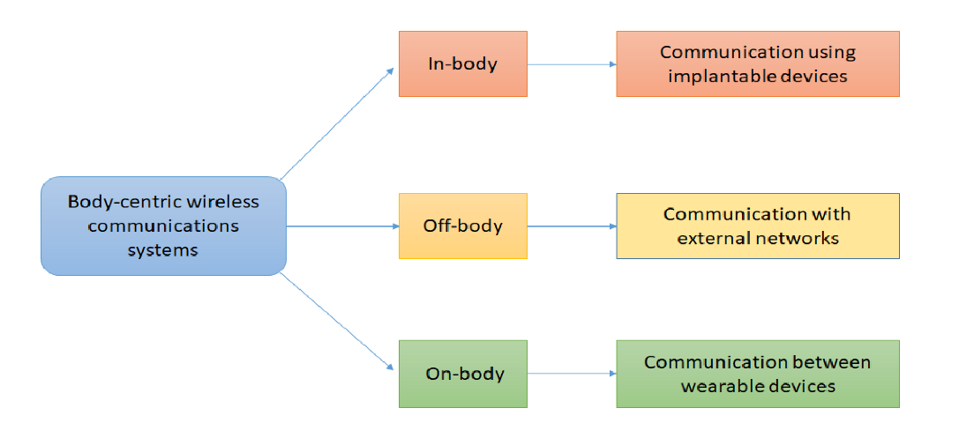
OBJECTIVE
This work focuses on how to increase the implanted antennas performance using external elements such as a grid structure, printed lines and lens
The dispersion of the dielectric constant of the tissues and variability of organ structures of the human body absorb most of the antenna radiation.
Designing an efficient, miniaturized and high performance dual-band implanted antenna and improving its performance using external elements.
Figure 3: body-centric wireless
communications

Slide 5
LITERATURE SURVEY
Paper Name | Authors | Methodology
Implantable Antennas for Bio-medical Applications [1]. | N A Malik et.al | This paper discuss the various methods and technologies indulge in various implantable antenna.
Miniaturized Dual-Band Circularly Polarized Implantable Antenna for Capsule Endoscopic System [2]. | S Hayat et.al | The proposed capsule device is intended for deep-tissue implantation with the standard dimensions of 26 x 11 mm2.
An Ultra-Miniaturized Antenna Using Loading Circuit Method for Medical Implant Applications [3]. | D NGUYEN et.al | In this paper, an ultra-miniaturized implantable antenna is proposed for biomedical applications, which operates in frequency of the industrial, and medical bands of 2.4 GHz.
A Review of Implantable Antennas for Wireless Biomedical Devices [4]. | C Liu et.al | The research progress on implantable antennas for wireless biomedical devices is discussed and summarized.

Slide 6
METHODOLOGY
Designed Reference Antenna Using HFSS.
Optimize The Co-axial Field For Impedance Matching.
Apply Techniques To Get Best Performance And Designed Proposed Antenna(by Using Sorting Pin Etc. ).
Getting The Results Like SAR Value , Return Loss , Gain , Band Width And Axial Ratio.
Analyzed And Compared The Results Of Reference Antenna With Proposed Antenna.
Writing A Research Paper.
Design circular patch antenna
Validate
Analyze all
Checking the Results
Figure 4: Methodology

Slide 7
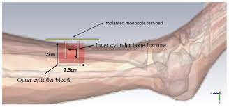
APPLICATIONS
Implant antenna for healing of bone fracture
Implant antenna for glucose level monitoring in blood
Implant antenna for diagnosis brain disease.
Implant antenna for blood pressure measurement
Figure 5: Healing of bone

Slide 8
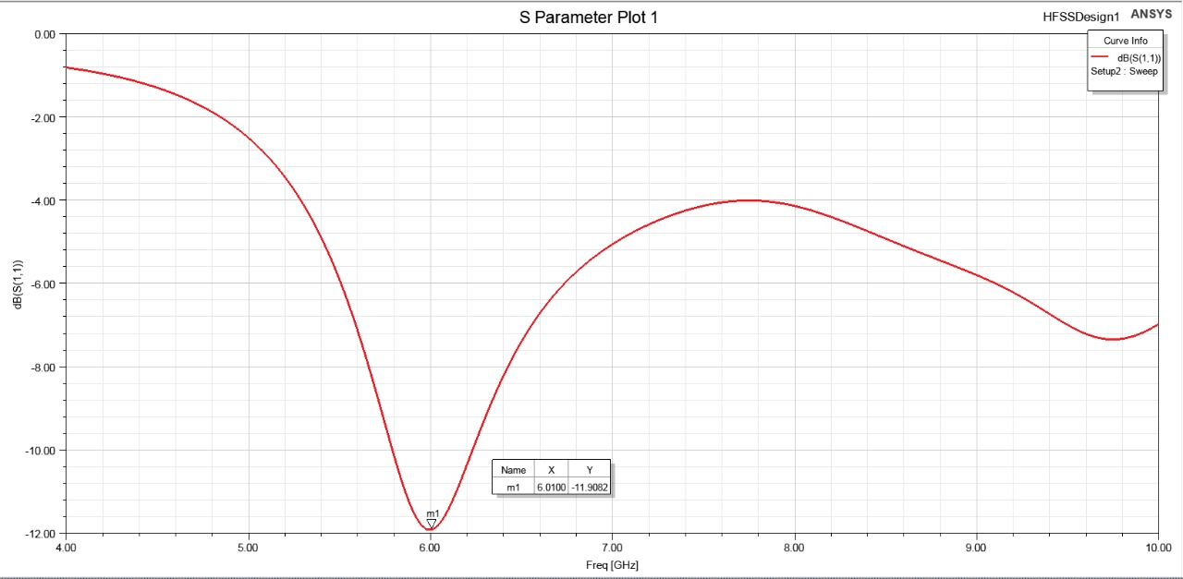
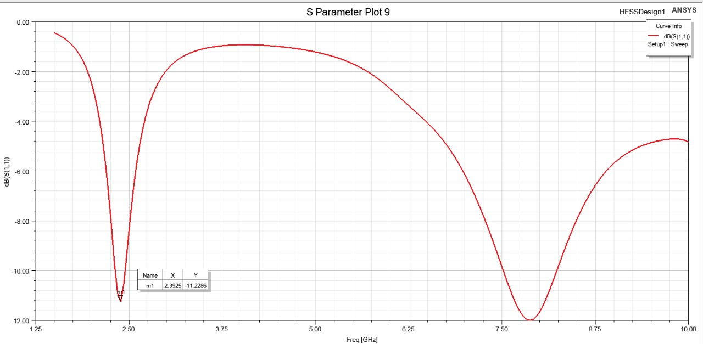
RESULT
Reference Antenna
Proposed Antenna
Figure 6: Return Loss

Slide 9
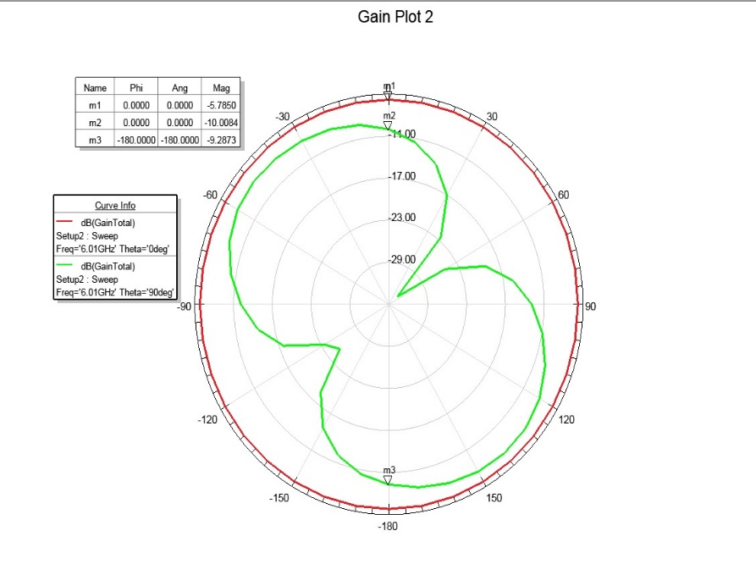
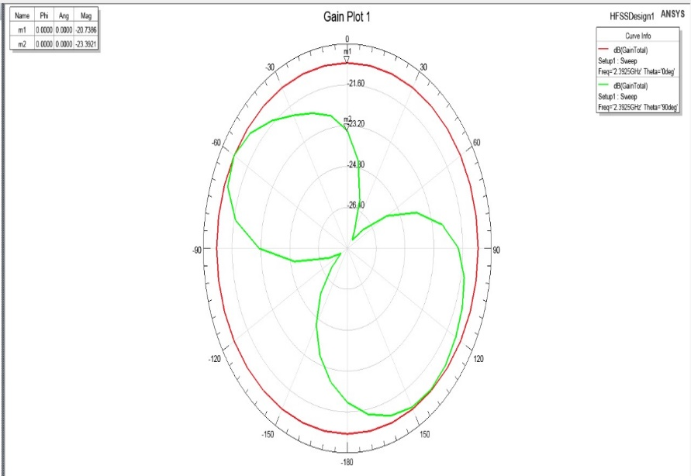
RESULT (conti.)
Reference Antenna
Proposed Antenna
Figure 7: Gain Value

Slide 10
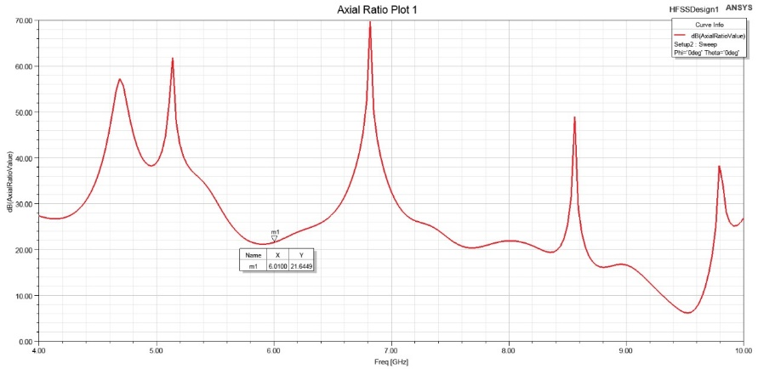
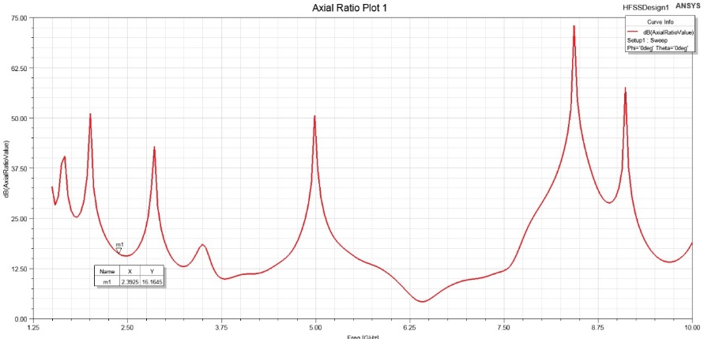
RESULT (conti.)
Reference Antenna
Proposed Antenna
Figure 8: Axial Ratio

Slide 11
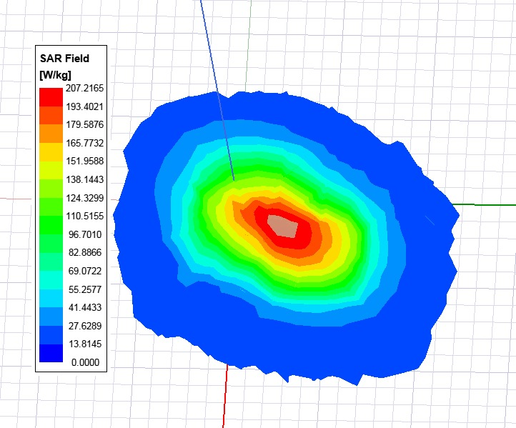
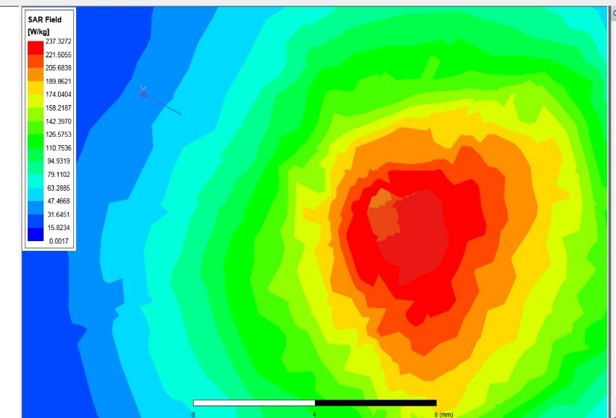
RESULT (conti.)
Reference Antenna
Proposed Antenna
Figure 9: SAR Value

Slide 12
COMPARISON
Table 2: COMPARISON Between Reference Antenna And Proposed Antenna
 | Resonating Frequency (GHz) | Return Loss (db) | Gain (db) | Impedance Bandwidth (MHz) | SAR (w/g)
Reference Antenna | 6.010 | -11.908 | -5.785 | 80 | 207.215
Proposed Antenna using Sorting Pin (1.9 , 2.4 , 0) ) | 2.4 7.87 | -11.22 -11.98 | -20.738 | 900 | 237.327

Slide 13
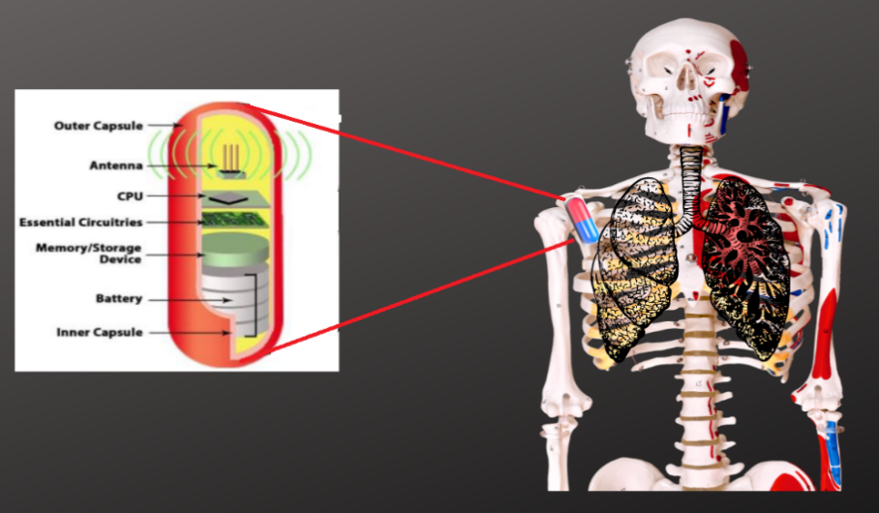
Future Scope
A significant amount of absorption results in low radiation efficiency and inefficient antenna operation.
The radiating wave travels through the near field and far field to reach the outside receiver antenna, since the absorption in the far-field is unavoidable. However, the absorption of a radio wave can be avoided if the biocompatibility of the implant antenna is covered near the field.
Figure 10: Encapsulation of Implantable
Medical Antenna

Slide 14
CONCLUSION
This work is simulated by using Hfss software. In this project, we have simulated the circular patched antenna.
We have implemented various techniques for miniaturization like High-permittivity dielectric substrate/superstrate, Use of a planar inverted-F antenna structure, lengthening the current channel, Impedance matching loading technique, higher operating frequency.
We have calculated the body-centric wireless communications. We have simulated the circular patched antenna using hfss software.
We have drawn the rectangular wave plot to show the relation between S parameters. This type of antenna can helps for Diagnosis of human body organs wirelessly

Slide 15
REFRENCES
N. A. Malik, P. Sant, T. Ajmal & M. Ur-Rehman, (2021). Implantable Antennas for Bio-Medical Applications. in IEEE Journal of Electromagnetics, RF and Microwaves.
S. Hayat, S. Shah & H. Yoo, (2021). Miniaturized Dual-Band Circularly Polarized Implantable Antenna for Capsule Endoscopic System.
D. Nguyen & C. Seo, (2021). An Ultra-Miniaturized Antenna Using Loading Circuit Method for Medical Implant Applications, in IEEE Access
Liu, C., Guo, Y., & Xiao, S. (2015). A Review of Implantable Antennas for Wireless Biomedical Devices.
Jaehoon K. & Y. Rahmat, (2004). Implanted antennas inside a human body: simulations, designs, and characterizations," in IEEE Transactions on Microwave Theory and Techniques.
V. Kaim, B. K. Kanaujia & K. Rambabu, (2021). Quadrilateral Spatial Diversity Circularly Polarized MIMO Cubic Implantable Antenna System for Biotelemetry, in IEEE Transactions on Antennas and Propagation.

Slide 16


