Slide 1


A PROJECT REPORT Submitted by
Automatic Question Tagging Using NLP Techniques
RATHEESH B [REGISTER NO:211417104223]
RAJA RAM A [REGISTER NO:211417104211]
SANJAY KUMAR V[REGISTER NO:211417104239]
Batch no:9
Project Guide
Mr.M.Shanmuganathan

Slide 2
INTRODUCTION
Internet has demonstrated itself as a magnificent design over time. Today, billions of people have contact to internet and they promote by making proper use of that technology. This technology can be used in abundant different ways to aid our comfort .
Tagging is a machine learning technique which provide tags to the information that user can easily identify the related information user searching for but there is flaw in that method most technology uses manual tagging and semi-manual tagging which is time consuming and people must be expert in that domain has the ability to identify the question and tag them it is not possible in real time and high in cost.
We propose an automatic tagging method using NLP which automatically tag question where user can get what information he is searching for which overcome earlier methods.
The main aim of this project is to give knowledge regarding Health and diseases of human by receiving user query.

Slide 3
LITERATURE SURVEY
EXISTING SYSTEM:
In existing system user search different information in internet to get the knowledge about the content in this environment there is possibility that user can’t get the desired information or it’s hard to find the required information or can’t get the clear knowledge about it and doesn’t give any alternative solution to the user these methods are done with manual tagging and semi automatic tagging
First method of manually tagging questions with knowledge units needs that the taggers be specialist in that subject a question bank usually contains a huge number of questions, which are updated constantly this makes manual tagging costly in terms of the time taken and related cost .
Semi-automatic tagging analyzes content and returns tags that need to be more processed by users, making human help mandatory. There is high chance that questions can be mismatched.
PROBLEM STATEMENT:
Manual tagging needs more time and manual work
Semi-automatic tagging the content has again to be processed
Higher level possibility of not able to receive requested user queries
High cost and time

Slide 4
PROPOSED SYSTEM
We propose an automatic tagging of questions by using NLP (Natural language processing) one of the machine learning techniques. Machine Learning (ML) is applications of artificial intelligence (AI) that provides systems the ability to automatically learn.NLP analyzes understand the human language in a smart and useful way.
The previous systems are build using manual and semi-auto tag which is not suitable in making daily updates of data and is not possible to generate requested information and mines the unwanted answers (information) to the user that are confusing and tags are mismatched wrong it makes difficult to observe the information.
In this work we done an automatic question tagging that overcome all existing problems. The Medical datasets are collected from the Medinet library. the data’s are stored in the CSV file formats for the later use. CSV file contains the questions and answers from the medical health domain and then the automatic tagging takes place of the question and Answer then the user search the query in AWS(Amazon web service) and the query is forwarded to the Medinet library to extract the user queried related answer .
Medinet library contains 700 medical domain files which is stored in tc2011 api if the requested file not found in Medinet it redirect to PDF box it will provide pdf files(contains information about domain or diseases) related to the question The pdf files are extracted by using lucene indexing which provide fast retrieval of files
If the answer is not related to query or not clear. the question will forwarded to the Expert(doctor) who can clear the doubts and replay for the query.
Finally providing the quiz for the student who want know their knowledge in the medical field and providing them domain score and overall score and feedback for the student.

Slide 5
Technology Stack
HARDWARE REQUIREMENTS
Hard Disk : 80GB and Above
RAM : 4GB and Above
Processor : P IV and Above
SOFTWARE REQUIREMENTS
Windows 7 or above
JDK 1.7 and JDK 1.6
Tomcat 6 and Tomcat 7
Struts, Servlets

Slide 6
System Architecture
First module Admin has to register first and then provide admin details (Name and password) valid admin enters the page.
Admin is responsible for the whole operation admin work includes cleaning, adding the CSV files, analyzing resources, NLP (Natural language processing) and cleaning NLP.
The user has to register their details first after that user login using (Name and Password) if user is valid enters the page then user chooses the categories of domain present in the page user clicks the categories it show list available domains then user select any one domain based on that related information or question and answers to that domain will be displayed.
If the requested domain information or question answer is not available it provides PDFs related to that domain the provided answers of the question are not satisfied when user feels.

Slide 7
User can ask question to the Expert (doctor) who can clearly answer the user query. Expert (doctor) has to register first like (Name, Expert id, category of doctor) after that login using valid credentials.
Here expert id is unique id for the expert and category is to identify the expert domain. Expert enters the page and he gets the notification from the user who asked the question after that Expert analyze the question and provides the related answer to the question the answer is forwarded to the user profile.
User can view the answer any time, student registers first after the login page is forwarded to the quiz page the student is asked to write quiz in medical domain.
Questions from medical domain is provided student has to answer it finally student gets the overall score of the test, domain score, and gets the feedback for the test which the student can improve knowledge in that domain.

Slide 8












Architecture Diagram:
Admin
Auto Tagging User Interface
User
User Search Category
Clean
Expert forward Answer
If Answer not There
Analyze CSV
Student
Analyze Resource
If Answer not found in PDF
NLP
Ask question to Expert
Feed Back
Expert

Slide 9
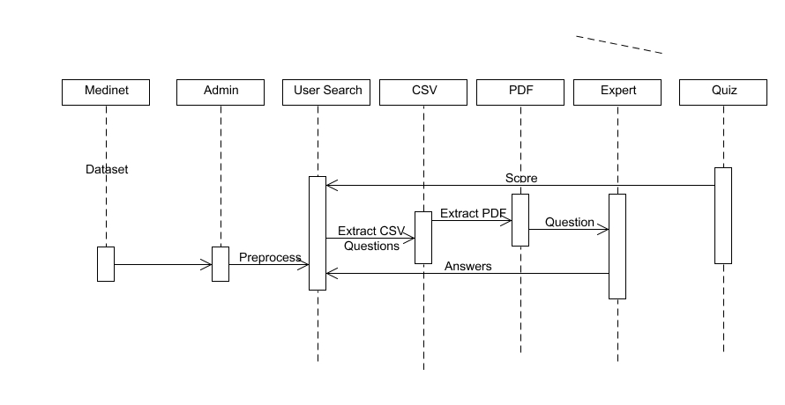
Sequence Diagram:

Slide 10
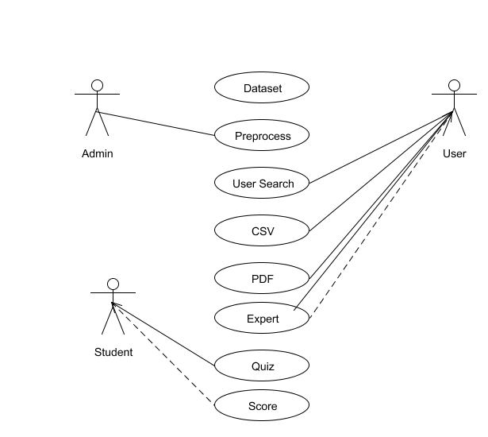
Use Case Diagram:

Slide 11
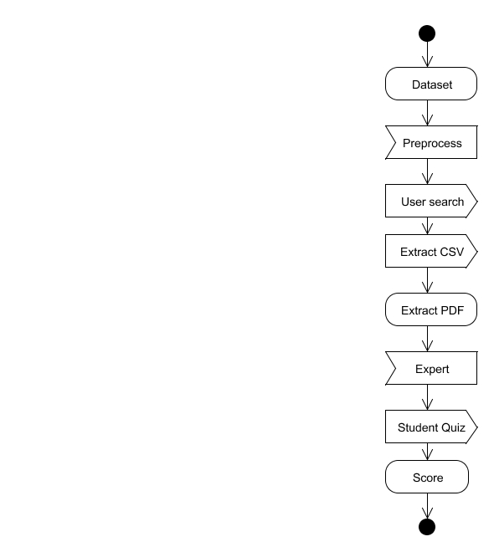
Activity Diagram:

Slide 12
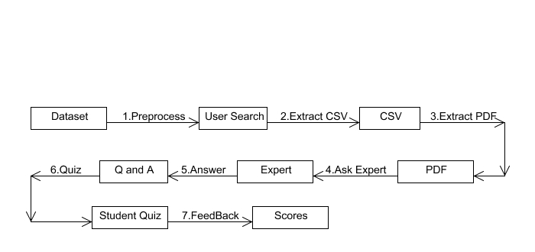
Collaboration Diagram:

Slide 13
DATA FLOW DIAGRAM:
Level 0:
Datasets
Preprocess
Analyze CSV
Analyze Resource
NLP
Level 1:
User Register
Search Question
Fetch Answer from CSV
Q and A
PDF Files

Slide 14
Level 2:
User Question
Forward To Expert
Expert
Expert Answer
User
Level 3:
Student Quiz
Domain select
Q and A
Scores

Slide 15
MODULE DESCRIPATION
TYPES OF MODULES :
1.Admin Preprocessing
2. Auto tagging Questions
3. Expert’s Answering Process
4. Student Assessment

Slide 16
MODULE EXPLANATION
1. Admin Preprocessing:
First module Admin has to register first and then provide admin details (Name and password) valid admin enters the page. Admin is responsible for the whole operation admin work includes cleaning, adding the CSV files, analyzing resources, NLP (Natural language processing) and cleaning NLP.
2. Auto tagging Questions:
In this module the user has to register their details first after that user login using (Name and Password) if user is valid enters the page then user chooses the categories of domain present in the page user clicks the categories it show list available domains then user select any one domain based on that related information or question and answers to that domain will be displayed.
If the requested domain information or question answer is not available it provides PDFs related to that domain the provided answers of the question are not satisfied when user feels. User can ask question to the Expert (doctor) who can clearly answer the user query.

Slide 17
3. Expert’s Answering Process:
In this module Expert (doctor) has to register first like (Name, Expert id, category of doctor) after that login using valid credentials. Here expert id is unique id for the expert and category is to identify the expert domain. Expert enters the page and he gets the notification from the user who asked the question after that Expert analyze the question and provides the related answer to the question the answer is forwarded to the user profile. User can view the answer any time.
4. Student Assessment:
In this module student registers first after the login page is forwarded to the quiz page the student is asked to write quiz in medical domain. Questions from medical domain is provided student has to answer it finally student gets the overall score of the test, domain score, and gets the feedback for the test which the student can improve knowledge in that domain.

Slide 18
TESTING:
SYSTEM TESTING :
Testing is performed to identify errors. It is used for quality assurance. Testing is an integral part of the entire development and maintenance process. The goal of the testing during phase is to verify that the specification has been accurately and completely incorporated into the design, as well as to ensure the correctness of the design itself. For example the design must not have any logic faults in the design is detected before coding commences, otherwise the cost of fixing the faults will be considerably higher as reflected. Detection of design faults can be achieved by means of inspection as well as walkthrough.
Testing is one of the important steps in the software development phase. Testing checks for the errors, as a whole of the project testing involves the following test cases:
Static analysis is used to investigate the structural properties of the Source code.
Dynamic testing is used to investigate the behavior of the source code by executing the program on the test data.

Slide 19
UNIT TESTING :
Unit testing is conducted to verify the functional performance of each modular component of the software. Unit testing focuses on the smallest unit of the software design (i.e.), the module. The white-box testing techniques were heavily employed for unit testing.
FUNCTIONAL TESTS
Functional test cases involved exercising the code with nominal input values for which the expected results are known, as well as boundary values and special values, such as logically related inputs, files of identical elements, and empty files.
Three types of tests in Functional test:
Performance Test
Stress Test
Structure Test

Slide 20
PERFORMANCE TEST :
It determines the amount of execution time spent in various parts of the unit, program throughput, and response time and device utilization by the program unit.
STRESS TEST :
Stress Test is those test designed to intentionally break the unit. A Great deal can be learned about the strength and limitations of a program by examining the manner in which a programmer in which a program unit breaks.

Slide 21
STRUCTURED TEST :
Structure Tests are concerned with exercising the internal logic of a program and traversing particular execution paths. The way in which White-Box test strategy was employed to ensure that the test cases could Guarantee that all independent paths within a module have been have been exercised at least once.
Exercise all logical decisions on their true or false sides.
Execute all loops at their boundaries and within their operational bounds.
Exercise internal data structures to assure their validity.
Checking attributes for their correctness.
Handling end of file condition, I/O errors, buffer problems and textual errors in output information

Slide 22
WHITE BOX TESTING :
This testing is also called as Glass box testing. In this testing, by knowing the specific functions that a product has been design to perform test can be conducted that demonstrate each function is fully operational at the same time searching for errors in each function. It is a test case design method that uses the control structure of the procedural design to derive test cases. Basis path testing is a white box testing.
Basis path testing:
Flow graph notation
Cyclometric complexity
Deriving test cases
Graph matrices Control

Slide 23
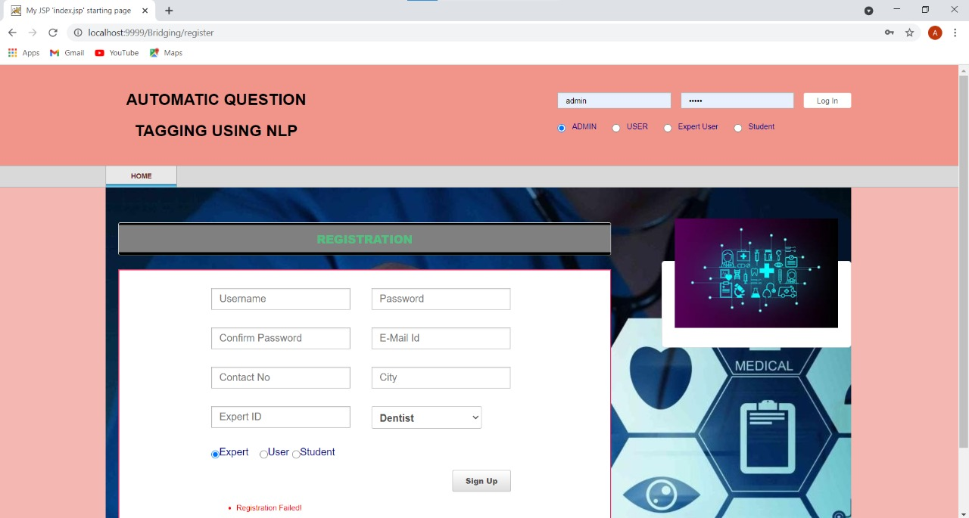
Output Screenshots :
HOME PAGE: Register and Login

Slide 24
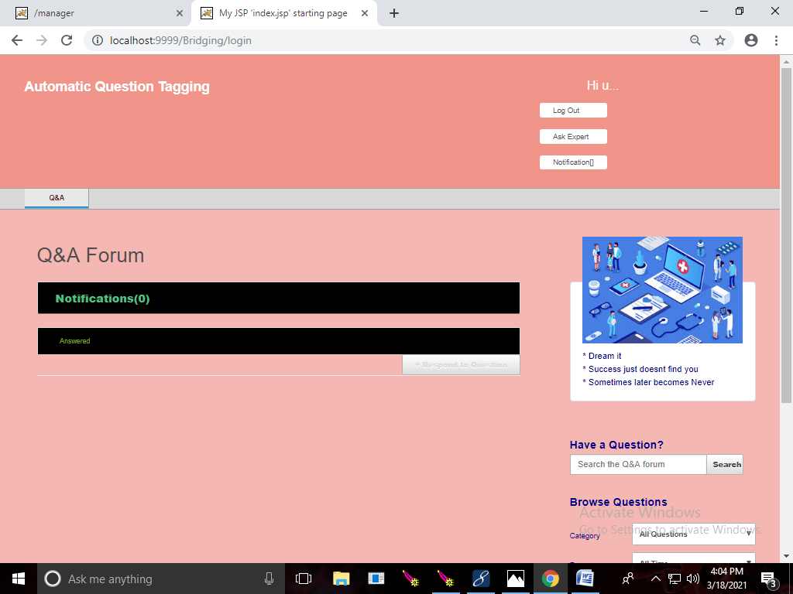
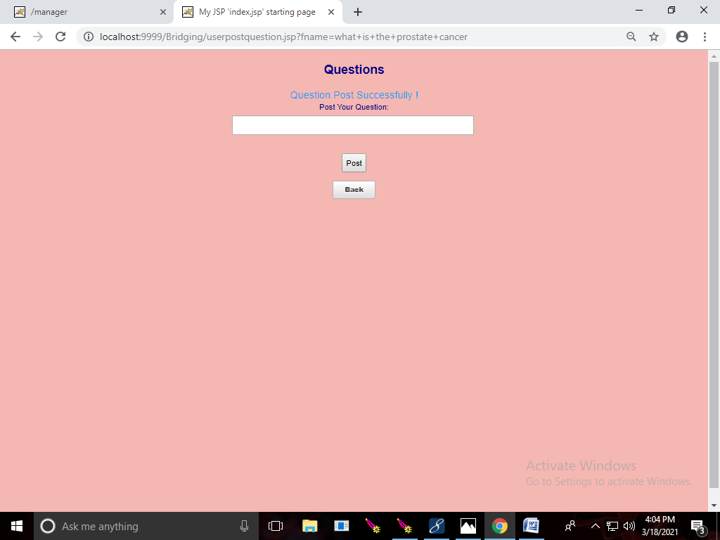
USER MODULE
User can post their questions in Ask Expert and if he receive the reply seen in the notification
Questions can be searched according to categories

Slide 25
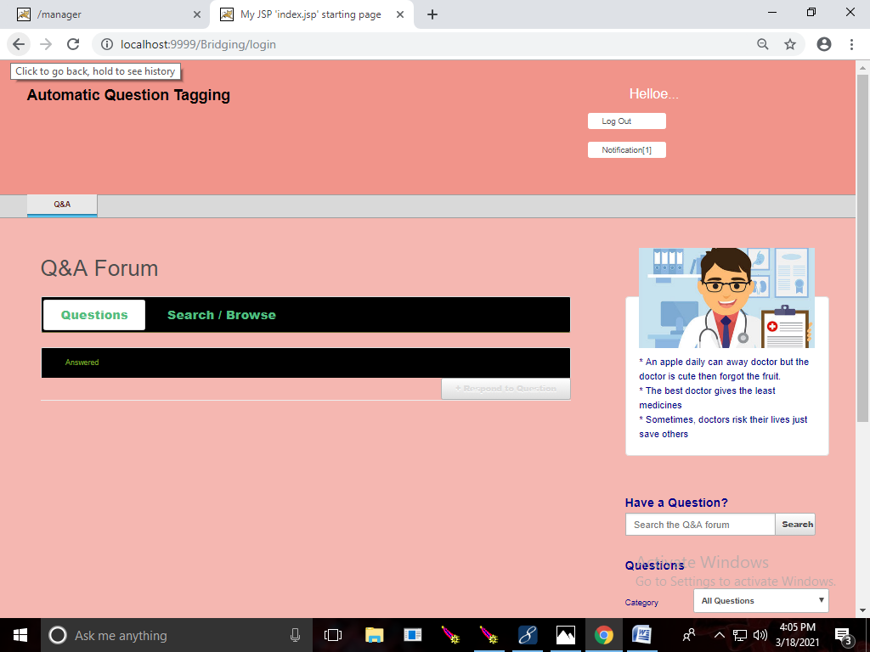
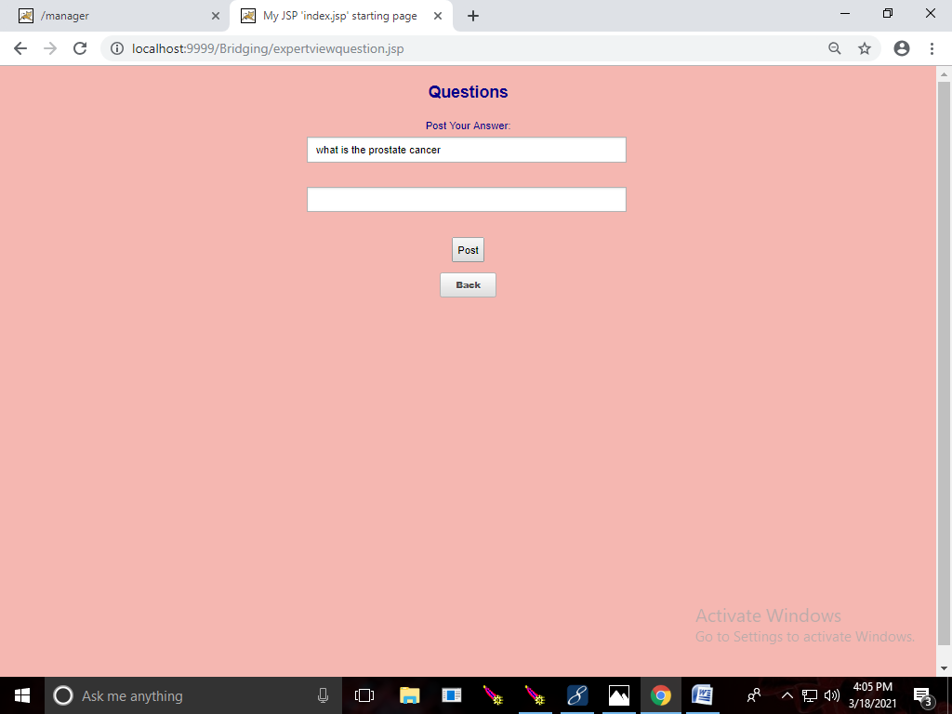
EXPERT MODULE
Users posted questions can be seen as notification
After receiving the user posted question,expert can answer in this and post

Slide 26
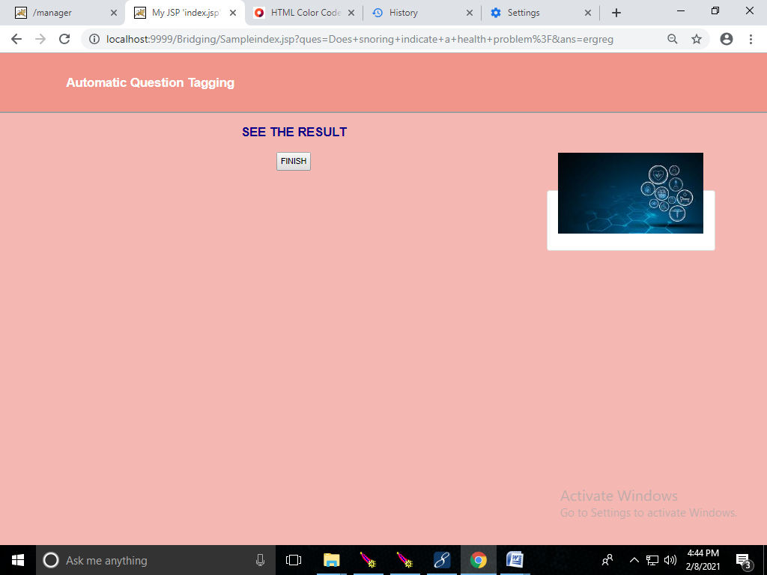
Choose a domain and start quiz
Answer the questions
Click Finish Button to see the result

Slide 27
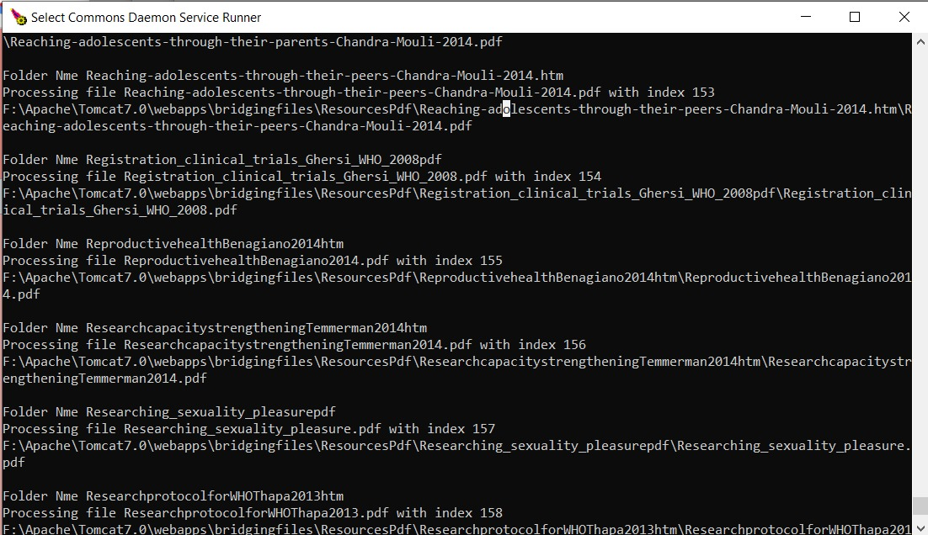
TOMCAT SERVICE RUNNER: Analysis of resource pdf files

Slide 28
Conclusion
Thus the main aim is to give knowledge regarding Health and diseases of human by receiving user query was implemented in this project.

Slide 29
REFERENCES
[1] A. Al-Hmouz, J. Shen, R. Al-Hmouz, and J. Yan, “Modeling and simulation of an adaptive neuro-fuzzy inference system (anfis) for mobile learning,” IEEE Trans. Learn. Technol., vol. 5, no. 3, pp. 226– 237, 2012.
[2] P. Brusilovsky, “Knowledgetree: A distributed architecture for adaptive e-learning,” in Proc. 13th Int. World Wide Web Conf. Alternate Track Papers & Posters. ACM, 2004, pp. 104–113.
[3] M. Mendicino, L. Razzaq, and N. T. Heffernan, “A comparison of traditional homework to computer-supported homework,” J. Res. on Technol. in Edu., vol. 41, no. 3, pp. 331–359, 2009.
[4] J. D. Forbey and Y. S. Ben-Porath, “Computerized adaptive personality testing: a review and illustration with the mmpi-2 computerized adaptive version.” Psychological Assessment, vol. 19, no. 1, p. 14, 2007.

