Slide 1
BASICS OF SWITCHING

Slide 2
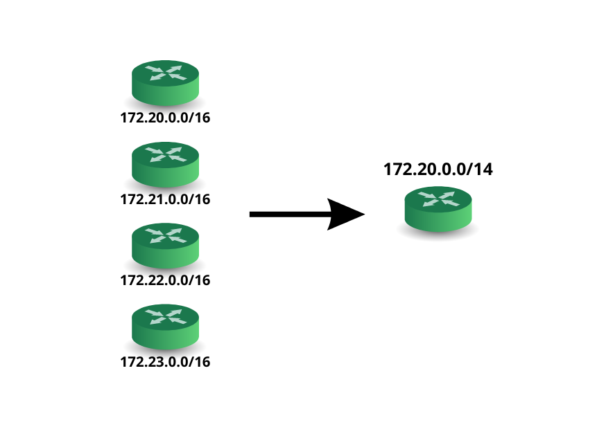
Supernetting
Supernetting, also known as route summarization or aggregation, is the process of combining multiple smaller network subnets into a single, larger subnet. It allows for more efficient routing by reducing the number of entries in routing tables.
Purpose of Supernetting:
The main purpose of supernetting is to minimize the size of routing tables in routers, which reduces the processing overhead and memory requirements. This results in faster routing lookups and improved network performance.

Slide 3
Benefits of Super netting:
1. Simplified Routing: Fewer entries in routing tables lead to faster and more efficient packet forwarding. 2. Reduced Network Overhead: Supernetting reduces the amount of routing information exchanged between routers. 3. Enhanced Scalability: Supernetting helps networks scale better by minimizing the number of routing table entries.

Slide 4
Supernetting Process
Identify Contiguous Subnets: To create a supernet, identify smaller subnets that are contiguous and have consecutive IP address ranges. These subnets should share the same higher-order bits in their subnet masks.
Determine the Supernet Address: Find the common higher-order bits in the subnet addresses and subnet masks. Group them together to form the supernet address and subnet mask.
Calculate the Supernet Range: Calculate the range of IP addresses covered by the supernet address and subnet mask. This range will encompass all the individual subnets within the supernet.
Given the following subnets:
Subnet 1: 192.168.1.0/24
Subnet 2: 192.168.2.0/24
Subnet 3: 192.168.3.0/24
We can supernet these subnets as follows:
Supernet: 192.168.1.0/23 (covering Subnet 1 and Subnet 2)
Supernet: 192.168.3.0/24 (covering Subnet 3)

Slide 5
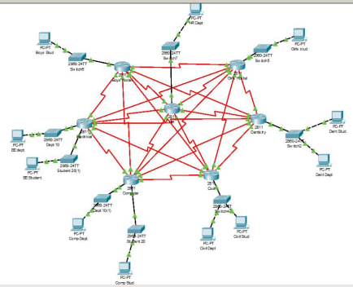
Supernetting Best Practices
Consider Network Growth: Plan for future network expansion when designing supernets to avoid frequent reconfiguration.
Avoid Over-aggregation: Avoid creating overly large supernets that cover unrelated subnets, as it can lead to inefficient routing.
Document Supernetting Changes: Maintain clear documentation of the supernetting scheme and any changes made to the network for reference and troubleshooting. Please add relevant images, diagrams, or examples to support the content on each slide.

