Slide 1
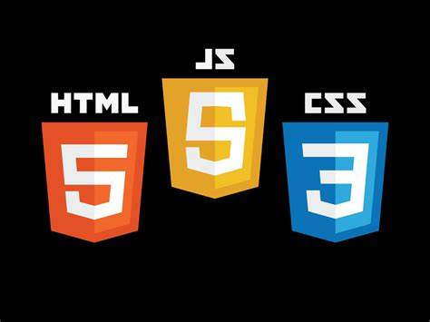

DOTNET BOOTCAMP

Slide 2
SQL CASE STUDY
TABLES AND OUTPUTS
Created a small database with my team on star health insurance .
In total we created six tables which includes
Star health insurance branch details
Transition details
Customer details
Insurance scheme
Accidental plan details
Dental plan details

Slide 3
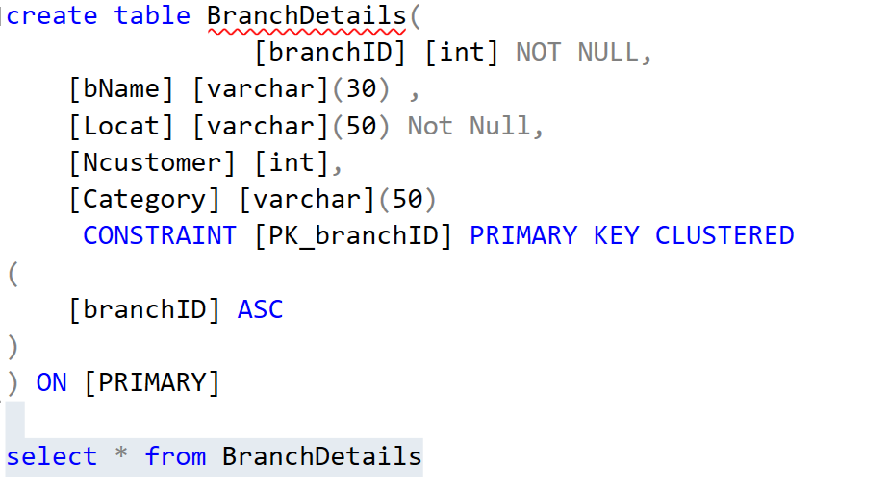
First table

Slide 4

INSERT COMMANDS
INSERT [BranchDetails] ([branchID], [bName], [Locat], [Ncustomer], [Category])VALUES (101, 'canda', 'isduqjj', 89, 'premium')
INSERT [BranchDetails] ([branchID], [bName], [Locat], [Ncustomer], [Category]) VALUES (102, 'Usa', 'hqddqhq', 85, 'gold')
INSERT [BranchDetails] ([branchID], [bName], [Locat], [Ncustomer], [Category]) VALUES (103, 'Russia', 'dwdbdjd', 65,' gold')
INSERT [BranchDetails] ([branchID], [bName], [Locat], [Ncustomer], [Category]) VALUES (104, 'China', 'jhdudwq', 32, ' silver')
INSERT [BranchDetails] ([branchID], [bName], [Locat], [Ncustomer], [Category]) VALUES (105, 'Ukraine', 'huwhnxjj', 24, ' Life cover')
INSERT [BranchDetails] ([branchID], [bName], [Locat], [Ncustomer], [Category]) VALUES (106, 'Algeria', 'uhsncnjk', null, 'Accident cover')
INSERT [BranchDetails] ([branchID], [bName], [Locat], [Ncustomer], [Category]) VALUES (107, 'Armenia', 'jhjdsgj',44, ' 1 crore life cover')
INSERT [BranchDetails] ([branchID], [bName], [Locat], [Ncustomer], [Category]) VALUES (108, 'Bangladesh','hdjdjhxn', 36,'premium')
INSERT [BranchDetails] ([branchID], [bName], [Locat], [Ncustomer], [Category]) VALUES (109, 'Belgium', 'poieijmd',05, 'gold')
INSERT [BranchDetails] ([branchID], [bName], [Locat], [Ncustomer], [Category]) VALUES (110, 'Estonia','hehbebmkd', 67,'life cover till 99')
INSERT [BranchDetails] ([branchID], [bName], [Locat], [Ncustomer], [Category]) VALUES (111, 'Romenia', 'hdhuuhbbh',43, 'critical illness')

Slide 5
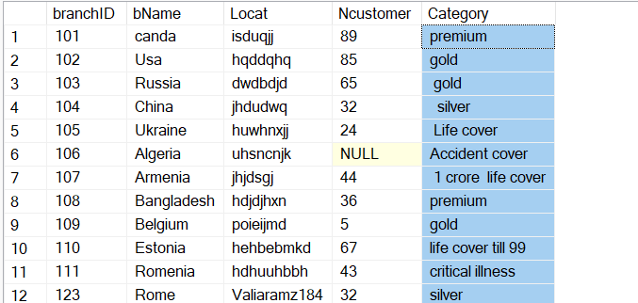
OUTPUT

Slide 6
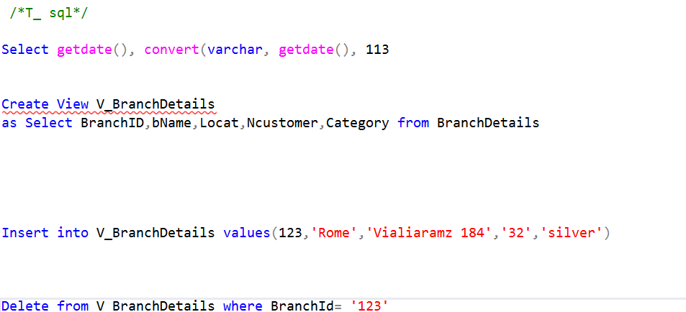
creating views
We can change the format of date
Delete command is used to delete the targeted row or column
Truncate is used to delete the data of a table

Slide 7
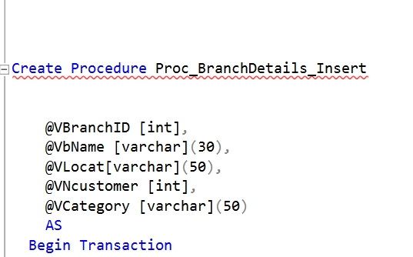
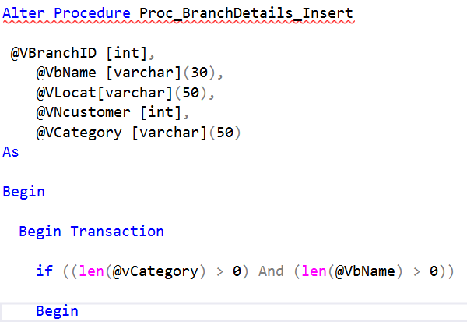
PROCEDURE & ALTER
Procedures or Stored Procedures in SQL are logical units of SQL queries that can be created once, fetched, and executed multiple times whenever there is a need to repeat the same operation.
The ALTER TABLE statement is used to add, delete, or modify columns in an existing table. The ALTER TABLE statement is also used to add and drop various constraints on an existing table.

Slide 8
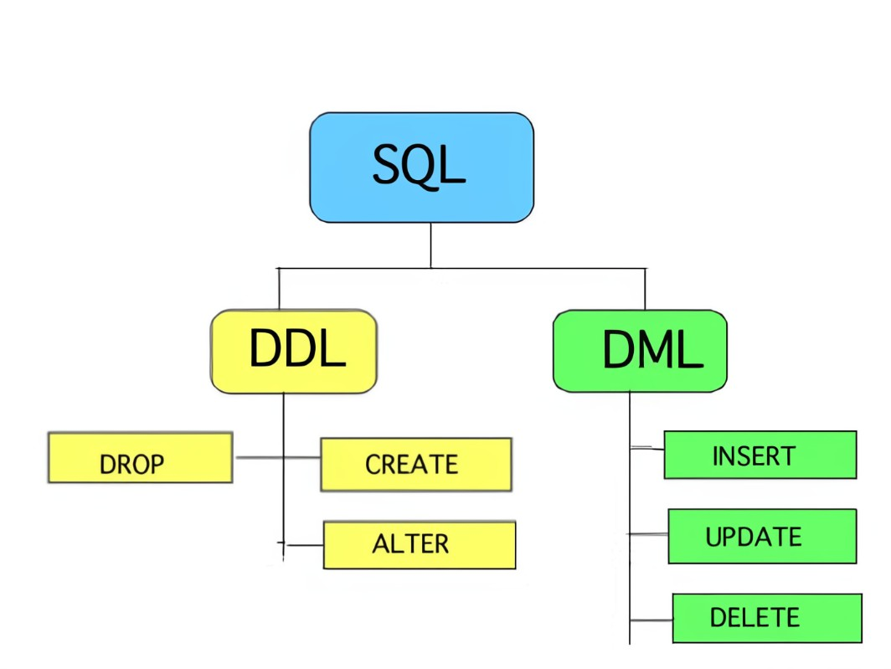
• Data Manipulation Language (DML)
▫ SELECT - extracts data from a database
▫ UPDATE - updates data in a database
▫ DELETE - deletes data from a database
▫ INSERT INTO - inserts new data into a database
• Data Definition Language (DDL)
▫ CREATE DATABASE - creates a new database
▫ ALTER DATABASE - modifies a database
▫ CREATE TABLE - creates a new table
▫ ALTER TABLE - modifies a table

Slide 9
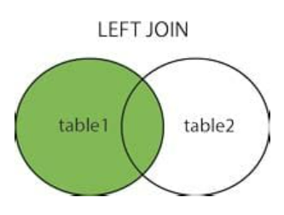
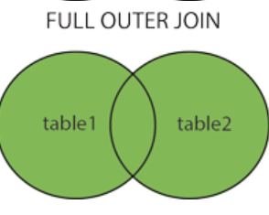
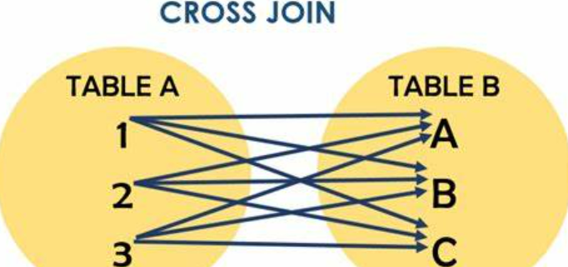
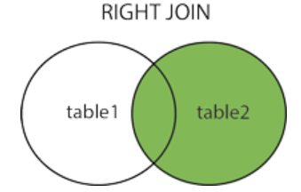
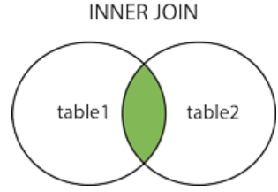
JOINS

Slide 10
Thank You

Slide 11
HTML
This is the body of a web page and has tags out of which some are listed in this ppt.
<footer> | It defines the footer section of a webpage.
<img> | It is used to insert an image within an HTML document.
<head> | It defines the head section of an HTML document.
<u> | It is used to render enclosed text with an underline.
<ul> | It defines unordered list of items.
<label> | It defines a text label for the input field of form.
<form> | It is used to define an HTML form.
<script> | It is used to declare the JavaScript within HTML document.
<section> | It defines a generic section for a document.

Slide 12
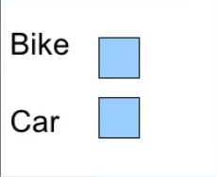
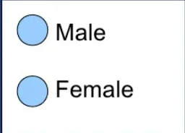
RADIO AND CHECK BOXES <form> <input type="radio" name="sex" value="male" /> Male <br /> <input type="radio" name="sex" value="female" /> Female </form> Checkboxes : <form> Bike: <input type="checkbox" name="vehicle" value="Bike"/> <br /> Car: <input type="checkbox" name="vehicle" value="Car"/><br /> </form>

Slide 13

SMALL EXAMPLE OF HTML
<html>
<h1 style="text-align:center">NATURE</h1>
<body style="background-color:yellow">
<p style="font-family:Purisa:color:red">Plant Tree</p>
<p style="font-family:times.color:red">Save Our Generation</p>
<p style="font-size:40">Value Our Environment</p> </body>
</html>

Slide 14
CSS (CASCADING STYLE SHEET
CSS is used to style and layout web page. It’s simply a design language which makes the web pages presentable and attractive
Using CSS we can control the colour, style, spacing ,background image etc.
CSS is easy to use and is easy to maintain also provides superior styles to HTML tags.

Slide 15
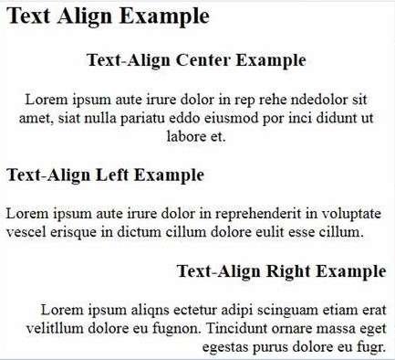
Text Alignment
The text-align property is used to set the horizontal alignment of a text. Text can be centered, or aligned to the left or right, or justified.
When text-align is set to "justify", each line is stretched so that every line has equal width, and the left and right margins are straight
Example
h1 {text-align:center;}
p.date (text-align:right;}
p.main (text-align:justify;)

Slide 16
CSS ID AND CLASS
The ID selector is used to specify a style for a single, unique element.
The id selector uses the id attribute of the HTML element, and is defined with a
A class can be used to identify and target more than one HTML element

Slide 17
JAVASCRIPT
Introduction
JavaScript is a scripting language most often used for client-side web development.
JavaScript is an implementation of the ECMAScript standard.
The ECMAScript only defines the syntax/characteristics of the language and a basic set of commonly used objects such as Number, Date, Regular Expression, etc.
The JavaScript supported in the browsers typically support additional objects.
e.g., Window, Frame, Form, DOM object, etc.

Slide 18

What can we do with JavaScript?
To create interactive user interface in a web page (e.g., menu, pop-up alert, windows, etc.)
Manipulating web content dynamically Change the content and style of an element Replace images on a page without Hide/Show contents page reload
Form validation
Generate HTML contents on the fly AJAX (e.g. Google complete) etc.

Slide 19
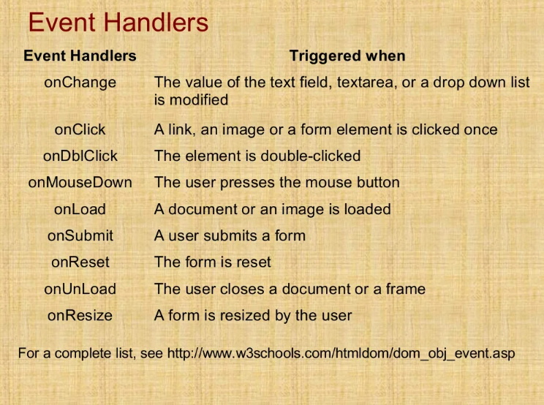
prompt ()
prompt("What is your student id number?"); prompt ("What is your name?", "No name");
Displays a message and allow the user to enter a value The second argument is the "default value" to be displayed in the input text field.
Without the default value, "undefined" is shown in the input text field
If the user click the "OK" button, prompt () returns the value in the input text field as a string. if the user click the "Cancel" button, prompt() returns null.

Slide 20
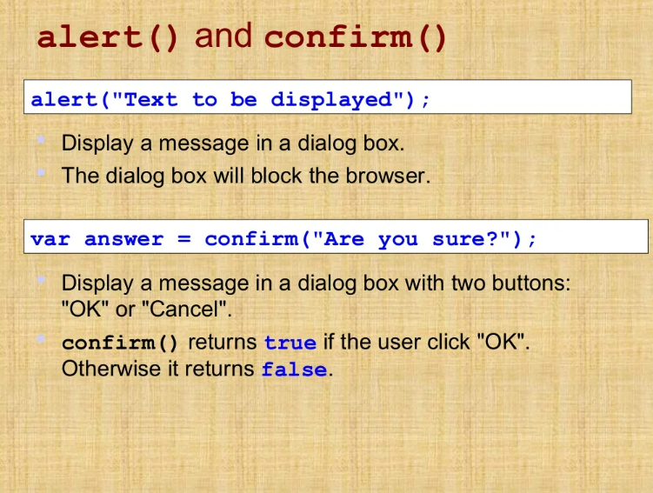
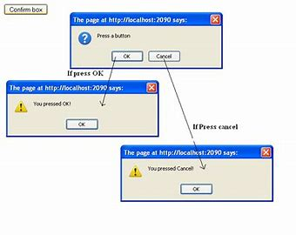
How to create ⚠ boxes

