Slide 1
Windows Authentication
Attack Detection
Cybersecurity Institute Project
Student: Ahmad Anwar | Institute: Edversity | Date: 8-11-2026

Slide 2
Project Objectives
Understand Windows authentication events.
Identify successful logons (Event ID 4624) and failed logons (Event ID 4625).
Collect and review Security events using Event Viewer and PowerShell.
Use Splunk searches to analyze authentication activity and test a detection threshold.
Windows Authentication Attack Detection | 2

Slide 3
Lab Environment & Data Sources
Windows Virtual Machine
Windows Security Event Log
PowerShell for event collection and CSV export
Splunk for searching, counting, grouping, and timeline analysis
Evidence stored in the project Evidence folder
Windows Authentication Attack Detection | 3

Slide 4
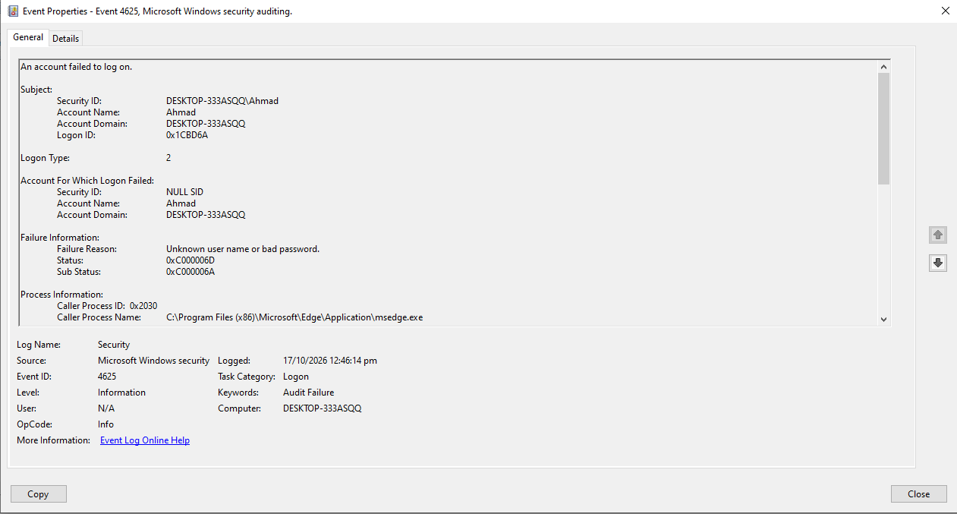
Windows Authentication Events
Event ID 4624: successful logon.
Event ID 4625: failed logon.
Logon Type 2: interactive logon.
Observed failure information indicated an incorrect username or password.
A failed logon is an investigation lead; it does not by itself prove an attack.
Windows Authentication Attack Detection | 4

Slide 5
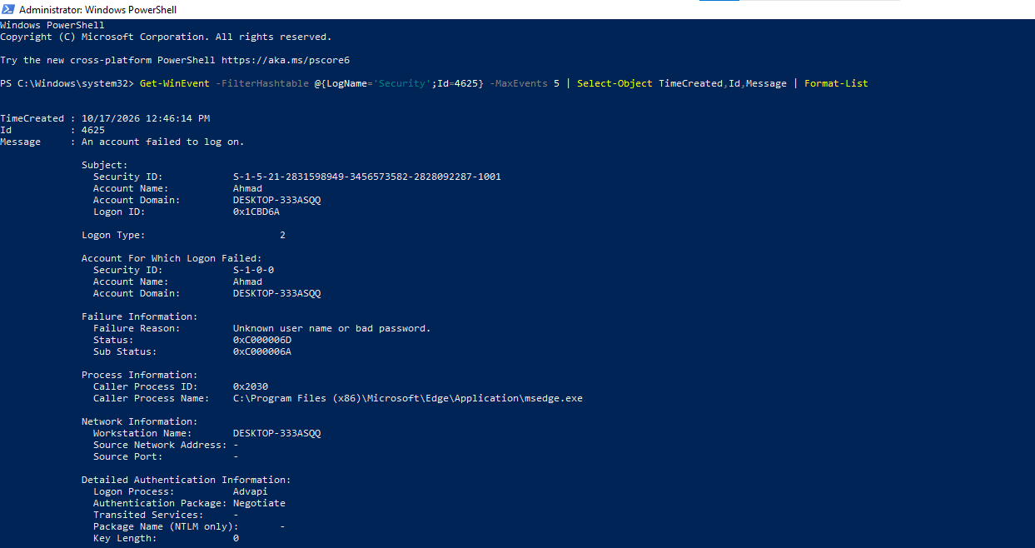
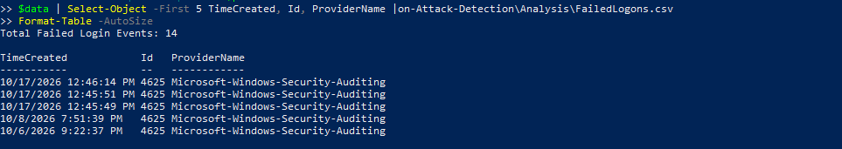
Collection & Analysis Workflow
Enabled auditing for failed logon events.
Generated a controlled failed logon in the lab and verified Event ID 4625.
Collected failed logon events with PowerShell and exported them to CSV.
Imported and searched Windows authentication events in Splunk.
Compared successful and failed logon counts and created a daily timeline.
Windows Authentication Attack Detection | 5

Slide 6
Splunk Detection Logic
Search for Event ID 4625.
Group events into five-minute windows.
Count failed logons in each window.
Flag windows containing two or more failed attempts for review.
This is a lab threshold for demonstration; tune it to the environment before production use.
Windows Authentication Attack Detection | 6

Slide 7
Results & SOC Interpretation
Splunk results observed: 1,733 successful logons (4624).
Splunk results observed: 16 failed logons (4625).
A five-minute threshold search was tested and returned a matching interval at the selected threshold.
Repeated failures may be caused by user error or suspicious activity; correlate account, source, time, and any subsequent successful logon.
The available evidence does not independently confirm a brute-force attack.
Windows Authentication Attack Detection | 7

Slide 8
Conclusion & Future Improvements
The project demonstrated Windows authentication log collection and analysis with PowerShell and Splunk.
Practical skills: Event Viewer investigation, CSV handling, SPL searches, threshold testing, and SOC triage documentation.
Future work: correlate source IP and account, build a Splunk alert, tune thresholds, and test safely in an isolated lab.
Windows Authentication Attack Detection | 8

Slide 9
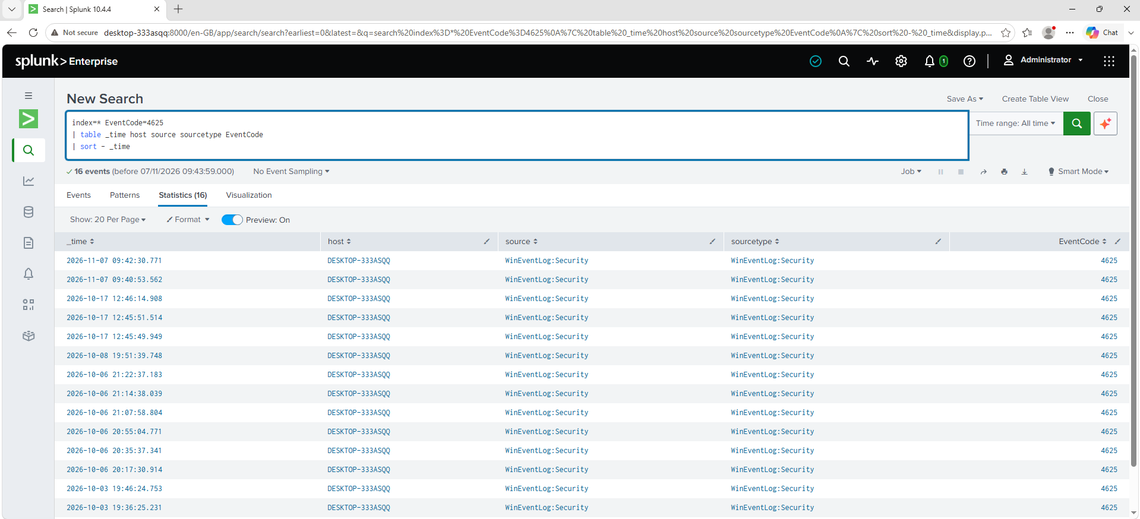
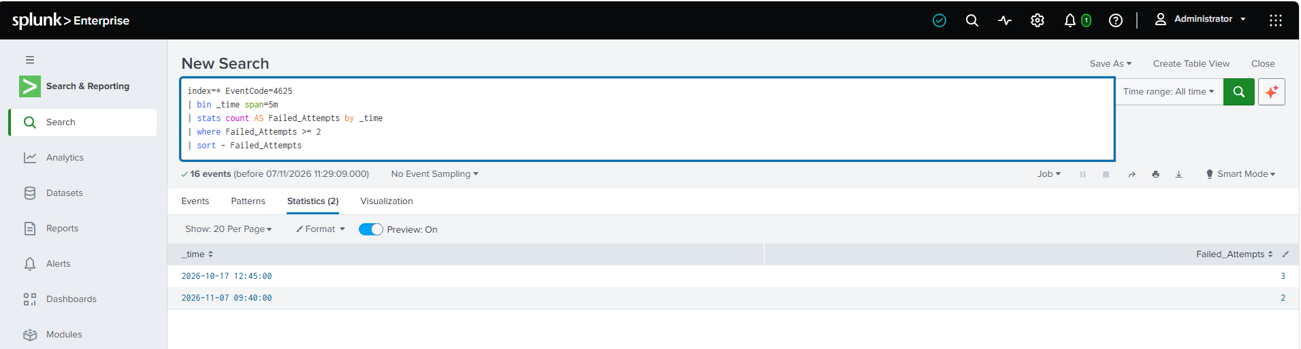
Practical Evidence Screenshots
Event Viewer: Event ID 4625 details
PowerShell: failed logon collection and CSV analysis
Splunk: 4625 search results and failed-login counts
Splunk: threshold detection result and 4624 vs 4625 comparison
Splunk: failed-login event details and daily incident timeline
Windows Authentication Attack Detection | 9

