Slide 1

Application for instantaneous text-based conversation using core Java
By
Amish Guleria – 12103096
Raja Jadon – 12109953
Aadarsh - 12116817

Slide 2

Introduction
A chat application using JFrames is a graphical user interface (GUI) based program that allows users to communicate with each other in real-time
Our application aims to facilitate the instant text-based conversation using Core Java.
Our solution addresses these problems by leveraging Core Java to provide a lightweight and secure chat application that delivers fast, reliable, and user-friendly communication.
We aim to offer a more comprehensive and customizable platform that allows users to tailor their messaging experience to their specific needs.
We have implemented the one-on-one communication using socket programming.

Slide 3

Features and Functionality
This type of application typically consists of two main components: a client-side application and a server-side application.
The client-side application is responsible for handling user interactions and sending messages to the server, which in turn distributes the messages to other connected clients.
The GUI is created using the JFrame class, which provides the necessary components for displaying windows, buttons, text fields, and other UI elements. The client side also includes the logic for handling user interactions, such as sending and receiving messages, displaying notifications, and managing the chat history.

Slide 4

Features and Functionality
The server-side application is responsible for managing the connections between clients and facilitating the transmission of messages between them.
It typically uses socket programming to establish and maintain the connection between clients and the server. The server also handles tasks such as sending and receiving messages, managing user accounts, and monitoring the system for any issues or errors. Additionally, it may use various protocols such as TCP/IP or HTTP to facilitate communication and data transfer between clients and the server.

Slide 5
Code samples and Explanation

Slide 6
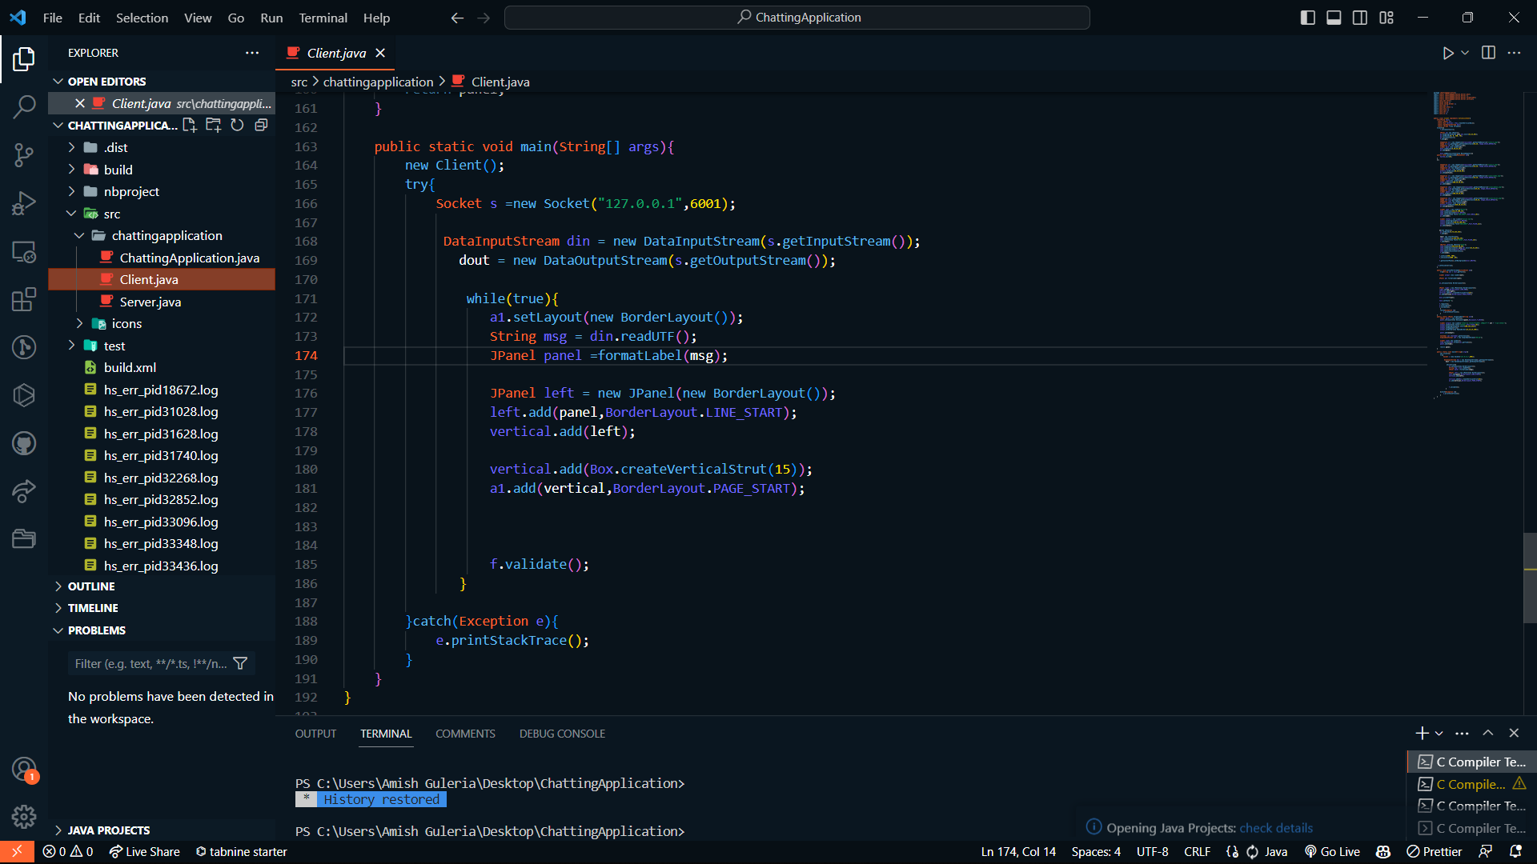
Client Module :

Slide 7
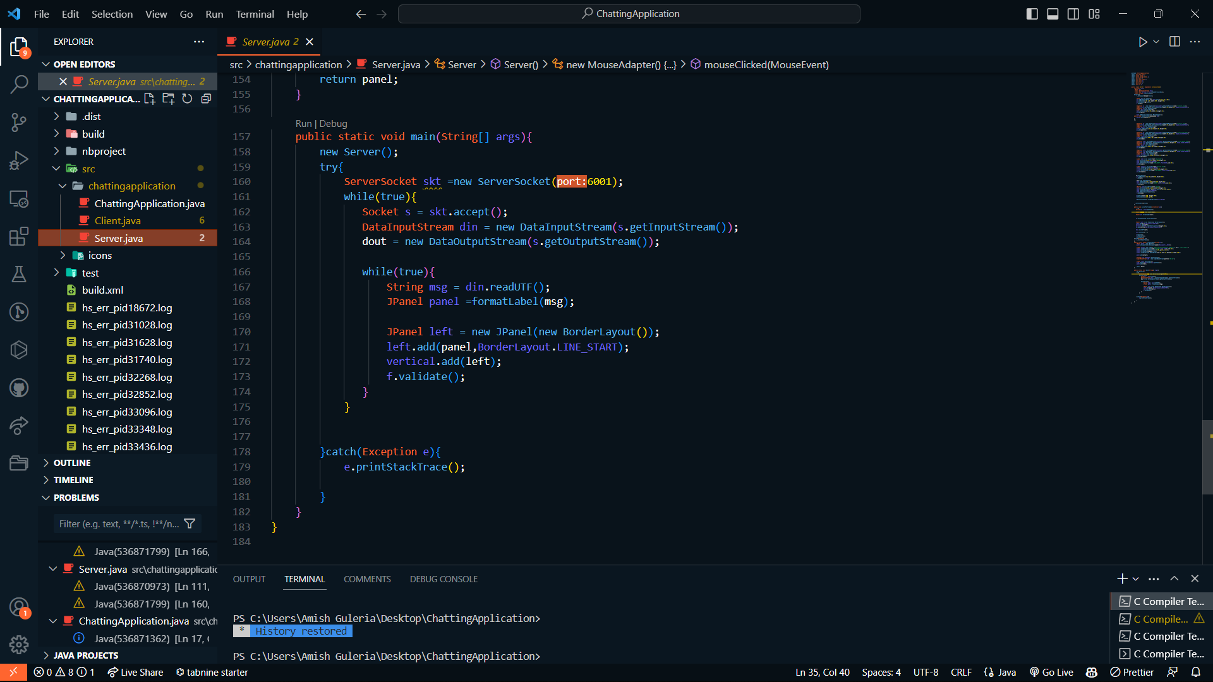
Server Module :

Slide 8
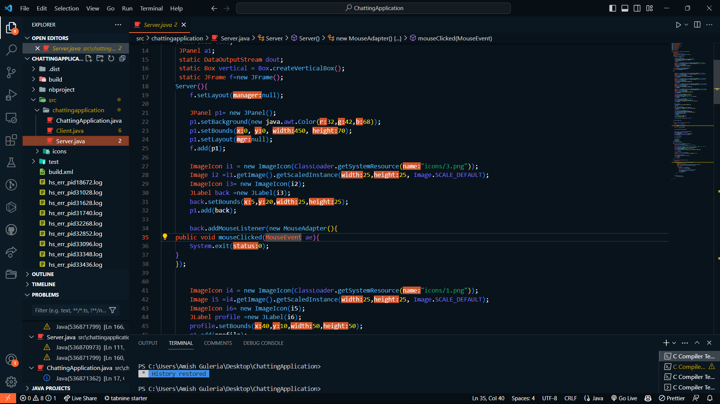
Design and UI :

Slide 9
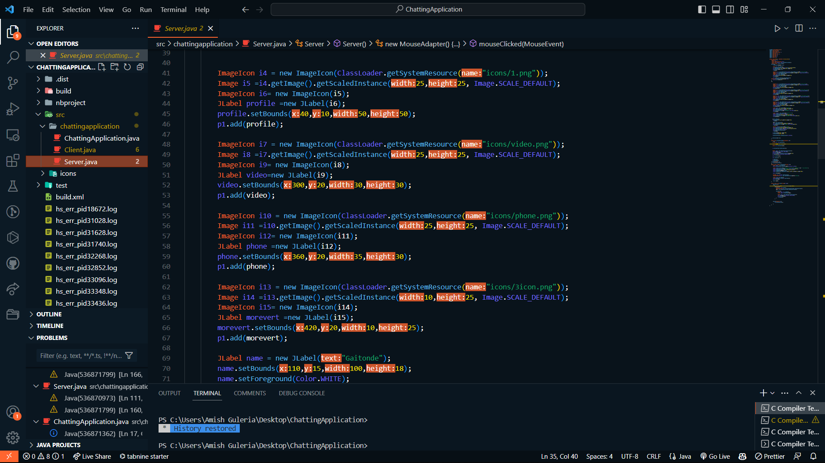

Slide 10
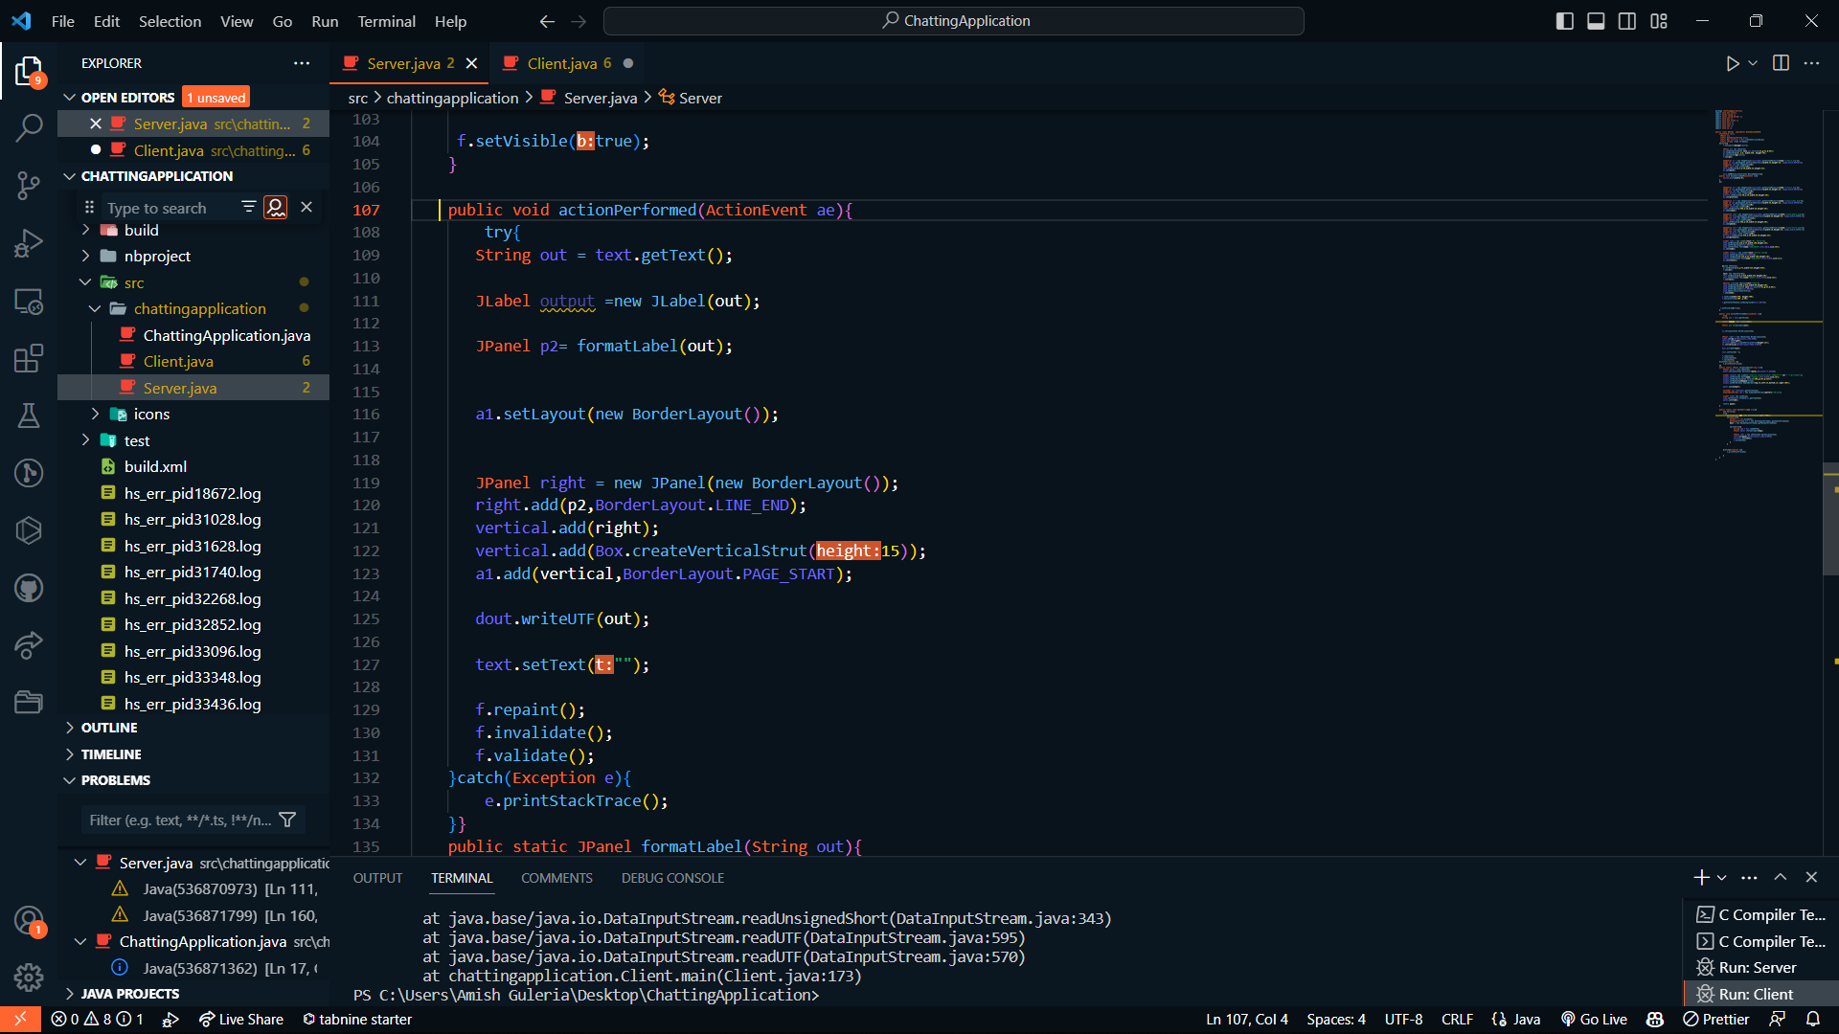
Action Listener

Slide 11
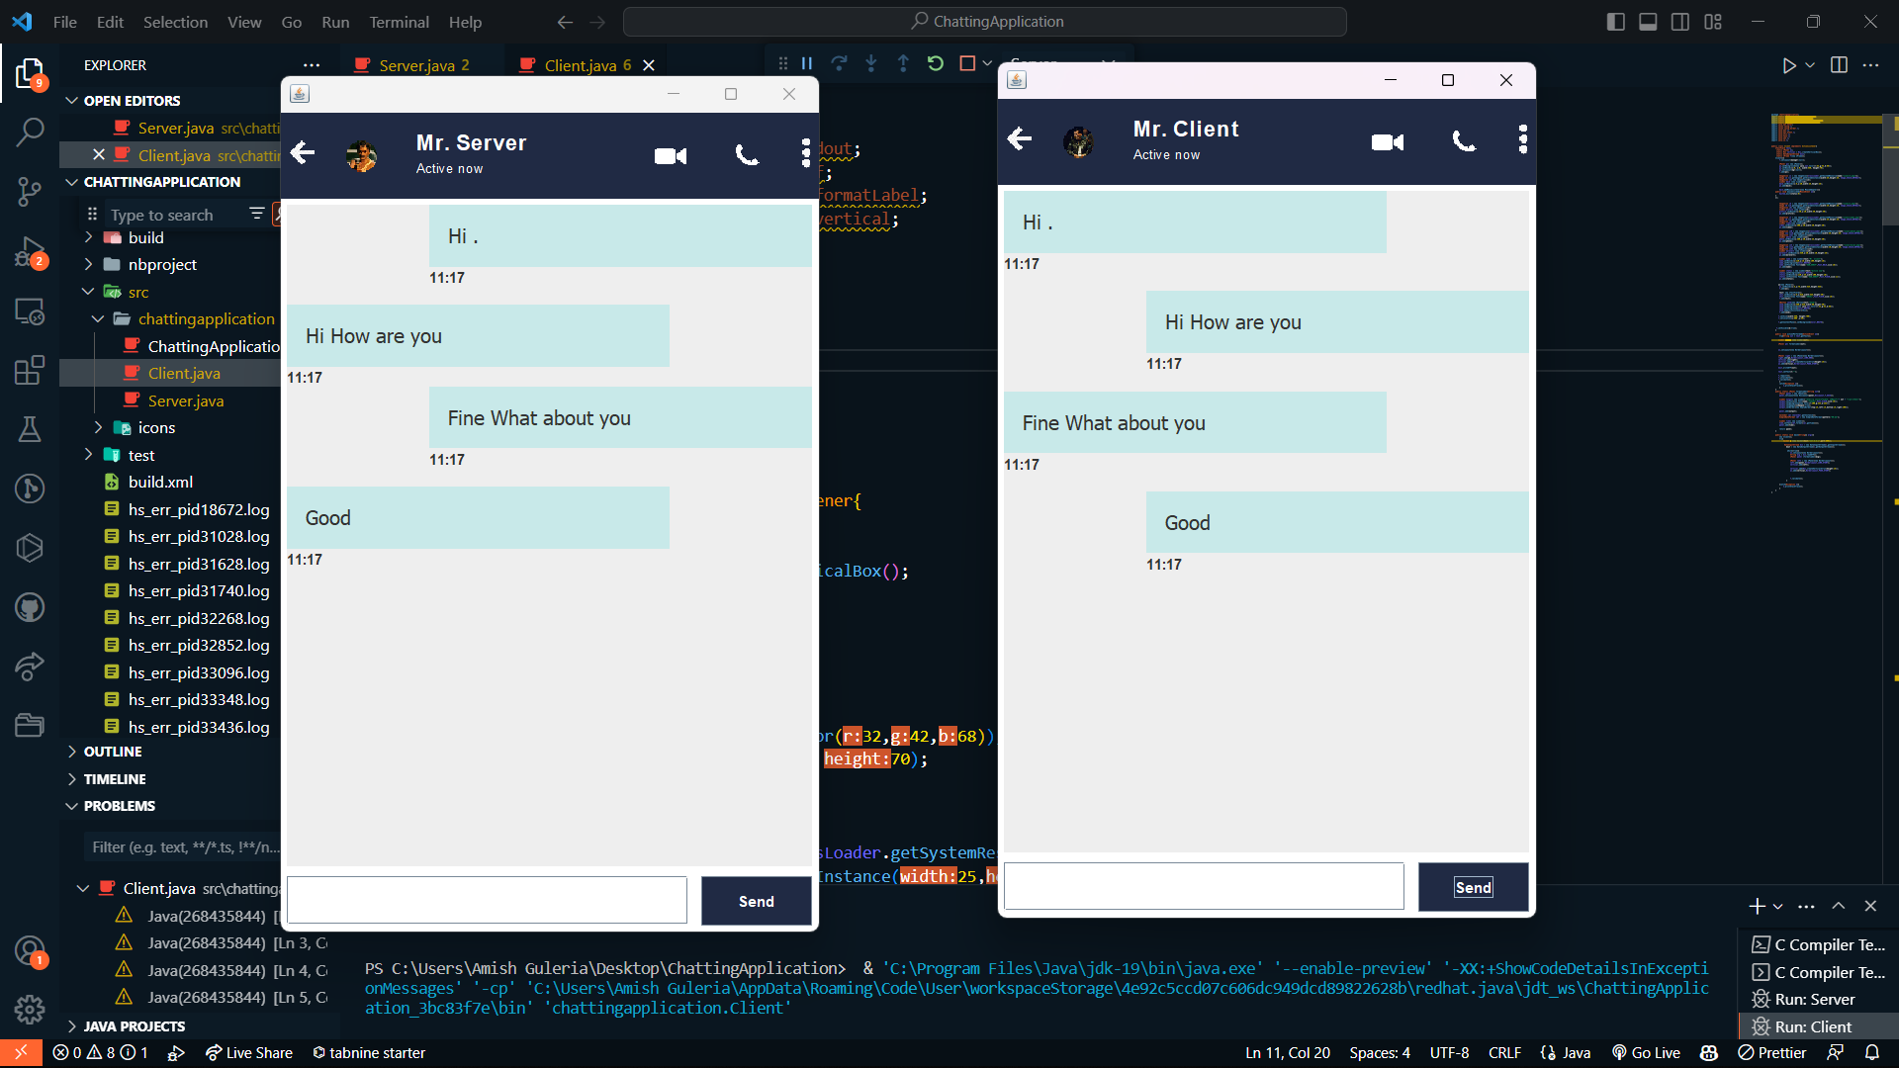
Snapshots of final project :

Slide 12
Future Growth :
We can add database connection and image sending functionality to our app so that we can send not only the text messages but images and other documents too.
We can also implement the group chat functionalities in future.

Slide 13

Conclusion
Chat applications have revolutionized the way we communicate with each other in the digital age.
They allow for instant messaging, which enables us to have real-time conversations with people across the world, regardless of distance or time zone.
With the advent of new technologies, chat applications will continue to evolve and offer new and innovative ways for people to connect and communicate with each other.

