Slide 1
MACHINE LEARNING PROJECT REVIEW
CartIQ
🛺
Grocery Market Basket Intelligence
Predicting product reorders from
50,000 real shopping baskets
Python · Pandas · scikit-learn · Flask · 2026
Notes:
Good morning madam. Our project is CartIQ - a grocery market basket intelligence system. We analyse 50,000 real Instacart shopping records to understand how people shop and to predict whether a product will be reordered. I'll walk you through our data, our fifteen models, and a live working web application.

Slide 2
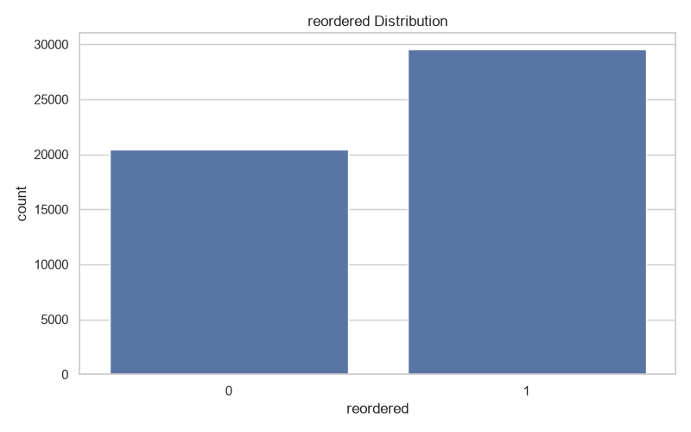
The problem & our data
02/10
• Predict product reorders from basket data
• 50,000 rows · 4,799 customers · 11,650 products
• 134 aisles · 21 departments
• 59% of items are reorders
M1
M2
M3
M4
M5
Understand
Clean & Encode
Predict
Cluster
Validate
CartIQ · Grocery Market Basket Intelligence
Notes:
Our goal is to predict whether a product in a shopping basket will be reordered. We used the Kaggle Instacart dataset - 50,000 rows, 14 columns, nearly 4,800 customers and over 11,000 products across 134 aisles and 21 departments. About 59 percent of basket lines are reorders, so the classes are well balanced. The whole project runs as five modules - understand, clean and encode, predict, cluster, and validate - with the raw data never modified.

Slide 3
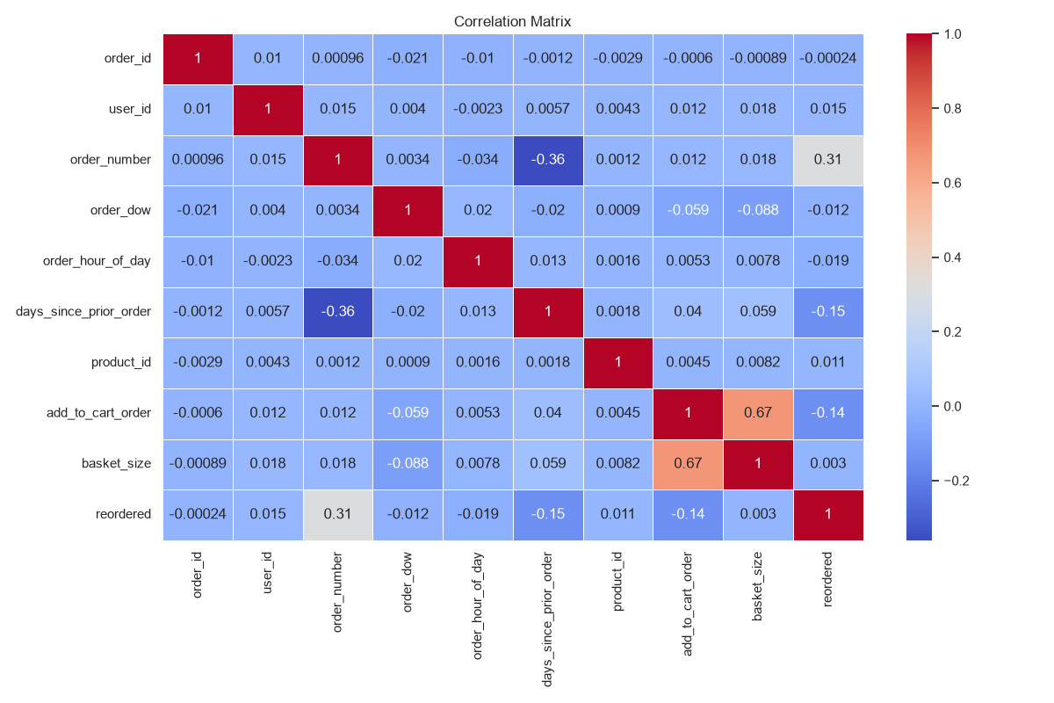
Cleaning & exploring the data
03/10
• 4 missing-value strategies compared
• Standard, Min-Max & L2 scaling
• 5 encoding techniques applied
• Correlation heatmap revealed feature links
Raw data is never modified
All cleaning works on copies → one clean all-numeric final dataset
CartIQ · Grocery Market Basket Intelligence
Notes:
Before modelling we explored and cleaned the data. We compared four missing-value strategies - deletion, mean, median and model-based imputation. Only one column, days_since_prior_order, had nulls. We applied three scaling methods and five encoding techniques - label, one-hot, ordinal, target and embedding - producing one clean all-numeric final dataset. The correlation heatmap showed how features move together and confirmed no single feature dominates the target.

Slide 4
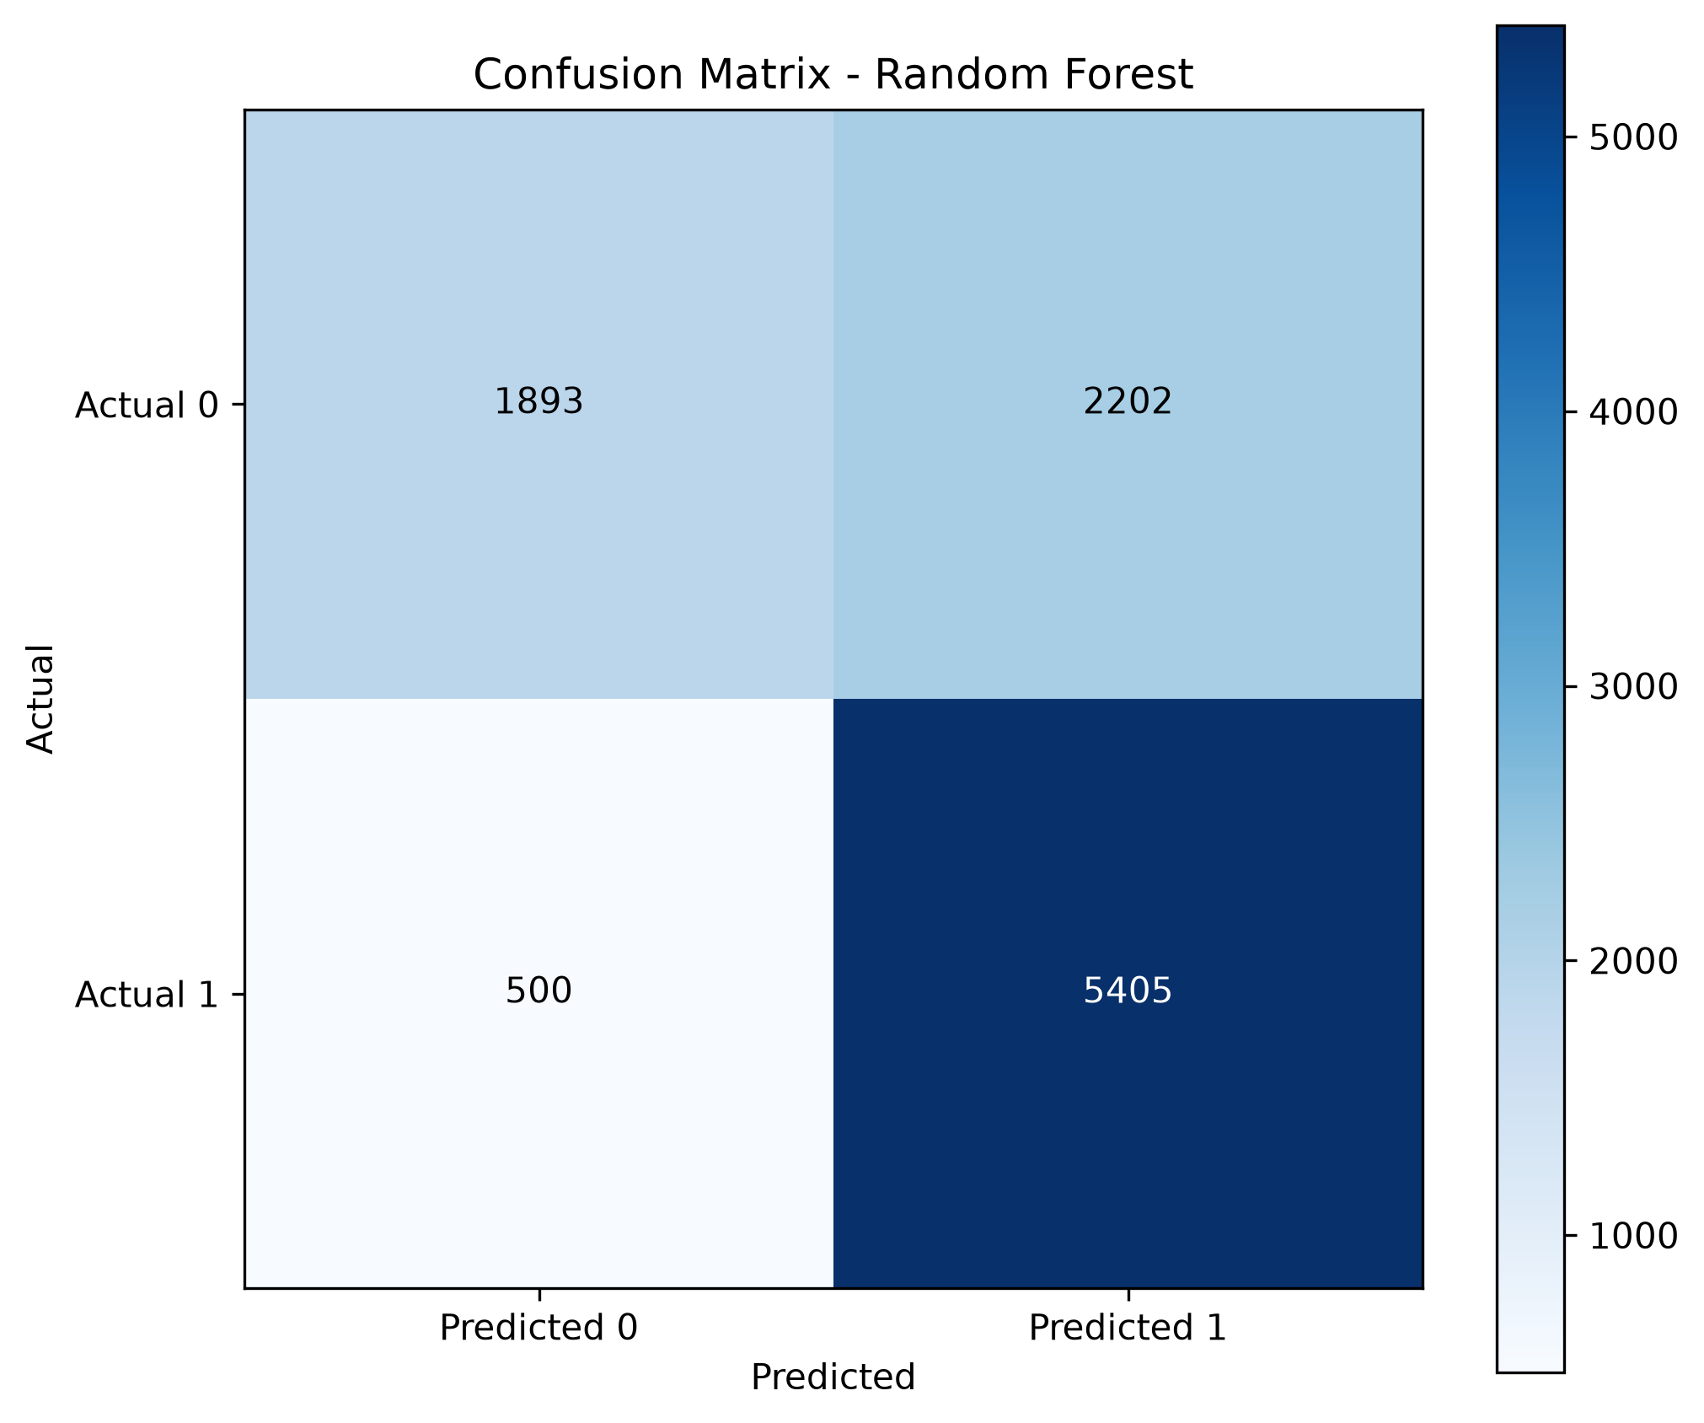
Models that predict reorders
04/10
Tree-based ensembles beat linear models — shopping behaviour is non-linear
Linear Regression
01
R² 0.011 — weak signal
Decision Tree
02
Acc 72.2% · F1 78.4%
Random Forest ★
03
Acc 73.0% · F1 80.0%
AdaBoost
04
Acc 73.3% · F1 79.2%
CartIQ · Grocery Market Basket Intelligence
Notes:
We started with linear regression to predict basket size - the R-squared was only 0.011, confirming the signal is non-linear. We then built three tree-based classifiers, each inside a complete sklearn pipeline with median imputation and one-hot encoding. The plain Decision Tree gave 72.2 percent accuracy. Random Forest achieved the best F1 score of 80 percent with high recall, and AdaBoost gave the best overall accuracy at 73.3 percent. The tree ensembles clearly outperform linear models, which tells us shopping behaviour is non-linear.

Slide 5
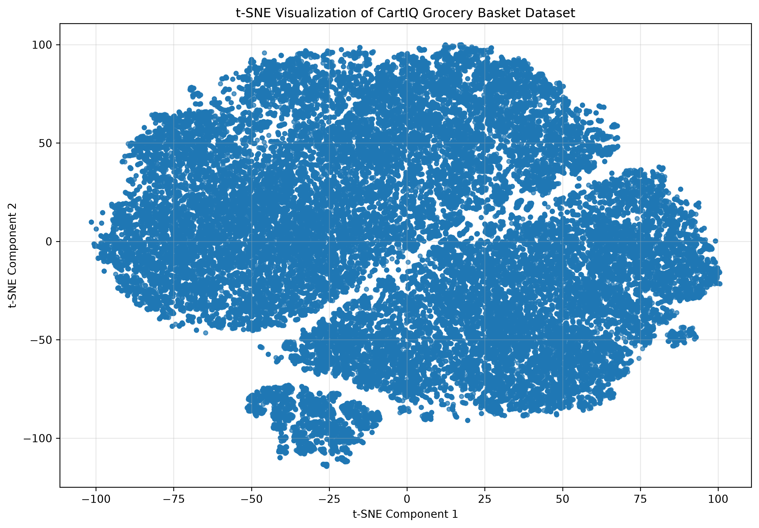
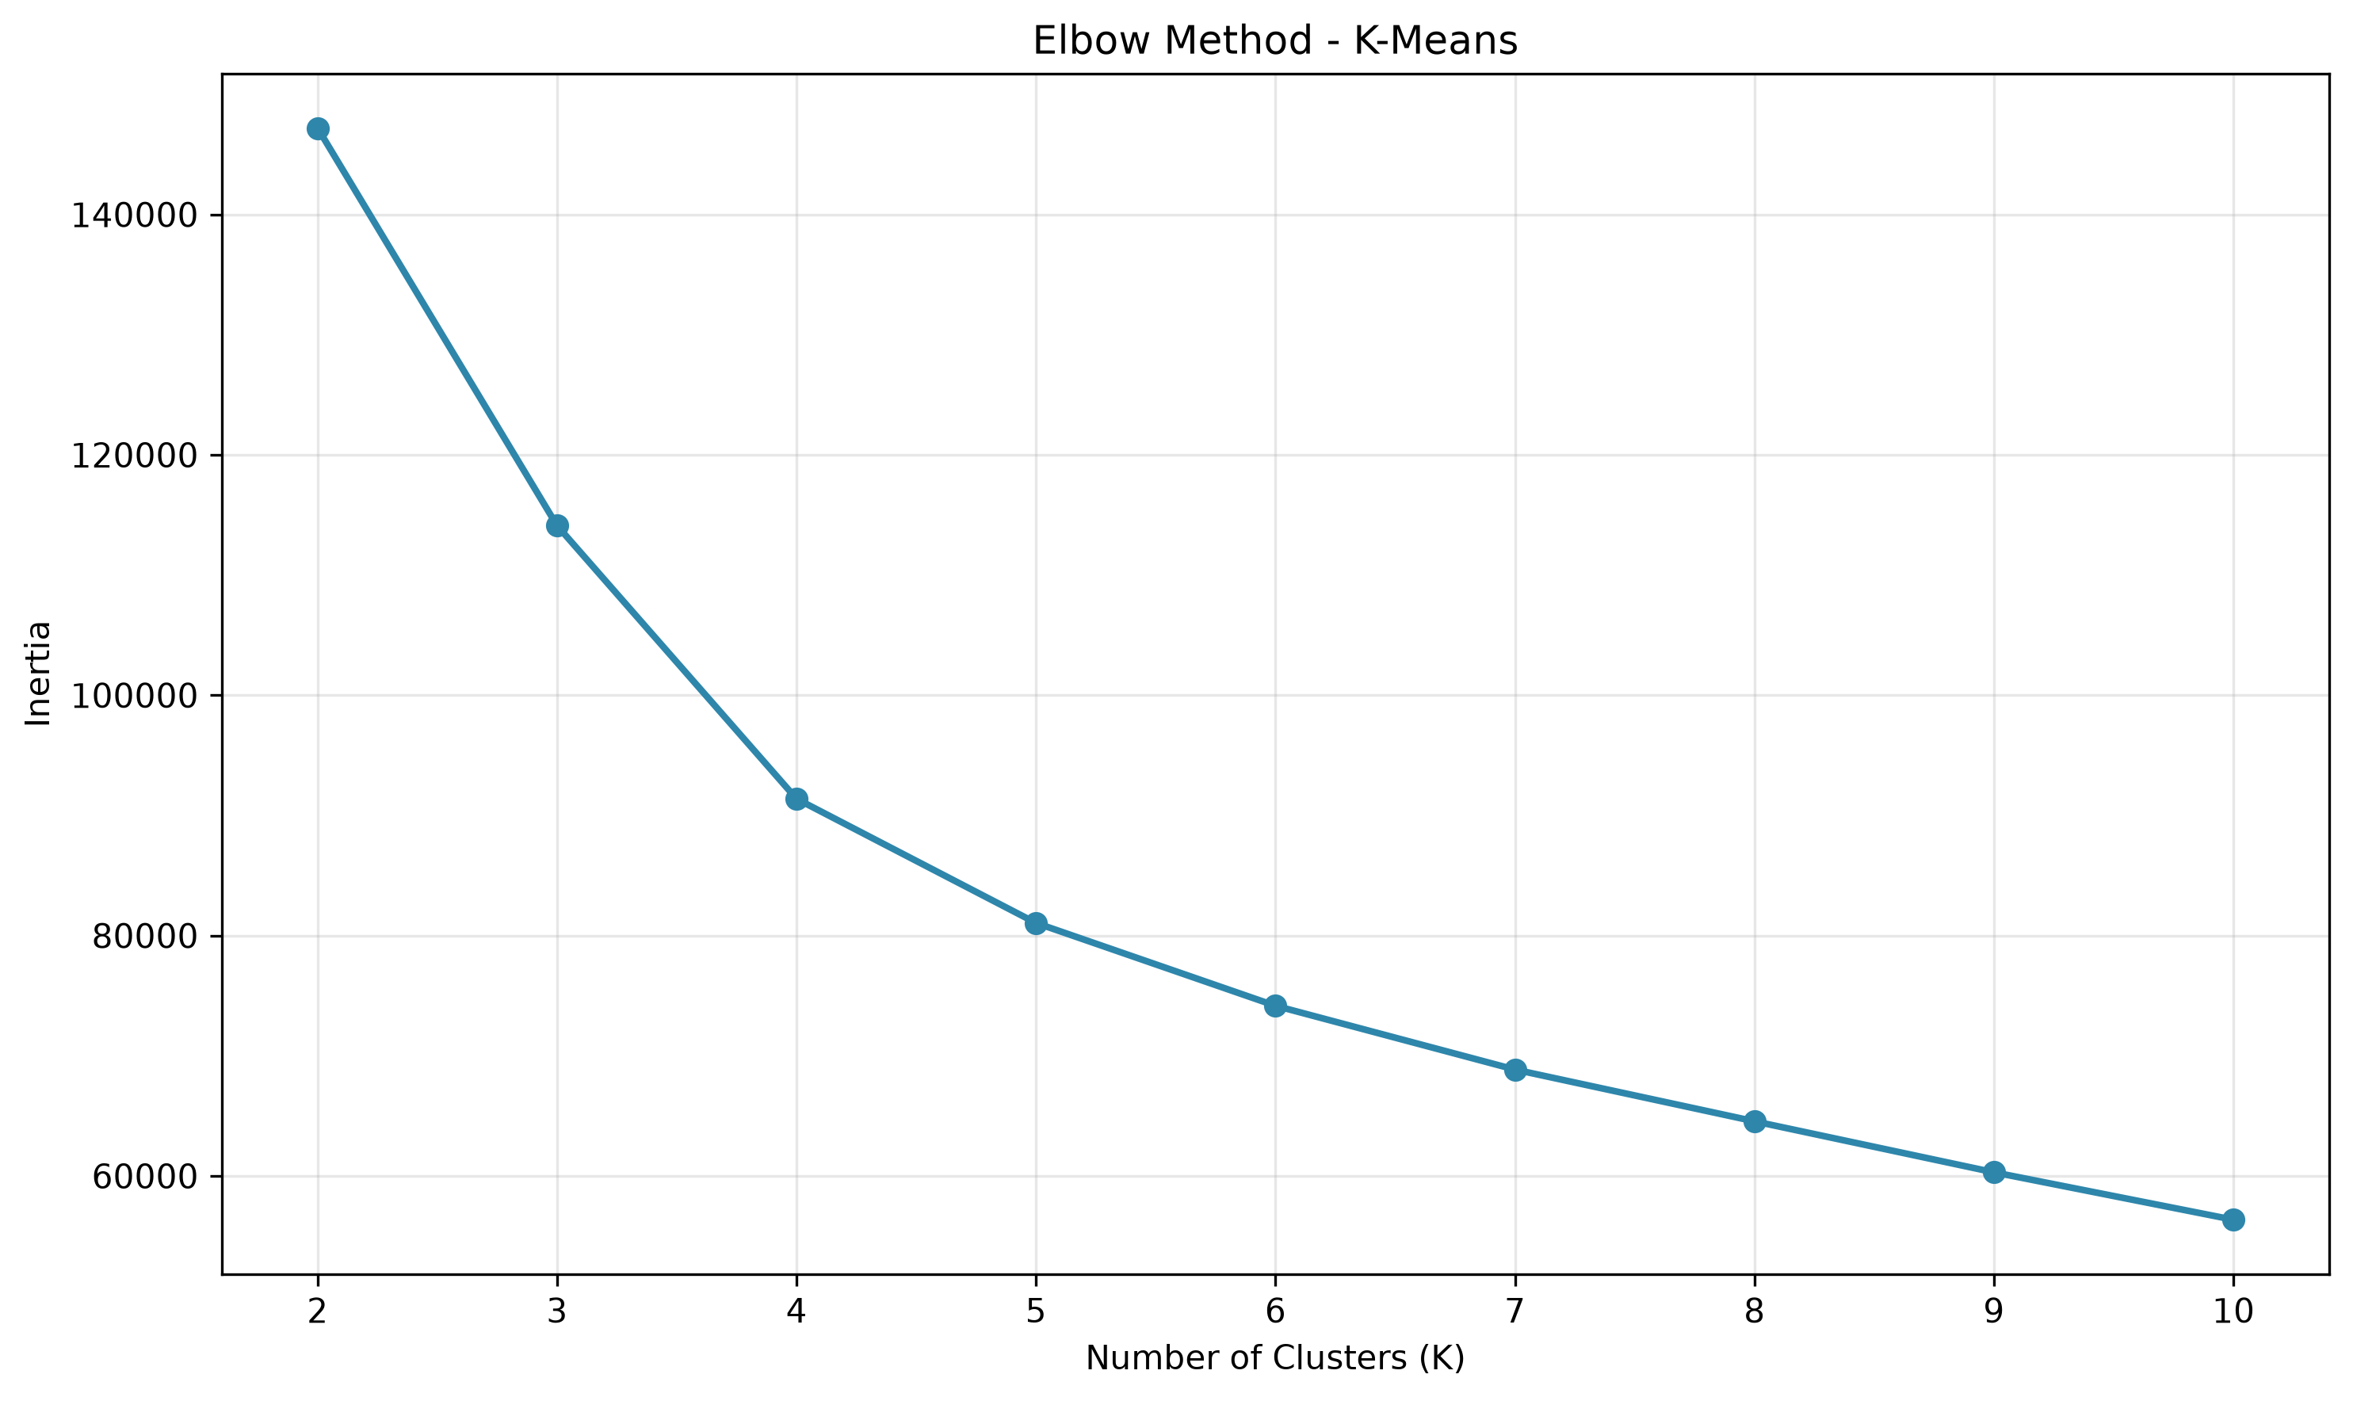
Clustering & reducing dimensions
05/10
Grouping shoppers and compressing 14 features into visual maps
• K-Means: best K = 3, silhouette 0.32
• t-SNE: 14 features mapped to 2-D
• PCA: 13 components keep 95% variance
• DBSCAN: 7 clusters · 0% noise
• Hierarchical: divisive beats agglomerative
Information is spread, not concentrated
PCA needs 13 of 14 components for 95% variance — reorders depend on many weak signals combined, not one strong feature.
CartIQ · Grocery Market Basket Intelligence
Notes:
Module 4 groups shoppers into clusters. Using the elbow curve and silhouette score, K-Means found the best grouping at K equals 3 with a silhouette of 0.32. We then reduced the 14 features to 2 dimensions - t-SNE produced a clear visual map, and PCA showed we need 13 of 14 components to keep 95 percent of the variance, confirming information is spread across many features. We also ran DBSCAN, which found 7 dense clusters with zero noise, and compared hierarchical methods where our divisive approach beat standard agglomerative clustering.

Slide 6
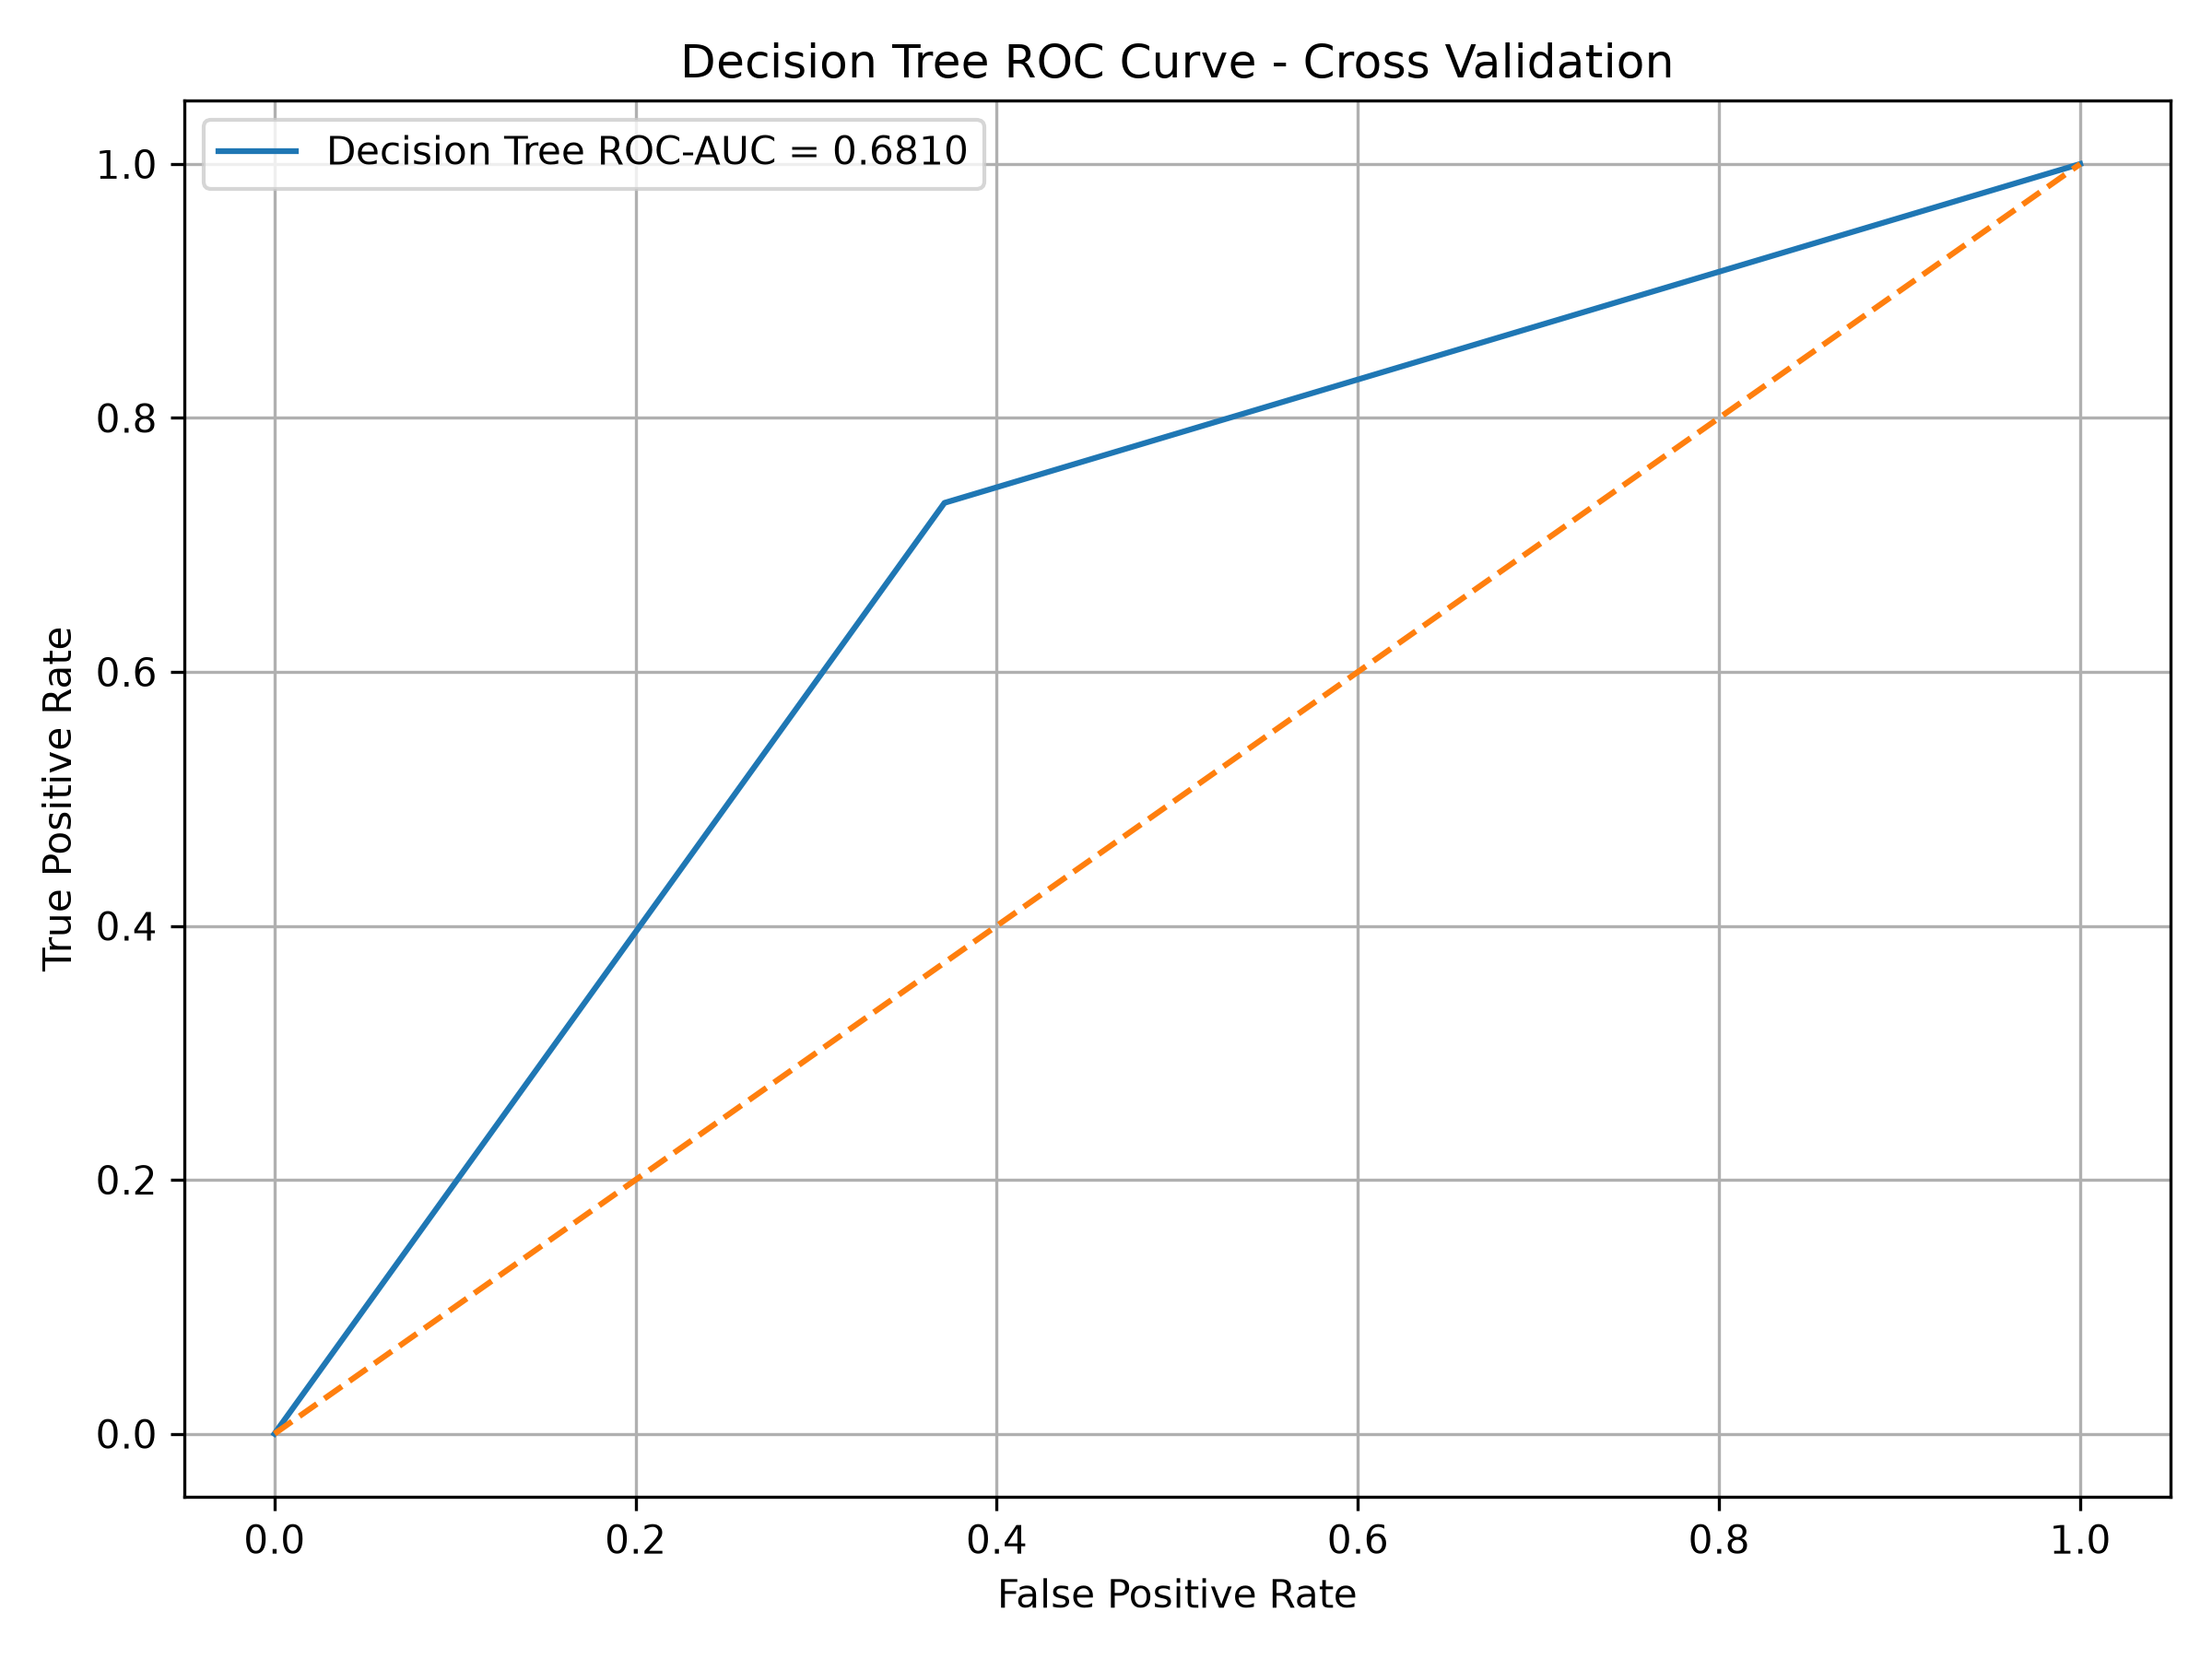
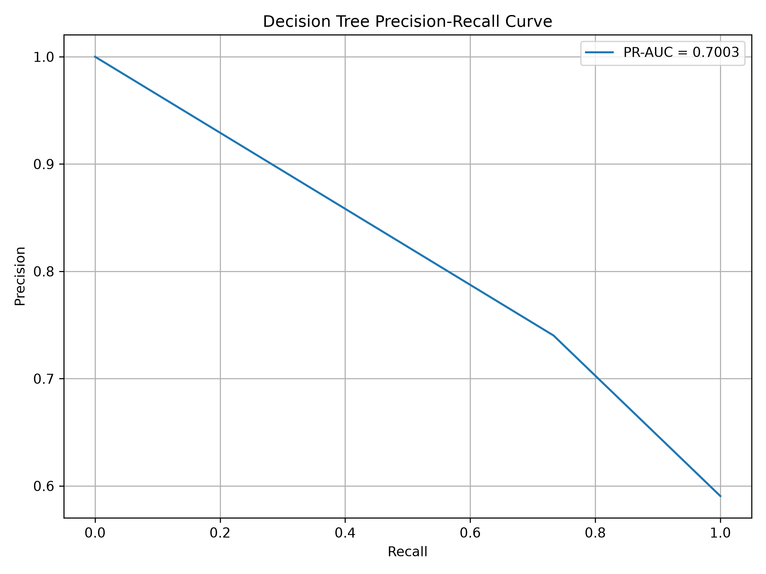
Validating the results
06/10
5-fold stratified cross-validation — numbers you can trust
• 5-fold stratified cross-validation
• Out-of-fold F1: 69.1%
• ROC-AUC 0.681 · PR-AUC 0.700
• Stable — outlier impact only 0.014
Why cross-validation?
The ROC and Precision-Recall curves show the model keeps useful discriminative power across thresholds — not just at one cutoff.
One train-test split can be lucky or unlucky. Five folds average out the noise so the reported score is reliable.
CartIQ · Grocery Market Basket Intelligence
Notes:
Module 5 validates our decision tree with 5-fold stratified cross-validation instead of a single train-test split, so the numbers are more trustworthy. The out-of-fold F1 was 69.1 percent, ROC-AUC 0.681 and PR-AUC 0.700. We also tested how sensitive the model is to outliers - the F1 difference between outlier and normal cases was only 0.014, so the model is stable and reliable.

Slide 7
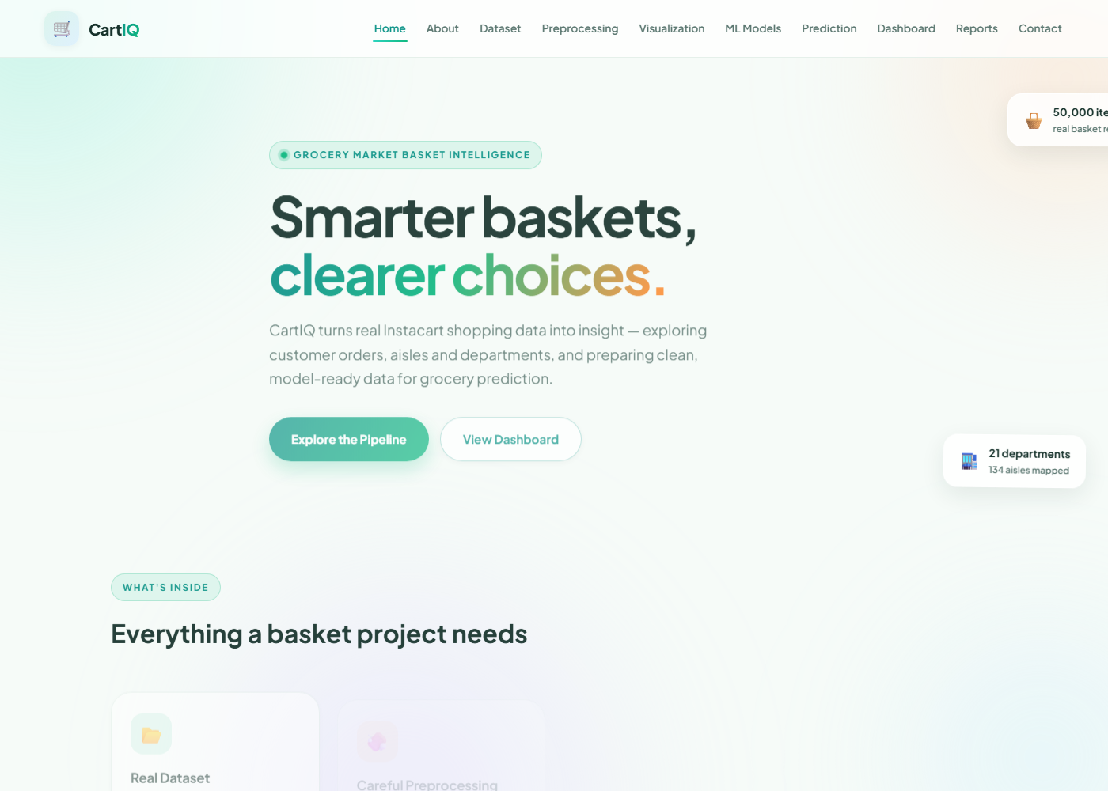
A working web application
07/10
Flask · 10 pages · live charts served from the outputs folder
• Flask website with 10 pages
• Live charts from outputs folder
• Auto-generated reports per module
• Light, modern interface
Pages included
Home · About · Dataset · Preprocessing · Visualization · Models · Prediction · Dashboard · Reports · Contact
CartIQ · Grocery Market Basket Intelligence
Notes:
We wrapped the entire project into a Flask web application with ten pages - home, dataset, preprocessing, visualization, models, prediction, dashboard, reports and contact. Every chart you've seen is served live from the outputs folder, and the reports page automatically lists every file each module generated. The interface uses a clean light design so results are easy to read.

Slide 8
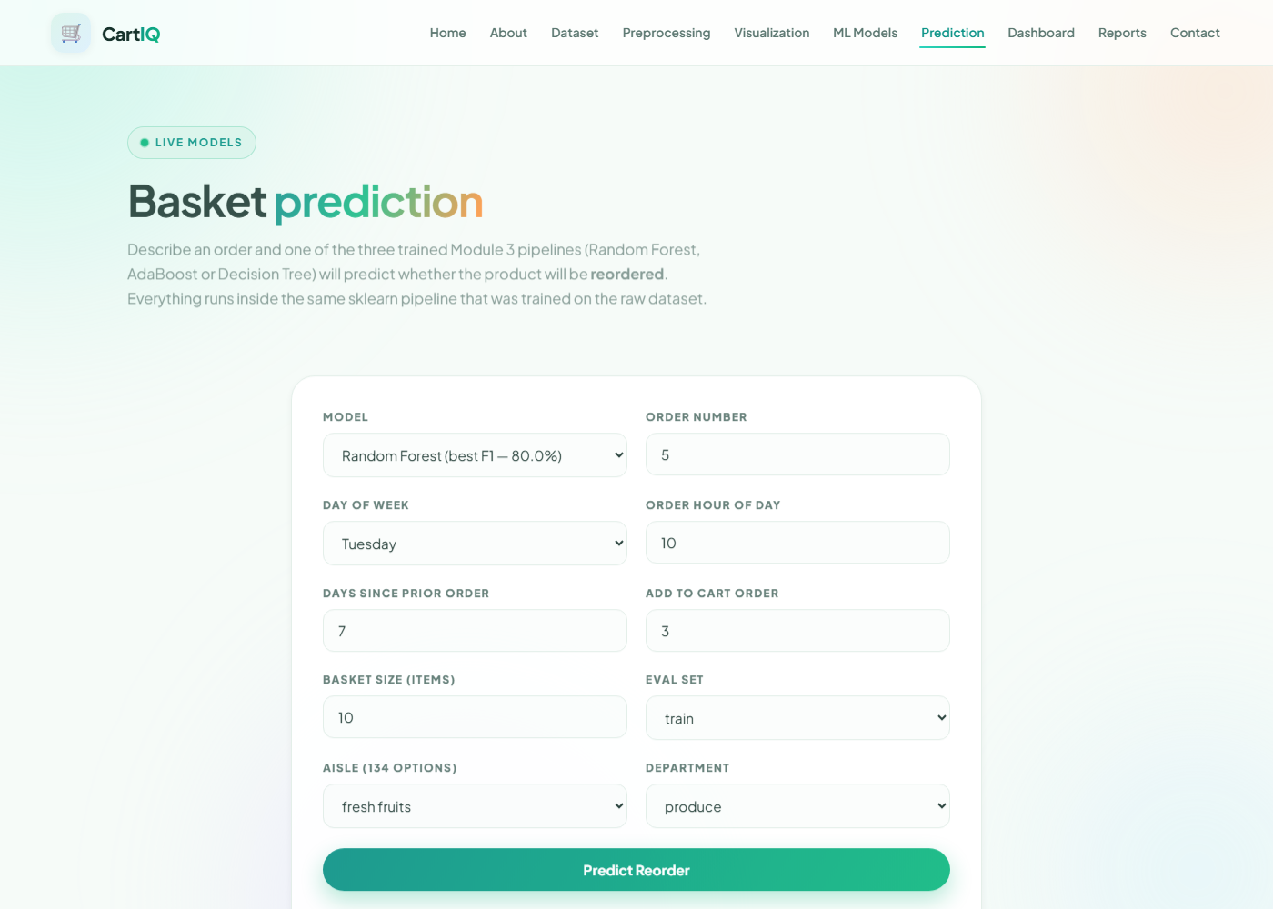
Predict a reorder in real time
08/10
The form loads the actual trained pipeline and answers instantly
• Choose model: RF, AdaBoost or Tree
• Enter 9 order features
• Get prediction + probability
• Runs the real trained pipeline
🔴 Live demo now
I'll open the website and run a real prediction in front of you — Random Forest, fresh fruits, produce department.
CartIQ · Grocery Market Basket Intelligence
Notes:
This is the live prediction page. You pick a model - Random Forest, AdaBoost or Decision Tree - enter nine order features such as order number, hour of day, aisle and department, and the app loads the actual trained pipeline and predicts instantly. I can demonstrate this live right now. [DEMO TRIGGER: switch to the browser, open http://127.0.0.1:5000/prediction, submit the form with default values, and show the result card with the probability bar.]

Slide 9
All 15 models at a glance
09/10
Random Forest is the champion — best F1 at 80.0%
Model
Key Result
Linear Regression
MAE 0.75 · R² 0.011
Ridge / Lasso / Elastic Net
Accuracy ≈ 69–70%
Logistic Regression
Accuracy 69.07%
Multinomial LogReg
Accuracy 34% (21 classes)
Decision Tree
Acc 72.2% · F1 78.4%
Random Forest ★
Acc 73.0% · F1 80.0%
AdaBoost
Acc 73.3% · F1 79.2%
K-Means / K-Means++
K = 3 · Silhouette 0.32
t-SNE / PCA / DBSCAN
7 clusters · 13 PCs for 95%
Hierarchical + CV Tree
Divisive 0.304 · CV F1 69.1%
CartIQ · Grocery Market Basket Intelligence
Notes:
This table summarises all fifteen models. For classification the tree ensembles clearly win - Random Forest and AdaBoost both around 73 percent accuracy with F1 near 80. Linear models underperformed, confirming basket behaviour is non-linear. Clustering and dimensionality reduction gave us interpretable views of shopper segments. Random Forest is our champion model with the best F1 score.

Slide 10
Thank you
Questions welcome
🤖
🌐
✨
Deep learning on order sequences
Real-time grocery API integration
Personalised recommendation engine
Future scope
CartIQ · Python · scikit-learn · Flask · 50,000 baskets
Notes:
Thank you madam. In short, we built a complete machine learning pipeline - from raw data exploration to fifteen trained models to a live web application - and found that tree-based ensembles best predict product reorders. For future scope we would add deep learning on order sequences, integrate a real-time grocery API, and build a personalised recommendation engine on top of the shopper clusters we discovered. We're happy to take any questions, and I can run the live demo again.

