Slide 1




Automating Docker Build & Deployment using GitHub Actions
Task: B - Ecosystem Integration Analysis
Domain: DevOps
Tools: Docker + GitHub Actions Course: AIDI 2002 - Careers and Digital Portfolio
Raja Lakshmi Ramasubbu (101006808)
20 June 2025

Slide 2
Problem Definition Multi-Stage Problem
Manual docker builds and image deployments can be inefficient and error-prone when done repeatedly.
Stakeholders: devops engineers, developers, qa engineers
Challenges
Manual builds delay CI/CD pipelines
Human errors in docker push/pull steps
No traceability or automatic re-deployment
Scenario
Every time a python file changes, the team wants docker to automatically build and push the latest image to docker hub and then deploy it for testing without manual intervention.

Slide 3
Requirements
Automation of Docker image build and push
Integration with version control (GitHub)
Secure storage of credentials (GitHub Secrets)
Portability and repeatability of container builds
Integration Requirement GitHub Actions must support Docker Buildx and login features seamlessly

Slide 4
Tool Overview and Analysis Docker
Description Containerization platform
Target Users Developers, SysAdmins, DevOps teams
Key Differentiator Lightweight and platform-agnostic packaging of applications
Marketing Claim vs. Reality "Docker ensures consistent environments" is True in most environments, but platform-specific bugs still occur
Use Cases Packaging Python apps, microservices, testing environments

Slide 5
Tool Overview and Analysis Docker
GitHub Actions
Description
CI/CD automation tool native to GitHub
Target Users
Developers using GitHub
Key Differentiator
Native integration with GitHub repos and event-based triggers
Marketing Claim vs. Reality
"Easy to set up CI/CD workflows" is True, but debugging YAML files and permissions can be tricky
Use Cases
Automating tests, builds, and deployment pipelines

Slide 6

Ecosystem Integration Role in Ecosystem
GitHub Actions triggers Docker builds automatically upon code changes
Docker handles the packaging and deployment of the app
Integration Points:
GitHub Secrets store Docker credentials
YAML workflow runs docker build, push, and run commands
Marketing Claim vs. Reality:
GitHub Actions: "Secure and seamless integration with Docker Hub“ is True with correct permissions
Challenges:
Managing secrets securely
Ensuring Docker Hub repository exists
Use Cases:
Auto-building containers for each commit
Automated testing in containerized environments

Slide 7
Decision Framework Implementation Guidelines:
Ensure secret management and access control is in place
1
Validate build and push commands locally before automating
2
Test the entire workflow on a test branch before merging to main
3
Git Push
GitHub Actions Triggered
Docker Build
Docker Push
Docker Run

Slide 8
Reflection Problem-First Approach Insight
Helped focus on automation as the pain point
Led to tool selection based on integration capability, not popularity
Future Tool Evaluation:
Will focus on integration readiness, scalability, and ecosystem fit
Prefer tools with active community support and documentation

Slide 9
References
Docker Inc. (2023). Docker Documentation. https://docs.docker.com
GitHub. (2023). GitHub Actions Documentation. https://docs.github.com/en/actions
Turnbull, J. (2018). The Docker Book: Containerization is the new virtualization. James Turnbull. https://github.com/dskcode/docker-books/blob/master/The%20Docker%20Book%20-%20James%20Turnbull%20-%20v17.03.0.pdf
Sharma, S. (2024, September 8). Integrate CI/CD for Azure NodeJS App using GitHub Actions. Medium. https://sidharath.medium.com/integrate-ci-cd-for-azure-nodejs-app-using-github-actions-8e7967104f1e

Slide 10
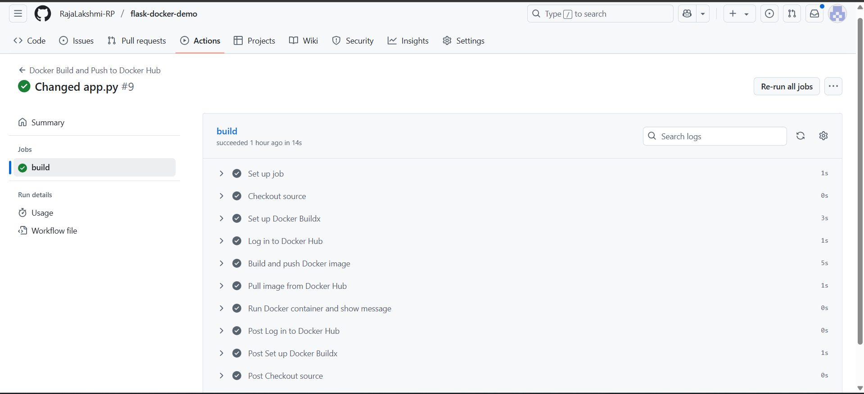
Appendix

Slide 11
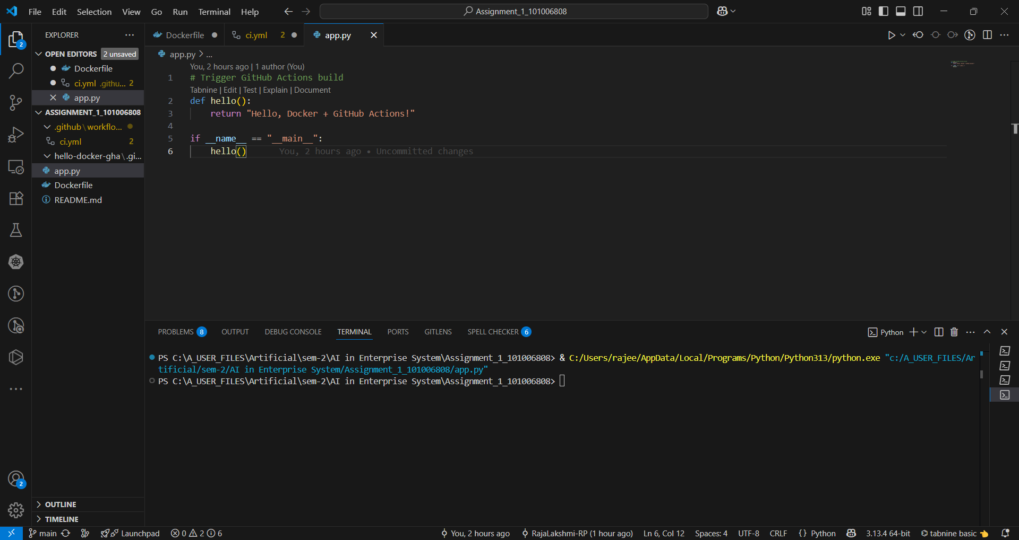
Appendix

